Slide 1
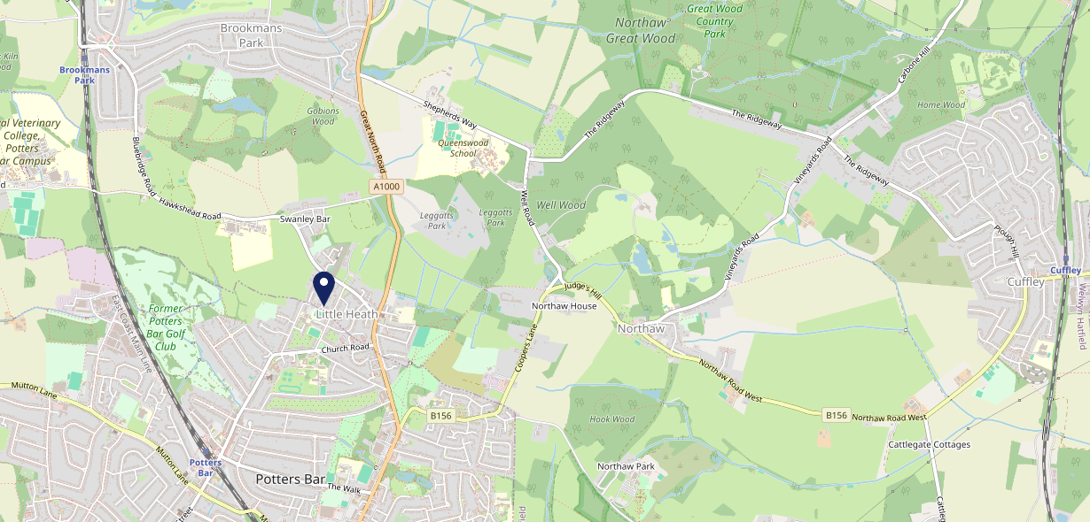
Site Intel
Builders Arms EN61LR
1 Miles
1 Chain
05/03/2025 - 25/02/2026
Site Summary
Builders Arms EN61LR
Work Area
Region
TV Region
Urbanicity
London
East of England
London
Urban city and town
EN61LR
McMullens
Top Competitors
ATV
Gender
#1
£18.61
69.09%
Male
Affluence
Segmentation
#2
66.48%
30.85%
High Income
Flourishing Society
Age Group
Visit Day
#3
29.91%
22.96%
55 to 64
Sun
Nearest Station
Potters Bar(1.26 miles)
729 Site Customers
0 Competitors
0 Competitor Customers

Slide 2
Site Intel
Builders Arms EN61LR
1 Miles
1 Chain
05/03/2025 - 25/02/2026
Spend by Weekpart
How is customer spend distributed throughout the week for Builders Arms EN61LR versus its competitors?
% of spend for Builders Arms EN61LR and 1 Chains in 1 Miles from 05/03/2025 - 25/02/2026 split by Day of Week
729 Site Customers
0 Competitors
0 Competitor Customers

Slide 3
Site Intel
Builders Arms EN61LR
1 Miles
1 Chain
05/03/2025 - 25/02/2026
Visit Frequency
How frequently per year do customers visit Builders Arms EN61LR versus its competitors?
% of customer numbers for Builders Arms EN61LR and 1 Chains in 1 Miles from 05/03/2025 - 25/02/2026 and the number of visits made Per Annum
729 Site Customers
0 Competitors
0 Competitor Customers

Slide 4
Site Intel
Builders Arms EN61LR
1 Miles
1 Chain
05/03/2025 - 25/02/2026
ATV Change
How has ATV changed between two date ranges?
729 Site Customers

Slide 5
Site Intel
Builders Arms EN61LR
1 Miles
1 Chain
05/03/2025 - 25/02/2026
Market Share Change
How has market share changed between two date ranges?
% of market share spend for Builders Arms EN61LR and 1 Chains in 1 Miles from 05/03/2025 - 25/02/2026
729 Site Customers

Slide 6
Site Intel
Builders Arms EN61LR
1 Miles
1 Chain
05/03/2025 - 25/02/2026
Age
How does the age profile of customers who visit Builders Arms EN61LR compare versus its competitors?
% of spend for Builders Arms EN61LR and 1 Chains in 1 Miles from 05/03/2025 - 25/02/2026 split by Age Range
338 Site Customers
0 Competitors

Slide 7
Site Intel
Builders Arms EN61LR
1 Miles
1 Chain
05/03/2025 - 25/02/2026
Affluence
How does the affluence of customers who visit Builders Arms EN61LR compare versus its competitors?
% of spend for Builders Arms EN61LR and 1 Chains in 1 Miles from 05/03/2025 - 25/02/2026 split by Affluence
319 Site Customers
0 Competitors

Slide 8
Site Intel
Builders Arms EN61LR
1 Miles
1 Chain
05/03/2025 - 25/02/2026
Gender
How does the gender profile of customers who visit Builders Arms EN61LR compare versus its competitors?
% of spend for Builders Arms EN61LR and 1 Chains in 1 Miles from 05/03/2025 - 25/02/2026 split by Gender
325 Site Customers
0 Competitors

Slide 9
Site Intel
Builders Arms EN61LR
1 Miles
1 Chain
05/03/2025 - 25/02/2026
Punch Segmentation
How does the Custom segmentation profile of customers who visit Builders Arms EN61LR compare versus its competitors?
% of spend for Builders Arms EN61LR and 1 Chains in 1 Miles from 05/03/2025 - 25/02/2026 split by Segment
729 Site Customers
0 Competitors
0 Competitor Customers

Slide 10
Site Intel
Builders Arms EN61LR
1 Miles
1 Chain
05/03/2025 - 25/02/2026
Spend by Distance
How does the spend profile of Builders Arms EN61LR compare versus its competitors based on travel distances?
% of spend for Builders Arms EN61LR and 1 Chains in 1 Miles from 05/03/2025 - 25/02/2026 split by Distance travelled
325 Site Customers
0 Competitors
0 Competitor Customers

Slide 11
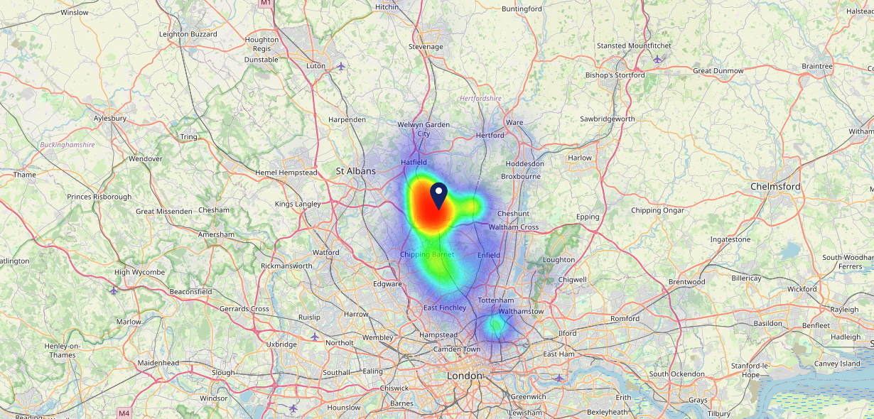
Site Intel
Builders Arms EN61LR
05/03/2025 - 25/02/2026
Map of Guest Origin
Where do customers of Builders Arms EN61LR come from?
Where do customers of Builders Arms EN61LR for 05/03/2025 - 25/02/2026 live
325 Site Customers

Slide 12
Site Intel
Builders Arms EN61LR
1 Miles
1 Chain
05/03/2025 - 25/02/2026
Share of Wallet
What are the Top 20 venues (by spend) that customers of Builders Arms EN61LR also visit?
For customers of Builders Arms EN61LR, who are the top 20 competitors from 1 Chains in 1 Miles for 05/03/2025 - 25/02/2026 split by Venue
729 Site Customers

Slide 13
Site Intel
Builders Arms EN61LR
1 Miles
1 Chain
05/03/2025 - 25/02/2026
Share of Wallet Change
How has share of wallet of customers of Builders Arms EN61LR changed between two date ranges?
729 Site Customers

Slide 14
Site Intel
Builders Arms EN61LR
05/03/2025 - 25/02/2026
Market Summary
How does the local area for Builders Arms EN61LR compare to the national average (1 = low, 10 = high)
Data Type | Name | Spend in 250m | 250m Spend vs National | Spend in 500m | 500m Spend vs National | Spend in 1 mile | 1 mile Spend vs National | Spend in 3 miles | 3 mile Spend vs National
Total | Annual Sales | £573K | 4 | £575K | 3 | £16.29M | 6 | £41.40M | 4
Weekpart | Mon - Thu | 43.4% | 7 | 43.3% | 7 | 44.9% | 8 | 41.1% | 5
Weekpart | Fri - Sat | 33.8% | 1 | 34.0% | 1 | 40.7% | 4 | 41.2% | 4
Weekpart | Sun | 22.8% | 10 | 22.7% | 10 | 14.4% | 4 | 17.7% | 9
Age | 18 to 24 | 2.1% | 2 | 2.1% | 2 | 2.6% | 2 | 4.1% | 2
Age | 25 to 34 | 7.4% | 1 | 7.5% | 1 | 10.4% | 1 | 11.1% | 1
Age | 35 to 44 | 18.7% | 2 | 18.7% | 2 | 21.2% | 4 | 21.4% | 3
Age | 45 to 54 | 16.6% | 2 | 16.6% | 2 | 20.1% | 5 | 20.1% | 5
Age | 55 to 64 | 30.7% | 10 | 30.7% | 10 | 23.3% | 10 | 22.1% | 10
Age | 65 to 74 | 10.3% | 8 | 10.3% | 8 | 13.7% | 10 | 12.3% | 10
Age | 75+ | 14.2% | 10 | 14.2% | 10 | 8.6% | 10 | 8.8% | 10
CAMEO | Business Elite | 30.8% | 10 | 30.9% | 10 | 20.1% | 9 | 22.6% | 10
CAMEO | Prosperous Professionals | 5.8% | 5 | 5.8% | 5 | 6.4% | 6 | 6.4% | 5
CAMEO | Flourishing Society | 29.8% | 10 | 29.8% | 10 | 25.5% | 10 | 22.8% | 9
CAMEO | Content Communities | 8.9% | 3 | 8.9% | 2 | 10.7% | 3 | 11.2% | 4
CAMEO | White Collar Neighbourhoods | 4.1% | 1 | 4.1% | 1 | 9.4% | 3 | 8.8% | 2
CAMEO | Enterprising Mainstream | 1.3% | 1 | 1.3% | 1 | 4.3% | 2 | 4.0% | 1
CAMEO | Paying The Mortgage | 7.0% | 1 | 7.0% | 1 | 11.2% | 3 | 11.8% | 3
CAMEO | Cash Conscious Communities | 5.5% | 3 | 5.5% | 2 | 5.6% | 2 | 5.6% | 2
CAMEO | On A Budget | 5.9% | 5 | 5.9% | 5 | 6.5% | 6 | 6.0% | 4
CAMEO | Family Value | 1.0% | 3 | 1.0% | 3 | 0.4% | 1 | 0.7% | 1
Affluence | AB | 66.4% | 10 | 66.4% | 10 | 52.0% | 10 | 51.8% | 10
Affluence | C1C2 | 21.3% | 1 | 21.3% | 1 | 35.5% | 1 | 35.8% | 1
Affluence | DE | 12.3% | 3 | 12.3% | 3 | 12.5% | 2 | 12.4% | 2

