Slide 1










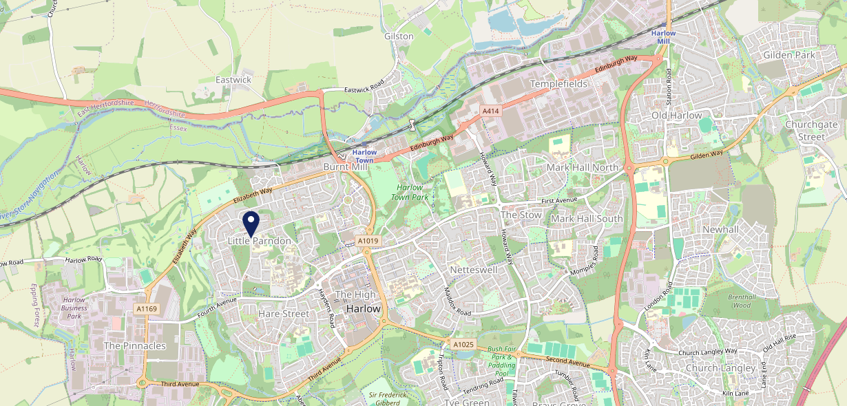









Site Intel
Shark CM201TH
1 Miles
1 Chain
05/03/2025 - 25/02/2026
Site Summary
Shark CM201TH
Work Area
Region
TV Region
Urbanicity
Cambridge
East of England
London
Urban city and town
CM201TH
McMullens
Top Competitors
ATV
Gender
#1
£9.55
52.50%
Male
Affluence
Segmentation
#2
46.88%
36.81%
Middle Income
Paying The Mortgage
Age Group
Visit Day
#3
44.93%
37.47%
35 to 44
Fri
Nearest Station
Harlow Town(1.27 miles)
475 Site Customers
0 Competitors
0 Competitor Customers

Slide 2

Site Intel
Shark CM201TH
1 Miles
1 Chain
05/03/2025 - 25/02/2026
Spend by Weekpart
How is customer spend distributed throughout the week for Shark CM201TH versus its competitors?
% of spend for Shark CM201TH and 1 Chains in 1 Miles from 05/03/2025 - 25/02/2026 split by Day of Week
475 Site Customers
0 Competitors
0 Competitor Customers

Slide 3
Site Intel
Shark CM201TH
1 Miles
1 Chain
05/03/2025 - 25/02/2026
Visit Frequency
How frequently per year do customers visit Shark CM201TH versus its competitors?
% of customer numbers for Shark CM201TH and 1 Chains in 1 Miles from 05/03/2025 - 25/02/2026 and the number of visits made Per Annum
475 Site Customers
0 Competitors
0 Competitor Customers

Slide 4
Site Intel
Shark CM201TH
1 Miles
1 Chain
05/03/2025 - 25/02/2026
ATV Change
How has ATV changed between two date ranges?
475 Site Customers

Slide 5
Site Intel
Shark CM201TH
1 Miles
1 Chain
05/03/2025 - 25/02/2026
Market Share Change
How has market share changed between two date ranges?
% of market share spend for Shark CM201TH and 1 Chains in 1 Miles from 05/03/2025 - 25/02/2026
475 Site Customers

Slide 6
Site Intel
Shark CM201TH
1 Miles
1 Chain
05/03/2025 - 25/02/2026
Age
How does the age profile of customers who visit Shark CM201TH compare versus its competitors?
% of spend for Shark CM201TH and 1 Chains in 1 Miles from 05/03/2025 - 25/02/2026 split by Age Range
218 Site Customers
0 Competitors

Slide 7
Site Intel
Shark CM201TH
1 Miles
1 Chain
05/03/2025 - 25/02/2026
Affluence
How does the affluence of customers who visit Shark CM201TH compare versus its competitors?
% of spend for Shark CM201TH and 1 Chains in 1 Miles from 05/03/2025 - 25/02/2026 split by Affluence
191 Site Customers
0 Competitors

Slide 8
Site Intel
Shark CM201TH
1 Miles
1 Chain
05/03/2025 - 25/02/2026
Gender
How does the gender profile of customers who visit Shark CM201TH compare versus its competitors?
% of spend for Shark CM201TH and 1 Chains in 1 Miles from 05/03/2025 - 25/02/2026 split by Gender
200 Site Customers
0 Competitors

Slide 9
Site Intel
Shark CM201TH
1 Miles
1 Chain
05/03/2025 - 25/02/2026
Punch Segmentation
How does the Custom segmentation profile of customers who visit Shark CM201TH compare versus its competitors?
% of spend for Shark CM201TH and 1 Chains in 1 Miles from 05/03/2025 - 25/02/2026 split by Segment
475 Site Customers
0 Competitors
0 Competitor Customers

Slide 10
Site Intel
Shark CM201TH
1 Miles
1 Chain
05/03/2025 - 25/02/2026
Spend by Distance
How does the spend profile of Shark CM201TH compare versus its competitors based on travel distances?
% of spend for Shark CM201TH and 1 Chains in 1 Miles from 05/03/2025 - 25/02/2026 split by Distance travelled
200 Site Customers
0 Competitors
0 Competitor Customers

Slide 11
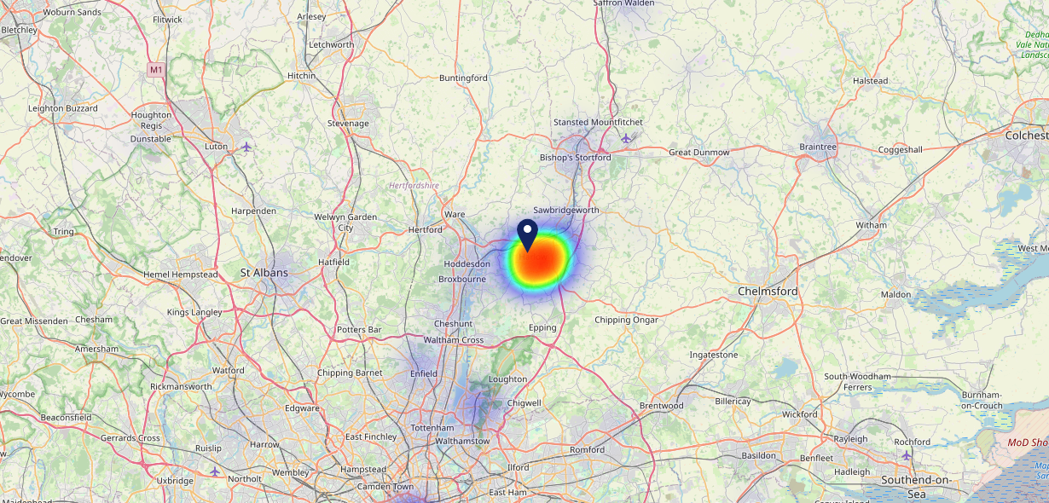

Site Intel
Shark CM201TH
05/03/2025 - 25/02/2026
Map of Guest Origin
Where do customers of Shark CM201TH come from?
Where do customers of Shark CM201TH for 05/03/2025 - 25/02/2026 live
200 Site Customers

Slide 12
Site Intel
Shark CM201TH
1 Miles
1 Chain
05/03/2025 - 25/02/2026
Share of Wallet
What are the Top 20 venues (by spend) that customers of Shark CM201TH also visit?
For customers of Shark CM201TH, who are the top 20 competitors from 1 Chains in 1 Miles for 05/03/2025 - 25/02/2026 split by Venue
475 Site Customers

Slide 13
Site Intel
Shark CM201TH
1 Miles
1 Chain
05/03/2025 - 25/02/2026
Share of Wallet Change
How has share of wallet of customers of Shark CM201TH changed between two date ranges?
475 Site Customers

Slide 14
Site Intel
Shark CM201TH
05/03/2025 - 25/02/2026
Market Summary
How does the local area for Shark CM201TH compare to the national average (1 = low, 10 = high)
Data Type | Name | Spend in 250m | 250m Spend vs National | Spend in 500m | 500m Spend vs National | Spend in 1 mile | 1 mile Spend vs National | Spend in 3 miles | 3 mile Spend vs National
Total | Annual Sales | £232K | 3 | £265K | 2 | £27.42M | 7 | £78.46M | 6
Weekpart | Mon - Thu | 24.7% | 1 | 21.7% | 1 | 46.7% | 9 | 43.8% | 8
Weekpart | Fri - Sat | 65.5% | 10 | 65.1% | 10 | 38.3% | 2 | 40.8% | 4
Weekpart | Sun | 9.8% | 2 | 13.2% | 3 | 15.0% | 5 | 15.5% | 5
Age | 18 to 24 | 8.3% | 7 | 7.6% | 7 | 7.4% | 6 | 7.1% | 5
Age | 25 to 34 | 9.3% | 1 | 10.3% | 1 | 15.2% | 2 | 14.4% | 1
Age | 35 to 44 | 44.0% | 10 | 43.2% | 10 | 26.3% | 8 | 26.0% | 8
Age | 45 to 54 | 25.5% | 9 | 26.2% | 10 | 19.3% | 4 | 19.5% | 4
Age | 55 to 64 | 10.1% | 2 | 10.2% | 2 | 15.7% | 6 | 17.0% | 8
Age | 65 to 74 | 2.1% | 1 | 2.0% | 1 | 10.8% | 9 | 10.7% | 9
Age | 75+ | 0.6% | 2 | 0.5% | 1 | 5.3% | 9 | 5.3% | 9
CAMEO | Business Elite | 9.7% | 7 | 8.9% | 7 | 5.5% | 4 | 5.3% | 4
CAMEO | Prosperous Professionals | 0.6% | 1 | 0.8% | 1 | 3.3% | 2 | 3.2% | 2
CAMEO | Flourishing Society | 8.4% | 4 | 10.7% | 5 | 14.1% | 6 | 14.9% | 7
CAMEO | Content Communities | 5.2% | 1 | 5.7% | 1 | 9.1% | 2 | 9.7% | 2
CAMEO | White Collar Neighbourhoods | 2.7% | 1 | 4.3% | 1 | 7.6% | 2 | 7.3% | 1
CAMEO | Enterprising Mainstream | 1.5% | 1 | 2.3% | 1 | 3.4% | 1 | 3.3% | 1
CAMEO | Paying The Mortgage | 35.1% | 10 | 32.5% | 10 | 24.2% | 10 | 25.7% | 10
CAMEO | Cash Conscious Communities | 6.2% | 3 | 6.9% | 4 | 8.5% | 5 | 7.1% | 3
CAMEO | On A Budget | 24.1% | 10 | 22.1% | 10 | 21.2% | 10 | 20.4% | 10
CAMEO | Family Value | 6.3% | 8 | 5.9% | 8 | 3.0% | 6 | 3.1% | 6
Affluence | AB | 18.8% | 3 | 20.4% | 4 | 22.9% | 4 | 23.4% | 4
Affluence | C1C2 | 44.6% | 4 | 44.7% | 4 | 44.4% | 4 | 46.0% | 4
Affluence | DE | 36.7% | 9 | 34.9% | 9 | 32.7% | 9 | 30.6% | 9

