Slide 1
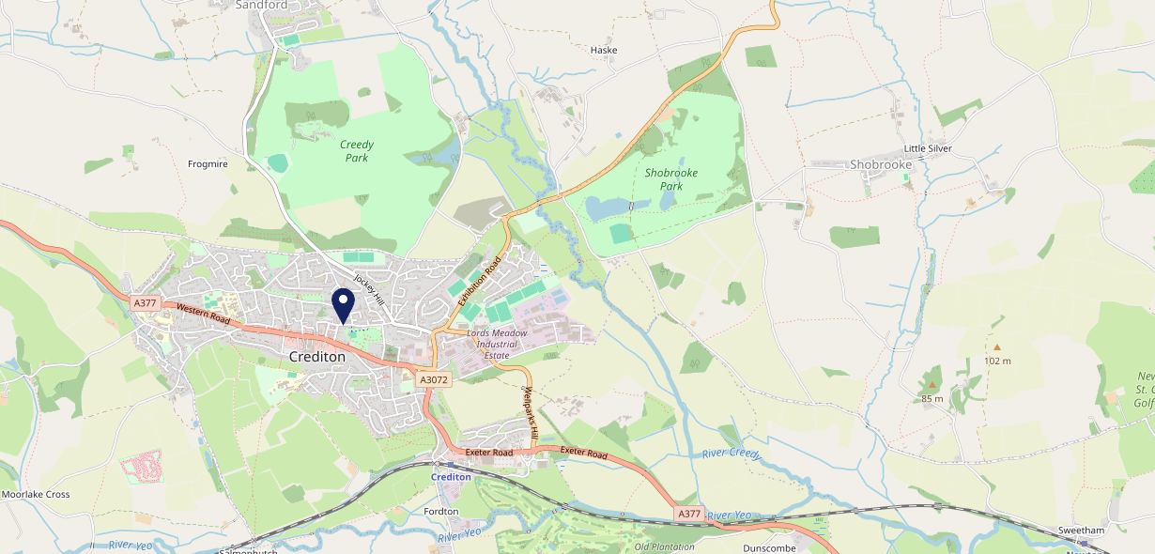
Site Intel
The Three Little Pigs EX172BP
1 Miles
338 Chains
29/01/2025 - 21/01/2026
Site Summary
The Three Little Pigs EX172BP
Work Area
Region
TV Region
Urbanicity
Exeter
South West
HarWest
Rural town and fringe
EX172BP
Pub / Bar
Top Competitors
ATV
Gender
Mcdonalds 1801credito
#1
£16.53
65.38%
Male
EX173FD
McDonalds
Affluence
Segmentation
Red Deer
#2
71.25%
28.03%
Middle Income
Content Communities
EX173PH
Marstons Community Food
Age Group
Visit Day
Mcdonalds 8261801
#3
19.96%
24.98%
EX171BZ
45 to 54
Sat
McDonalds
Nearest Station
Crediton(1.15 miles)
2110 Site Customers
53 Competitors
20636 Competitor Customers

Slide 2
Site Intel
The Three Little Pigs EX172BP
1 Miles
338 Chains
29/01/2025 - 21/01/2026
Spend by Weekpart
How is customer spend distributed throughout the week for The Three Little Pigs EX172BP versus its competitors?
% of spend for The Three Little Pigs EX172BP and 338 Chains in 1 Miles from 29/01/2025 - 21/01/2026 split by Day of Week
2110 Site Customers
53 Competitors
20636 Competitor Customers

Slide 3
Site Intel
The Three Little Pigs EX172BP
1 Miles
338 Chains
29/01/2025 - 21/01/2026
Visit Frequency
How frequently per year do customers visit The Three Little Pigs EX172BP versus its competitors?
% of customer numbers for The Three Little Pigs EX172BP and 338 Chains in 1 Miles from 29/01/2025 - 21/01/2026 and the number of visits made Per Annum
2110 Site Customers
53 Competitors
20636 Competitor Customers

Slide 4
Site Intel
The Three Little Pigs EX172BP
1 Miles
338 Chains
29/01/2025 - 21/01/2026
ATV Change
How has ATV changed between two date ranges?
2110 Site Customers

Slide 5
Site Intel
The Three Little Pigs EX172BP
1 Miles
338 Chains
29/01/2025 - 21/01/2026
Market Share Change
How has market share changed between two date ranges?
% of market share spend for The Three Little Pigs EX172BP and 338 Chains in 1 Miles from 29/01/2025 - 21/01/2026
2110 Site Customers

Slide 6
Site Intel
The Three Little Pigs EX172BP
1 Miles
338 Chains
29/01/2025 - 21/01/2026
Age
How does the age profile of customers who visit The Three Little Pigs EX172BP compare versus its competitors?
% of spend for The Three Little Pigs EX172BP and 338 Chains in 1 Miles from 29/01/2025 - 21/01/2026 split by Age Range
991 Site Customers
53 Competitors
9547 Competitor Customers

Slide 7
Site Intel
The Three Little Pigs EX172BP
1 Miles
338 Chains
29/01/2025 - 21/01/2026
Affluence
How does the affluence of customers who visit The Three Little Pigs EX172BP compare versus its competitors?
% of spend for The Three Little Pigs EX172BP and 338 Chains in 1 Miles from 29/01/2025 - 21/01/2026 split by Affluence
893 Site Customers
53 Competitors
8603 Competitor Customers

Slide 8
Site Intel
The Three Little Pigs EX172BP
1 Miles
338 Chains
29/01/2025 - 21/01/2026
Gender
How does the gender profile of customers who visit The Three Little Pigs EX172BP compare versus its competitors?
% of spend for The Three Little Pigs EX172BP and 338 Chains in 1 Miles from 29/01/2025 - 21/01/2026 split by Gender
947 Site Customers
53 Competitors
9157 Competitor Customers

Slide 9
Site Intel
The Three Little Pigs EX172BP
1 Miles
338 Chains
29/01/2025 - 21/01/2026
Punch Segmentation
How does the Custom segmentation profile of customers who visit The Three Little Pigs EX172BP compare versus its competitors?
% of spend for The Three Little Pigs EX172BP and 338 Chains in 1 Miles from 29/01/2025 - 21/01/2026 split by Segment
2110 Site Customers
53 Competitors
20636 Competitor Customers

Slide 10
Site Intel
The Three Little Pigs EX172BP
1 Miles
338 Chains
29/01/2025 - 21/01/2026
Spend by Distance
How does the spend profile of The Three Little Pigs EX172BP compare versus its competitors based on travel distances?
% of spend for The Three Little Pigs EX172BP and 338 Chains in 1 Miles from 29/01/2025 - 21/01/2026 split by Distance travelled
945 Site Customers
53 Competitors
9150 Competitor Customers

Slide 11
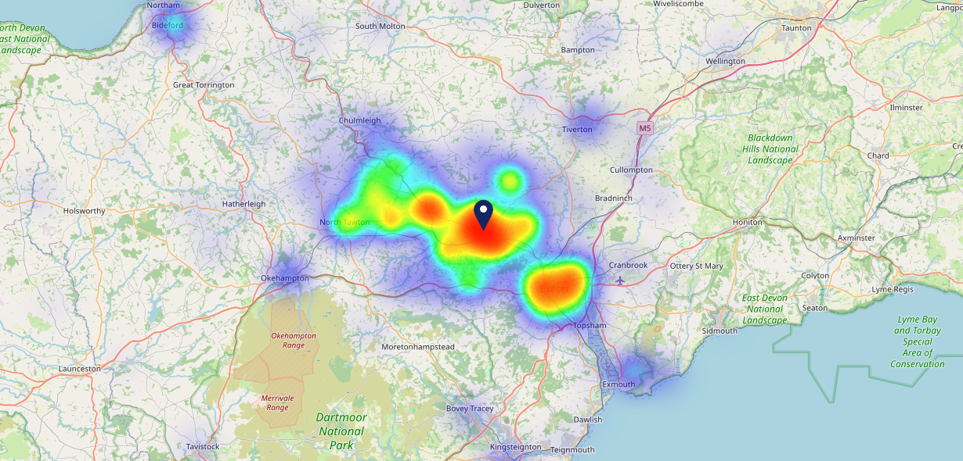
Site Intel
The Three Little Pigs EX172BP
29/01/2025 - 21/01/2026
Map of Guest Origin
Where do customers of The Three Little Pigs EX172BP come from?
Where do customers of The Three Little Pigs EX172BP for 29/01/2025 - 21/01/2026 live
945 Site Customers

Slide 12
Site Intel
The Three Little Pigs EX172BP
1 Miles
338 Chains
29/01/2025 - 21/01/2026
Share of Wallet
What are the Top 20 venues (by spend) that customers of The Three Little Pigs EX172BP also visit?
For customers of The Three Little Pigs EX172BP, who are the top 20 competitors from 338 Chains in 1 Miles for 29/01/2025 - 21/01/2026 split by Venue
2110 Site Customers

Slide 13
Site Intel
The Three Little Pigs EX172BP
1 Miles
338 Chains
29/01/2025 - 21/01/2026
Share of Wallet Change
How has share of wallet of customers of The Three Little Pigs EX172BP changed between two date ranges?
2110 Site Customers

Slide 14
Site Intel
The Three Little Pigs EX172BP
29/01/2025 - 21/01/2026
Market Summary
How does the local area for The Three Little Pigs EX172BP compare to the national average (1 = low, 10 = high)
Data Type | Name | Spend in 250m | 250m Spend vs National | Spend in 500m | 500m Spend vs National | Spend in 1 mile | 1 mile Spend vs National | Spend in 3 miles | 3 mile Spend vs National
Total | Annual Sales | £3.10M | 6 | £4.91M | 6 | £12.77M | 5 | £14.91M | 2
Weekpart | Mon - Thu | 42.0% | 6 | 41.8% | 6 | 45.0% | 8 | 44.1% | 8
Weekpart | Fri - Sat | 46.9% | 7 | 48.0% | 8 | 42.0% | 5 | 43.0% | 7
Weekpart | Sun | 11.1% | 2 | 10.2% | 1 | 13.0% | 2 | 12.9% | 1
Age | 18 to 24 | 5.3% | 5 | 6.9% | 6 | 6.4% | 5 | 5.9% | 4
Age | 25 to 34 | 15.6% | 3 | 16.3% | 3 | 18.9% | 4 | 17.1% | 2
Age | 35 to 44 | 18.1% | 2 | 19.4% | 3 | 25.6% | 7 | 23.2% | 5
Age | 45 to 54 | 17.4% | 3 | 17.5% | 3 | 16.8% | 2 | 17.4% | 1
Age | 55 to 64 | 21.1% | 9 | 20.3% | 8 | 16.3% | 6 | 18.4% | 9
Age | 65 to 74 | 11.5% | 9 | 10.7% | 8 | 9.5% | 8 | 10.8% | 9
Age | 75+ | 11.0% | 10 | 8.9% | 10 | 6.5% | 9 | 7.1% | 10
CAMEO | Business Elite | 1.6% | 2 | 1.6% | 2 | 1.2% | 1 | 1.6% | 1
CAMEO | Prosperous Professionals | 4.7% | 4 | 4.0% | 3 | 4.6% | 4 | 5.1% | 4
CAMEO | Flourishing Society | 9.5% | 4 | 9.1% | 4 | 11.8% | 5 | 12.3% | 5
CAMEO | Content Communities | 28.4% | 10 | 25.9% | 10 | 21.3% | 10 | 22.2% | 10
CAMEO | White Collar Neighbourhoods | 12.6% | 7 | 12.1% | 6 | 11.8% | 6 | 11.5% | 5
CAMEO | Enterprising Mainstream | 11.2% | 8 | 12.7% | 9 | 13.9% | 9 | 12.6% | 9
CAMEO | Paying The Mortgage | 15.8% | 7 | 17.4% | 8 | 17.2% | 7 | 17.5% | 8
CAMEO | Cash Conscious Communities | 8.7% | 5 | 9.1% | 6 | 9.2% | 6 | 9.0% | 5
CAMEO | On A Budget | 3.3% | 2 | 3.3% | 2 | 4.2% | 3 | 3.8% | 2
CAMEO | Family Value | 4.2% | 7 | 4.9% | 7 | 4.8% | 7 | 4.4% | 7
Affluence | AB | 15.8% | 3 | 14.7% | 2 | 17.6% | 3 | 18.9% | 3
Affluence | C1C2 | 68.0% | 10 | 68.1% | 10 | 64.1% | 10 | 63.8% | 10
Affluence | DE | 16.2% | 4 | 17.2% | 4 | 18.2% | 5 | 17.2% | 4

