Slide 1
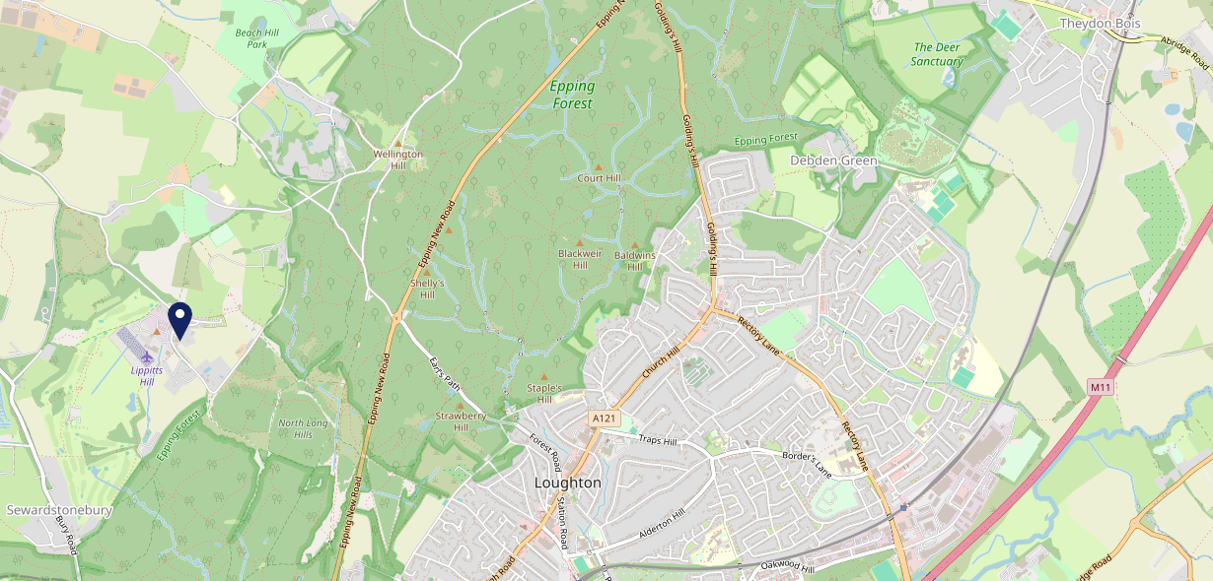
Site Intel
Owl Loughton IG104AL
1 Miles
371 Chains
16/04/2025 - 08/04/2026
Site Summary
Owl Loughton IG104AL
Work Area
Region
TV Region
Urbanicity
London
East of England
London
Rural village
IG104AL
Punch - Fireside Inns
Top Competitors
ATV
Gender
West Essex Golf Club
#1
£24.12
59.54%
Male
E47QL
Clubs
Affluence
Segmentation
Fives And Heronian
#2
44.07%
19.09%
High Income
Flourishing Society
E47QL
Pub / Bar
Age Group
Visit Day
#3
26.54%
30.08%
35 to 44
Sun
Nearest Station
Chingford(2.46 miles)
1899 Site Customers
2 Competitors
380 Competitor Customers

Slide 2
Site Intel
Owl Loughton IG104AL
1 Miles
371 Chains
16/04/2025 - 08/04/2026
Spend by Weekpart
How is customer spend distributed throughout the week for Owl Loughton IG104AL versus its competitors?
% of spend for Owl Loughton IG104AL and 371 Chains in 1 Miles from 16/04/2025 - 08/04/2026 split by Day of Week
1899 Site Customers
2 Competitors
380 Competitor Customers

Slide 3
Site Intel
Owl Loughton IG104AL
1 Miles
371 Chains
16/04/2025 - 08/04/2026
Visit Frequency
How frequently per year do customers visit Owl Loughton IG104AL versus its competitors?
% of customer numbers for Owl Loughton IG104AL and 371 Chains in 1 Miles from 16/04/2025 - 08/04/2026 and the number of visits made Per Annum
1899 Site Customers
2 Competitors
380 Competitor Customers

Slide 4
Site Intel
Owl Loughton IG104AL
1 Miles
371 Chains
16/04/2025 - 08/04/2026
ATV Change
How has ATV changed between two date ranges?
1899 Site Customers

Slide 5
Site Intel
Owl Loughton IG104AL
1 Miles
371 Chains
16/04/2025 - 08/04/2026
Market Share Change
How has market share changed between two date ranges?
% of market share spend for Owl Loughton IG104AL and 371 Chains in 1 Miles from 16/04/2025 - 08/04/2026
1899 Site Customers

Slide 6
Site Intel
Owl Loughton IG104AL
1 Miles
371 Chains
16/04/2025 - 08/04/2026
Age
How does the age profile of customers who visit Owl Loughton IG104AL compare versus its competitors?
% of spend for Owl Loughton IG104AL and 371 Chains in 1 Miles from 16/04/2025 - 08/04/2026 split by Age Range
931 Site Customers
2 Competitors
193 Competitor Customers

Slide 7
Site Intel
Owl Loughton IG104AL
1 Miles
371 Chains
16/04/2025 - 08/04/2026
Affluence
How does the affluence of customers who visit Owl Loughton IG104AL compare versus its competitors?
% of spend for Owl Loughton IG104AL and 371 Chains in 1 Miles from 16/04/2025 - 08/04/2026 split by Affluence
881 Site Customers
2 Competitors
173 Competitor Customers

Slide 8
Site Intel
Owl Loughton IG104AL
1 Miles
371 Chains
16/04/2025 - 08/04/2026
Gender
How does the gender profile of customers who visit Owl Loughton IG104AL compare versus its competitors?
% of spend for Owl Loughton IG104AL and 371 Chains in 1 Miles from 16/04/2025 - 08/04/2026 split by Gender
904 Site Customers
2 Competitors
183 Competitor Customers

Slide 9
Site Intel
Owl Loughton IG104AL
1 Miles
371 Chains
16/04/2025 - 08/04/2026
Punch Segmentation
How does the Custom segmentation profile of customers who visit Owl Loughton IG104AL compare versus its competitors?
% of spend for Owl Loughton IG104AL and 371 Chains in 1 Miles from 16/04/2025 - 08/04/2026 split by Segment
1899 Site Customers
2 Competitors
380 Competitor Customers

Slide 10
Site Intel
Owl Loughton IG104AL
1 Miles
371 Chains
16/04/2025 - 08/04/2026
Spend by Distance
How does the spend profile of Owl Loughton IG104AL compare versus its competitors based on travel distances?
% of spend for Owl Loughton IG104AL and 371 Chains in 1 Miles from 16/04/2025 - 08/04/2026 split by Distance travelled
904 Site Customers
2 Competitors
183 Competitor Customers

Slide 11
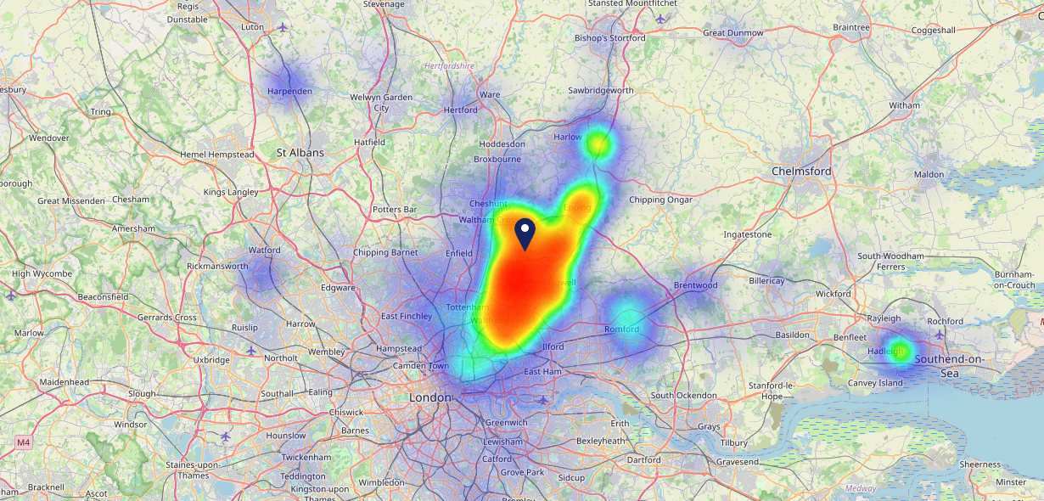
Site Intel
Owl Loughton IG104AL
16/04/2025 - 08/04/2026
Map of Guest Origin
Where do customers of Owl Loughton IG104AL come from?
Where do customers of Owl Loughton IG104AL for 16/04/2025 - 08/04/2026 live
904 Site Customers

Slide 12
Site Intel
Owl Loughton IG104AL
1 Miles
371 Chains
16/04/2025 - 08/04/2026
Share of Wallet
What are the Top 20 venues (by spend) that customers of Owl Loughton IG104AL also visit?
For customers of Owl Loughton IG104AL, who are the top 20 competitors from 371 Chains in 1 Miles for 16/04/2025 - 08/04/2026 split by Venue
1899 Site Customers

Slide 13
Site Intel
Owl Loughton IG104AL
1 Miles
371 Chains
16/04/2025 - 08/04/2026
Share of Wallet Change
How has share of wallet of customers of Owl Loughton IG104AL changed between two date ranges?
1899 Site Customers

Slide 14
Site Intel
Owl Loughton IG104AL
16/04/2025 - 08/04/2026
Market Summary
How does the local area for Owl Loughton IG104AL compare to the national average (1 = low, 10 = high)
Data Type | Name | Spend in 250m | 250m Spend vs National | Spend in 500m | 500m Spend vs National | Spend in 1 mile | 1 mile Spend vs National | Spend in 3 miles | 3 mile Spend vs National
Total | Annual Sales | £928K | 4 | £928K | 3 | £1.48M | 2 | £119.60M | 7
Weekpart | Mon - Thu | 33.1% | 2 | 33.1% | 1 | 45.9% | 9 | 43.1% | 7
Weekpart | Fri - Sat | 37.3% | 2 | 37.3% | 2 | 34.3% | 1 | 40.6% | 4
Weekpart | Sun | 29.6% | 10 | 29.6% | 10 | 19.8% | 10 | 16.3% | 7
Age | 18 to 24 | 3.9% | 4 | 3.9% | 3 | 7.2% | 6 | 4.6% | 2
Age | 25 to 34 | 13.4% | 2 | 13.4% | 2 | 12.7% | 1 | 13.2% | 1
Age | 35 to 44 | 26.8% | 8 | 26.8% | 8 | 20.4% | 3 | 26.9% | 9
Age | 45 to 54 | 13.5% | 1 | 13.5% | 1 | 21.1% | 7 | 20.7% | 6
Age | 55 to 64 | 15.7% | 6 | 15.7% | 6 | 15.4% | 6 | 19.9% | 9
Age | 65 to 74 | 18.2% | 10 | 18.2% | 10 | 12.7% | 9 | 9.9% | 9
Age | 75+ | 8.5% | 10 | 8.5% | 10 | 10.4% | 10 | 4.7% | 9
CAMEO | Business Elite | 10.7% | 7 | 10.7% | 7 | 22.2% | 10 | 12.3% | 8
CAMEO | Prosperous Professionals | 13.7% | 10 | 13.7% | 10 | 13.2% | 10 | 3.3% | 2
CAMEO | Flourishing Society | 19.2% | 8 | 19.2% | 8 | 17.6% | 8 | 20.3% | 9
CAMEO | Content Communities | 10.4% | 4 | 10.4% | 4 | 12.4% | 5 | 9.3% | 2
CAMEO | White Collar Neighbourhoods | 12.2% | 6 | 12.2% | 6 | 8.2% | 2 | 10.7% | 4
CAMEO | Enterprising Mainstream | 4.0% | 2 | 4.0% | 2 | 2.5% | 1 | 4.4% | 2
CAMEO | Paying The Mortgage | 17.7% | 8 | 17.7% | 8 | 15.5% | 6 | 18.4% | 8
CAMEO | Cash Conscious Communities | 5.5% | 3 | 5.5% | 2 | 4.0% | 1 | 8.1% | 4
CAMEO | On A Budget | 6.0% | 5 | 6.0% | 5 | 4.1% | 2 | 11.7% | 10
CAMEO | Family Value | 0.5% | 2 | 0.5% | 1 | 0.3% | 1 | 1.4% | 4
Affluence | AB | 43.6% | 9 | 43.6% | 9 | 52.9% | 10 | 35.9% | 7
Affluence | C1C2 | 44.4% | 4 | 44.4% | 4 | 38.7% | 2 | 42.9% | 3
Affluence | DE | 12.0% | 3 | 12.0% | 2 | 8.4% | 1 | 21.2% | 6

Slide 15
Site Intel
Owl Loughton IG104AL
Local Market Profile
Mix of spend by customer segment in Punch site and local market
 | Customer Count | Family Familiar | Occasional & Local | Mid-Week Seniors | Part Of The Pub | Metro Sophisticates | Young & Connected | Bubbly Weekenders | Upmarket Diners
Owl Loughton | 368 | 5.90% | 18.95% | 12.60% | 0.91% | 18.77% | 8.14% | 10.83% | 23.87%
Local Catchment | 60 | 1.13% | 0.00% | 1.91% | 0.56% | 63.55% | 1.03% | 14.03% | 17.75%
Punch T&L | 93520 | 8.89% | 6.05% | 28.80% | 11.19% | 11.34% | 11.05% | 7.03% | 15.61%
Owl Loughton vs Local Catchment |  | 4.77% | 0.00% | 10.69% | 0.35% | -44.78% | 7.11% | -3.20% | 6.12%
Owl Loughton vs Punch T&L |  | -2.99% | 12.90% | -16.20% | -10.28% | 7.43% | -2.91% | 3.80% | 8.26%
Local Catchment vs Punch T&L |  | -7.76% | 0.00% | -26.89% | -10.63% | 52.21% | -10.02% | 7.00% | 2.14%

Slide 16
Site Intel
Owl Loughton IG104AL
Local Competitor Profiles
Mix of spend by customer segment in Punch site and local competitors
 | Customer Count | Family Familiar | Occasional & Local | Mid-Week Seniors | Part Of The Pub | Metro Sophisticates | Young & Connected | Bubbly Weekenders | Upmarket Diners
Owl Loughton IG104AL | 368 | 5.90% | 18.95% | 12.60% | 0.91% | 18.77% | 8.14% | 10.83% | 23.87%
West Essex Golf Club E47QL | 59 | 1.13% | 0.00% | 1.91% | 0.56% | 63.59% | 1.03% | 13.98% | 17.76%
Fives And Heronian E47QL | 1 | 0.00% | 0.00% | 0.00% | 0.00% | 0.00% | 0.00% | 100.00% | 0.00%

