Slide 1











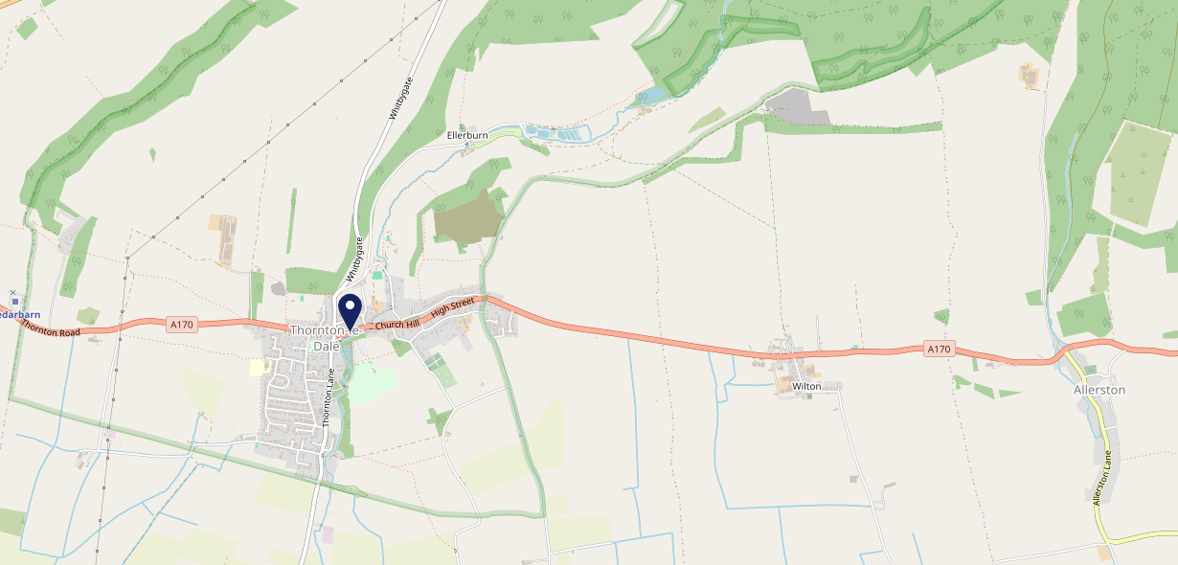











Site Intel
Buck Inn YO187RW
1 Miles
338 Chains
29/01/2025 - 21/01/2026
Site Summary
Buck Inn YO187RW
Work Area
Region
TV Region
Urbanicity
Malton
Yorkshire and The Humber
Tyne Tees
Rural town and fringe in a sparse setting
YO187RW
Punch T&L
Top Competitors
ATV
Gender
Munch
#1
£15.79
84.78%
Male
YO187LH
Restaurant
Affluence
Segmentation
Brandysnap Bistro
#2
44.49%
39.35%
High Income
Flourishing Society
YO187RY
Restaurant
Age Group
Visit Day
Moores Delicat
#3
40.39%
25.54%
YO187RJ
65 to 74
Sat
Café
Nearest Station
Malton(12.62 miles)
1256 Site Customers
13 Competitors
651 Competitor Customers

Slide 2

Site Intel
Buck Inn YO187RW
1 Miles
338 Chains
29/01/2025 - 21/01/2026
Spend by Weekpart
How is customer spend distributed throughout the week for Buck Inn YO187RW versus its competitors?
% of spend for Buck Inn YO187RW and 338 Chains in 1 Miles from 29/01/2025 - 21/01/2026 split by Day of Week
1256 Site Customers
13 Competitors
651 Competitor Customers

Slide 3
Site Intel
Buck Inn YO187RW
1 Miles
338 Chains
29/01/2025 - 21/01/2026
Visit Frequency
How frequently per year do customers visit Buck Inn YO187RW versus its competitors?
% of customer numbers for Buck Inn YO187RW and 338 Chains in 1 Miles from 29/01/2025 - 21/01/2026 and the number of visits made Per Annum
1256 Site Customers
13 Competitors
651 Competitor Customers

Slide 4
Site Intel
Buck Inn YO187RW
1 Miles
338 Chains
29/01/2025 - 21/01/2026
ATV Change
How has ATV changed between two date ranges?
1256 Site Customers

Slide 5
Site Intel
Buck Inn YO187RW
1 Miles
338 Chains
29/01/2025 - 21/01/2026
Market Share Change
How has market share changed between two date ranges?
% of market share spend for Buck Inn YO187RW and 338 Chains in 1 Miles from 29/01/2025 - 21/01/2026
1256 Site Customers

Slide 6
Site Intel
Buck Inn YO187RW
1 Miles
338 Chains
29/01/2025 - 21/01/2026
Age
How does the age profile of customers who visit Buck Inn YO187RW compare versus its competitors?
% of spend for Buck Inn YO187RW and 338 Chains in 1 Miles from 29/01/2025 - 21/01/2026 split by Age Range
653 Site Customers
13 Competitors
349 Competitor Customers

Slide 7
Site Intel
Buck Inn YO187RW
1 Miles
338 Chains
29/01/2025 - 21/01/2026
Affluence
How does the affluence of customers who visit Buck Inn YO187RW compare versus its competitors?
% of spend for Buck Inn YO187RW and 338 Chains in 1 Miles from 29/01/2025 - 21/01/2026 split by Affluence
604 Site Customers
13 Competitors
328 Competitor Customers

Slide 8
Site Intel
Buck Inn YO187RW
1 Miles
338 Chains
29/01/2025 - 21/01/2026
Gender
How does the gender profile of customers who visit Buck Inn YO187RW compare versus its competitors?
% of spend for Buck Inn YO187RW and 338 Chains in 1 Miles from 29/01/2025 - 21/01/2026 split by Gender
632 Site Customers
13 Competitors
341 Competitor Customers

Slide 9
Site Intel
Buck Inn YO187RW
1 Miles
338 Chains
29/01/2025 - 21/01/2026
Punch Segmentation
How does the Custom segmentation profile of customers who visit Buck Inn YO187RW compare versus its competitors?
% of spend for Buck Inn YO187RW and 338 Chains in 1 Miles from 29/01/2025 - 21/01/2026 split by Segment
1256 Site Customers
13 Competitors
651 Competitor Customers

Slide 10
Site Intel
Buck Inn YO187RW
1 Miles
338 Chains
29/01/2025 - 21/01/2026
Spend by Distance
How does the spend profile of Buck Inn YO187RW compare versus its competitors based on travel distances?
% of spend for Buck Inn YO187RW and 338 Chains in 1 Miles from 29/01/2025 - 21/01/2026 split by Distance travelled
633 Site Customers
13 Competitors
341 Competitor Customers

Slide 11
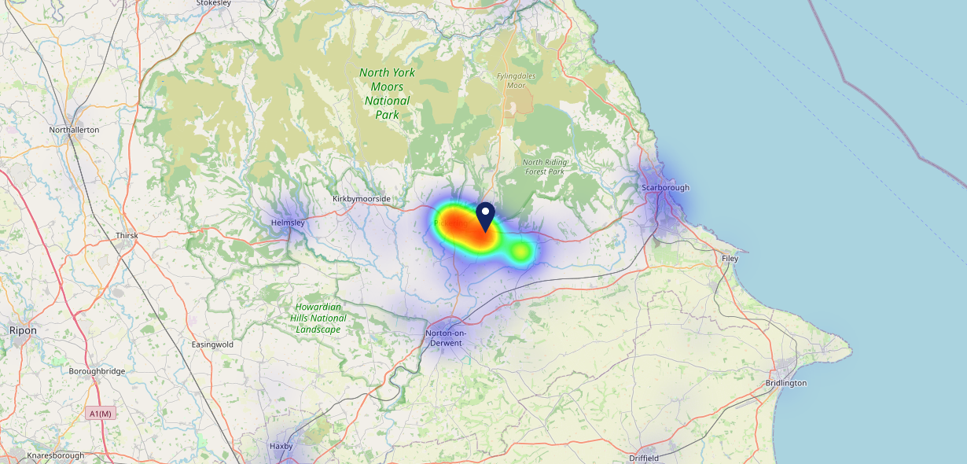

Site Intel
Buck Inn YO187RW
29/01/2025 - 21/01/2026
Map of Guest Origin
Where do customers of Buck Inn YO187RW come from?
Where do customers of Buck Inn YO187RW for 29/01/2025 - 21/01/2026 live
633 Site Customers

Slide 12
Site Intel
Buck Inn YO187RW
1 Miles
338 Chains
29/01/2025 - 21/01/2026
Share of Wallet
What are the Top 20 venues (by spend) that customers of Buck Inn YO187RW also visit?
For customers of Buck Inn YO187RW, who are the top 20 competitors from 338 Chains in 1 Miles for 29/01/2025 - 21/01/2026 split by Venue
1256 Site Customers

Slide 13
Site Intel
Buck Inn YO187RW
1 Miles
338 Chains
29/01/2025 - 21/01/2026
Share of Wallet Change
How has share of wallet of customers of Buck Inn YO187RW changed between two date ranges?
1256 Site Customers

Slide 14
Site Intel
Buck Inn YO187RW
29/01/2025 - 21/01/2026
Market Summary
How does the local area for Buck Inn YO187RW compare to the national average (1 = low, 10 = high)
Data Type | Name | Spend in 250m | 250m Spend vs National | Spend in 500m | 500m Spend vs National | Spend in 1 mile | 1 mile Spend vs National | Spend in 3 miles | 3 mile Spend vs National
Total | Annual Sales | £867K | 4 | £886K | 3 | £1.01M | 2 | £10.46M | 2
Weekpart | Mon - Thu | 37.9% | 4 | 39.3% | 5 | 39.4% | 4 | 40.5% | 4
Weekpart | Fri - Sat | 46.5% | 7 | 45.5% | 7 | 45.5% | 8 | 45.2% | 9
Weekpart | Sun | 15.5% | 7 | 15.2% | 6 | 15.1% | 5 | 14.3% | 2
Age | 18 to 24 | 3.9% | 4 | 3.9% | 3 | 3.4% | 2 | 4.3% | 2
Age | 25 to 34 | 6.5% | 1 | 7.0% | 1 | 7.1% | 1 | 10.2% | 1
Age | 35 to 44 | 11.1% | 1 | 11.1% | 1 | 11.2% | 1 | 18.2% | 1
Age | 45 to 54 | 12.3% | 1 | 12.4% | 1 | 14.1% | 1 | 16.9% | 1
Age | 55 to 64 | 19.7% | 8 | 19.7% | 8 | 20.9% | 9 | 23.0% | 10
Age | 65 to 74 | 40.2% | 10 | 39.8% | 10 | 37.0% | 10 | 20.1% | 10
Age | 75+ | 6.2% | 9 | 6.2% | 9 | 6.2% | 9 | 7.3% | 10
CAMEO | Business Elite | 1.8% | 2 | 1.9% | 2 | 2.4% | 2 | 3.3% | 2
CAMEO | Prosperous Professionals | 3.8% | 3 | 3.8% | 3 | 4.3% | 3 | 4.8% | 3
CAMEO | Flourishing Society | 40.2% | 10 | 39.8% | 10 | 37.4% | 10 | 23.4% | 10
CAMEO | Content Communities | 8.2% | 2 | 8.9% | 2 | 9.8% | 3 | 13.4% | 7
CAMEO | White Collar Neighbourhoods | 10.1% | 4 | 9.9% | 4 | 9.5% | 3 | 10.1% | 4
CAMEO | Enterprising Mainstream | 11.3% | 8 | 11.5% | 8 | 12.5% | 9 | 14.2% | 10
CAMEO | Paying The Mortgage | 9.2% | 2 | 9.1% | 2 | 9.4% | 2 | 14.6% | 5
CAMEO | Cash Conscious Communities | 12.5% | 8 | 12.3% | 8 | 11.5% | 8 | 10.0% | 6
CAMEO | On A Budget | 0.8% | 1 | 0.8% | 1 | 1.1% | 1 | 3.8% | 2
CAMEO | Family Value | 2.0% | 5 | 2.0% | 5 | 2.1% | 5 | 2.4% | 5
Affluence | AB | 45.8% | 9 | 45.5% | 9 | 44.1% | 9 | 31.5% | 6
Affluence | C1C2 | 38.9% | 3 | 39.4% | 3 | 41.2% | 3 | 52.3% | 7
Affluence | DE | 15.3% | 4 | 15.1% | 4 | 14.7% | 3 | 16.2% | 3

Slide 15

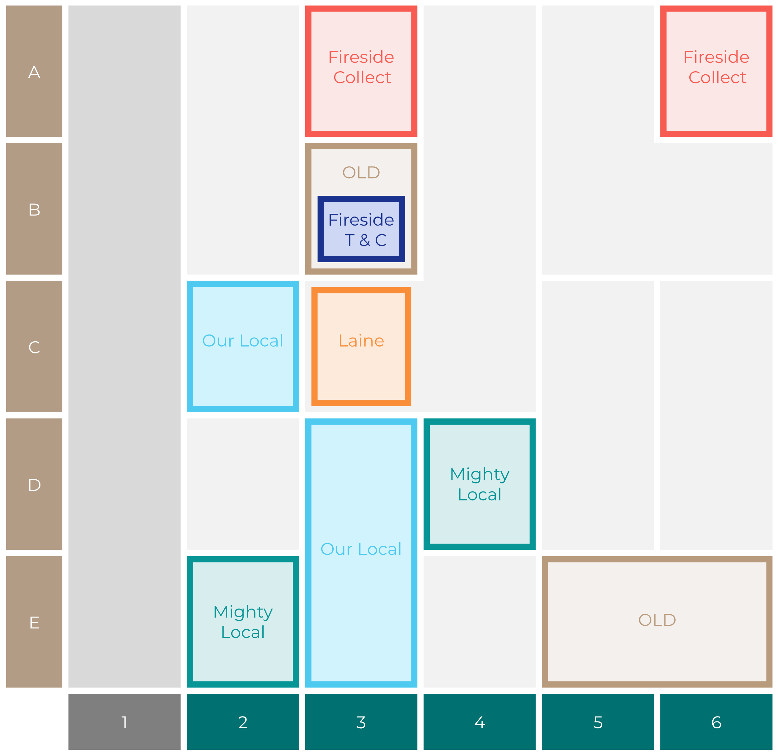

Site Intel
Buck Inn YO187RW
Site Potential 1
Site Characteristics
£3000
£18000
OCC Concept Fit
Achievable Average Weekly Takings
Non-Core
£9500
A Food-Led High Affluence B Food-Led Mid Affluence C Wet-Led Mid/High Affluence D Wet-Led Low Affluence E Food-Led Low Affluence
AWT 2 Local Regulars 3 Local Passing Trade 4 Destination Wet-Led 5 Destination Food-Led 6 Destination Very Food-Led
A
B
C
D
E
1
2
3
4
5
6

Slide 16
Site Intel
Buck Inn YO187RW
Site Potential 2
Concept Recommendation

Slide 17
Site Intel
Buck Inn YO187RW
Local Market Profile
Mix of spend by customer segment in Punch site and local market
 | Customer Count | Family Familiar | Occasional & Local | Mid-Week Seniors | Part Of The Pub | Metro Sophisticates | Young & Connected | Bubbly Weekenders | Upmarket Diners
Buck Inn | 241 | 2.24% | 10.08% | 47.71% | 23.76% | 2.73% | 5.65% | 2.70% | 5.08%
Local Catchment | 97 | 4.67% | 2.57% | 25.61% | 2.52% | 5.92% | 28.73% | 1.97% | 27.98%
Punch T&L | 97244 | 8.88% | 6.05% | 28.69% | 11.37% | 11.23% | 11.04% | 7.12% | 15.57%
Buck Inn vs Local Catchment |  | -2.43% | 7.51% | 22.10% | 21.24% | -3.19% | -23.08% | 0.73% | -22.90%
Buck Inn vs Punch T&L |  | -6.64% | 4.03% | 19.02% | 12.39% | -8.50% | -5.39% | -4.42% | -10.49%
Local Catchment vs Punch T&L |  | -4.21% | -3.48% | -3.08% | -8.85% | -5.31% | 17.69% | -5.15% | 12.41%

Slide 18
Site Intel
Buck Inn YO187RW
Local Competitor Profiles
Mix of spend by customer segment in Punch site and local competitors
 | Customer Count | Family Familiar | Occasional & Local | Mid-Week Seniors | Part Of The Pub | Metro Sophisticates | Young & Connected | Bubbly Weekenders | Upmarket Diners
Buck Inn YO187RW | 241 | 2.24% | 10.08% | 47.71% | 23.76% | 2.73% | 5.65% | 2.70% | 5.08%
Munch YO187LH | 30 | 9.23% | 5.05% | 8.98% | 5.34% | 0.00% | 61.87% | 1.12% | 8.38%
Brandysnap Bistro YO187RY | 7 | 0.00% | 0.00% | 38.45% | 0.00% | 9.17% | 12.77% | 0.00% | 39.59%
Moores Delicat YO187RJ | 43 | 7.43% | 2.49% | 30.47% | 0.00% | 7.04% | 35.10% | 3.80% | 13.64%
Thackraynilss YO187RJ | 4 | 0.00% | 0.00% | 11.03% | 0.00% | 0.00% | 11.99% | 0.00% | 76.97%

