Slide 1
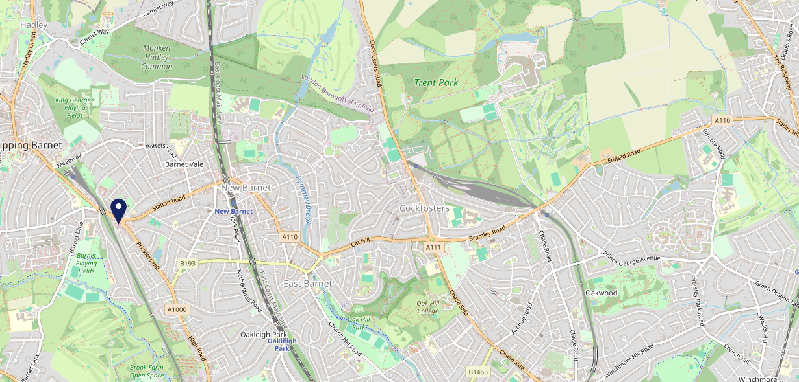
Site Intel
Queens Arms EN51AB
1 Miles
1 Chain
05/03/2025 - 25/02/2026
Site Summary
Queens Arms EN51AB
Work Area
Region
TV Region
Urbanicity
London
London
London
Urban major conurbation
EN51AB
McMullens
Top Competitors
ATV
Gender
#1
£11.60
72.15%
Male
Affluence
Segmentation
#2
44.97%
22.83%
Middle Income
Cash Conscious Communities
Age Group
Visit Day
#3
25.28%
25.87%
25 to 34
Sat
Nearest Station
High Barnet(0.70 miles)
242 Site Customers
0 Competitors
0 Competitor Customers

Slide 2
Site Intel
Queens Arms EN51AB
1 Miles
1 Chain
05/03/2025 - 25/02/2026
Spend by Weekpart
How is customer spend distributed throughout the week for Queens Arms EN51AB versus its competitors?
% of spend for Queens Arms EN51AB and 1 Chains in 1 Miles from 05/03/2025 - 25/02/2026 split by Day of Week
242 Site Customers
0 Competitors
0 Competitor Customers

Slide 3
Site Intel
Queens Arms EN51AB
1 Miles
1 Chain
05/03/2025 - 25/02/2026
Visit Frequency
How frequently per year do customers visit Queens Arms EN51AB versus its competitors?
% of customer numbers for Queens Arms EN51AB and 1 Chains in 1 Miles from 05/03/2025 - 25/02/2026 and the number of visits made Per Annum
242 Site Customers
0 Competitors
0 Competitor Customers

Slide 4
Site Intel
Queens Arms EN51AB
1 Miles
1 Chain
05/03/2025 - 25/02/2026
ATV Change
How has ATV changed between two date ranges?
242 Site Customers

Slide 5
Site Intel
Queens Arms EN51AB
1 Miles
1 Chain
05/03/2025 - 25/02/2026
Market Share Change
How has market share changed between two date ranges?
% of market share spend for Queens Arms EN51AB and 1 Chains in 1 Miles from 05/03/2025 - 25/02/2026
242 Site Customers

Slide 6
Site Intel
Queens Arms EN51AB
1 Miles
1 Chain
05/03/2025 - 25/02/2026
Age
How does the age profile of customers who visit Queens Arms EN51AB compare versus its competitors?
% of spend for Queens Arms EN51AB and 1 Chains in 1 Miles from 05/03/2025 - 25/02/2026 split by Age Range
99 Site Customers
0 Competitors

Slide 7
Site Intel
Queens Arms EN51AB
1 Miles
1 Chain
05/03/2025 - 25/02/2026
Affluence
How does the affluence of customers who visit Queens Arms EN51AB compare versus its competitors?
% of spend for Queens Arms EN51AB and 1 Chains in 1 Miles from 05/03/2025 - 25/02/2026 split by Affluence
95 Site Customers
0 Competitors

Slide 8
Site Intel
Queens Arms EN51AB
1 Miles
1 Chain
05/03/2025 - 25/02/2026
Gender
How does the gender profile of customers who visit Queens Arms EN51AB compare versus its competitors?
% of spend for Queens Arms EN51AB and 1 Chains in 1 Miles from 05/03/2025 - 25/02/2026 split by Gender
99 Site Customers
0 Competitors

Slide 9
Site Intel
Queens Arms EN51AB
1 Miles
1 Chain
05/03/2025 - 25/02/2026
Punch Segmentation
How does the Custom segmentation profile of customers who visit Queens Arms EN51AB compare versus its competitors?
% of spend for Queens Arms EN51AB and 1 Chains in 1 Miles from 05/03/2025 - 25/02/2026 split by Segment
242 Site Customers
0 Competitors
0 Competitor Customers

Slide 10
Site Intel
Queens Arms EN51AB
1 Miles
1 Chain
05/03/2025 - 25/02/2026
Spend by Distance
How does the spend profile of Queens Arms EN51AB compare versus its competitors based on travel distances?
% of spend for Queens Arms EN51AB and 1 Chains in 1 Miles from 05/03/2025 - 25/02/2026 split by Distance travelled
99 Site Customers
0 Competitors
0 Competitor Customers

Slide 11
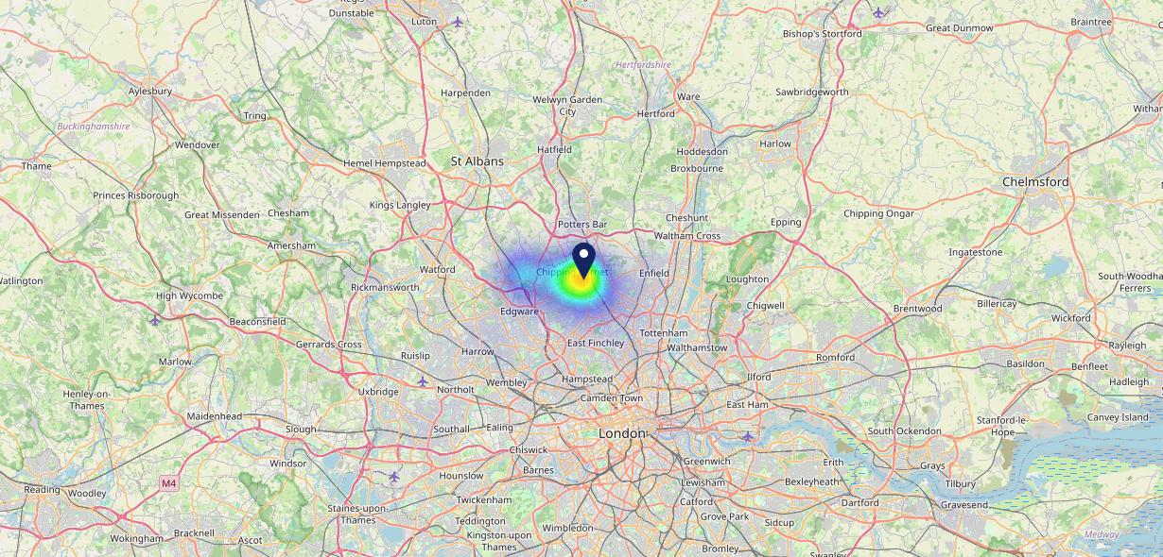
Site Intel
Queens Arms EN51AB
05/03/2025 - 25/02/2026
Map of Guest Origin
Where do customers of Queens Arms EN51AB come from?
Where do customers of Queens Arms EN51AB for 05/03/2025 - 25/02/2026 live
99 Site Customers

Slide 12
Site Intel
Queens Arms EN51AB
1 Miles
1 Chain
05/03/2025 - 25/02/2026
Share of Wallet
What are the Top 20 venues (by spend) that customers of Queens Arms EN51AB also visit?
For customers of Queens Arms EN51AB, who are the top 20 competitors from 1 Chains in 1 Miles for 05/03/2025 - 25/02/2026 split by Venue
242 Site Customers

Slide 13
Site Intel
Queens Arms EN51AB
1 Miles
1 Chain
05/03/2025 - 25/02/2026
Share of Wallet Change
How has share of wallet of customers of Queens Arms EN51AB changed between two date ranges?
242 Site Customers

Slide 14
Site Intel
Queens Arms EN51AB
05/03/2025 - 25/02/2026
Market Summary
How does the local area for Queens Arms EN51AB compare to the national average (1 = low, 10 = high)
Data Type | Name | Spend in 250m | 250m Spend vs National | Spend in 500m | 500m Spend vs National | Spend in 1 mile | 1 mile Spend vs National | Spend in 3 miles | 3 mile Spend vs National
Total | Annual Sales | £2.21M | 6 | £2.28M | 5 | £25.02M | 7 | £157.01M | 7
Weekpart | Mon - Thu | 44.4% | 8 | 45.0% | 8 | 45.2% | 8 | 42.8% | 7
Weekpart | Fri - Sat | 41.5% | 4 | 41.3% | 4 | 40.0% | 3 | 39.8% | 3
Weekpart | Sun | 14.1% | 5 | 13.7% | 4 | 14.7% | 4 | 17.4% | 9
Age | 18 to 24 | 1.3% | 2 | 1.3% | 1 | 2.9% | 2 | 4.2% | 2
Age | 25 to 34 | 13.0% | 2 | 12.7% | 2 | 11.7% | 1 | 11.8% | 1
Age | 35 to 44 | 20.2% | 3 | 20.0% | 3 | 21.8% | 4 | 23.6% | 6
Age | 45 to 54 | 21.6% | 7 | 21.4% | 7 | 21.3% | 7 | 23.0% | 9
Age | 55 to 64 | 17.8% | 7 | 18.2% | 7 | 19.1% | 8 | 19.3% | 9
Age | 65 to 74 | 13.2% | 9 | 13.2% | 9 | 14.3% | 10 | 11.6% | 9
Age | 75+ | 13.0% | 10 | 13.1% | 10 | 8.8% | 10 | 6.6% | 10
CAMEO | Business Elite | 18.4% | 9 | 18.6% | 9 | 18.7% | 9 | 20.1% | 9
CAMEO | Prosperous Professionals | 4.5% | 4 | 4.4% | 4 | 4.0% | 3 | 3.8% | 2
CAMEO | Flourishing Society | 18.2% | 8 | 18.2% | 8 | 20.0% | 9 | 16.6% | 7
CAMEO | Content Communities | 21.6% | 10 | 22.1% | 10 | 16.7% | 9 | 17.2% | 9
CAMEO | White Collar Neighbourhoods | 10.0% | 4 | 9.9% | 4 | 12.4% | 7 | 11.5% | 5
CAMEO | Enterprising Mainstream | 2.9% | 1 | 2.8% | 1 | 3.3% | 1 | 4.4% | 2
CAMEO | Paying The Mortgage | 7.7% | 2 | 7.6% | 1 | 10.5% | 3 | 10.6% | 3
CAMEO | Cash Conscious Communities | 10.4% | 7 | 10.2% | 6 | 8.1% | 5 | 8.5% | 5
CAMEO | On A Budget | 4.9% | 4 | 4.8% | 4 | 5.4% | 4 | 6.0% | 4
CAMEO | Family Value | 1.4% | 4 | 1.4% | 4 | 1.0% | 3 | 1.3% | 3
Affluence | AB | 41.1% | 8 | 41.2% | 8 | 42.7% | 8 | 40.5% | 8
Affluence | C1C2 | 42.2% | 3 | 42.3% | 3 | 42.8% | 3 | 43.8% | 4
Affluence | DE | 16.7% | 4 | 16.5% | 4 | 14.6% | 3 | 15.8% | 3

