Slide 1
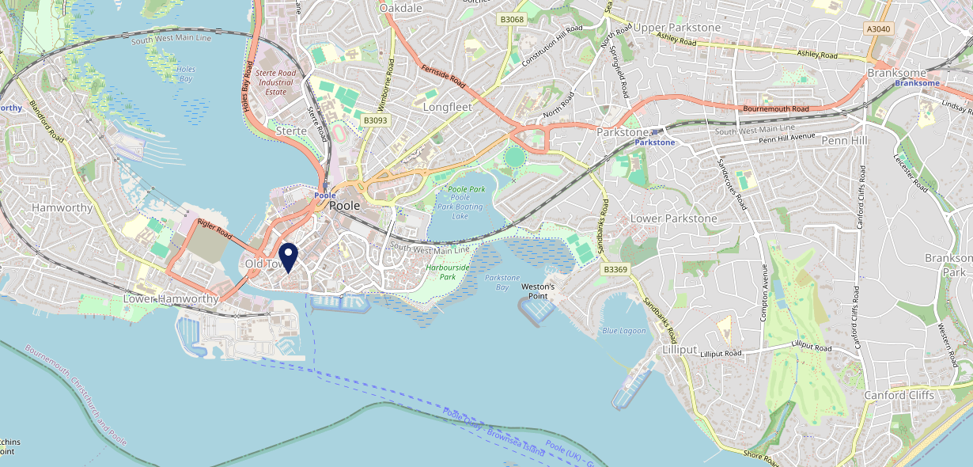
Site Intel
The Kings Head BH151BP
1 Miles
1 Chain
05/03/2025 - 25/02/2026
Site Summary
The Kings Head BH151BP
Work Area
Region
TV Region
Urbanicity
Poole
South West
South
Urban city and town
BH151BP
Hall & Woodhouse - L&T
Top Competitors
ATV
Gender
Rope And Anchor
#1
£15.37
67.32%
Male
BH151JW
Pub Restaurant
Affluence
Segmentation
#2
58.50%
17.54%
Middle Income
Content Communities
Age Group
Visit Day
#3
26.88%
32.20%
55 to 64
Sat
Nearest Station
Poole(0.75 miles)
863 Site Customers
1 Competitors
446 Competitor Customers

Slide 2
Site Intel
The Kings Head BH151BP
1 Miles
1 Chain
05/03/2025 - 25/02/2026
Spend by Weekpart
How is customer spend distributed throughout the week for The Kings Head BH151BP versus its competitors?
% of spend for The Kings Head BH151BP and 1 Chains in 1 Miles from 05/03/2025 - 25/02/2026 split by Day of Week
863 Site Customers
1 Competitors
446 Competitor Customers

Slide 3
Site Intel
The Kings Head BH151BP
1 Miles
1 Chain
05/03/2025 - 25/02/2026
Visit Frequency
How frequently per year do customers visit The Kings Head BH151BP versus its competitors?
% of customer numbers for The Kings Head BH151BP and 1 Chains in 1 Miles from 05/03/2025 - 25/02/2026 and the number of visits made Per Annum
863 Site Customers
1 Competitors
446 Competitor Customers

Slide 4
Site Intel
The Kings Head BH151BP
1 Miles
1 Chain
05/03/2025 - 25/02/2026
ATV Change
How has ATV changed between two date ranges?
863 Site Customers

Slide 5
Site Intel
The Kings Head BH151BP
1 Miles
1 Chain
05/03/2025 - 25/02/2026
Market Share Change
How has market share changed between two date ranges?
% of market share spend for The Kings Head BH151BP and 1 Chains in 1 Miles from 05/03/2025 - 25/02/2026
863 Site Customers

Slide 6
Site Intel
The Kings Head BH151BP
1 Miles
1 Chain
05/03/2025 - 25/02/2026
Age
How does the age profile of customers who visit The Kings Head BH151BP compare versus its competitors?
% of spend for The Kings Head BH151BP and 1 Chains in 1 Miles from 05/03/2025 - 25/02/2026 split by Age Range
473 Site Customers
1 Competitors
255 Competitor Customers

Slide 7
Site Intel
The Kings Head BH151BP
1 Miles
1 Chain
05/03/2025 - 25/02/2026
Affluence
How does the affluence of customers who visit The Kings Head BH151BP compare versus its competitors?
% of spend for The Kings Head BH151BP and 1 Chains in 1 Miles from 05/03/2025 - 25/02/2026 split by Affluence
454 Site Customers
1 Competitors
235 Competitor Customers

Slide 8
Site Intel
The Kings Head BH151BP
1 Miles
1 Chain
05/03/2025 - 25/02/2026
Gender
How does the gender profile of customers who visit The Kings Head BH151BP compare versus its competitors?
% of spend for The Kings Head BH151BP and 1 Chains in 1 Miles from 05/03/2025 - 25/02/2026 split by Gender
463 Site Customers
1 Competitors
248 Competitor Customers

Slide 9
Site Intel
The Kings Head BH151BP
1 Miles
1 Chain
05/03/2025 - 25/02/2026
Punch Segmentation
How does the Custom segmentation profile of customers who visit The Kings Head BH151BP compare versus its competitors?
% of spend for The Kings Head BH151BP and 1 Chains in 1 Miles from 05/03/2025 - 25/02/2026 split by Segment
863 Site Customers
1 Competitors
446 Competitor Customers

Slide 10
Site Intel
The Kings Head BH151BP
1 Miles
1 Chain
05/03/2025 - 25/02/2026
Spend by Distance
How does the spend profile of The Kings Head BH151BP compare versus its competitors based on travel distances?
% of spend for The Kings Head BH151BP and 1 Chains in 1 Miles from 05/03/2025 - 25/02/2026 split by Distance travelled
462 Site Customers
1 Competitors
247 Competitor Customers

Slide 11
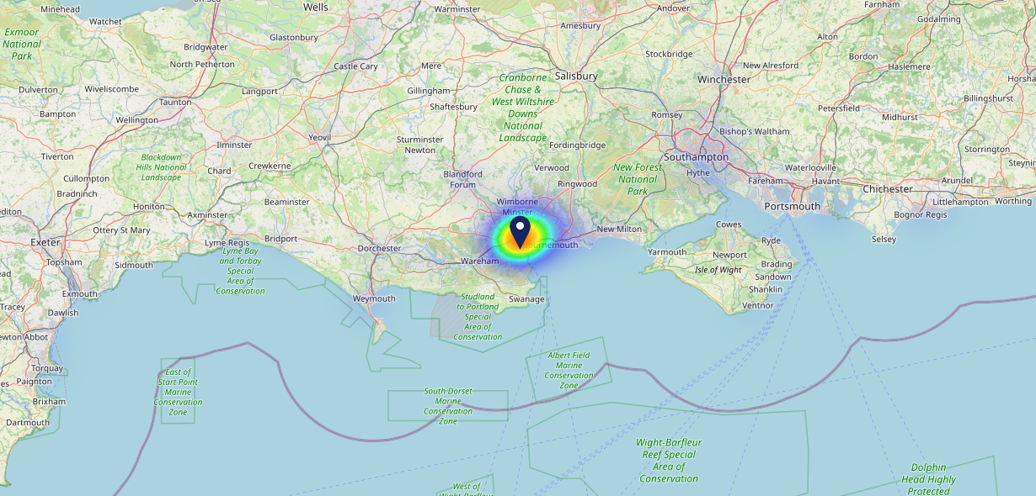
Site Intel
The Kings Head BH151BP
05/03/2025 - 25/02/2026
Map of Guest Origin
Where do customers of The Kings Head BH151BP come from?
Where do customers of The Kings Head BH151BP for 05/03/2025 - 25/02/2026 live
462 Site Customers

Slide 12
Site Intel
The Kings Head BH151BP
1 Miles
1 Chain
05/03/2025 - 25/02/2026
Share of Wallet
What are the Top 20 venues (by spend) that customers of The Kings Head BH151BP also visit?
For customers of The Kings Head BH151BP, who are the top 20 competitors from 1 Chains in 1 Miles for 05/03/2025 - 25/02/2026 split by Venue
863 Site Customers

Slide 13
Site Intel
The Kings Head BH151BP
1 Miles
1 Chain
05/03/2025 - 25/02/2026
Share of Wallet Change
How has share of wallet of customers of The Kings Head BH151BP changed between two date ranges?
863 Site Customers

Slide 14
Site Intel
The Kings Head BH151BP
05/03/2025 - 25/02/2026
Market Summary
How does the local area for The Kings Head BH151BP compare to the national average (1 = low, 10 = high)
Data Type | Name | Spend in 250m | 250m Spend vs National | Spend in 500m | 500m Spend vs National | Spend in 1 mile | 1 mile Spend vs National | Spend in 3 miles | 3 mile Spend vs National
Total | Annual Sales | £18.47M | 9 | £23.52M | 9 | £42.34M | 8 | £139.45M | 7
Weekpart | Mon - Thu | 38.8% | 4 | 39.4% | 5 | 44.7% | 8 | 43.4% | 8
Weekpart | Fri - Sat | 46.8% | 7 | 46.0% | 7 | 42.2% | 5 | 41.7% | 5
Weekpart | Sun | 14.4% | 5 | 14.6% | 5 | 13.1% | 2 | 15.0% | 4
Age | 18 to 24 | 4.2% | 4 | 4.1% | 4 | 4.7% | 3 | 5.0% | 3
Age | 25 to 34 | 10.4% | 1 | 10.3% | 1 | 11.4% | 1 | 13.9% | 1
Age | 35 to 44 | 17.9% | 2 | 17.9% | 2 | 18.6% | 2 | 22.2% | 4
Age | 45 to 54 | 18.7% | 4 | 18.6% | 4 | 18.6% | 3 | 19.3% | 4
Age | 55 to 64 | 23.8% | 10 | 23.3% | 10 | 20.8% | 9 | 19.3% | 9
Age | 65 to 74 | 16.6% | 10 | 16.7% | 10 | 15.7% | 10 | 12.7% | 10
Age | 75+ | 8.4% | 10 | 9.0% | 10 | 10.1% | 10 | 7.5% | 10
CAMEO | Business Elite | 8.0% | 6 | 7.5% | 6 | 6.3% | 5 | 8.1% | 6
CAMEO | Prosperous Professionals | 9.2% | 8 | 8.9% | 8 | 8.1% | 8 | 9.5% | 9
CAMEO | Flourishing Society | 13.6% | 6 | 13.2% | 6 | 11.7% | 5 | 11.6% | 5
CAMEO | Content Communities | 17.6% | 9 | 17.4% | 9 | 17.0% | 9 | 16.3% | 9
CAMEO | White Collar Neighbourhoods | 12.6% | 7 | 12.6% | 7 | 13.0% | 8 | 13.5% | 9
CAMEO | Enterprising Mainstream | 12.7% | 9 | 12.9% | 9 | 13.1% | 9 | 13.6% | 9
CAMEO | Paying The Mortgage | 11.1% | 4 | 11.3% | 4 | 12.6% | 4 | 12.0% | 4
CAMEO | Cash Conscious Communities | 8.3% | 5 | 8.5% | 5 | 9.5% | 6 | 7.6% | 4
CAMEO | On A Budget | 5.2% | 4 | 5.8% | 5 | 6.3% | 5 | 5.6% | 4
CAMEO | Family Value | 1.8% | 5 | 2.0% | 5 | 2.4% | 5 | 2.3% | 5
Affluence | AB | 30.8% | 6 | 29.6% | 6 | 26.1% | 5 | 29.2% | 5
Affluence | C1C2 | 53.9% | 8 | 54.1% | 8 | 55.7% | 9 | 55.3% | 9
Affluence | DE | 15.3% | 4 | 16.3% | 4 | 18.2% | 5 | 15.5% | 3

