Slide 1
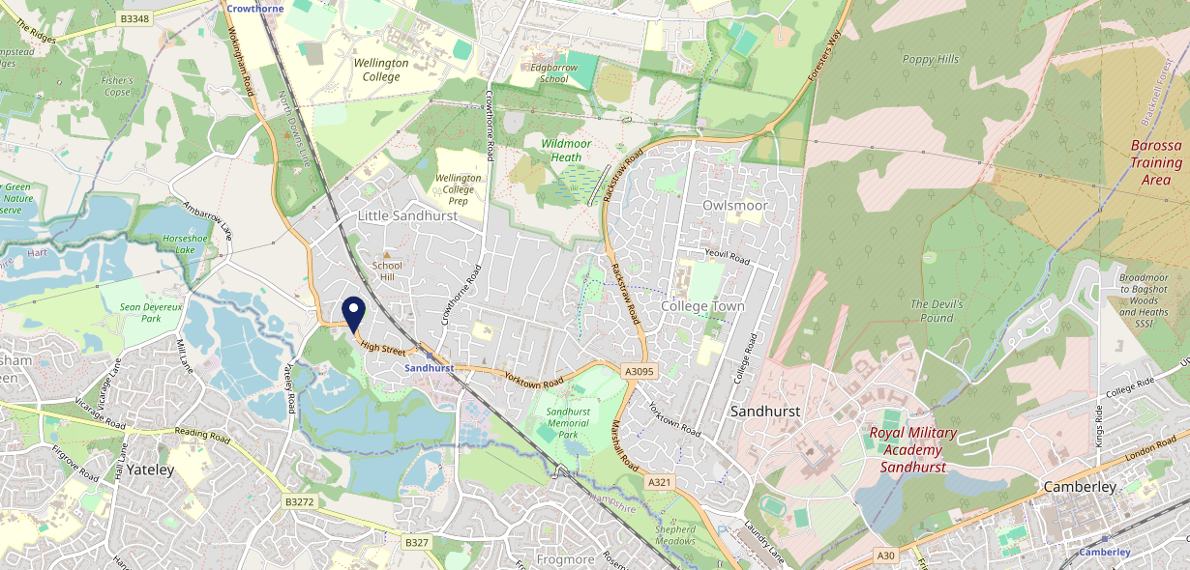
Site Intel
Rose & Crown GU478HA
1 Miles
371 Chains
16/04/2025 - 08/04/2026
Site Summary
Rose & Crown GU478HA
Work Area
Region
TV Region
Urbanicity
Reading
South East
London
Urban city and town
GU478HA
Punch - Our Local
Top Competitors
ATV
Gender
Wellington Arms
#1
£12.88
78.62%
Male
GU479BN
Brakspear - L&T
Affluence
Segmentation
White Swan (Sandhurst)
#2
61.14%
25.02%
High Income
Business Elite
GU479BU
GK Proper Locals
Age Group
Visit Day
Bird in Hand (Little Sandhurst)
#3
35.40%
21.55%
GU478LQ
35 to 44
Sat
GK Pub Partners
Nearest Station
Sandhurst (Berks)(0.45 miles)
862 Site Customers
78 Competitors
32514 Competitor Customers

Slide 2
Site Intel
Rose & Crown GU478HA
1 Miles
371 Chains
16/04/2025 - 08/04/2026
Spend by Weekpart
How is customer spend distributed throughout the week for Rose & Crown GU478HA versus its competitors?
% of spend for Rose & Crown GU478HA and 371 Chains in 1 Miles from 16/04/2025 - 08/04/2026 split by Day of Week
862 Site Customers
78 Competitors
32514 Competitor Customers

Slide 3
Site Intel
Rose & Crown GU478HA
1 Miles
371 Chains
16/04/2025 - 08/04/2026
Visit Frequency
How frequently per year do customers visit Rose & Crown GU478HA versus its competitors?
% of customer numbers for Rose & Crown GU478HA and 371 Chains in 1 Miles from 16/04/2025 - 08/04/2026 and the number of visits made Per Annum
862 Site Customers
78 Competitors
32514 Competitor Customers

Slide 4
Site Intel
Rose & Crown GU478HA
1 Miles
371 Chains
16/04/2025 - 08/04/2026
ATV Change
How has ATV changed between two date ranges?
862 Site Customers

Slide 5
Site Intel
Rose & Crown GU478HA
1 Miles
371 Chains
16/04/2025 - 08/04/2026
Market Share Change
How has market share changed between two date ranges?
% of market share spend for Rose & Crown GU478HA and 371 Chains in 1 Miles from 16/04/2025 - 08/04/2026
862 Site Customers

Slide 6
Site Intel
Rose & Crown GU478HA
1 Miles
371 Chains
16/04/2025 - 08/04/2026
Age
How does the age profile of customers who visit Rose & Crown GU478HA compare versus its competitors?
% of spend for Rose & Crown GU478HA and 371 Chains in 1 Miles from 16/04/2025 - 08/04/2026 split by Age Range
378 Site Customers
78 Competitors
15324 Competitor Customers

Slide 7
Site Intel
Rose & Crown GU478HA
1 Miles
371 Chains
16/04/2025 - 08/04/2026
Affluence
How does the affluence of customers who visit Rose & Crown GU478HA compare versus its competitors?
% of spend for Rose & Crown GU478HA and 371 Chains in 1 Miles from 16/04/2025 - 08/04/2026 split by Affluence
341 Site Customers
78 Competitors
14103 Competitor Customers

Slide 8
Site Intel
Rose & Crown GU478HA
1 Miles
371 Chains
16/04/2025 - 08/04/2026
Gender
How does the gender profile of customers who visit Rose & Crown GU478HA compare versus its competitors?
% of spend for Rose & Crown GU478HA and 371 Chains in 1 Miles from 16/04/2025 - 08/04/2026 split by Gender
361 Site Customers
78 Competitors
14875 Competitor Customers

Slide 9
Site Intel
Rose & Crown GU478HA
1 Miles
371 Chains
16/04/2025 - 08/04/2026
Punch Segmentation
How does the Custom segmentation profile of customers who visit Rose & Crown GU478HA compare versus its competitors?
% of spend for Rose & Crown GU478HA and 371 Chains in 1 Miles from 16/04/2025 - 08/04/2026 split by Segment
862 Site Customers
78 Competitors
32514 Competitor Customers

Slide 10
Site Intel
Rose & Crown GU478HA
1 Miles
371 Chains
16/04/2025 - 08/04/2026
Spend by Distance
How does the spend profile of Rose & Crown GU478HA compare versus its competitors based on travel distances?
% of spend for Rose & Crown GU478HA and 371 Chains in 1 Miles from 16/04/2025 - 08/04/2026 split by Distance travelled
361 Site Customers
78 Competitors
14857 Competitor Customers

Slide 11
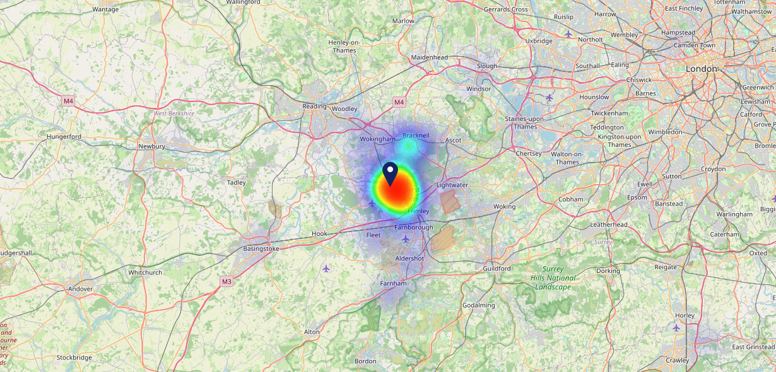
Site Intel
Rose & Crown GU478HA
16/04/2025 - 08/04/2026
Map of Guest Origin
Where do customers of Rose & Crown GU478HA come from?
Where do customers of Rose & Crown GU478HA for 16/04/2025 - 08/04/2026 live
361 Site Customers

Slide 12
Site Intel
Rose & Crown GU478HA
1 Miles
371 Chains
16/04/2025 - 08/04/2026
Share of Wallet
What are the Top 20 venues (by spend) that customers of Rose & Crown GU478HA also visit?
For customers of Rose & Crown GU478HA, who are the top 20 competitors from 371 Chains in 1 Miles for 16/04/2025 - 08/04/2026 split by Venue
862 Site Customers

Slide 13
Site Intel
Rose & Crown GU478HA
1 Miles
371 Chains
16/04/2025 - 08/04/2026
Share of Wallet Change
How has share of wallet of customers of Rose & Crown GU478HA changed between two date ranges?
862 Site Customers

Slide 14
Site Intel
Rose & Crown GU478HA
16/04/2025 - 08/04/2026
Market Summary
How does the local area for Rose & Crown GU478HA compare to the national average (1 = low, 10 = high)
Data Type | Name | Spend in 250m | 250m Spend vs National | Spend in 500m | 500m Spend vs National | Spend in 1 mile | 1 mile Spend vs National | Spend in 3 miles | 3 mile Spend vs National
Total | Annual Sales | £1.42M | 5 | £1.42M | 4 | £15.61M | 5 | £78.49M | 6
Weekpart | Mon - Thu | 41.0% | 6 | 41.0% | 6 | 42.4% | 6 | 41.9% | 6
Weekpart | Fri - Sat | 40.2% | 3 | 40.2% | 3 | 43.3% | 6 | 42.5% | 6
Weekpart | Sun | 18.8% | 9 | 18.8% | 9 | 14.3% | 4 | 15.6% | 5
Age | 18 to 24 | 2.7% | 3 | 2.7% | 2 | 3.5% | 2 | 4.9% | 3
Age | 25 to 34 | 15.1% | 3 | 15.1% | 2 | 10.3% | 1 | 12.8% | 1
Age | 35 to 44 | 36.8% | 10 | 36.8% | 10 | 23.6% | 6 | 24.2% | 6
Age | 45 to 54 | 11.7% | 1 | 11.7% | 1 | 22.4% | 8 | 22.1% | 8
Age | 55 to 64 | 17.1% | 7 | 17.1% | 7 | 18.4% | 8 | 19.0% | 9
Age | 65 to 74 | 13.9% | 9 | 13.9% | 10 | 17.1% | 10 | 11.9% | 9
Age | 75+ | 2.7% | 6 | 2.7% | 6 | 4.8% | 9 | 5.1% | 9
CAMEO | Business Elite | 15.0% | 8 | 15.0% | 8 | 10.1% | 7 | 12.5% | 8
CAMEO | Prosperous Professionals | 10.6% | 9 | 10.6% | 9 | 12.5% | 10 | 11.8% | 10
CAMEO | Flourishing Society | 24.2% | 9 | 24.2% | 10 | 30.0% | 10 | 23.6% | 10
CAMEO | Content Communities | 10.0% | 3 | 10.0% | 3 | 10.3% | 3 | 13.2% | 7
CAMEO | White Collar Neighbourhoods | 15.3% | 9 | 15.3% | 9 | 14.4% | 9 | 14.7% | 9
CAMEO | Enterprising Mainstream | 4.8% | 3 | 4.8% | 3 | 3.9% | 2 | 4.6% | 2
CAMEO | Paying The Mortgage | 10.8% | 3 | 10.8% | 3 | 11.5% | 3 | 10.9% | 3
CAMEO | Cash Conscious Communities | 3.9% | 2 | 3.9% | 1 | 4.0% | 1 | 4.3% | 1
CAMEO | On A Budget | 4.9% | 4 | 4.9% | 4 | 2.8% | 1 | 3.9% | 2
CAMEO | Family Value | 0.6% | 2 | 0.6% | 2 | 0.3% | 1 | 0.5% | 1
Affluence | AB | 49.8% | 9 | 49.8% | 9 | 52.7% | 10 | 47.9% | 10
Affluence | C1C2 | 40.9% | 3 | 40.9% | 3 | 40.2% | 3 | 43.4% | 3
Affluence | DE | 9.4% | 2 | 9.4% | 2 | 7.2% | 1 | 8.7% | 1

Slide 15
Site Intel
Rose & Crown GU478HA
Site Potential 1
Site Characteristics
£3000
£18000
OCC Concept Fit
Achievable Average Weekly Takings
Non-Core
£9500
A Food-Led High Affluence B Food-Led Mid Affluence C Wet-Led Mid/High Affluence D Wet-Led Low Affluence E Food-Led Low Affluence
AWT 2 Local Regulars 3 Local Passing Trade 4 Destination Wet-Led 5 Destination Food-Led 6 Destination Very Food-Led
A
B
C
D
E
1
2
3
4
5
6

Slide 16
Site Intel
Rose & Crown GU478HA
Site Potential 2
Concept Recommendation

Slide 17
Site Intel
Rose & Crown GU478HA
Local Market Profile
Mix of spend by customer segment in Punch site and local market
 | Customer Count | Family Familiar | Occasional & Local | Mid-Week Seniors | Part Of The Pub | Metro Sophisticates | Young & Connected | Bubbly Weekenders | Upmarket Diners
Rose & Crown | 146 | 9.09% | 4.68% | 45.49% | 1.70% | 8.48% | 8.32% | 7.52% | 14.68%
Local Catchment | 2116 | 13.72% | 5.97% | 16.49% | 19.40% | 6.14% | 8.65% | 9.91% | 19.68%
Punch T&L | 94346 | 8.90% | 6.08% | 28.74% | 11.25% | 11.34% | 11.07% | 7.03% | 15.56%
Rose & Crown vs Local Catchment |  | -4.63% | -1.29% | 29.00% | -17.70% | 2.34% | -0.33% | -2.39% | -5.00%
Rose & Crown vs Punch T&L |  | 0.19% | -1.40% | 16.75% | -9.55% | -2.86% | -2.75% | 0.49% | -0.88%
Local Catchment vs Punch T&L |  | 4.82% | -0.11% | -12.25% | 8.15% | -5.20% | -2.42% | 2.88% | 4.12%

Slide 18
Site Intel
Rose & Crown GU478HA
Local Competitor Profiles
Mix of spend by customer segment in Punch site and local competitors
 | Customer Count | Family Familiar | Occasional & Local | Mid-Week Seniors | Part Of The Pub | Metro Sophisticates | Young & Connected | Bubbly Weekenders | Upmarket Diners
Rose & Crown GU478HA | 146 | 9.09% | 4.68% | 45.49% | 1.70% | 8.48% | 8.32% | 7.52% | 14.68%
Wellington Arms GU479BN | 249 | 4.42% | 1.70% | 11.47% | 65.89% | 0.61% | 5.95% | 2.92% | 7.00%
White Swan (Sandhurst) GU479BU | 157 | 7.24% | 8.54% | 18.59% | 50.18% | 1.83% | 6.21% | 2.48% | 4.89%
Bird in Hand (Little Sandhurst) GU478LQ | 83 | 17.01% | 11.09% | 11.52% | 1.87% | 17.20% | 22.06% | 2.93% | 16.28%
Sandhurst Social Club GU479AW | 50 | 6.65% | 4.85% | 29.66% | 7.33% | 0.02% | 0.76% | 46.47% | 4.23%
Village Inn GU479DX | 87 | 4.69% | 20.55% | 18.62% | 47.41% | 1.20% | 2.76% | 3.74% | 1.00%
Dog & Partridge GU467LR | 234 | 10.65% | 1.66% | 32.69% | 2.56% | 9.18% | 10.54% | 13.13% | 19.55%
Greggs Sandhurst GU479DU | 386 | 25.70% | 3.83% | 11.43% | 2.08% | 5.98% | 13.76% | 14.85% | 22.33%
The White Lion GU467RX | 226 | 16.50% | 2.88% | 20.32% | 2.37% | 14.49% | 5.70% | 11.53% | 26.16%
Sandhurst Park Cafe GU479BJ | 281 | 11.73% | 0.98% | 15.81% | 23.88% | 4.45% | 11.44% | 10.07% | 21.60%
Shenai GU479BT | 57 | 10.32% | 0.00% | 13.90% | 15.84% | 0.86% | 4.75% | 6.83% | 47.47%
Old Mill Cafe GU478ED | 121 | 24.68% | 3.81% | 14.81% | 6.90% | 5.46% | 24.71% | 4.26% | 15.33%
Royal Oak (Yateley) GU467UG | 118 | 10.93% | 34.41% | 16.69% | 4.03% | 8.80% | 11.70% | 5.32% | 8.09%
Greggs GU467LR | 347 | 26.31% | 5.00% | 8.91% | 2.27% | 4.22% | 7.77% | 25.99% | 19.49%
KFC Yateley Reading Road GU467LR | 249 | 23.25% | 4.01% | 7.60% | 3.11% | 9.01% | 14.76% | 10.11% | 28.12%
Silver Sea GU479DT | 122 | 15.41% | 2.98% | 6.52% | 0.63% | 3.21% | 5.78% | 6.20% | 59.22%
Bistro19 GU467SZ | 158 | 15.05% | 0.32% | 12.51% | 2.42% | 27.06% | 5.13% | 6.20% | 31.28%
Fenixia Restaurant GU479DT | 36 | 11.13% | 8.74% | 35.91% | 4.60% | 0.77% | 5.49% | 12.84% | 20.49%
Short And Sweet Ca GU467SB | 121 | 34.20% | 4.08% | 12.41% | 0.89% | 6.57% | 2.75% | 9.58% | 29.49%
Rice Restaurant GU467UR | 36 | 24.41% | 1.09% | 28.57% | 2.76% | 11.82% | 0.00% | 2.80% | 28.52%
Alishan Tandoori GU170LL | 31 | 22.66% | 0.00% | 19.96% | 10.49% | 0.40% | 11.15% | 2.02% | 33.28%
See You Again Soon GU467SB | 59 | 19.80% | 0.83% | 9.08% | 5.50% | 4.53% | 10.33% | 4.12% | 45.77%
Rice Chinese Restaurant GU467UR | 52 | 18.23% | 7.71% | 4.70% | 1.89% | 7.09% | 5.62% | 10.77% | 43.95%
Lakeview Cafe GU478JW | 85 | 11.13% | 0.19% | 9.15% | 0.00% | 2.47% | 4.75% | 11.02% | 61.26%
Dominos Sandhurst GU479DT | 36 | 14.72% | 7.29% | 31.09% | 0.53% | 0.84% | 13.56% | 9.20% | 22.73%

