Slide 1
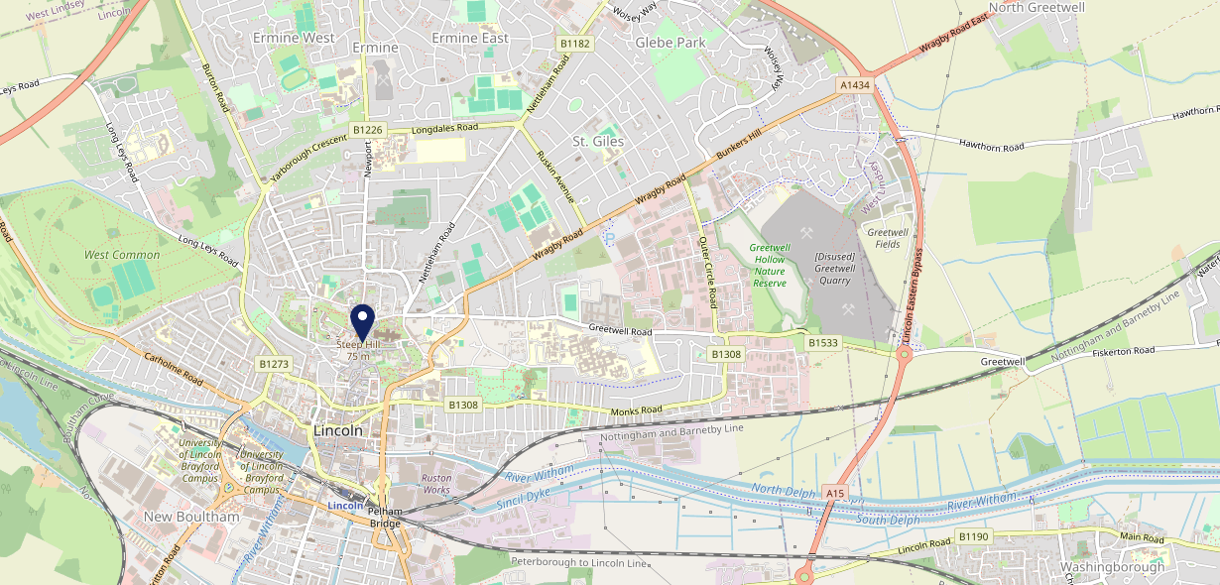
Site Intel
Wig And Mitre LN21LU
1 Miles
338 Chains
29/01/2025 - 21/01/2026
Site Summary
Wig And Mitre LN21LU
Work Area
Region
TV Region
Urbanicity
Lincoln
East Midlands
Yorkshire
Urban city and town
LN21LU
Punch - Fireside Inns
Top Competitors
ATV
Gender
Duke William
#1
£19.87
71.14%
Male
LN13AP
Pub Restaurant
Affluence
Segmentation
Prince Of Wales Lincoln
#2
53.85%
15.87%
Middle Income
Paying The Mortgage
LN13AR
SPK
Age Group
Visit Day
Ole Ole Tapas Bar & Restaurant
#3
29.75%
27.86%
LN13BU
55 to 64
Sat
Restaurant
Nearest Station
Lincoln(0.88 miles)
2834 Site Customers
373 Competitors
321331 Competitor Customers

Slide 2
Site Intel
Wig And Mitre LN21LU
1 Miles
338 Chains
29/01/2025 - 21/01/2026
Spend by Weekpart
How is customer spend distributed throughout the week for Wig And Mitre LN21LU versus its competitors?
% of spend for Wig And Mitre LN21LU and 338 Chains in 1 Miles from 29/01/2025 - 21/01/2026 split by Day of Week
2834 Site Customers
373 Competitors
321331 Competitor Customers

Slide 3
Site Intel
Wig And Mitre LN21LU
1 Miles
338 Chains
29/01/2025 - 21/01/2026
Visit Frequency
How frequently per year do customers visit Wig And Mitre LN21LU versus its competitors?
% of customer numbers for Wig And Mitre LN21LU and 338 Chains in 1 Miles from 29/01/2025 - 21/01/2026 and the number of visits made Per Annum
2834 Site Customers
373 Competitors
321331 Competitor Customers

Slide 4
Site Intel
Wig And Mitre LN21LU
1 Miles
338 Chains
29/01/2025 - 21/01/2026
ATV Change
How has ATV changed between two date ranges?
2834 Site Customers

Slide 5
Site Intel
Wig And Mitre LN21LU
1 Miles
338 Chains
29/01/2025 - 21/01/2026
Market Share Change
How has market share changed between two date ranges?
% of market share spend for Wig And Mitre LN21LU and 338 Chains in 1 Miles from 29/01/2025 - 21/01/2026
2834 Site Customers

Slide 6
Site Intel
Wig And Mitre LN21LU
1 Miles
338 Chains
29/01/2025 - 21/01/2026
Age
How does the age profile of customers who visit Wig And Mitre LN21LU compare versus its competitors?
% of spend for Wig And Mitre LN21LU and 338 Chains in 1 Miles from 29/01/2025 - 21/01/2026 split by Age Range
1498 Site Customers
373 Competitors
132768 Competitor Customers

Slide 7
Site Intel
Wig And Mitre LN21LU
1 Miles
338 Chains
29/01/2025 - 21/01/2026
Affluence
How does the affluence of customers who visit Wig And Mitre LN21LU compare versus its competitors?
% of spend for Wig And Mitre LN21LU and 338 Chains in 1 Miles from 29/01/2025 - 21/01/2026 split by Affluence
1408 Site Customers
373 Competitors
119889 Competitor Customers

Slide 8
Site Intel
Wig And Mitre LN21LU
1 Miles
338 Chains
29/01/2025 - 21/01/2026
Gender
How does the gender profile of customers who visit Wig And Mitre LN21LU compare versus its competitors?
% of spend for Wig And Mitre LN21LU and 338 Chains in 1 Miles from 29/01/2025 - 21/01/2026 split by Gender
1465 Site Customers
373 Competitors
128540 Competitor Customers

Slide 9
Site Intel
Wig And Mitre LN21LU
1 Miles
338 Chains
29/01/2025 - 21/01/2026
Punch Segmentation
How does the Custom segmentation profile of customers who visit Wig And Mitre LN21LU compare versus its competitors?
% of spend for Wig And Mitre LN21LU and 338 Chains in 1 Miles from 29/01/2025 - 21/01/2026 split by Segment
2834 Site Customers
373 Competitors
321331 Competitor Customers

Slide 10
Site Intel
Wig And Mitre LN21LU
1 Miles
338 Chains
29/01/2025 - 21/01/2026
Spend by Distance
How does the spend profile of Wig And Mitre LN21LU compare versus its competitors based on travel distances?
% of spend for Wig And Mitre LN21LU and 338 Chains in 1 Miles from 29/01/2025 - 21/01/2026 split by Distance travelled
1465 Site Customers
373 Competitors
128438 Competitor Customers

Slide 11
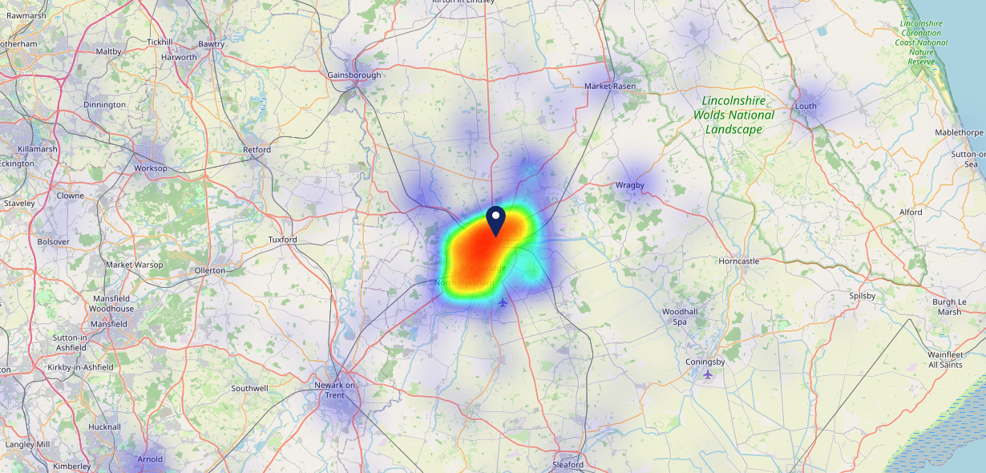
Site Intel
Wig And Mitre LN21LU
29/01/2025 - 21/01/2026
Map of Guest Origin
Where do customers of Wig And Mitre LN21LU come from?
Where do customers of Wig And Mitre LN21LU for 29/01/2025 - 21/01/2026 live
1465 Site Customers

Slide 12
Site Intel
Wig And Mitre LN21LU
1 Miles
338 Chains
29/01/2025 - 21/01/2026
Share of Wallet
What are the Top 20 venues (by spend) that customers of Wig And Mitre LN21LU also visit?
For customers of Wig And Mitre LN21LU, who are the top 20 competitors from 338 Chains in 1 Miles for 29/01/2025 - 21/01/2026 split by Venue
2834 Site Customers

Slide 13
Site Intel
Wig And Mitre LN21LU
1 Miles
338 Chains
29/01/2025 - 21/01/2026
Share of Wallet Change
How has share of wallet of customers of Wig And Mitre LN21LU changed between two date ranges?
2834 Site Customers

Slide 14
Site Intel
Wig And Mitre LN21LU
29/01/2025 - 21/01/2026
Market Summary
How does the local area for Wig And Mitre LN21LU compare to the national average (1 = low, 10 = high)
Data Type | Name | Spend in 250m | 250m Spend vs National | Spend in 500m | 500m Spend vs National | Spend in 1 mile | 1 mile Spend vs National | Spend in 3 miles | 3 mile Spend vs National
Total | Annual Sales | £14.20M | 9 | £56.45M | 10 | £122.87M | 9 | £163.33M | 8
Weekpart | Mon - Thu | 34.9% | 2 | 31.2% | 1 | 37.0% | 2 | 39.1% | 2
Weekpart | Fri - Sat | 53.3% | 10 | 53.3% | 10 | 48.3% | 10 | 46.1% | 10
Weekpart | Sun | 11.9% | 3 | 15.5% | 7 | 14.7% | 4 | 14.8% | 3
Age | 18 to 24 | 4.2% | 4 | 7.3% | 6 | 7.5% | 6 | 7.1% | 5
Age | 25 to 34 | 12.2% | 2 | 17.4% | 3 | 17.5% | 3 | 16.9% | 2
Age | 35 to 44 | 20.4% | 4 | 22.4% | 5 | 23.8% | 6 | 24.2% | 6
Age | 45 to 54 | 22.8% | 8 | 21.3% | 7 | 21.4% | 7 | 20.9% | 7
Age | 55 to 64 | 25.0% | 10 | 19.8% | 8 | 18.8% | 8 | 18.6% | 9
Age | 65 to 74 | 11.5% | 9 | 9.0% | 8 | 8.3% | 7 | 9.0% | 8
Age | 75+ | 3.8% | 8 | 2.9% | 7 | 2.6% | 6 | 3.3% | 7
CAMEO | Business Elite | 3.5% | 3 | 2.8% | 3 | 2.5% | 2 | 2.2% | 1
CAMEO | Prosperous Professionals | 8.9% | 8 | 7.6% | 7 | 6.3% | 6 | 5.6% | 4
CAMEO | Flourishing Society | 10.7% | 5 | 9.6% | 4 | 8.6% | 3 | 8.3% | 3
CAMEO | Content Communities | 17.5% | 9 | 17.0% | 9 | 15.9% | 9 | 15.8% | 9
CAMEO | White Collar Neighbourhoods | 9.5% | 4 | 9.4% | 4 | 9.2% | 3 | 8.7% | 2
CAMEO | Enterprising Mainstream | 12.8% | 9 | 13.6% | 9 | 14.1% | 9 | 14.5% | 10
CAMEO | Paying The Mortgage | 18.0% | 8 | 18.4% | 8 | 18.4% | 8 | 19.5% | 9
CAMEO | Cash Conscious Communities | 9.9% | 6 | 10.2% | 6 | 11.1% | 7 | 11.0% | 7
CAMEO | On A Budget | 5.0% | 4 | 6.3% | 5 | 7.5% | 7 | 7.0% | 6
CAMEO | Family Value | 4.1% | 7 | 4.9% | 7 | 6.6% | 8 | 7.4% | 8
Affluence | AB | 23.2% | 4 | 20.1% | 4 | 17.3% | 3 | 16.1% | 2
Affluence | C1C2 | 57.8% | 9 | 58.5% | 9 | 57.6% | 9 | 58.5% | 10
Affluence | DE | 19.0% | 5 | 21.4% | 6 | 25.1% | 7 | 25.4% | 7

Slide 15
Site Intel
Wig And Mitre LN21LU
Local Market Profile
Mix of spend by customer segment in Punch site and local market
 | Customer Count | Family Familiar | Occasional & Local | Mid-Week Seniors | Part Of The Pub | Metro Sophisticates | Young & Connected | Bubbly Weekenders | Upmarket Diners
Wig And Mitre | 617 | 8.43% | 9.21% | 30.34% | 4.67% | 10.46% | 12.39% | 8.06% | 16.41%
Local Catchment | 12964 | 17.18% | 5.00% | 20.53% | 5.57% | 6.74% | 19.27% | 11.74% | 13.92%
Punch T&L | 97242 | 8.88% | 6.05% | 28.69% | 11.37% | 11.23% | 11.04% | 7.12% | 15.57%
Wig And Mitre vs Local Catchment |  | -8.75% | 4.21% | 9.81% | -0.90% | 3.72% | -6.88% | -3.68% | 2.49%
Wig And Mitre vs Punch T&L |  | -0.45% | 3.16% | 1.65% | -6.70% | -0.77% | 1.35% | 0.94% | 0.84%
Local Catchment vs Punch T&L |  | 8.30% | -1.05% | -8.16% | -5.80% | -4.49% | 8.23% | 4.62% | -1.65%

Slide 16
Site Intel
Wig And Mitre LN21LU
Local Competitor Profiles
Mix of spend by customer segment in Punch site and local competitors
 | Customer Count | Family Familiar | Occasional & Local | Mid-Week Seniors | Part Of The Pub | Metro Sophisticates | Young & Connected | Bubbly Weekenders | Upmarket Diners
Wig And Mitre LN21LU | 617 | 8.43% | 9.21% | 30.34% | 4.67% | 10.46% | 12.39% | 8.06% | 16.41%
Duke William LN13AP | 913 | 8.47% | 4.60% | 27.52% | 6.03% | 11.72% | 12.58% | 8.50% | 20.54%
Prince Of Wales Lincoln LN13AR | 750 | 10.78% | 3.50% | 18.58% | 9.11% | 12.88% | 26.49% | 13.90% | 4.73%
Ole Ole Tapas Bar & Restaurant LN13BU | 576 | 9.83% | 3.39% | 27.00% | 1.90% | 6.38% | 15.97% | 11.25% | 24.22%
McDonalds Lincoln - Rope Walk LN67DQ | 1444 | 33.33% | 5.55% | 11.20% | 5.06% | 2.80% | 25.96% | 10.12% | 5.93%
Magna Carta LN21PZ | 1209 | 10.65% | 3.77% | 25.17% | 6.50% | 8.09% | 22.55% | 11.74% | 11.50%
Lion & Snake LN13AR | 905 | 18.14% | 4.51% | 20.55% | 6.61% | 6.25% | 22.32% | 14.68% | 6.89%
Ls White Horse LN11ES | 430 | 6.51% | 4.03% | 20.31% | 0.83% | 11.52% | 12.26% | 12.05% | 32.44%
The Mailbox Lincoln LN11TR | 977 | 17.60% | 4.44% | 12.74% | 9.32% | 10.18% | 30.75% | 11.87% | 3.06%
The Botanist Lincoln LN57ET | 841 | 20.60% | 2.52% | 19.62% | 1.78% | 6.07% | 18.48% | 14.76% | 16.13%
Royal William IV LN11YX | 1009 | 10.63% | 8.29% | 25.12% | 5.04% | 9.30% | 20.57% | 9.76% | 11.24%
Cosy Club Lincoln LN57HE | 900 | 13.20% | 4.57% | 23.80% | 2.80% | 4.65% | 22.03% | 13.22% | 15.68%
Castle View Indian LN13BJ | 280 | 14.31% | 2.91% | 28.56% | 3.16% | 13.91% | 15.49% | 10.96% | 10.65%
McDonalds Lincoln High St LN57DW | 1267 | 23.76% | 9.25% | 11.92% | 5.34% | 3.85% | 28.72% | 10.95% | 6.18%
Olivares Tapas Bar LN13AA | 180 | 7.51% | 2.53% | 31.74% | 2.47% | 10.10% | 12.57% | 7.64% | 25.39%
Thailand No1 LN13AR | 211 | 8.05% | 2.58% | 34.04% | 5.33% | 10.69% | 6.89% | 9.16% | 23.22%
Wagamama Lincoln LN11YX | 426 | 21.94% | 1.85% | 15.48% | 2.79% | 3.86% | 29.78% | 9.89% | 14.37%
Di Maro Restaurants Li LN13AE | 296 | 16.75% | 5.60% | 26.14% | 3.27% | 7.87% | 10.92% | 9.41% | 20.02%
Slug and Lettuce Lincoln LN21JG | 938 | 23.17% | 3.77% | 12.58% | 6.17% | 3.73% | 28.15% | 17.87% | 4.52%
PHO Lincoln LN57BT | 259 | 8.94% | 3.82% | 18.13% | 2.22% | 9.17% | 13.90% | 14.32% | 29.45%
Walkabout Lincoln LN21AT | 745 | 20.70% | 2.97% | 10.92% | 7.49% | 3.53% | 36.07% | 14.43% | 3.84%
Bailgate LN13AN | 250 | 9.99% | 4.89% | 44.22% | 2.65% | 4.90% | 9.72% | 6.56% | 17.04%
Mowgli Street Food Linoln LN21AT | 331 | 12.93% | 3.49% | 21.45% | 1.31% | 7.48% | 15.95% | 12.27% | 25.08%
Greggs LN13AP | 645 | 24.09% | 14.11% | 13.66% | 8.78% | 3.24% | 18.45% | 9.55% | 8.09%
Turtle Bay Lincoln LN57ET | 355 | 23.23% | 3.44% | 16.46% | 2.25% | 4.38% | 22.63% | 18.55% | 9.02%

