Slide 1
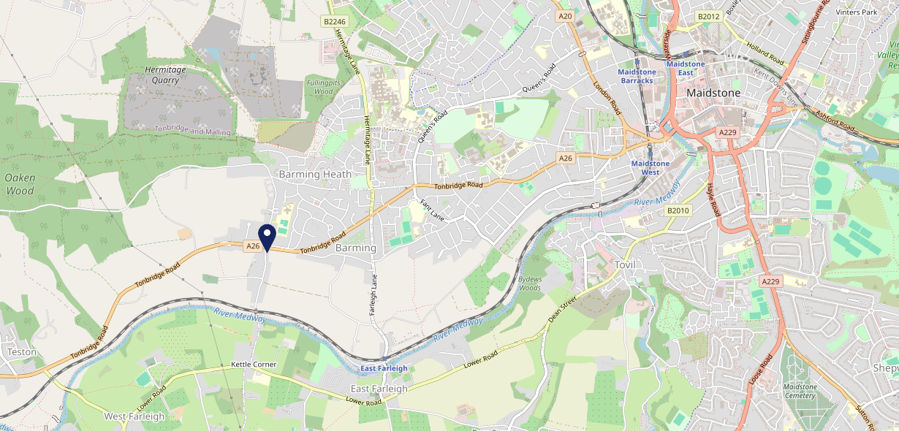
Site Intel
Bull ME169HB
1 Miles
371 Chains
16/04/2025 - 08/04/2026
Site Summary
Bull ME169HB
Work Area
Region
TV Region
Urbanicity
Medway
South East
South
Urban city and town
ME169HB
Punch - Fireside Inns
Top Competitors
ATV
Gender
Redstart Barming
#1
£20.07
65.30%
Male
ME169HF
Stonegate PP
Affluence
Segmentation
Duke Of Edinburgh
#2
50.26%
24.36%
Middle Income
Flourishing Society
ME169AR
Pub / Bar
Age Group
Visit Day
Melad Tandoori
#3
24.13%
20.90%
ME169LW
55 to 64
Fri
Restaurant
Nearest Station
East Farleigh(1.33 miles)
1992 Site Customers
40 Competitors
10951 Competitor Customers

Slide 2
Site Intel
Bull ME169HB
1 Miles
371 Chains
16/04/2025 - 08/04/2026
Spend by Weekpart
How is customer spend distributed throughout the week for Bull ME169HB versus its competitors?
% of spend for Bull ME169HB and 371 Chains in 1 Miles from 16/04/2025 - 08/04/2026 split by Day of Week
1992 Site Customers
40 Competitors
10951 Competitor Customers

Slide 3
Site Intel
Bull ME169HB
1 Miles
371 Chains
16/04/2025 - 08/04/2026
Visit Frequency
How frequently per year do customers visit Bull ME169HB versus its competitors?
% of customer numbers for Bull ME169HB and 371 Chains in 1 Miles from 16/04/2025 - 08/04/2026 and the number of visits made Per Annum
1992 Site Customers
40 Competitors
10951 Competitor Customers

Slide 4
Site Intel
Bull ME169HB
1 Miles
371 Chains
16/04/2025 - 08/04/2026
ATV Change
How has ATV changed between two date ranges?
1992 Site Customers

Slide 5
Site Intel
Bull ME169HB
1 Miles
371 Chains
16/04/2025 - 08/04/2026
Market Share Change
How has market share changed between two date ranges?
% of market share spend for Bull ME169HB and 371 Chains in 1 Miles from 16/04/2025 - 08/04/2026
1992 Site Customers

Slide 6
Site Intel
Bull ME169HB
1 Miles
371 Chains
16/04/2025 - 08/04/2026
Age
How does the age profile of customers who visit Bull ME169HB compare versus its competitors?
% of spend for Bull ME169HB and 371 Chains in 1 Miles from 16/04/2025 - 08/04/2026 split by Age Range
950 Site Customers
40 Competitors
4524 Competitor Customers

Slide 7
Site Intel
Bull ME169HB
1 Miles
371 Chains
16/04/2025 - 08/04/2026
Affluence
How does the affluence of customers who visit Bull ME169HB compare versus its competitors?
% of spend for Bull ME169HB and 371 Chains in 1 Miles from 16/04/2025 - 08/04/2026 split by Affluence
860 Site Customers
40 Competitors
3984 Competitor Customers

Slide 8
Site Intel
Bull ME169HB
1 Miles
371 Chains
16/04/2025 - 08/04/2026
Gender
How does the gender profile of customers who visit Bull ME169HB compare versus its competitors?
% of spend for Bull ME169HB and 371 Chains in 1 Miles from 16/04/2025 - 08/04/2026 split by Gender
917 Site Customers
40 Competitors
4333 Competitor Customers

Slide 9
Site Intel
Bull ME169HB
1 Miles
371 Chains
16/04/2025 - 08/04/2026
Punch Segmentation
How does the Custom segmentation profile of customers who visit Bull ME169HB compare versus its competitors?
% of spend for Bull ME169HB and 371 Chains in 1 Miles from 16/04/2025 - 08/04/2026 split by Segment
1992 Site Customers
40 Competitors
10951 Competitor Customers

Slide 10
Site Intel
Bull ME169HB
1 Miles
371 Chains
16/04/2025 - 08/04/2026
Spend by Distance
How does the spend profile of Bull ME169HB compare versus its competitors based on travel distances?
% of spend for Bull ME169HB and 371 Chains in 1 Miles from 16/04/2025 - 08/04/2026 split by Distance travelled
915 Site Customers
40 Competitors
4331 Competitor Customers

Slide 11
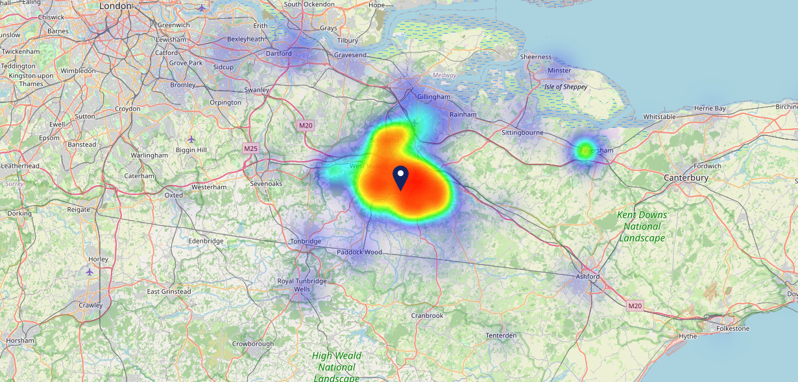
Site Intel
Bull ME169HB
16/04/2025 - 08/04/2026
Map of Guest Origin
Where do customers of Bull ME169HB come from?
Where do customers of Bull ME169HB for 16/04/2025 - 08/04/2026 live
915 Site Customers

Slide 12
Site Intel
Bull ME169HB
1 Miles
371 Chains
16/04/2025 - 08/04/2026
Share of Wallet
What are the Top 20 venues (by spend) that customers of Bull ME169HB also visit?
For customers of Bull ME169HB, who are the top 20 competitors from 371 Chains in 1 Miles for 16/04/2025 - 08/04/2026 split by Venue
1992 Site Customers

Slide 13
Site Intel
Bull ME169HB
1 Miles
371 Chains
16/04/2025 - 08/04/2026
Share of Wallet Change
How has share of wallet of customers of Bull ME169HB changed between two date ranges?
1992 Site Customers

Slide 14
Site Intel
Bull ME169HB
16/04/2025 - 08/04/2026
Market Summary
How does the local area for Bull ME169HB compare to the national average (1 = low, 10 = high)
Data Type | Name | Spend in 250m | 250m Spend vs National | Spend in 500m | 500m Spend vs National | Spend in 1 mile | 1 mile Spend vs National | Spend in 3 miles | 3 mile Spend vs National
Total | Annual Sales | £1.49M | 5 | £2.47M | 5 | £7.37M | 4 | £154.38M | 7
Weekpart | Mon - Thu | 42.6% | 7 | 44.4% | 8 | 41.3% | 6 | 40.3% | 4
Weekpart | Fri - Sat | 41.2% | 4 | 38.1% | 2 | 44.3% | 7 | 44.7% | 8
Weekpart | Sun | 16.2% | 7 | 17.5% | 8 | 14.4% | 4 | 15.1% | 4
Age | 18 to 24 | 10.5% | 8 | 7.4% | 7 | 7.3% | 6 | 7.3% | 6
Age | 25 to 34 | 10.7% | 1 | 9.5% | 1 | 11.1% | 1 | 16.3% | 2
Age | 35 to 44 | 20.2% | 3 | 18.5% | 2 | 19.3% | 2 | 24.1% | 6
Age | 45 to 54 | 19.1% | 4 | 17.8% | 3 | 25.1% | 10 | 21.2% | 7
Age | 55 to 64 | 23.7% | 10 | 24.3% | 10 | 21.9% | 9 | 17.3% | 8
Age | 65 to 74 | 9.3% | 8 | 11.0% | 9 | 7.8% | 7 | 8.7% | 8
Age | 75+ | 6.5% | 9 | 11.4% | 10 | 7.4% | 10 | 5.1% | 9
CAMEO | Business Elite | 6.3% | 5 | 6.5% | 5 | 4.6% | 4 | 5.3% | 4
CAMEO | Prosperous Professionals | 10.3% | 9 | 10.3% | 9 | 6.6% | 6 | 5.7% | 4
CAMEO | Flourishing Society | 23.3% | 9 | 25.4% | 10 | 21.9% | 9 | 21.9% | 9
CAMEO | Content Communities | 11.0% | 4 | 13.2% | 7 | 13.0% | 6 | 11.5% | 4
CAMEO | White Collar Neighbourhoods | 19.0% | 10 | 16.6% | 9 | 16.4% | 10 | 17.5% | 10
CAMEO | Enterprising Mainstream | 4.0% | 2 | 4.3% | 2 | 4.7% | 2 | 8.1% | 5
CAMEO | Paying The Mortgage | 17.8% | 8 | 15.0% | 6 | 17.1% | 7 | 14.1% | 5
CAMEO | Cash Conscious Communities | 4.5% | 2 | 5.0% | 2 | 6.1% | 3 | 7.4% | 4
CAMEO | On A Budget | 3.7% | 3 | 3.4% | 2 | 9.2% | 8 | 7.8% | 7
CAMEO | Family Value | 0.1% | 1 | 0.1% | 1 | 0.3% | 1 | 0.7% | 1
Affluence | AB | 39.9% | 8 | 42.3% | 8 | 33.2% | 7 | 33.0% | 6
Affluence | C1C2 | 51.8% | 7 | 49.2% | 6 | 51.2% | 7 | 51.1% | 7
Affluence | DE | 8.3% | 1 | 8.5% | 1 | 15.6% | 4 | 15.9% | 3

Slide 15
Site Intel
Bull ME169HB
Local Market Profile
Mix of spend by customer segment in Punch site and local market
 | Customer Count | Family Familiar | Occasional & Local | Mid-Week Seniors | Part Of The Pub | Metro Sophisticates | Young & Connected | Bubbly Weekenders | Upmarket Diners
Bull | 312 | 13.16% | 7.10% | 28.02% | 1.36% | 8.75% | 14.12% | 10.84% | 16.62%
Local Catchment | 926 | 21.07% | 9.85% | 23.22% | 7.98% | 5.62% | 8.82% | 7.04% | 16.35%
Punch T&L | 95021 | 8.91% | 6.06% | 28.64% | 11.34% | 11.30% | 11.04% | 7.03% | 15.64%
Bull vs Local Catchment |  | -7.91% | -2.75% | 4.80% | -6.62% | 3.13% | 5.30% | 3.80% | 0.27%
Bull vs Punch T&L |  | 4.25% | 1.04% | -0.62% | -9.98% | -2.55% | 3.08% | 3.81% | 0.98%
Local Catchment vs Punch T&L |  | 12.16% | 3.79% | -5.42% | -3.36% | -5.68% | -2.22% | 0.01% | 0.71%

Slide 16
Site Intel
Bull ME169HB
Local Competitor Profiles
Mix of spend by customer segment in Punch site and local competitors
 | Customer Count | Family Familiar | Occasional & Local | Mid-Week Seniors | Part Of The Pub | Metro Sophisticates | Young & Connected | Bubbly Weekenders | Upmarket Diners
Bull ME169HB | 312 | 13.16% | 7.10% | 28.02% | 1.36% | 8.75% | 14.12% | 10.84% | 16.62%
Redstart Barming ME169HF | 161 | 20.39% | 9.45% | 33.73% | 0.97% | 12.71% | 3.76% | 6.23% | 12.73%
Duke Of Edinburgh ME169AR | 125 | 29.83% | 2.63% | 13.93% | 29.11% | 4.01% | 3.89% | 7.30% | 9.26%
Melad Tandoori ME169LW | 106 | 17.57% | 10.48% | 17.22% | 3.95% | 3.53% | 7.26% | 9.64% | 30.30%
Happypandamaidstone ME168NH | 84 | 23.09% | 1.84% | 17.99% | 0.25% | 6.89% | 10.65% | 9.61% | 29.64%
Barming Fish Chips ME168TR | 116 | 18.50% | 5.32% | 9.97% | 2.00% | 5.12% | 22.80% | 9.31% | 26.95%
Subway ME169BF | 168 | 31.52% | 3.09% | 8.25% | 2.03% | 2.72% | 22.43% | 14.08% | 15.84%
Cherry Tree Maidstone ME168NJ | 38 | 11.51% | 34.16% | 35.96% | 12.05% | 0.41% | 1.81% | 3.50% | 0.57%
Field Of Dreams Kent L ME168NJ | 32 | 3.11% | 14.78% | 62.28% | 18.22% | 0.18% | 0.92% | 0.47% | 0.00%
Bull East Farleigh ME150HD | 122 | 19.01% | 9.87% | 19.97% | 20.35% | 4.65% | 6.58% | 3.81% | 15.72%
Melad Trading ME169LW | 31 | 20.37% | 19.39% | 20.97% | 2.85% | 5.07% | 2.82% | 8.76% | 19.72%
Victory ME169NB | 43 | 6.74% | 15.60% | 55.15% | 2.69% | 0.87% | 5.06% | 3.35% | 10.49%
Dominos Maidstone Barming ME169NZ | 43 | 41.00% | 3.05% | 18.71% | 0.00% | 6.97% | 16.05% | 10.87% | 3.32%
Pizza Gogo Maidstone ME168TG | 22 | 36.77% | 20.52% | 8.52% | 0.00% | 0.00% | 13.89% | 4.13% | 16.14%
East Farleigh Club ME150JL | 42 | 27.17% | 24.66% | 16.11% | 0.68% | 13.21% | 5.53% | 4.46% | 8.13%
Belashindian ME169BB | 12 | 5.56% | 8.23% | 2.59% | 0.00% | 4.14% | 43.51% | 0.00% | 35.94%
Subway406340 ME169BF | 7 | 83.42% | 0.00% | 0.00% | 0.00% | 0.00% | 4.93% | 5.97% | 5.66%
Sewaro ME168PE | 14 | 15.04% | 0.00% | 19.19% | 0.00% | 4.92% | 31.12% | 29.71% | 0.00%
Subway399520 ME169AH | 133 | 26.61% | 0.84% | 8.93% | 1.26% | 3.44% | 36.01% | 9.11% | 13.75%
Joy Bangla ME169FJ | 8 | 12.23% | 10.65% | 0.00% | 0.00% | 7.22% | 0.00% | 56.16% | 13.71%
Britfood ME168UH | 22 | 39.15% | 2.20% | 17.97% | 0.00% | 7.08% | 4.46% | 0.00% | 29.10%
Subway688430 ME169BF | 2 | 32.87% | 0.00% | 67.12% | 0.00% | 0.00% | 0.00% | 0.00% | 0.00%
Subway718260 ME169BF | 6 | 44.98% | 0.00% | 0.00% | 0.00% | 0.00% | 44.46% | 10.55% | 0.00%

