Slide 1
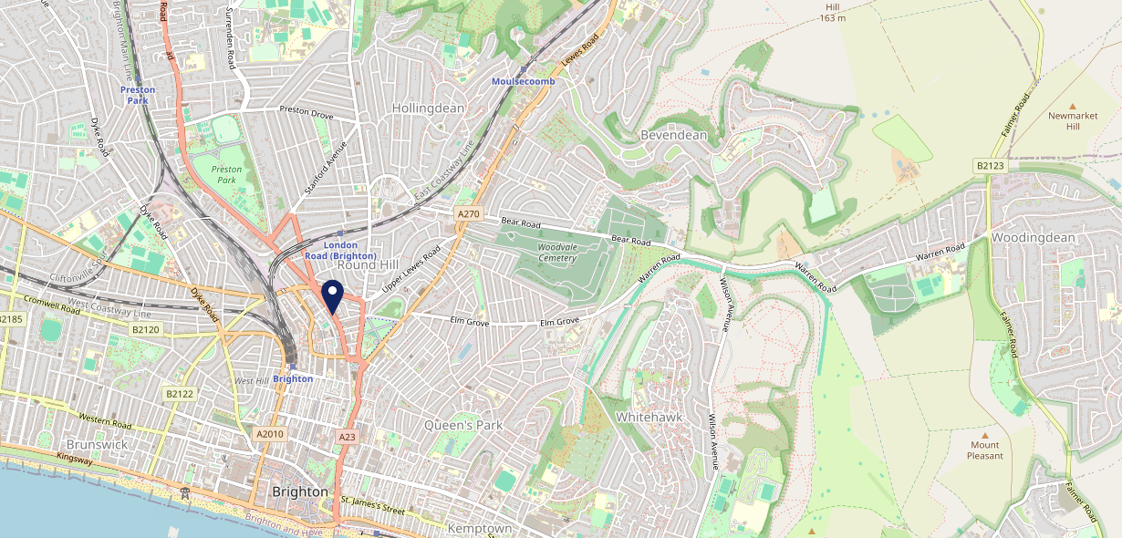
Site Intel
New Unity Brighton BN14JD
1 Miles
371 Chains
16/04/2025 - 08/04/2026
Site Summary
New Unity Brighton BN14JD
Work Area
Region
TV Region
Urbanicity
Brighton
South East
South
Urban city and town
BN14JD
Laine Pub Company
Top Competitors
ATV
Gender
Hare & Hounds
#1
£9.81
80.56%
Male
BN14JF
Pub / Bar
Affluence
Segmentation
Waggon & Horses
#2
51.13%
16.43%
Middle Income
White Collar Neighbourhoods
BN11UD
Pub / Bar
Age Group
Visit Day
Joker
#3
31.87%
36.83%
BN14QF
35 to 44
Sat
Brakspear - L&T
Nearest Station
Brighton(0.43 miles)
1329 Site Customers
1000 of 1919 Competitors
687726 Competitor Customers

Slide 2
Site Intel
New Unity Brighton BN14JD
1 Miles
371 Chains
16/04/2025 - 08/04/2026
Spend by Weekpart
How is customer spend distributed throughout the week for New Unity Brighton BN14JD versus its competitors?
% of spend for New Unity Brighton BN14JD and 371 Chains in 1 Miles from 16/04/2025 - 08/04/2026 split by Day of Week
1329 Site Customers
1000 of 1919 Competitors
687726 Competitor Customers

Slide 3
Site Intel
New Unity Brighton BN14JD
1 Miles
371 Chains
16/04/2025 - 08/04/2026
Visit Frequency
How frequently per year do customers visit New Unity Brighton BN14JD versus its competitors?
% of customer numbers for New Unity Brighton BN14JD and 371 Chains in 1 Miles from 16/04/2025 - 08/04/2026 and the number of visits made Per Annum
1329 Site Customers
1000 of 1919 Competitors
687726 Competitor Customers

Slide 4
Site Intel
New Unity Brighton BN14JD
1 Miles
371 Chains
16/04/2025 - 08/04/2026
ATV Change
How has ATV changed between two date ranges?
1329 Site Customers

Slide 5
Site Intel
New Unity Brighton BN14JD
1 Miles
371 Chains
16/04/2025 - 08/04/2026
Market Share Change
How has market share changed between two date ranges?
% of market share spend for New Unity Brighton BN14JD and 371 Chains in 1 Miles from 16/04/2025 - 08/04/2026
1329 Site Customers

Slide 6
Site Intel
New Unity Brighton BN14JD
1 Miles
371 Chains
16/04/2025 - 08/04/2026
Age
How does the age profile of customers who visit New Unity Brighton BN14JD compare versus its competitors?
% of spend for New Unity Brighton BN14JD and 371 Chains in 1 Miles from 16/04/2025 - 08/04/2026 split by Age Range
394 Site Customers
1000 of 1919 Competitors
233814 Competitor Customers

Slide 7
Site Intel
New Unity Brighton BN14JD
1 Miles
371 Chains
16/04/2025 - 08/04/2026
Affluence
How does the affluence of customers who visit New Unity Brighton BN14JD compare versus its competitors?
% of spend for New Unity Brighton BN14JD and 371 Chains in 1 Miles from 16/04/2025 - 08/04/2026 split by Affluence
360 Site Customers
1000 of 1919 Competitors
217381 Competitor Customers

Slide 8
Site Intel
New Unity Brighton BN14JD
1 Miles
371 Chains
16/04/2025 - 08/04/2026
Gender
How does the gender profile of customers who visit New Unity Brighton BN14JD compare versus its competitors?
% of spend for New Unity Brighton BN14JD and 371 Chains in 1 Miles from 16/04/2025 - 08/04/2026 split by Gender
375 Site Customers
1000 of 1919 Competitors
224830 Competitor Customers

Slide 9
Site Intel
New Unity Brighton BN14JD
1 Miles
371 Chains
16/04/2025 - 08/04/2026
Punch Segmentation
How does the Custom segmentation profile of customers who visit New Unity Brighton BN14JD compare versus its competitors?
% of spend for New Unity Brighton BN14JD and 371 Chains in 1 Miles from 16/04/2025 - 08/04/2026 split by Segment
1329 Site Customers
1000 of 1919 Competitors
687726 Competitor Customers

Slide 10
Site Intel
New Unity Brighton BN14JD
1 Miles
371 Chains
16/04/2025 - 08/04/2026
Spend by Distance
How does the spend profile of New Unity Brighton BN14JD compare versus its competitors based on travel distances?
% of spend for New Unity Brighton BN14JD and 371 Chains in 1 Miles from 16/04/2025 - 08/04/2026 split by Distance travelled
375 Site Customers
1000 of 1919 Competitors
224576 Competitor Customers

Slide 11
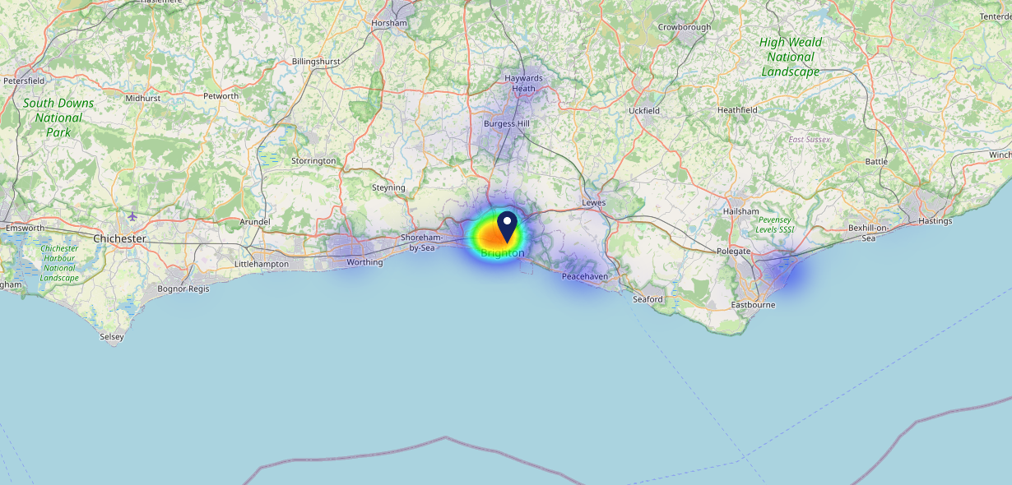
Site Intel
New Unity Brighton BN14JD
16/04/2025 - 08/04/2026
Map of Guest Origin
Where do customers of New Unity Brighton BN14JD come from?
Where do customers of New Unity Brighton BN14JD for 16/04/2025 - 08/04/2026 live
375 Site Customers

Slide 12
Site Intel
New Unity Brighton BN14JD
1 Miles
371 Chains
16/04/2025 - 08/04/2026
Share of Wallet
What are the Top 20 venues (by spend) that customers of New Unity Brighton BN14JD also visit?
For customers of New Unity Brighton BN14JD, who are the top 20 competitors from 371 Chains in 1 Miles for 16/04/2025 - 08/04/2026 split by Venue
1329 Site Customers

Slide 13
Site Intel
New Unity Brighton BN14JD
1 Miles
371 Chains
16/04/2025 - 08/04/2026
Share of Wallet Change
How has share of wallet of customers of New Unity Brighton BN14JD changed between two date ranges?
1329 Site Customers

Slide 14
Site Intel
New Unity Brighton BN14JD
16/04/2025 - 08/04/2026
Market Summary
How does the local area for New Unity Brighton BN14JD compare to the national average (1 = low, 10 = high)
Data Type | Name | Spend in 250m | 250m Spend vs National | Spend in 500m | 500m Spend vs National | Spend in 1 mile | 1 mile Spend vs National | Spend in 3 miles | 3 mile Spend vs National
Total | Annual Sales | £14.65M | 9 | £40.32M | 9 | £352.74M | 10 | £490.32M | 9
Weekpart | Mon - Thu | 46.7% | 8 | 40.9% | 6 | 38.1% | 3 | 38.8% | 2
Weekpart | Fri - Sat | 40.7% | 4 | 44.7% | 6 | 46.5% | 9 | 45.5% | 9
Weekpart | Sun | 12.6% | 3 | 14.4% | 5 | 15.4% | 6 | 15.7% | 5
Age | 18 to 24 | 7.6% | 7 | 6.9% | 6 | 4.8% | 3 | 3.9% | 2
Age | 25 to 34 | 18.2% | 4 | 19.6% | 4 | 16.1% | 2 | 15.0% | 1
Age | 35 to 44 | 24.1% | 6 | 25.9% | 7 | 24.4% | 6 | 24.4% | 7
Age | 45 to 54 | 22.0% | 7 | 21.4% | 7 | 23.2% | 9 | 23.2% | 9
Age | 55 to 64 | 17.4% | 7 | 17.4% | 7 | 20.3% | 9 | 21.1% | 10
Age | 65 to 74 | 7.6% | 7 | 6.9% | 6 | 7.9% | 7 | 8.5% | 8
Age | 75+ | 2.9% | 7 | 2.0% | 5 | 3.3% | 7 | 3.9% | 8
CAMEO | Business Elite | 7.5% | 6 | 9.4% | 7 | 10.5% | 7 | 10.7% | 7
CAMEO | Prosperous Professionals | 6.0% | 5 | 7.0% | 7 | 7.7% | 7 | 7.4% | 7
CAMEO | Flourishing Society | 9.7% | 4 | 10.5% | 5 | 13.3% | 6 | 13.0% | 6
CAMEO | Content Communities | 8.1% | 2 | 8.9% | 2 | 10.3% | 3 | 10.2% | 3
CAMEO | White Collar Neighbourhoods | 21.3% | 10 | 21.5% | 10 | 20.2% | 10 | 20.8% | 10
CAMEO | Enterprising Mainstream | 10.0% | 7 | 10.2% | 7 | 9.0% | 6 | 8.8% | 6
CAMEO | Paying The Mortgage | 14.2% | 5 | 13.7% | 5 | 13.0% | 4 | 13.0% | 4
CAMEO | Cash Conscious Communities | 8.9% | 5 | 8.2% | 5 | 7.5% | 4 | 7.4% | 4
CAMEO | On A Budget | 11.0% | 9 | 8.4% | 7 | 6.7% | 6 | 6.4% | 5
CAMEO | Family Value | 3.3% | 6 | 2.2% | 5 | 1.9% | 5 | 2.3% | 5
Affluence | AB | 23.2% | 4 | 26.8% | 5 | 31.5% | 6 | 31.2% | 6
Affluence | C1C2 | 53.6% | 8 | 54.4% | 8 | 52.4% | 7 | 52.7% | 7
Affluence | DE | 23.1% | 6 | 18.8% | 5 | 16.1% | 4 | 16.1% | 3

