Slide 1
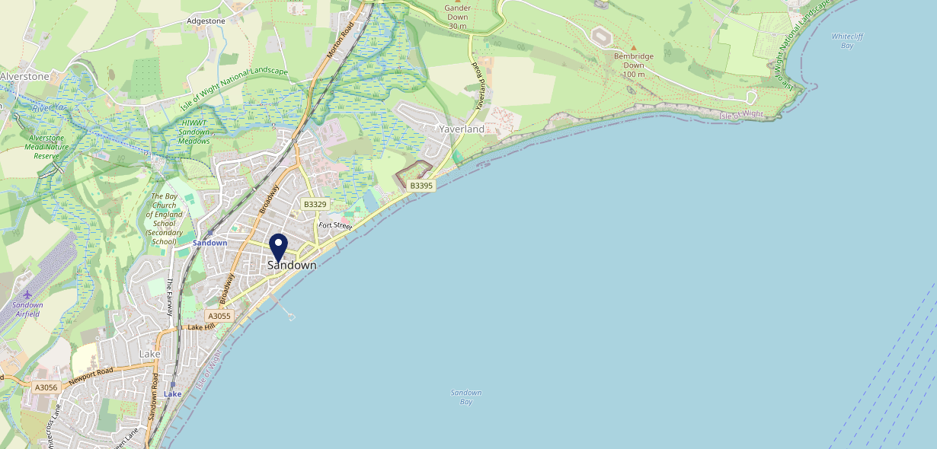
Site Intel
Old Comical PO368ES
1 Miles
371 Chains
16/04/2025 - 08/04/2026
Site Summary
Old Comical PO368ES
Work Area
Region
TV Region
Urbanicity
Isle of Wight
South East
South
Urban city and town
PO368ES
Punch T&L
Top Competitors
ATV
Gender
Tap Pub Sandown Lt
#1
£9.45
65.54%
Male
PO368AW
Pub / Bar
Affluence
Segmentation
Castle
#2
67.33%
22.75%
Middle Income
White Collar Neighbourhoods
PO368HY
Pub / Bar
Age Group
Visit Day
Old Corner Bank Ltd
#3
25.36%
28.59%
PO369JP
25 to 34
Sat
Restaurant
Nearest Station
Sandown(0.57 miles)
488 Site Customers
89 Competitors
21471 Competitor Customers

Slide 2
Site Intel
Old Comical PO368ES
1 Miles
371 Chains
16/04/2025 - 08/04/2026
Spend by Weekpart
How is customer spend distributed throughout the week for Old Comical PO368ES versus its competitors?
% of spend for Old Comical PO368ES and 371 Chains in 1 Miles from 16/04/2025 - 08/04/2026 split by Day of Week
488 Site Customers
89 Competitors
21471 Competitor Customers

Slide 3
Site Intel
Old Comical PO368ES
1 Miles
371 Chains
16/04/2025 - 08/04/2026
Visit Frequency
How frequently per year do customers visit Old Comical PO368ES versus its competitors?
% of customer numbers for Old Comical PO368ES and 371 Chains in 1 Miles from 16/04/2025 - 08/04/2026 and the number of visits made Per Annum
488 Site Customers
89 Competitors
21471 Competitor Customers

Slide 4
Site Intel
Old Comical PO368ES
1 Miles
371 Chains
16/04/2025 - 08/04/2026
ATV Change
How has ATV changed between two date ranges?
488 Site Customers

Slide 5
Site Intel
Old Comical PO368ES
1 Miles
371 Chains
16/04/2025 - 08/04/2026
Market Share Change
How has market share changed between two date ranges?
% of market share spend for Old Comical PO368ES and 371 Chains in 1 Miles from 16/04/2025 - 08/04/2026
488 Site Customers

Slide 6
Site Intel
Old Comical PO368ES
1 Miles
371 Chains
16/04/2025 - 08/04/2026
Age
How does the age profile of customers who visit Old Comical PO368ES compare versus its competitors?
% of spend for Old Comical PO368ES and 371 Chains in 1 Miles from 16/04/2025 - 08/04/2026 split by Age Range
200 Site Customers
89 Competitors
10696 Competitor Customers

Slide 7
Site Intel
Old Comical PO368ES
1 Miles
371 Chains
16/04/2025 - 08/04/2026
Affluence
How does the affluence of customers who visit Old Comical PO368ES compare versus its competitors?
% of spend for Old Comical PO368ES and 371 Chains in 1 Miles from 16/04/2025 - 08/04/2026 split by Affluence
185 Site Customers
89 Competitors
9988 Competitor Customers

Slide 8
Site Intel
Old Comical PO368ES
1 Miles
371 Chains
16/04/2025 - 08/04/2026
Gender
How does the gender profile of customers who visit Old Comical PO368ES compare versus its competitors?
% of spend for Old Comical PO368ES and 371 Chains in 1 Miles from 16/04/2025 - 08/04/2026 split by Gender
189 Site Customers
89 Competitors
10289 Competitor Customers

Slide 9
Site Intel
Old Comical PO368ES
1 Miles
371 Chains
16/04/2025 - 08/04/2026
Punch Segmentation
How does the Custom segmentation profile of customers who visit Old Comical PO368ES compare versus its competitors?
% of spend for Old Comical PO368ES and 371 Chains in 1 Miles from 16/04/2025 - 08/04/2026 split by Segment
488 Site Customers
89 Competitors
21471 Competitor Customers

Slide 10
Site Intel
Old Comical PO368ES
1 Miles
371 Chains
16/04/2025 - 08/04/2026
Spend by Distance
How does the spend profile of Old Comical PO368ES compare versus its competitors based on travel distances?
% of spend for Old Comical PO368ES and 371 Chains in 1 Miles from 16/04/2025 - 08/04/2026 split by Distance travelled
189 Site Customers
89 Competitors
10280 Competitor Customers

Slide 11
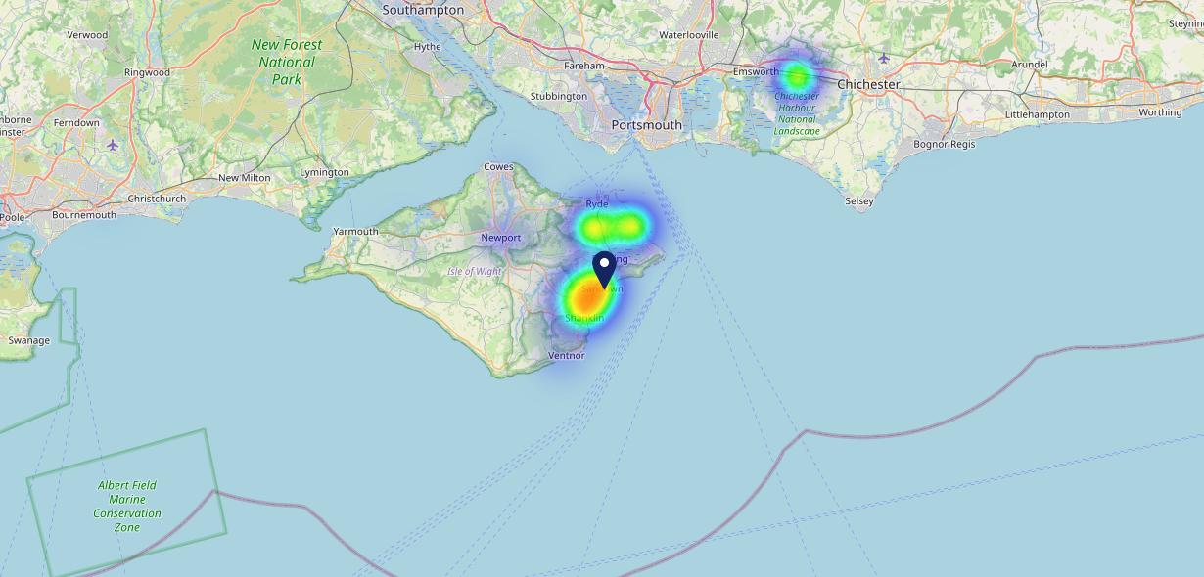
Site Intel
Old Comical PO368ES
16/04/2025 - 08/04/2026
Map of Guest Origin
Where do customers of Old Comical PO368ES come from?
Where do customers of Old Comical PO368ES for 16/04/2025 - 08/04/2026 live
189 Site Customers

Slide 12
Site Intel
Old Comical PO368ES
1 Miles
371 Chains
16/04/2025 - 08/04/2026
Share of Wallet
What are the Top 20 venues (by spend) that customers of Old Comical PO368ES also visit?
For customers of Old Comical PO368ES, who are the top 20 competitors from 371 Chains in 1 Miles for 16/04/2025 - 08/04/2026 split by Venue
488 Site Customers

Slide 13
Site Intel
Old Comical PO368ES
1 Miles
371 Chains
16/04/2025 - 08/04/2026
Share of Wallet Change
How has share of wallet of customers of Old Comical PO368ES changed between two date ranges?
488 Site Customers

Slide 14
Site Intel
Old Comical PO368ES
16/04/2025 - 08/04/2026
Market Summary
How does the local area for Old Comical PO368ES compare to the national average (1 = low, 10 = high)
Data Type | Name | Spend in 250m | 250m Spend vs National | Spend in 500m | 500m Spend vs National | Spend in 1 mile | 1 mile Spend vs National | Spend in 3 miles | 3 mile Spend vs National
Total | Annual Sales | £3.73M | 7 | £5.59M | 6 | £7.57M | 4 | £27.15M | 3
Weekpart | Mon - Thu | 45.1% | 8 | 44.2% | 8 | 44.0% | 8 | 45.6% | 9
Weekpart | Fri - Sat | 39.9% | 3 | 39.1% | 3 | 40.0% | 3 | 38.2% | 1
Weekpart | Sun | 15.0% | 6 | 16.7% | 8 | 16.0% | 7 | 16.3% | 7
Age | 18 to 24 | 3.3% | 3 | 3.3% | 3 | 3.4% | 2 | 2.2% | 1
Age | 25 to 34 | 9.1% | 1 | 9.4% | 1 | 10.7% | 1 | 9.5% | 1
Age | 35 to 44 | 17.0% | 2 | 18.5% | 2 | 20.2% | 3 | 19.5% | 2
Age | 45 to 54 | 17.6% | 3 | 18.5% | 4 | 19.1% | 4 | 17.9% | 2
Age | 55 to 64 | 24.1% | 10 | 23.1% | 10 | 22.0% | 9 | 23.1% | 10
Age | 65 to 74 | 23.7% | 10 | 21.3% | 10 | 19.1% | 10 | 19.4% | 10
Age | 75+ | 5.1% | 9 | 6.0% | 9 | 5.6% | 9 | 8.4% | 10
CAMEO | Business Elite | 2.8% | 3 | 3.2% | 3 | 3.4% | 3 | 3.6% | 2
CAMEO | Prosperous Professionals | 5.8% | 5 | 6.3% | 6 | 6.4% | 6 | 7.9% | 8
CAMEO | Flourishing Society | 11.3% | 5 | 12.1% | 5 | 13.1% | 6 | 16.2% | 7
CAMEO | Content Communities | 13.6% | 7 | 14.6% | 8 | 14.8% | 8 | 15.3% | 8
CAMEO | White Collar Neighbourhoods | 16.0% | 9 | 14.2% | 8 | 13.5% | 8 | 13.3% | 8
CAMEO | Enterprising Mainstream | 12.6% | 9 | 13.5% | 9 | 13.9% | 9 | 14.6% | 10
CAMEO | Paying The Mortgage | 12.2% | 4 | 12.5% | 4 | 12.9% | 4 | 12.4% | 4
CAMEO | Cash Conscious Communities | 18.3% | 10 | 15.5% | 9 | 14.2% | 9 | 9.6% | 6
CAMEO | On A Budget | 6.1% | 5 | 6.8% | 6 | 6.5% | 5 | 5.6% | 3
CAMEO | Family Value | 1.4% | 4 | 1.3% | 4 | 1.2% | 3 | 1.6% | 4
Affluence | AB | 19.8% | 4 | 21.6% | 4 | 23.0% | 4 | 27.7% | 5
Affluence | C1C2 | 54.4% | 8 | 54.8% | 8 | 55.1% | 8 | 55.6% | 9
Affluence | DE | 25.8% | 7 | 23.6% | 7 | 21.9% | 6 | 16.7% | 4

Slide 15
Site Intel
Old Comical PO368ES
Site Potential 1
Site Characteristics
£3000
£18000
OCC Concept Fit
Achievable Average Weekly Takings
Our Local
£6500
A Food-Led High Affluence B Food-Led Mid Affluence C Wet-Led Mid/High Affluence D Wet-Led Low Affluence E Food-Led Low Affluence
AWT 2 Local Regulars 3 Local Passing Trade 4 Destination Wet-Led 5 Destination Food-Led 6 Destination Very Food-Led
A
B
C
D
E
1
2
3
4
5
6

Slide 16
Site Intel
Old Comical PO368ES
Site Potential 2
Concept Recommendation

Slide 17
Site Intel
Old Comical PO368ES
Local Market Profile
Mix of spend by customer segment in Punch site and local market
 | Customer Count | Family Familiar | Occasional & Local | Mid-Week Seniors | Part Of The Pub | Metro Sophisticates | Young & Connected | Bubbly Weekenders | Upmarket Diners
Old Comical | 92 | 5.43% | 3.94% | 15.58% | 19.91% | 2.48% | 38.38% | 9.04% | 5.20%
Local Catchment | 1929 | 16.05% | 3.49% | 20.32% | 4.35% | 4.69% | 16.10% | 9.54% | 25.42%
Punch T&L | 95121 | 8.84% | 6.05% | 28.76% | 10.94% | 11.46% | 10.98% | 7.06% | 15.86%
Old Comical vs Local Catchment |  | -10.62% | 0.45% | -4.74% | 15.56% | -2.21% | 22.28% | -0.50% | -20.22%
Old Comical vs Punch T&L |  | -3.41% | -2.11% | -13.18% | 8.97% | -8.98% | 27.40% | 1.98% | -10.66%
Local Catchment vs Punch T&L |  | 7.21% | -2.56% | -8.44% | -6.59% | -6.77% | 5.12% | 2.48% | 9.56%

Slide 18
Site Intel
Old Comical PO368ES
Local Competitor Profiles
Mix of spend by customer segment in Punch site and local competitors
 | Customer Count | Family Familiar | Occasional & Local | Mid-Week Seniors | Part Of The Pub | Metro Sophisticates | Young & Connected | Bubbly Weekenders | Upmarket Diners
Old Comical PO368ES | 92 | 5.43% | 3.94% | 15.58% | 19.91% | 2.48% | 38.38% | 9.04% | 5.20%
Tap Pub Sandown Lt PO368AW | 89 | 8.93% | 3.54% | 17.30% | 23.96% | 3.61% | 14.14% | 25.77% | 2.70%
Castle PO368HY | 111 | 12.30% | 3.57% | 26.76% | 30.73% | 6.88% | 6.26% | 2.17% | 11.29%
Old Corner Bank Ltd PO369JP | 49 | 13.38% | 2.58% | 33.29% | 6.47% | 3.91% | 9.30% | 2.72% | 28.30%
Caulkheads PO368AY | 121 | 26.38% | 4.00% | 32.89% | 3.93% | 2.25% | 17.02% | 6.51% | 6.99%
Flanagans PO368JR | 234 | 9.89% | 4.12% | 27.57% | 4.70% | 7.32% | 18.43% | 9.51% | 18.42%
Reef PO368AE | 152 | 9.76% | 3.95% | 18.22% | 2.74% | 2.17% | 12.63% | 14.25% | 36.25%
Sandown Pub And Kitch PO368LA | 221 | 21.71% | 3.85% | 18.08% | 5.44% | 3.39% | 25.64% | 4.66% | 17.20%
Fins PO369JT | 215 | 7.75% | 0.75% | 14.82% | 0.79% | 3.74% | 24.53% | 12.82% | 34.77%
Cardamom PO368DE | 44 | 13.40% | 6.56% | 31.50% | 2.92% | 6.91% | 12.51% | 10.00% | 16.16%
Mccarthys PO369PS | 21 | 27.75% | 1.96% | 12.52% | 0.57% | 0.00% | 47.16% | 9.54% | 0.46%
Trade Winds PO368JT | 179 | 5.78% | 4.22% | 23.19% | 0.37% | 7.46% | 8.82% | 9.08% | 41.06%
Happy Haddock PO368DF | 80 | 29.08% | 6.95% | 25.41% | 4.07% | 3.68% | 9.25% | 8.74% | 12.78%
Ocean Deck PO368AE | 124 | 13.19% | 4.72% | 22.72% | 2.65% | 8.28% | 18.19% | 8.41% | 21.81%
Royal China PO368DE | 28 | 13.70% | 0.00% | 15.86% | 4.03% | 15.09% | 4.34% | 11.87% | 35.08%
Sandown Boulevard PO368AT | 78 | 31.13% | 2.21% | 17.01% | 1.06% | 2.78% | 8.61% | 15.01% | 22.15%
Driftwood Bar PO368AT | 150 | 13.43% | 2.17% | 16.87% | 2.64% | 8.99% | 8.94% | 20.33% | 26.60%
Beach Cafe PO368JR | 118 | 19.74% | 2.92% | 28.96% | 0.00% | 2.54% | 8.46% | 10.31% | 27.03%
The Coffee Bubble PO368JS | 74 | 9.07% | 0.57% | 25.69% | 0.18% | 5.41% | 16.14% | 10.63% | 32.28%
Ko Sing Take Away PO369JL | 36 | 17.89% | 5.21% | 15.89% | 0.64% | 2.18% | 8.38% | 11.29% | 38.47%
Sundial Cafe PO368AS | 224 | 15.21% | 2.27% | 17.66% | 2.32% | 5.31% | 13.29% | 6.67% | 37.23%
Bayleaf Lake PO369JL | 34 | 32.81% | 0.00% | 6.84% | 1.88% | 0.80% | 11.57% | 6.40% | 39.66%
Buttie Box PO368AN | 33 | 15.98% | 6.29% | 14.63% | 6.49% | 4.65% | 26.64% | 6.78% | 18.50%
Lake Kebab House PO369JL | 31 | 23.53% | 0.00% | 8.94% | 0.94% | 2.33% | 33.78% | 0.48% | 29.97%
Ajs Takeaway PO369JP | 42 | 14.47% | 5.17% | 26.49% | 2.53% | 8.42% | 10.93% | 0.00% | 31.95%

