Slide 1
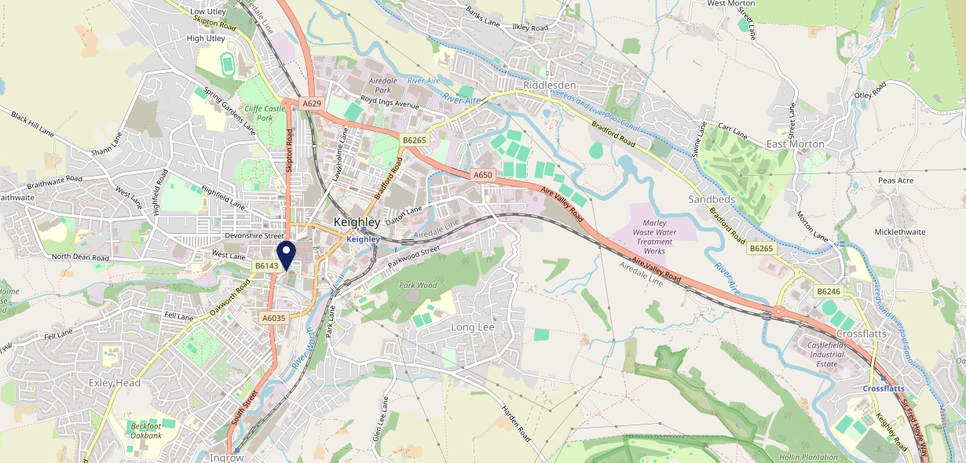
Site Intel
Red Pig BD215HS
1 Miles
371 Chains
16/04/2025 - 08/04/2026
Site Summary
Red Pig BD215HS
Work Area
Region
TV Region
Urbanicity
Bradford
Yorkshire and The Humber
Yorkshire
Urban city and town
BD215HS
Pub / Bar
Top Competitors
ATV
Gender
Albert Hotel
#1
£8.81
77.67%
Male
BD211AA
Pub / Bar
Affluence
Segmentation
McDonalds Keighley Hard Ings Rd
#2
76.88%
34.17%
Low Income
Family Value
BD213NB
McDonalds
Age Group
Visit Day
Three Horses (Keighley)
#3
33.86%
24.70%
BD226BZ
55 to 64
Fri
GK Pub Partners
Nearest Station
Keighley(0.63 miles)
352 Site Customers
234 Competitors
72140 Competitor Customers

Slide 2
Site Intel
Red Pig BD215HS
1 Miles
371 Chains
16/04/2025 - 08/04/2026
Spend by Weekpart
How is customer spend distributed throughout the week for Red Pig BD215HS versus its competitors?
% of spend for Red Pig BD215HS and 371 Chains in 1 Miles from 16/04/2025 - 08/04/2026 split by Day of Week
352 Site Customers
234 Competitors
72140 Competitor Customers

Slide 3
Site Intel
Red Pig BD215HS
1 Miles
371 Chains
16/04/2025 - 08/04/2026
Visit Frequency
How frequently per year do customers visit Red Pig BD215HS versus its competitors?
% of customer numbers for Red Pig BD215HS and 371 Chains in 1 Miles from 16/04/2025 - 08/04/2026 and the number of visits made Per Annum
352 Site Customers
234 Competitors
72140 Competitor Customers

Slide 4
Site Intel
Red Pig BD215HS
1 Miles
371 Chains
16/04/2025 - 08/04/2026
ATV Change
How has ATV changed between two date ranges?
352 Site Customers

Slide 5
Site Intel
Red Pig BD215HS
1 Miles
371 Chains
16/04/2025 - 08/04/2026
Market Share Change
How has market share changed between two date ranges?
% of market share spend for Red Pig BD215HS and 371 Chains in 1 Miles from 16/04/2025 - 08/04/2026
352 Site Customers

Slide 6
Site Intel
Red Pig BD215HS
1 Miles
371 Chains
16/04/2025 - 08/04/2026
Age
How does the age profile of customers who visit Red Pig BD215HS compare versus its competitors?
% of spend for Red Pig BD215HS and 371 Chains in 1 Miles from 16/04/2025 - 08/04/2026 split by Age Range
162 Site Customers
234 Competitors
30434 Competitor Customers

Slide 7
Site Intel
Red Pig BD215HS
1 Miles
371 Chains
16/04/2025 - 08/04/2026
Affluence
How does the affluence of customers who visit Red Pig BD215HS compare versus its competitors?
% of spend for Red Pig BD215HS and 371 Chains in 1 Miles from 16/04/2025 - 08/04/2026 split by Affluence
149 Site Customers
234 Competitors
27794 Competitor Customers

Slide 8
Site Intel
Red Pig BD215HS
1 Miles
371 Chains
16/04/2025 - 08/04/2026
Gender
How does the gender profile of customers who visit Red Pig BD215HS compare versus its competitors?
% of spend for Red Pig BD215HS and 371 Chains in 1 Miles from 16/04/2025 - 08/04/2026 split by Gender
155 Site Customers
234 Competitors
29084 Competitor Customers

Slide 9
Site Intel
Red Pig BD215HS
1 Miles
371 Chains
16/04/2025 - 08/04/2026
Punch Segmentation
How does the Custom segmentation profile of customers who visit Red Pig BD215HS compare versus its competitors?
% of spend for Red Pig BD215HS and 371 Chains in 1 Miles from 16/04/2025 - 08/04/2026 split by Segment
352 Site Customers
234 Competitors
72140 Competitor Customers

Slide 10
Site Intel
Red Pig BD215HS
1 Miles
371 Chains
16/04/2025 - 08/04/2026
Spend by Distance
How does the spend profile of Red Pig BD215HS compare versus its competitors based on travel distances?
% of spend for Red Pig BD215HS and 371 Chains in 1 Miles from 16/04/2025 - 08/04/2026 split by Distance travelled
155 Site Customers
234 Competitors
29071 Competitor Customers

Slide 11
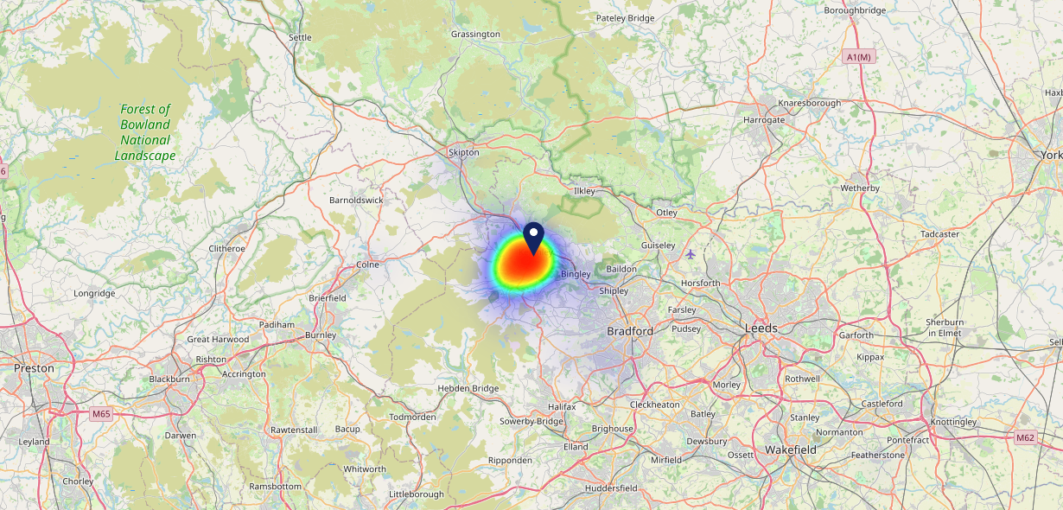
Site Intel
Red Pig BD215HS
16/04/2025 - 08/04/2026
Map of Guest Origin
Where do customers of Red Pig BD215HS come from?
Where do customers of Red Pig BD215HS for 16/04/2025 - 08/04/2026 live
155 Site Customers

Slide 12
Site Intel
Red Pig BD215HS
1 Miles
371 Chains
16/04/2025 - 08/04/2026
Share of Wallet
What are the Top 20 venues (by spend) that customers of Red Pig BD215HS also visit?
For customers of Red Pig BD215HS, who are the top 20 competitors from 371 Chains in 1 Miles for 16/04/2025 - 08/04/2026 split by Venue
352 Site Customers

Slide 13
Site Intel
Red Pig BD215HS
1 Miles
371 Chains
16/04/2025 - 08/04/2026
Share of Wallet Change
How has share of wallet of customers of Red Pig BD215HS changed between two date ranges?
352 Site Customers

Slide 14
Site Intel
Red Pig BD215HS
16/04/2025 - 08/04/2026
Market Summary
How does the local area for Red Pig BD215HS compare to the national average (1 = low, 10 = high)
Data Type | Name | Spend in 250m | 250m Spend vs National | Spend in 500m | 500m Spend vs National | Spend in 1 mile | 1 mile Spend vs National | Spend in 3 miles | 3 mile Spend vs National
Total | Annual Sales | £5.24M | 7 | £10.63M | 7 | £24.98M | 7 | £44.96M | 4
Weekpart | Mon - Thu | 41.5% | 6 | 44.9% | 8 | 46.6% | 9 | 42.3% | 6
Weekpart | Fri - Sat | 42.9% | 5 | 40.9% | 4 | 37.5% | 2 | 40.6% | 4
Weekpart | Sun | 15.7% | 7 | 14.1% | 5 | 15.9% | 7 | 17.1% | 9
Age | 18 to 24 | 1.9% | 2 | 3.0% | 2 | 4.2% | 3 | 2.7% | 1
Age | 25 to 34 | 18.4% | 4 | 17.0% | 3 | 20.2% | 4 | 16.3% | 2
Age | 35 to 44 | 22.7% | 5 | 24.5% | 7 | 27.2% | 9 | 24.8% | 7
Age | 45 to 54 | 19.5% | 5 | 19.1% | 4 | 20.3% | 6 | 19.5% | 4
Age | 55 to 64 | 20.1% | 8 | 18.3% | 8 | 15.5% | 6 | 20.3% | 9
Age | 65 to 74 | 13.6% | 9 | 14.2% | 10 | 9.7% | 8 | 11.6% | 9
Age | 75+ | 3.8% | 8 | 3.9% | 8 | 2.9% | 6 | 4.7% | 9
CAMEO | Business Elite | 2.1% | 2 | 2.1% | 2 | 2.2% | 2 | 3.5% | 2
CAMEO | Prosperous Professionals | 3.0% | 3 | 3.5% | 3 | 3.5% | 2 | 4.4% | 3
CAMEO | Flourishing Society | 9.0% | 4 | 8.5% | 4 | 8.3% | 3 | 11.1% | 4
CAMEO | Content Communities | 7.2% | 2 | 6.2% | 1 | 7.1% | 1 | 8.0% | 1
CAMEO | White Collar Neighbourhoods | 13.7% | 8 | 12.6% | 7 | 12.1% | 6 | 13.3% | 8
CAMEO | Enterprising Mainstream | 13.0% | 9 | 14.4% | 9 | 13.4% | 9 | 13.6% | 9
CAMEO | Paying The Mortgage | 14.9% | 6 | 16.4% | 7 | 16.3% | 7 | 17.7% | 8
CAMEO | Cash Conscious Communities | 14.1% | 9 | 14.6% | 9 | 15.1% | 9 | 13.0% | 9
CAMEO | On A Budget | 15.6% | 10 | 14.6% | 10 | 13.9% | 10 | 9.8% | 9
CAMEO | Family Value | 7.3% | 8 | 7.2% | 8 | 8.2% | 8 | 5.6% | 7
Affluence | AB | 14.1% | 2 | 14.1% | 2 | 14.0% | 2 | 19.0% | 3
Affluence | C1C2 | 48.9% | 6 | 49.5% | 6 | 48.8% | 6 | 52.6% | 7
Affluence | DE | 37.0% | 9 | 36.4% | 9 | 37.2% | 9 | 28.4% | 8

