Slide 1
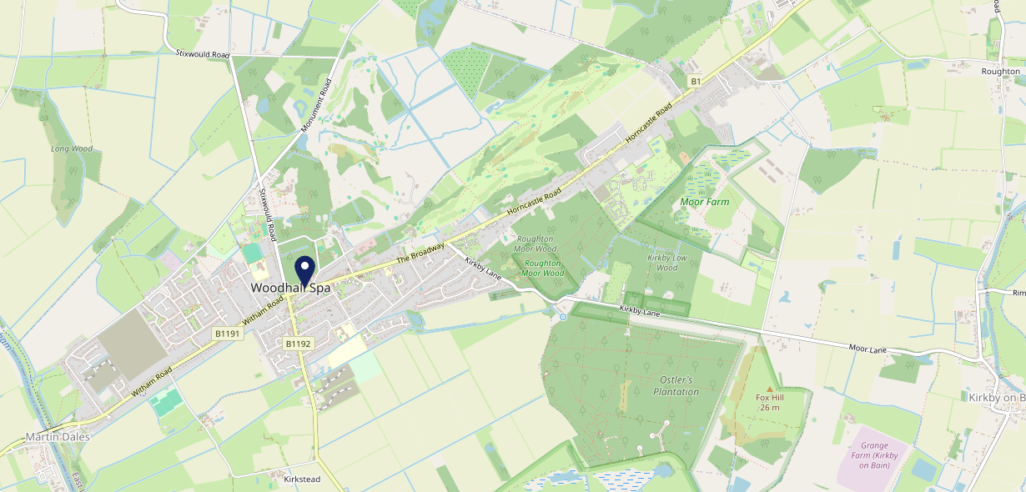
Site Intel
The Mall LN106QL
1 Miles
338 Chains
29/01/2025 - 21/01/2026
Site Summary
The Mall LN106QL
Work Area
Region
TV Region
Urbanicity
Lincoln
East Midlands
Yorkshire
Rural town and fringe
LN106QL
Punch - Fireside Inns
Top Competitors
ATV
Gender
Golden Phoenix
#1
£17.28
66.85%
Male
LN106QL
Takeaway
Affluence
Segmentation
Tea House In the Woods
#2
59.08%
20.02%
Middle Income
Paying The Mortgage
LN106QD
Restaurant
Age Group
Visit Day
Woodlands Cafe
#3
26.78%
25.80%
LN106ST
55 to 64
Sat
Café
Nearest Station
Metheringham(11.72 miles)
2163 Site Customers
20 Competitors
9763 Competitor Customers

Slide 2
Site Intel
The Mall LN106QL
1 Miles
338 Chains
29/01/2025 - 21/01/2026
Spend by Weekpart
How is customer spend distributed throughout the week for The Mall LN106QL versus its competitors?
% of spend for The Mall LN106QL and 338 Chains in 1 Miles from 29/01/2025 - 21/01/2026 split by Day of Week
2163 Site Customers
20 Competitors
9763 Competitor Customers

Slide 3
Site Intel
The Mall LN106QL
1 Miles
338 Chains
29/01/2025 - 21/01/2026
Visit Frequency
How frequently per year do customers visit The Mall LN106QL versus its competitors?
% of customer numbers for The Mall LN106QL and 338 Chains in 1 Miles from 29/01/2025 - 21/01/2026 and the number of visits made Per Annum
2163 Site Customers
20 Competitors
9763 Competitor Customers

Slide 4
Site Intel
The Mall LN106QL
1 Miles
338 Chains
29/01/2025 - 21/01/2026
ATV Change
How has ATV changed between two date ranges?
2163 Site Customers

Slide 5
Site Intel
The Mall LN106QL
1 Miles
338 Chains
29/01/2025 - 21/01/2026
Market Share Change
How has market share changed between two date ranges?
% of market share spend for The Mall LN106QL and 338 Chains in 1 Miles from 29/01/2025 - 21/01/2026
2163 Site Customers

Slide 6
Site Intel
The Mall LN106QL
1 Miles
338 Chains
29/01/2025 - 21/01/2026
Age
How does the age profile of customers who visit The Mall LN106QL compare versus its competitors?
% of spend for The Mall LN106QL and 338 Chains in 1 Miles from 29/01/2025 - 21/01/2026 split by Age Range
1146 Site Customers
20 Competitors
5312 Competitor Customers

Slide 7
Site Intel
The Mall LN106QL
1 Miles
338 Chains
29/01/2025 - 21/01/2026
Affluence
How does the affluence of customers who visit The Mall LN106QL compare versus its competitors?
% of spend for The Mall LN106QL and 338 Chains in 1 Miles from 29/01/2025 - 21/01/2026 split by Affluence
1071 Site Customers
20 Competitors
4907 Competitor Customers

Slide 8
Site Intel
The Mall LN106QL
1 Miles
338 Chains
29/01/2025 - 21/01/2026
Gender
How does the gender profile of customers who visit The Mall LN106QL compare versus its competitors?
% of spend for The Mall LN106QL and 338 Chains in 1 Miles from 29/01/2025 - 21/01/2026 split by Gender
1118 Site Customers
20 Competitors
5168 Competitor Customers

Slide 9
Site Intel
The Mall LN106QL
1 Miles
338 Chains
29/01/2025 - 21/01/2026
Punch Segmentation
How does the Custom segmentation profile of customers who visit The Mall LN106QL compare versus its competitors?
% of spend for The Mall LN106QL and 338 Chains in 1 Miles from 29/01/2025 - 21/01/2026 split by Segment
2163 Site Customers
20 Competitors
9763 Competitor Customers

Slide 10
Site Intel
The Mall LN106QL
1 Miles
338 Chains
29/01/2025 - 21/01/2026
Spend by Distance
How does the spend profile of The Mall LN106QL compare versus its competitors based on travel distances?
% of spend for The Mall LN106QL and 338 Chains in 1 Miles from 29/01/2025 - 21/01/2026 split by Distance travelled
1118 Site Customers
20 Competitors
5163 Competitor Customers

Slide 11
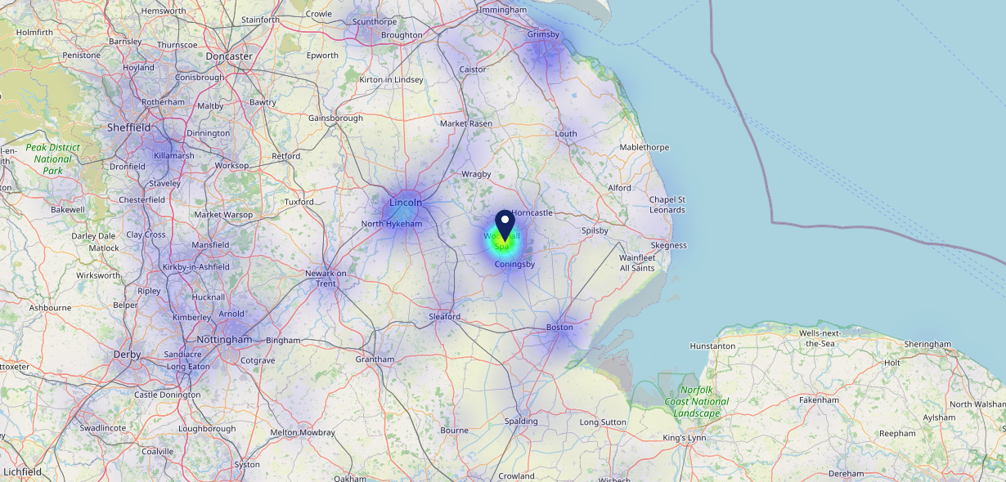
Site Intel
The Mall LN106QL
29/01/2025 - 21/01/2026
Map of Guest Origin
Where do customers of The Mall LN106QL come from?
Where do customers of The Mall LN106QL for 29/01/2025 - 21/01/2026 live
1118 Site Customers

Slide 12
Site Intel
The Mall LN106QL
1 Miles
338 Chains
29/01/2025 - 21/01/2026
Share of Wallet
What are the Top 20 venues (by spend) that customers of The Mall LN106QL also visit?
For customers of The Mall LN106QL, who are the top 20 competitors from 338 Chains in 1 Miles for 29/01/2025 - 21/01/2026 split by Venue
2163 Site Customers

Slide 13
Site Intel
The Mall LN106QL
1 Miles
338 Chains
29/01/2025 - 21/01/2026
Share of Wallet Change
How has share of wallet of customers of The Mall LN106QL changed between two date ranges?
2163 Site Customers

Slide 14
Site Intel
The Mall LN106QL
29/01/2025 - 21/01/2026
Market Summary
How does the local area for The Mall LN106QL compare to the national average (1 = low, 10 = high)
Data Type | Name | Spend in 250m | 250m Spend vs National | Spend in 500m | 500m Spend vs National | Spend in 1 mile | 1 mile Spend vs National | Spend in 3 miles | 3 mile Spend vs National
Total | Annual Sales | £1.69M | 5 | £5.09M | 6 | £5.09M | 3 | £6.42M | 2
Weekpart | Mon - Thu | 38.0% | 4 | 38.7% | 4 | 38.7% | 3 | 38.3% | 1
Weekpart | Fri - Sat | 45.0% | 6 | 45.0% | 6 | 45.0% | 7 | 45.4% | 9
Weekpart | Sun | 17.0% | 8 | 16.3% | 7 | 16.3% | 7 | 16.3% | 7
Age | 18 to 24 | 2.9% | 3 | 3.7% | 3 | 3.7% | 2 | 4.0% | 2
Age | 25 to 34 | 9.2% | 1 | 8.8% | 1 | 8.8% | 1 | 7.9% | 1
Age | 35 to 44 | 16.4% | 2 | 14.9% | 1 | 14.9% | 1 | 14.2% | 1
Age | 45 to 54 | 21.9% | 7 | 18.8% | 4 | 18.8% | 3 | 18.4% | 3
Age | 55 to 64 | 24.9% | 10 | 25.2% | 10 | 25.2% | 10 | 25.5% | 10
Age | 65 to 74 | 18.9% | 10 | 20.8% | 10 | 20.8% | 10 | 21.1% | 10
Age | 75+ | 5.8% | 9 | 7.8% | 10 | 7.8% | 10 | 8.8% | 10
CAMEO | Business Elite | 1.5% | 2 | 2.6% | 2 | 2.6% | 2 | 2.3% | 1
CAMEO | Prosperous Professionals | 5.5% | 5 | 7.1% | 7 | 7.1% | 7 | 8.9% | 9
CAMEO | Flourishing Society | 11.6% | 5 | 12.9% | 6 | 12.9% | 6 | 13.4% | 6
CAMEO | Content Communities | 14.3% | 7 | 15.4% | 8 | 15.4% | 8 | 15.1% | 8
CAMEO | White Collar Neighbourhoods | 10.7% | 5 | 10.1% | 4 | 10.1% | 4 | 10.5% | 4
CAMEO | Enterprising Mainstream | 21.3% | 10 | 20.8% | 10 | 20.8% | 10 | 19.7% | 10
CAMEO | Paying The Mortgage | 14.2% | 5 | 14.2% | 5 | 14.2% | 5 | 13.4% | 5
CAMEO | Cash Conscious Communities | 10.4% | 7 | 9.6% | 6 | 9.6% | 6 | 9.0% | 5
CAMEO | On A Budget | 6.3% | 5 | 4.4% | 3 | 4.4% | 3 | 4.5% | 2
CAMEO | Family Value | 4.3% | 7 | 2.9% | 6 | 2.9% | 6 | 3.1% | 6
Affluence | AB | 18.6% | 3 | 22.5% | 4 | 22.5% | 4 | 24.6% | 4
Affluence | C1C2 | 60.5% | 9 | 60.5% | 10 | 60.5% | 10 | 58.7% | 10
Affluence | DE | 20.9% | 6 | 16.9% | 4 | 16.9% | 4 | 16.6% | 3

Slide 15
Site Intel
The Mall LN106QL
Site Potential 1
Site Characteristics
£3000
£18000
OCC Concept Fit
Achievable Average Weekly Takings
Non-Core
£11500
A Food-Led High Affluence B Food-Led Mid Affluence C Wet-Led Mid/High Affluence D Wet-Led Low Affluence E Food-Led Low Affluence
AWT 2 Local Regulars 3 Local Passing Trade 4 Destination Wet-Led 5 Destination Food-Led 6 Destination Very Food-Led
A
B
C
D
E
1
2
3
4
5
6

Slide 16
Site Intel
The Mall LN106QL
Site Potential 2
Concept Recommendation

Slide 17
Site Intel
The Mall LN106QL
Local Market Profile
Mix of spend by customer segment in Punch site and local market
 | Customer Count | Family Familiar | Occasional & Local | Mid-Week Seniors | Part Of The Pub | Metro Sophisticates | Young & Connected | Bubbly Weekenders | Upmarket Diners
The Mall | 447 | 17.11% | 3.02% | 33.17% | 8.07% | 8.26% | 11.77% | 8.00% | 10.57%
Local Catchment | 1106 | 13.82% | 2.54% | 37.79% | 4.11% | 6.25% | 10.09% | 7.75% | 17.62%
Punch T&L | 97242 | 8.88% | 6.05% | 28.69% | 11.37% | 11.23% | 11.04% | 7.12% | 15.57%
The Mall vs Local Catchment |  | 3.29% | 0.48% | -4.62% | 3.96% | 2.01% | 1.68% | 0.25% | -7.05%
The Mall vs Punch T&L |  | 8.23% | -3.03% | 4.48% | -3.30% | -2.97% | 0.73% | 0.88% | -5.00%
Local Catchment vs Punch T&L |  | 4.94% | -3.51% | 9.10% | -7.26% | -4.98% | -0.95% | 0.63% | 2.05%

Slide 18
Site Intel
The Mall LN106QL
Local Competitor Profiles
Mix of spend by customer segment in Punch site and local competitors
 | Customer Count | Family Familiar | Occasional & Local | Mid-Week Seniors | Part Of The Pub | Metro Sophisticates | Young & Connected | Bubbly Weekenders | Upmarket Diners
The Mall LN106QL | 447 | 17.11% | 3.02% | 33.17% | 8.07% | 8.26% | 11.77% | 8.00% | 10.57%
Golden Phoenix LN106QL | 66 | 8.54% | 3.87% | 38.30% | 2.98% | 4.37% | 7.79% | 14.01% | 20.09%
Tea House In the Woods LN106QD | 287 | 14.08% | 1.85% | 51.12% | 2.51% | 2.94% | 8.10% | 5.24% | 14.12%
Woodlands Cafe LN106ST | 342 | 13.70% | 2.32% | 34.54% | 2.43% | 4.26% | 15.28% | 6.98% | 20.45%
India Village LN106ST | 87 | 9.75% | 0.00% | 36.82% | 2.16% | 10.08% | 9.78% | 8.54% | 22.83%
Woodhall Indian LN106ST | 60 | 15.66% | 1.72% | 27.68% | 3.88% | 9.94% | 4.90% | 8.28% | 27.90%
Archers Fish Shop LN106RW | 68 | 21.69% | 3.36% | 26.59% | 4.36% | 6.31% | 16.49% | 11.87% | 9.29%
Lorenzos Restaurant LN106ST | 41 | 3.92% | 0.00% | 43.78% | 7.65% | 7.29% | 13.56% | 3.86% | 19.91%
Luxe Bistro Bar LN106QL | 97 | 15.75% | 5.65% | 23.85% | 4.22% | 16.56% | 10.52% | 10.37% | 13.04%
Jubilee Park Cafe LN106QH | 228 | 25.80% | 3.80% | 23.59% | 5.37% | 4.13% | 14.82% | 10.33% | 12.13%
Little Dorrits LN106QL | 106 | 27.06% | 2.18% | 27.99% | 7.10% | 10.60% | 4.26% | 11.28% | 9.51%
Melrose Tearoom LN106ST | 43 | 11.56% | 15.64% | 43.70% | 2.96% | 6.50% | 6.18% | 4.06% | 9.37%
Zucci Restaurant LN106QL | 8 | 13.78% | 0.00% | 9.35% | 50.95% | 0.00% | 0.00% | 0.00% | 25.91%

