Slide 1
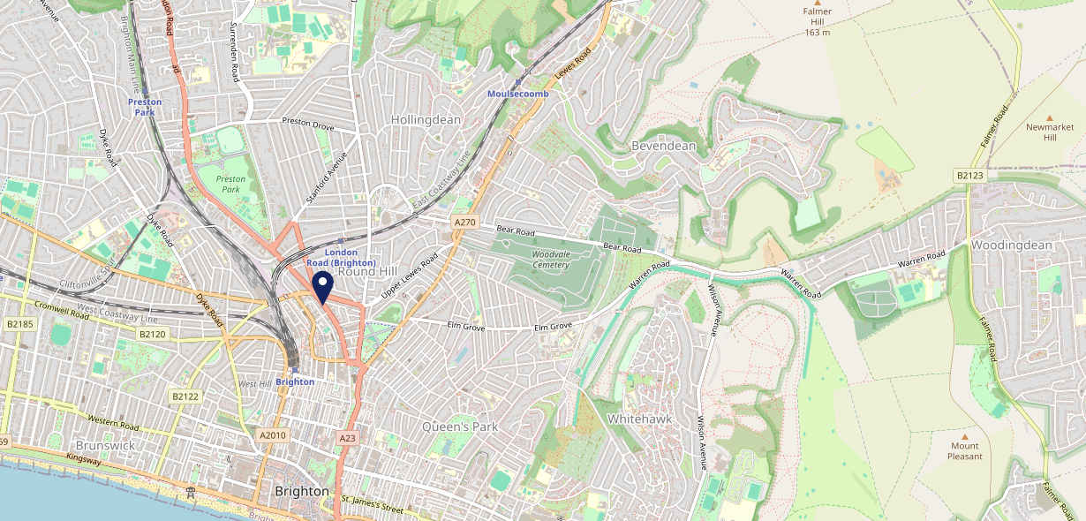
Site Intel
Worlds End BN14JE
1 Miles
371 Chains
16/04/2025 - 08/04/2026
Site Summary
Worlds End BN14JE
Work Area
Region
TV Region
Urbanicity
Brighton
South East
South
Urban city and town
BN14JE
Laine Pub Company
Top Competitors
ATV
Gender
Hare & Hounds
#1
£12.20
67.86%
Male
BN14JF
Pub / Bar
Affluence
Segmentation
Joker
#2
57.04%
23.27%
Middle Income
White Collar Neighbourhoods
BN14QF
Brakspear - L&T
Age Group
Visit Day
Waggon & Horses
#3
33.44%
38.67%
BN11UD
25 to 34
Sat
Pub / Bar
Nearest Station
London Road (Brighton)(0.44 miles)
2401 Site Customers
1000 of 1907 Competitors
702932 Competitor Customers

Slide 2
Site Intel
Worlds End BN14JE
1 Miles
371 Chains
16/04/2025 - 08/04/2026
Spend by Weekpart
How is customer spend distributed throughout the week for Worlds End BN14JE versus its competitors?
% of spend for Worlds End BN14JE and 371 Chains in 1 Miles from 16/04/2025 - 08/04/2026 split by Day of Week
2401 Site Customers
1000 of 1907 Competitors
702932 Competitor Customers

Slide 3
Site Intel
Worlds End BN14JE
1 Miles
371 Chains
16/04/2025 - 08/04/2026
Visit Frequency
How frequently per year do customers visit Worlds End BN14JE versus its competitors?
% of customer numbers for Worlds End BN14JE and 371 Chains in 1 Miles from 16/04/2025 - 08/04/2026 and the number of visits made Per Annum
2401 Site Customers
1000 of 1907 Competitors
702932 Competitor Customers

Slide 4
Site Intel
Worlds End BN14JE
1 Miles
371 Chains
16/04/2025 - 08/04/2026
ATV Change
How has ATV changed between two date ranges?
2401 Site Customers

Slide 5
Site Intel
Worlds End BN14JE
1 Miles
371 Chains
16/04/2025 - 08/04/2026
Market Share Change
How has market share changed between two date ranges?
% of market share spend for Worlds End BN14JE and 371 Chains in 1 Miles from 16/04/2025 - 08/04/2026
2401 Site Customers

Slide 6
Site Intel
Worlds End BN14JE
1 Miles
371 Chains
16/04/2025 - 08/04/2026
Age
How does the age profile of customers who visit Worlds End BN14JE compare versus its competitors?
% of spend for Worlds End BN14JE and 371 Chains in 1 Miles from 16/04/2025 - 08/04/2026 split by Age Range
677 Site Customers
1000 of 1907 Competitors
234819 Competitor Customers

Slide 7
Site Intel
Worlds End BN14JE
1 Miles
371 Chains
16/04/2025 - 08/04/2026
Affluence
How does the affluence of customers who visit Worlds End BN14JE compare versus its competitors?
% of spend for Worlds End BN14JE and 371 Chains in 1 Miles from 16/04/2025 - 08/04/2026 split by Affluence
637 Site Customers
1000 of 1907 Competitors
218175 Competitor Customers

Slide 8
Site Intel
Worlds End BN14JE
1 Miles
371 Chains
16/04/2025 - 08/04/2026
Gender
How does the gender profile of customers who visit Worlds End BN14JE compare versus its competitors?
% of spend for Worlds End BN14JE and 371 Chains in 1 Miles from 16/04/2025 - 08/04/2026 split by Gender
663 Site Customers
1000 of 1907 Competitors
225607 Competitor Customers

Slide 9
Site Intel
Worlds End BN14JE
1 Miles
371 Chains
16/04/2025 - 08/04/2026
Punch Segmentation
How does the Custom segmentation profile of customers who visit Worlds End BN14JE compare versus its competitors?
% of spend for Worlds End BN14JE and 371 Chains in 1 Miles from 16/04/2025 - 08/04/2026 split by Segment
2401 Site Customers
1000 of 1907 Competitors
702932 Competitor Customers

Slide 10
Site Intel
Worlds End BN14JE
1 Miles
371 Chains
16/04/2025 - 08/04/2026
Spend by Distance
How does the spend profile of Worlds End BN14JE compare versus its competitors based on travel distances?
% of spend for Worlds End BN14JE and 371 Chains in 1 Miles from 16/04/2025 - 08/04/2026 split by Distance travelled
663 Site Customers
1000 of 1907 Competitors
225348 Competitor Customers

Slide 11
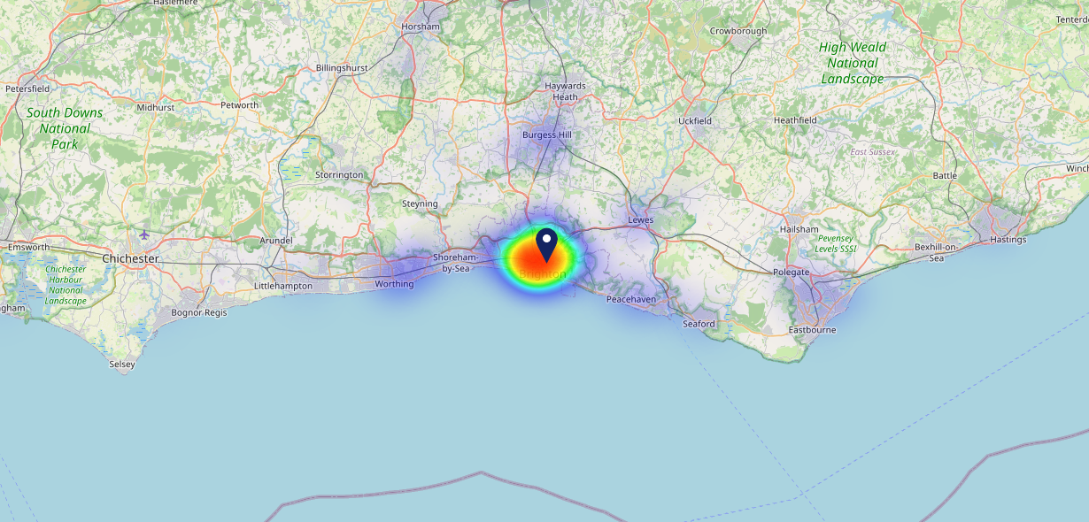
Site Intel
Worlds End BN14JE
16/04/2025 - 08/04/2026
Map of Guest Origin
Where do customers of Worlds End BN14JE come from?
Where do customers of Worlds End BN14JE for 16/04/2025 - 08/04/2026 live
663 Site Customers

Slide 12
Site Intel
Worlds End BN14JE
1 Miles
371 Chains
16/04/2025 - 08/04/2026
Share of Wallet
What are the Top 20 venues (by spend) that customers of Worlds End BN14JE also visit?
For customers of Worlds End BN14JE, who are the top 20 competitors from 371 Chains in 1 Miles for 16/04/2025 - 08/04/2026 split by Venue
2401 Site Customers

Slide 13
Site Intel
Worlds End BN14JE
1 Miles
371 Chains
16/04/2025 - 08/04/2026
Share of Wallet Change
How has share of wallet of customers of Worlds End BN14JE changed between two date ranges?
2401 Site Customers

Slide 14
Site Intel
Worlds End BN14JE
16/04/2025 - 08/04/2026
Market Summary
How does the local area for Worlds End BN14JE compare to the national average (1 = low, 10 = high)
Data Type | Name | Spend in 250m | 250m Spend vs National | Spend in 500m | 500m Spend vs National | Spend in 1 mile | 1 mile Spend vs National | Spend in 3 miles | 3 mile Spend vs National
Total | Annual Sales | £11.48M | 9 | £27.95M | 9 | £351.39M | 10 | £497.44M | 9
Weekpart | Mon - Thu | 44.9% | 8 | 44.3% | 8 | 38.2% | 3 | 39.0% | 2
Weekpart | Fri - Sat | 42.6% | 5 | 42.1% | 4 | 46.5% | 9 | 45.4% | 9
Weekpart | Sun | 12.5% | 3 | 13.6% | 4 | 15.3% | 6 | 15.6% | 5
Age | 18 to 24 | 6.8% | 6 | 5.1% | 5 | 4.8% | 3 | 3.9% | 2
Age | 25 to 34 | 20.2% | 5 | 17.9% | 3 | 16.1% | 2 | 15.0% | 1
Age | 35 to 44 | 27.8% | 8 | 25.8% | 7 | 24.5% | 7 | 24.5% | 7
Age | 45 to 54 | 20.8% | 6 | 22.0% | 7 | 23.2% | 9 | 23.2% | 9
Age | 55 to 64 | 16.3% | 6 | 19.0% | 8 | 20.2% | 9 | 21.0% | 10
Age | 65 to 74 | 6.0% | 5 | 7.8% | 7 | 7.9% | 7 | 8.5% | 8
Age | 75+ | 2.1% | 6 | 2.5% | 6 | 3.3% | 7 | 3.9% | 8
CAMEO | Business Elite | 8.5% | 6 | 8.8% | 7 | 10.5% | 7 | 10.7% | 7
CAMEO | Prosperous Professionals | 5.9% | 5 | 6.6% | 6 | 7.7% | 7 | 7.4% | 7
CAMEO | Flourishing Society | 9.8% | 4 | 10.1% | 4 | 13.3% | 6 | 13.0% | 6
CAMEO | Content Communities | 8.9% | 3 | 8.7% | 2 | 10.3% | 3 | 10.2% | 3
CAMEO | White Collar Neighbourhoods | 23.2% | 10 | 22.8% | 10 | 20.1% | 10 | 20.7% | 10
CAMEO | Enterprising Mainstream | 9.9% | 7 | 9.9% | 7 | 9.0% | 6 | 8.8% | 6
CAMEO | Paying The Mortgage | 13.4% | 5 | 13.6% | 5 | 13.0% | 4 | 13.0% | 4
CAMEO | Cash Conscious Communities | 9.0% | 6 | 8.4% | 5 | 7.5% | 4 | 7.4% | 4
CAMEO | On A Budget | 8.8% | 7 | 8.9% | 8 | 6.7% | 6 | 6.4% | 5
CAMEO | Family Value | 2.6% | 6 | 2.2% | 5 | 1.9% | 4 | 2.3% | 5
Affluence | AB | 24.2% | 5 | 25.5% | 5 | 31.5% | 6 | 31.1% | 6
Affluence | C1C2 | 55.4% | 8 | 55.0% | 8 | 52.4% | 7 | 52.7% | 8
Affluence | DE | 20.4% | 6 | 19.5% | 5 | 16.1% | 4 | 16.2% | 3

