Slide 1
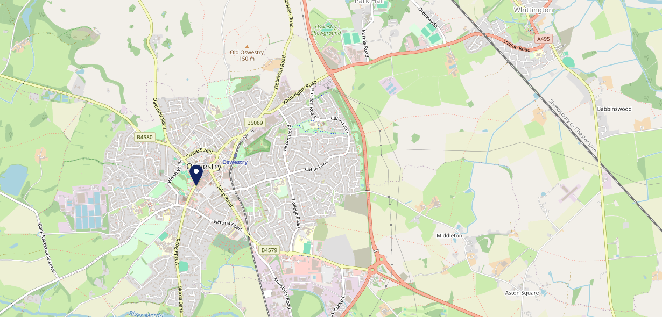
Site Intel
Kings Head Inn SY112SP
1 Miles
371 Chains
16/04/2025 - 08/04/2026
Site Summary
Kings Head Inn SY112SP
Work Area
Region
TV Region
Urbanicity
Oswestry
West Midlands
North West
Urban city and town
SY112SP
Star Pubs & Bars
Top Competitors
ATV
Gender
Mcdonalds 1714
#1
£14.79
54.42%
Male
SY114QA
McDonalds
Affluence
Segmentation
Oak Inn (Oswestry)
#2
60.57%
23.59%
Middle Income
Content Communities
SY112SZ
Pub / Bar
Age Group
Visit Day
The Wilfred Owen
#3
24.95%
33.39%
SY111AF
55 to 64
Sat
JD Wetherspoon
Nearest Station
Gobowen(4.10 miles)
594 Site Customers
132 Competitors
46972 Competitor Customers

Slide 2
Site Intel
Kings Head Inn SY112SP
1 Miles
371 Chains
16/04/2025 - 08/04/2026
Spend by Weekpart
How is customer spend distributed throughout the week for Kings Head Inn SY112SP versus its competitors?
% of spend for Kings Head Inn SY112SP and 371 Chains in 1 Miles from 16/04/2025 - 08/04/2026 split by Day of Week
594 Site Customers
132 Competitors
46972 Competitor Customers

Slide 3
Site Intel
Kings Head Inn SY112SP
1 Miles
371 Chains
16/04/2025 - 08/04/2026
Visit Frequency
How frequently per year do customers visit Kings Head Inn SY112SP versus its competitors?
% of customer numbers for Kings Head Inn SY112SP and 371 Chains in 1 Miles from 16/04/2025 - 08/04/2026 and the number of visits made Per Annum
594 Site Customers
132 Competitors
46972 Competitor Customers

Slide 4
Site Intel
Kings Head Inn SY112SP
1 Miles
371 Chains
16/04/2025 - 08/04/2026
ATV Change
How has ATV changed between two date ranges?
594 Site Customers

Slide 5
Site Intel
Kings Head Inn SY112SP
1 Miles
371 Chains
16/04/2025 - 08/04/2026
Market Share Change
How has market share changed between two date ranges?
% of market share spend for Kings Head Inn SY112SP and 371 Chains in 1 Miles from 16/04/2025 - 08/04/2026
594 Site Customers

Slide 6
Site Intel
Kings Head Inn SY112SP
1 Miles
371 Chains
16/04/2025 - 08/04/2026
Age
How does the age profile of customers who visit Kings Head Inn SY112SP compare versus its competitors?
% of spend for Kings Head Inn SY112SP and 371 Chains in 1 Miles from 16/04/2025 - 08/04/2026 split by Age Range
299 Site Customers
132 Competitors
21690 Competitor Customers

Slide 7
Site Intel
Kings Head Inn SY112SP
1 Miles
371 Chains
16/04/2025 - 08/04/2026
Affluence
How does the affluence of customers who visit Kings Head Inn SY112SP compare versus its competitors?
% of spend for Kings Head Inn SY112SP and 371 Chains in 1 Miles from 16/04/2025 - 08/04/2026 split by Affluence
287 Site Customers
132 Competitors
20293 Competitor Customers

Slide 8
Site Intel
Kings Head Inn SY112SP
1 Miles
371 Chains
16/04/2025 - 08/04/2026
Gender
How does the gender profile of customers who visit Kings Head Inn SY112SP compare versus its competitors?
% of spend for Kings Head Inn SY112SP and 371 Chains in 1 Miles from 16/04/2025 - 08/04/2026 split by Gender
292 Site Customers
132 Competitors
20991 Competitor Customers

Slide 9
Site Intel
Kings Head Inn SY112SP
1 Miles
371 Chains
16/04/2025 - 08/04/2026
Punch Segmentation
How does the Custom segmentation profile of customers who visit Kings Head Inn SY112SP compare versus its competitors?
% of spend for Kings Head Inn SY112SP and 371 Chains in 1 Miles from 16/04/2025 - 08/04/2026 split by Segment
594 Site Customers
132 Competitors
46972 Competitor Customers

Slide 10
Site Intel
Kings Head Inn SY112SP
1 Miles
371 Chains
16/04/2025 - 08/04/2026
Spend by Distance
How does the spend profile of Kings Head Inn SY112SP compare versus its competitors based on travel distances?
% of spend for Kings Head Inn SY112SP and 371 Chains in 1 Miles from 16/04/2025 - 08/04/2026 split by Distance travelled
292 Site Customers
132 Competitors
20980 Competitor Customers

Slide 11
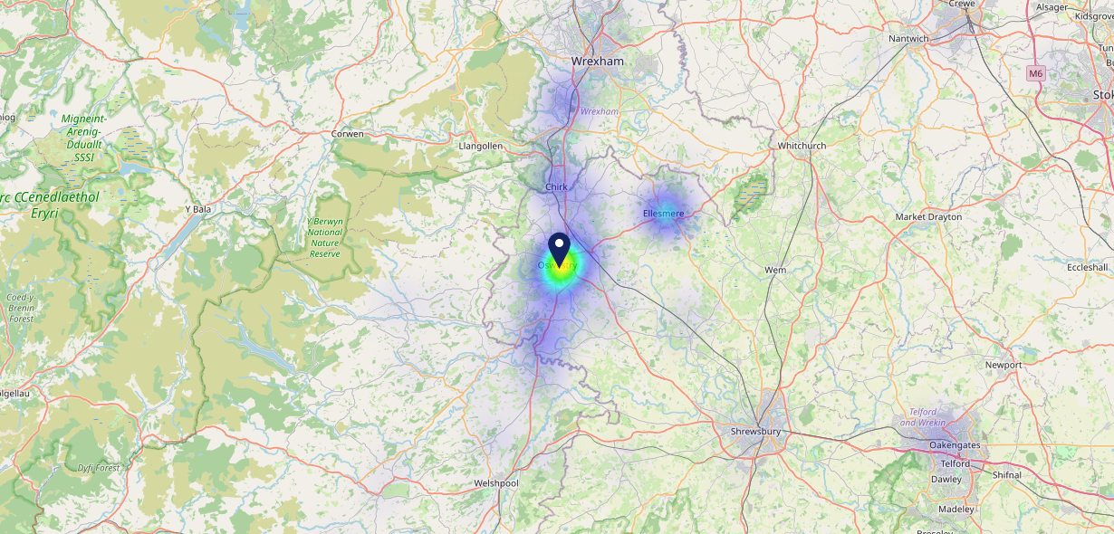
Site Intel
Kings Head Inn SY112SP
16/04/2025 - 08/04/2026
Map of Guest Origin
Where do customers of Kings Head Inn SY112SP come from?
Where do customers of Kings Head Inn SY112SP for 16/04/2025 - 08/04/2026 live
292 Site Customers

Slide 12
Site Intel
Kings Head Inn SY112SP
1 Miles
371 Chains
16/04/2025 - 08/04/2026
Share of Wallet
What are the Top 20 venues (by spend) that customers of Kings Head Inn SY112SP also visit?
For customers of Kings Head Inn SY112SP, who are the top 20 competitors from 371 Chains in 1 Miles for 16/04/2025 - 08/04/2026 split by Venue
594 Site Customers

Slide 13
Site Intel
Kings Head Inn SY112SP
1 Miles
371 Chains
16/04/2025 - 08/04/2026
Share of Wallet Change
How has share of wallet of customers of Kings Head Inn SY112SP changed between two date ranges?
594 Site Customers

Slide 14
Site Intel
Kings Head Inn SY112SP
16/04/2025 - 08/04/2026
Market Summary
How does the local area for Kings Head Inn SY112SP compare to the national average (1 = low, 10 = high)
Data Type | Name | Spend in 250m | 250m Spend vs National | Spend in 500m | 500m Spend vs National | Spend in 1 mile | 1 mile Spend vs National | Spend in 3 miles | 3 mile Spend vs National
Total | Annual Sales | £10.18M | 9 | £12.39M | 8 | £20.76M | 6 | £30.88M | 4
Weekpart | Mon - Thu | 41.7% | 6 | 40.4% | 5 | 43.3% | 7 | 44.8% | 9
Weekpart | Fri - Sat | 45.2% | 6 | 46.9% | 8 | 42.7% | 5 | 41.0% | 4
Weekpart | Sun | 13.1% | 4 | 12.7% | 3 | 14.0% | 3 | 14.2% | 2
Age | 18 to 24 | 5.8% | 6 | 5.2% | 5 | 6.1% | 5 | 6.3% | 5
Age | 25 to 34 | 13.9% | 2 | 13.5% | 2 | 15.5% | 2 | 16.1% | 2
Age | 35 to 44 | 19.8% | 3 | 19.6% | 3 | 23.1% | 5 | 23.4% | 5
Age | 45 to 54 | 19.1% | 4 | 20.4% | 6 | 20.0% | 5 | 19.6% | 4
Age | 55 to 64 | 20.1% | 8 | 20.4% | 8 | 18.1% | 8 | 17.8% | 8
Age | 65 to 74 | 14.0% | 9 | 14.2% | 10 | 11.3% | 9 | 10.9% | 9
Age | 75+ | 7.3% | 10 | 6.8% | 10 | 5.8% | 9 | 5.9% | 9
CAMEO | Business Elite | 3.3% | 3 | 2.9% | 3 | 2.4% | 2 | 2.4% | 1
CAMEO | Prosperous Professionals | 7.3% | 7 | 6.9% | 7 | 6.4% | 6 | 6.5% | 5
CAMEO | Flourishing Society | 10.2% | 5 | 10.2% | 4 | 9.5% | 4 | 10.0% | 4
CAMEO | Content Communities | 21.5% | 10 | 21.0% | 10 | 19.0% | 10 | 19.2% | 10
CAMEO | White Collar Neighbourhoods | 7.1% | 2 | 7.2% | 2 | 6.4% | 1 | 6.7% | 1
CAMEO | Enterprising Mainstream | 10.0% | 7 | 10.1% | 7 | 11.1% | 8 | 10.5% | 7
CAMEO | Paying The Mortgage | 16.3% | 7 | 16.8% | 7 | 18.0% | 8 | 18.3% | 8
CAMEO | Cash Conscious Communities | 11.7% | 7 | 12.0% | 8 | 13.2% | 8 | 12.3% | 8
CAMEO | On A Budget | 5.7% | 5 | 5.8% | 5 | 5.8% | 4 | 5.9% | 4
CAMEO | Family Value | 6.9% | 8 | 7.1% | 8 | 8.3% | 9 | 8.1% | 8
Affluence | AB | 20.7% | 4 | 20.1% | 4 | 18.3% | 3 | 18.9% | 3
Affluence | C1C2 | 54.9% | 8 | 55.1% | 8 | 54.4% | 8 | 54.7% | 8
Affluence | DE | 24.4% | 7 | 24.8% | 7 | 27.3% | 8 | 26.3% | 8

