Slide 1
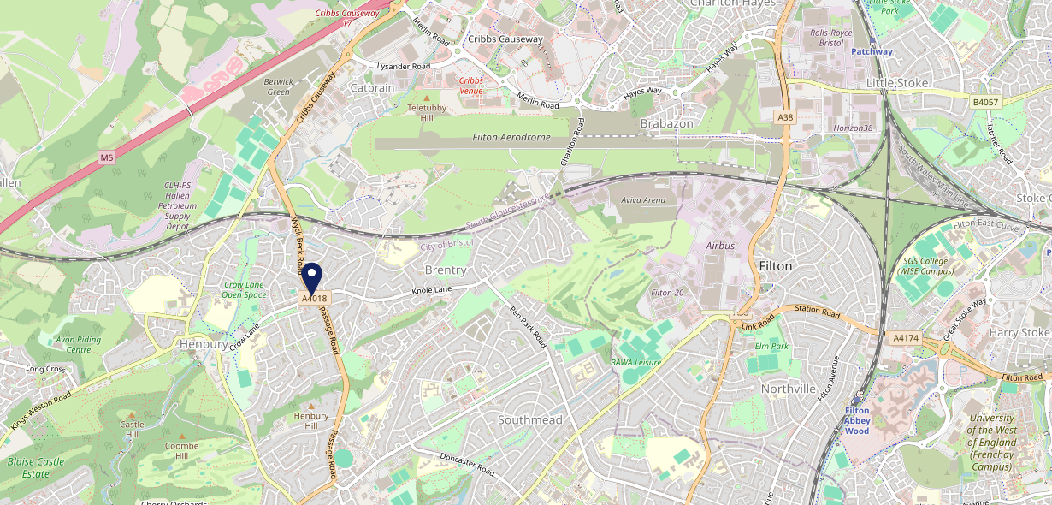
Site Intel
Old Crow BS107DW
1 Miles
371 Chains
16/04/2025 - 08/04/2026
Site Summary
Old Crow BS107DW
Work Area
Region
TV Region
Urbanicity
Bristol
South West
Harwest
Urban city and town
BS107DW
Pub / Bar
Top Competitors
ATV
Gender
Henbury Arms
#1
£7.42
87.66%
Male
BS107AD
Stonehouse
Affluence
Segmentation
Blaise Inn
#2
82.47%
45.49%
Low Income
Family Value
BS107QR
Pub / Bar
Age Group
Visit Day
Greggs
#3
41.13%
22.36%
BS107DR
45 to 54
Sat
Greggs
Nearest Station
Filton Abbey Wood(3.94 miles)
423 Site Customers
54 Competitors
28162 Competitor Customers

Slide 2
Site Intel
Old Crow BS107DW
1 Miles
371 Chains
16/04/2025 - 08/04/2026
Spend by Weekpart
How is customer spend distributed throughout the week for Old Crow BS107DW versus its competitors?
% of spend for Old Crow BS107DW and 371 Chains in 1 Miles from 16/04/2025 - 08/04/2026 split by Day of Week
423 Site Customers
54 Competitors
28162 Competitor Customers

Slide 3
Site Intel
Old Crow BS107DW
1 Miles
371 Chains
16/04/2025 - 08/04/2026
Visit Frequency
How frequently per year do customers visit Old Crow BS107DW versus its competitors?
% of customer numbers for Old Crow BS107DW and 371 Chains in 1 Miles from 16/04/2025 - 08/04/2026 and the number of visits made Per Annum
423 Site Customers
54 Competitors
28162 Competitor Customers

Slide 4
Site Intel
Old Crow BS107DW
1 Miles
371 Chains
16/04/2025 - 08/04/2026
ATV Change
How has ATV changed between two date ranges?
423 Site Customers

Slide 5
Site Intel
Old Crow BS107DW
1 Miles
371 Chains
16/04/2025 - 08/04/2026
Market Share Change
How has market share changed between two date ranges?
% of market share spend for Old Crow BS107DW and 371 Chains in 1 Miles from 16/04/2025 - 08/04/2026
423 Site Customers

Slide 6
Site Intel
Old Crow BS107DW
1 Miles
371 Chains
16/04/2025 - 08/04/2026
Age
How does the age profile of customers who visit Old Crow BS107DW compare versus its competitors?
% of spend for Old Crow BS107DW and 371 Chains in 1 Miles from 16/04/2025 - 08/04/2026 split by Age Range
165 Site Customers
54 Competitors
12428 Competitor Customers

Slide 7
Site Intel
Old Crow BS107DW
1 Miles
371 Chains
16/04/2025 - 08/04/2026
Affluence
How does the affluence of customers who visit Old Crow BS107DW compare versus its competitors?
% of spend for Old Crow BS107DW and 371 Chains in 1 Miles from 16/04/2025 - 08/04/2026 split by Affluence
150 Site Customers
54 Competitors
11520 Competitor Customers

Slide 8
Site Intel
Old Crow BS107DW
1 Miles
371 Chains
16/04/2025 - 08/04/2026
Gender
How does the gender profile of customers who visit Old Crow BS107DW compare versus its competitors?
% of spend for Old Crow BS107DW and 371 Chains in 1 Miles from 16/04/2025 - 08/04/2026 split by Gender
152 Site Customers
54 Competitors
11989 Competitor Customers

Slide 9
Site Intel
Old Crow BS107DW
1 Miles
371 Chains
16/04/2025 - 08/04/2026
Punch Segmentation
How does the Custom segmentation profile of customers who visit Old Crow BS107DW compare versus its competitors?
% of spend for Old Crow BS107DW and 371 Chains in 1 Miles from 16/04/2025 - 08/04/2026 split by Segment
423 Site Customers
54 Competitors
28162 Competitor Customers

Slide 10
Site Intel
Old Crow BS107DW
1 Miles
371 Chains
16/04/2025 - 08/04/2026
Spend by Distance
How does the spend profile of Old Crow BS107DW compare versus its competitors based on travel distances?
% of spend for Old Crow BS107DW and 371 Chains in 1 Miles from 16/04/2025 - 08/04/2026 split by Distance travelled
152 Site Customers
54 Competitors
11983 Competitor Customers

Slide 11
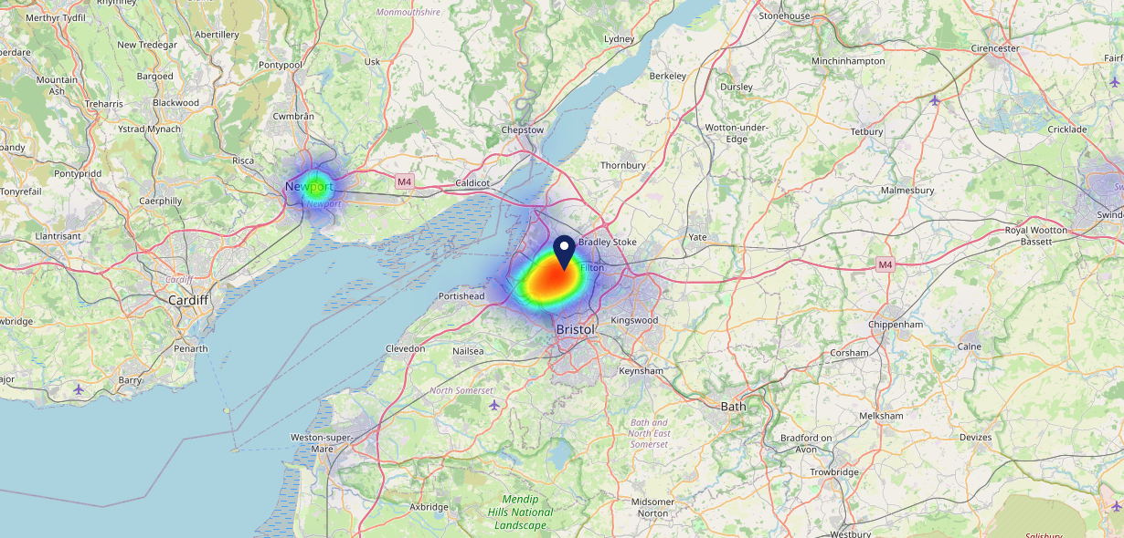
Site Intel
Old Crow BS107DW
16/04/2025 - 08/04/2026
Map of Guest Origin
Where do customers of Old Crow BS107DW come from?
Where do customers of Old Crow BS107DW for 16/04/2025 - 08/04/2026 live
152 Site Customers

Slide 12
Site Intel
Old Crow BS107DW
1 Miles
371 Chains
16/04/2025 - 08/04/2026
Share of Wallet
What are the Top 20 venues (by spend) that customers of Old Crow BS107DW also visit?
For customers of Old Crow BS107DW, who are the top 20 competitors from 371 Chains in 1 Miles for 16/04/2025 - 08/04/2026 split by Venue
423 Site Customers

Slide 13
Site Intel
Old Crow BS107DW
1 Miles
371 Chains
16/04/2025 - 08/04/2026
Share of Wallet Change
How has share of wallet of customers of Old Crow BS107DW changed between two date ranges?
423 Site Customers

Slide 14
Site Intel
Old Crow BS107DW
16/04/2025 - 08/04/2026
Market Summary
How does the local area for Old Crow BS107DW compare to the national average (1 = low, 10 = high)
Data Type | Name | Spend in 250m | 250m Spend vs National | Spend in 500m | 500m Spend vs National | Spend in 1 mile | 1 mile Spend vs National | Spend in 3 miles | 3 mile Spend vs National
Total | Annual Sales | £1.75M | 5 | £1.75M | 4 | £11.30M | 5 | £232.60M | 8
Weekpart | Mon - Thu | 51.9% | 10 | 51.9% | 10 | 41.3% | 6 | 44.8% | 9
Weekpart | Fri - Sat | 39.0% | 3 | 39.0% | 3 | 40.3% | 3 | 41.2% | 4
Weekpart | Sun | 9.2% | 2 | 9.2% | 1 | 18.4% | 9 | 14.0% | 2
Age | 18 to 24 | 10.0% | 8 | 10.0% | 8 | 5.6% | 4 | 4.8% | 3
Age | 25 to 34 | 12.7% | 2 | 12.7% | 2 | 14.6% | 2 | 17.0% | 2
Age | 35 to 44 | 18.2% | 2 | 18.2% | 2 | 21.5% | 4 | 24.6% | 7
Age | 45 to 54 | 28.3% | 10 | 28.3% | 10 | 22.9% | 9 | 20.9% | 7
Age | 55 to 64 | 14.0% | 5 | 14.0% | 4 | 17.7% | 8 | 17.9% | 8
Age | 65 to 74 | 6.5% | 6 | 6.5% | 5 | 10.9% | 9 | 9.6% | 8
Age | 75+ | 10.2% | 10 | 10.2% | 10 | 6.9% | 10 | 5.1% | 9
CAMEO | Business Elite | 0.7% | 1 | 0.7% | 1 | 3.0% | 2 | 7.9% | 6
CAMEO | Prosperous Professionals | 1.4% | 1 | 1.4% | 1 | 3.9% | 3 | 8.5% | 8
CAMEO | Flourishing Society | 3.6% | 1 | 3.6% | 1 | 8.4% | 3 | 13.5% | 6
CAMEO | Content Communities | 4.2% | 1 | 4.2% | 1 | 7.0% | 1 | 10.0% | 2
CAMEO | White Collar Neighbourhoods | 8.2% | 3 | 8.2% | 3 | 8.0% | 2 | 11.6% | 5
CAMEO | Enterprising Mainstream | 6.5% | 4 | 6.5% | 4 | 8.9% | 6 | 9.0% | 6
CAMEO | Paying The Mortgage | 13.2% | 5 | 13.2% | 5 | 17.6% | 8 | 17.5% | 8
CAMEO | Cash Conscious Communities | 8.0% | 5 | 8.0% | 5 | 9.9% | 6 | 7.6% | 4
CAMEO | On A Budget | 19.2% | 10 | 19.2% | 10 | 10.6% | 9 | 7.2% | 6
CAMEO | Family Value | 35.0% | 10 | 35.0% | 10 | 22.6% | 10 | 7.2% | 8
Affluence | AB | 5.7% | 1 | 5.7% | 1 | 15.3% | 2 | 29.8% | 6
Affluence | C1C2 | 32.1% | 1 | 32.1% | 1 | 41.5% | 3 | 48.1% | 5
Affluence | DE | 62.2% | 10 | 62.2% | 10 | 43.2% | 10 | 22.1% | 6

