Slide 1











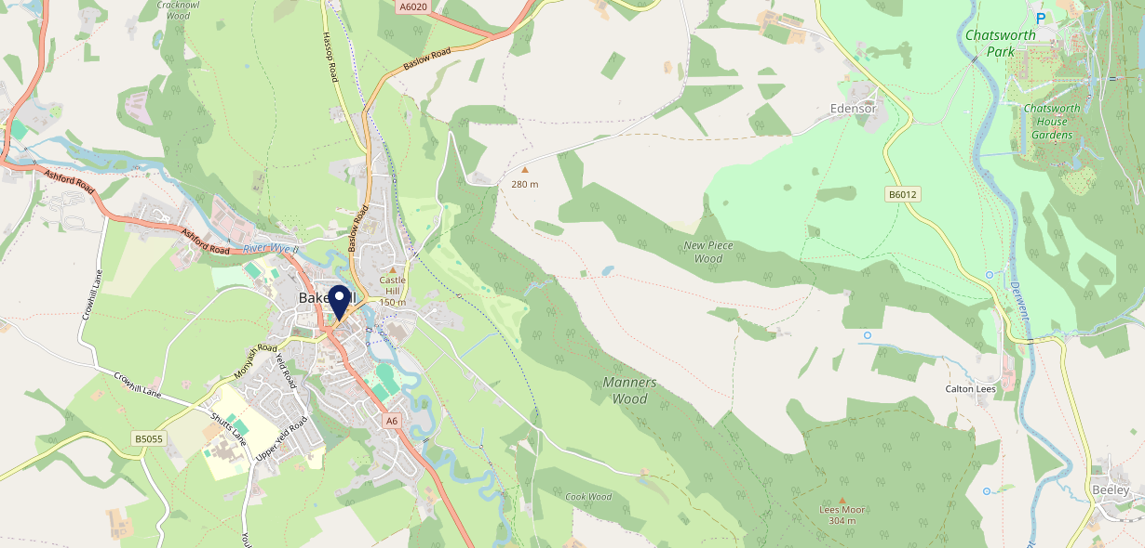











Site Intel
Red Lion Bakewell DE451BT
1 Miles
338 Chains
29/01/2025 - 21/01/2026
Site Summary
Red Lion Bakewell DE451BT
Work Area
Region
TV Region
Urbanicity
Chesterfield
East Midlands
Central
Rural town and fringe
DE451BT
Punch - Fireside Inns
Top Competitors
ATV
Gender
Rutland Arms Hotel
#1
£17.51
62.14%
Male
DE451BT
Coaching Inn Group
Affluence
Segmentation
Taproom
#2
56.12%
17.41%
Middle Income
Content Communities
DE451GZ
Restaurant
Age Group
Visit Day
Castle (Bakewell)
#3
28.25%
28.88%
DE451DU
55 to 64
Sat
GK Community Food
Nearest Station
Grindleford(10.72 miles)
4783 Site Customers
64 Competitors
83265 Competitor Customers

Slide 2

Site Intel
Red Lion Bakewell DE451BT
1 Miles
338 Chains
29/01/2025 - 21/01/2026
Spend by Weekpart
How is customer spend distributed throughout the week for Red Lion Bakewell DE451BT versus its competitors?
% of spend for Red Lion Bakewell DE451BT and 338 Chains in 1 Miles from 29/01/2025 - 21/01/2026 split by Day of Week
4783 Site Customers
64 Competitors
83265 Competitor Customers

Slide 3
Site Intel
Red Lion Bakewell DE451BT
1 Miles
338 Chains
29/01/2025 - 21/01/2026
Visit Frequency
How frequently per year do customers visit Red Lion Bakewell DE451BT versus its competitors?
% of customer numbers for Red Lion Bakewell DE451BT and 338 Chains in 1 Miles from 29/01/2025 - 21/01/2026 and the number of visits made Per Annum
4783 Site Customers
64 Competitors
83265 Competitor Customers

Slide 4
Site Intel
Red Lion Bakewell DE451BT
1 Miles
338 Chains
29/01/2025 - 21/01/2026
ATV Change
How has ATV changed between two date ranges?
4783 Site Customers

Slide 5
Site Intel
Red Lion Bakewell DE451BT
1 Miles
338 Chains
29/01/2025 - 21/01/2026
Market Share Change
How has market share changed between two date ranges?
% of market share spend for Red Lion Bakewell DE451BT and 338 Chains in 1 Miles from 29/01/2025 - 21/01/2026
4783 Site Customers

Slide 6
Site Intel
Red Lion Bakewell DE451BT
1 Miles
338 Chains
29/01/2025 - 21/01/2026
Age
How does the age profile of customers who visit Red Lion Bakewell DE451BT compare versus its competitors?
% of spend for Red Lion Bakewell DE451BT and 338 Chains in 1 Miles from 29/01/2025 - 21/01/2026 split by Age Range
2285 Site Customers
64 Competitors
39305 Competitor Customers

Slide 7
Site Intel
Red Lion Bakewell DE451BT
1 Miles
338 Chains
29/01/2025 - 21/01/2026
Affluence
How does the affluence of customers who visit Red Lion Bakewell DE451BT compare versus its competitors?
% of spend for Red Lion Bakewell DE451BT and 338 Chains in 1 Miles from 29/01/2025 - 21/01/2026 split by Affluence
2142 Site Customers
64 Competitors
36738 Competitor Customers

Slide 8
Site Intel
Red Lion Bakewell DE451BT
1 Miles
338 Chains
29/01/2025 - 21/01/2026
Gender
How does the gender profile of customers who visit Red Lion Bakewell DE451BT compare versus its competitors?
% of spend for Red Lion Bakewell DE451BT and 338 Chains in 1 Miles from 29/01/2025 - 21/01/2026 split by Gender
2224 Site Customers
64 Competitors
38257 Competitor Customers

Slide 9
Site Intel
Red Lion Bakewell DE451BT
1 Miles
338 Chains
29/01/2025 - 21/01/2026
Punch Segmentation
How does the Custom segmentation profile of customers who visit Red Lion Bakewell DE451BT compare versus its competitors?
% of spend for Red Lion Bakewell DE451BT and 338 Chains in 1 Miles from 29/01/2025 - 21/01/2026 split by Segment
4783 Site Customers
64 Competitors
83265 Competitor Customers

Slide 10
Site Intel
Red Lion Bakewell DE451BT
1 Miles
338 Chains
29/01/2025 - 21/01/2026
Spend by Distance
How does the spend profile of Red Lion Bakewell DE451BT compare versus its competitors based on travel distances?
% of spend for Red Lion Bakewell DE451BT and 338 Chains in 1 Miles from 29/01/2025 - 21/01/2026 split by Distance travelled
2221 Site Customers
64 Competitors
38203 Competitor Customers

Slide 11
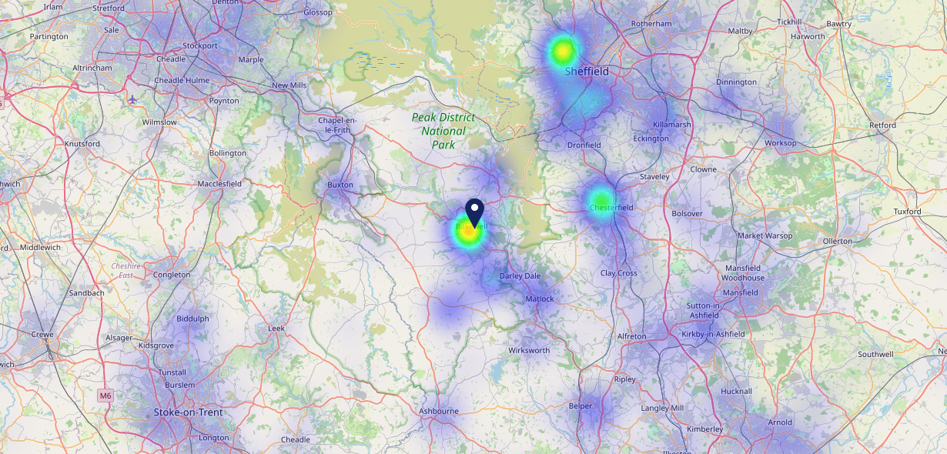

Site Intel
Red Lion Bakewell DE451BT
29/01/2025 - 21/01/2026
Map of Guest Origin
Where do customers of Red Lion Bakewell DE451BT come from?
Where do customers of Red Lion Bakewell DE451BT for 29/01/2025 - 21/01/2026 live
2221 Site Customers

Slide 12
Site Intel
Red Lion Bakewell DE451BT
1 Miles
338 Chains
29/01/2025 - 21/01/2026
Share of Wallet
What are the Top 20 venues (by spend) that customers of Red Lion Bakewell DE451BT also visit?
For customers of Red Lion Bakewell DE451BT, who are the top 20 competitors from 338 Chains in 1 Miles for 29/01/2025 - 21/01/2026 split by Venue
4783 Site Customers

Slide 13
Site Intel
Red Lion Bakewell DE451BT
1 Miles
338 Chains
29/01/2025 - 21/01/2026
Share of Wallet Change
How has share of wallet of customers of Red Lion Bakewell DE451BT changed between two date ranges?
4783 Site Customers

Slide 14
Site Intel
Red Lion Bakewell DE451BT
29/01/2025 - 21/01/2026
Market Summary
How does the local area for Red Lion Bakewell DE451BT compare to the national average (1 = low, 10 = high)
Data Type | Name | Spend in 250m | 250m Spend vs National | Spend in 500m | 500m Spend vs National | Spend in 1 mile | 1 mile Spend vs National | Spend in 3 miles | 3 mile Spend vs National
Total | Annual Sales | £22.72M | 10 | £25.25M | 9 | £29.39M | 7 | £59.02M | 5
Weekpart | Mon - Thu | 42.2% | 6 | 42.2% | 7 | 41.6% | 6 | 42.6% | 7
Weekpart | Fri - Sat | 41.5% | 4 | 41.2% | 4 | 42.0% | 5 | 39.5% | 2
Weekpart | Sun | 16.4% | 7 | 16.7% | 8 | 16.3% | 7 | 17.9% | 10
Age | 18 to 24 | 3.2% | 3 | 3.2% | 3 | 3.3% | 2 | 2.7% | 1
Age | 25 to 34 | 11.1% | 1 | 11.0% | 1 | 11.8% | 1 | 10.4% | 1
Age | 35 to 44 | 16.8% | 2 | 16.8% | 1 | 17.4% | 1 | 16.2% | 1
Age | 45 to 54 | 20.5% | 6 | 20.2% | 5 | 20.0% | 5 | 17.9% | 2
Age | 55 to 64 | 25.7% | 10 | 25.6% | 10 | 25.5% | 10 | 26.3% | 10
Age | 65 to 74 | 14.9% | 10 | 14.9% | 10 | 14.3% | 10 | 16.5% | 10
Age | 75+ | 7.9% | 10 | 8.3% | 10 | 7.7% | 10 | 9.8% | 10
CAMEO | Business Elite | 8.0% | 6 | 7.9% | 6 | 7.9% | 6 | 8.8% | 6
CAMEO | Prosperous Professionals | 9.3% | 8 | 9.7% | 9 | 9.8% | 9 | 9.9% | 9
CAMEO | Flourishing Society | 15.6% | 7 | 15.5% | 7 | 15.8% | 7 | 16.6% | 7
CAMEO | Content Communities | 15.1% | 8 | 15.2% | 8 | 15.2% | 8 | 16.6% | 9
CAMEO | White Collar Neighbourhoods | 8.5% | 3 | 8.5% | 3 | 8.8% | 3 | 8.3% | 2
CAMEO | Enterprising Mainstream | 11.3% | 8 | 11.2% | 8 | 11.1% | 8 | 11.0% | 8
CAMEO | Paying The Mortgage | 14.0% | 5 | 14.1% | 5 | 13.9% | 5 | 13.5% | 5
CAMEO | Cash Conscious Communities | 10.0% | 6 | 9.9% | 6 | 10.0% | 6 | 9.0% | 5
CAMEO | On A Budget | 4.0% | 3 | 3.9% | 3 | 3.8% | 2 | 3.3% | 1
CAMEO | Family Value | 4.2% | 7 | 4.1% | 7 | 3.8% | 6 | 3.0% | 6
Affluence | AB | 33.0% | 7 | 33.2% | 7 | 33.4% | 7 | 35.3% | 7
Affluence | C1C2 | 48.8% | 6 | 49.0% | 6 | 49.1% | 6 | 49.4% | 6
Affluence | DE | 18.1% | 5 | 17.9% | 5 | 17.5% | 4 | 15.2% | 3

Slide 15

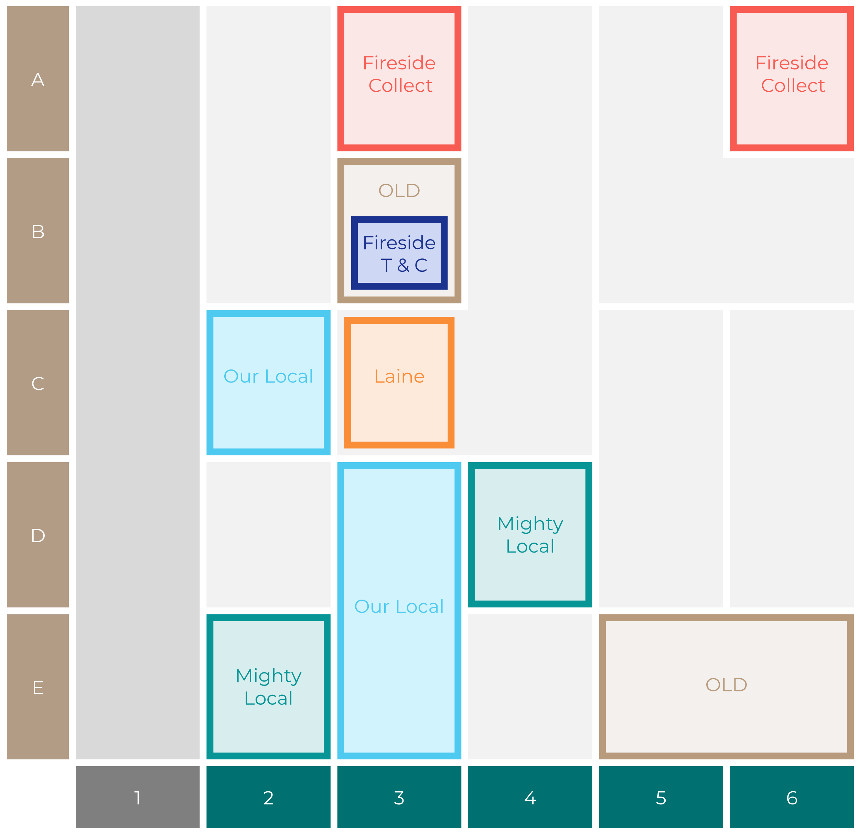

Site Intel
Red Lion Bakewell DE451BT
Site Potential 1
Site Characteristics
£3000
£18000
OCC Concept Fit
Achievable Average Weekly Takings
Our Local Destination
£7500
A Food-Led High Affluence B Food-Led Mid Affluence C Wet-Led Mid/High Affluence D Wet-Led Low Affluence E Food-Led Low Affluence
AWT 2 Local Regulars 3 Local Passing Trade 4 Destination Wet-Led 5 Destination Food-Led 6 Destination Very Food-Led
A
B
C
D
E
1
2
3
4
5
6

Slide 16
Site Intel
Red Lion Bakewell DE451BT
Site Potential 2
Concept Recommendation

Slide 17
Site Intel
Red Lion Bakewell DE451BT
Local Market Profile
Mix of spend by customer segment in Punch site and local market
 | Customer Count | Family Familiar | Occasional & Local | Mid-Week Seniors | Part Of The Pub | Metro Sophisticates | Young & Connected | Bubbly Weekenders | Upmarket Diners
Red Lion Bakewell | 955 | 13.53% | 2.69% | 30.55% | 5.73% | 10.47% | 12.74% | 7.85% | 16.40%
Local Catchment | 8742 | 10.44% | 4.08% | 29.18% | 2.93% | 10.47% | 10.01% | 8.29% | 24.55%
Punch T&L | 97337 | 8.90% | 6.10% | 28.77% | 11.00% | 11.27% | 10.99% | 7.17% | 15.76%
Red Lion Bakewell vs Local Catchment |  | 3.09% | -1.39% | 1.37% | 2.80% | 0.00% | 2.73% | -0.44% | -8.15%
Red Lion Bakewell vs Punch T&L |  | 4.63% | -3.41% | 1.78% | -5.27% | -0.80% | 1.75% | 0.68% | 0.64%
Local Catchment vs Punch T&L |  | 1.54% | -2.02% | 0.41% | -8.07% | -0.80% | -0.98% | 1.12% | 8.79%

Slide 18
Site Intel
Red Lion Bakewell DE451BT
Local Competitor Profiles
Mix of spend by customer segment in Punch site and local competitors
 | Customer Count | Family Familiar | Occasional & Local | Mid-Week Seniors | Part Of The Pub | Metro Sophisticates | Young & Connected | Bubbly Weekenders | Upmarket Diners
Red Lion Bakewell DE451BT | 955 | 13.53% | 2.69% | 30.55% | 5.73% | 10.47% | 12.74% | 7.85% | 16.40%
Rutland Arms Hotel DE451BT | 849 | 5.58% | 3.64% | 35.47% | 2.49% | 10.82% | 7.00% | 4.59% | 30.37%
Taproom DE451GZ | 1466 | 6.04% | 2.47% | 29.24% | 3.88% | 14.78% | 13.02% | 10.78% | 19.76%
Castle (Bakewell) DE451DU | 579 | 12.98% | 11.06% | 36.08% | 5.93% | 5.70% | 10.49% | 6.76% | 10.96%
Rajas DE451DS | 153 | 3.53% | 1.33% | 26.66% | 1.63% | 19.64% | 6.94% | 6.04% | 34.20%
The Manners DE451EP | 223 | 7.98% | 3.37% | 33.01% | 5.47% | 14.81% | 10.81% | 10.39% | 14.12%
Old Original Bakew DE451BT | 2125 | 13.43% | 2.98% | 21.67% | 2.43% | 9.75% | 12.53% | 10.44% | 26.73%
Riverside Fish And Chi DE451EW | 762 | 23.73% | 3.29% | 22.82% | 4.12% | 5.88% | 13.14% | 10.99% | 15.99%
Bakewell Fish & Chips DE451EW | 615 | 19.92% | 3.95% | 25.98% | 4.02% | 5.16% | 11.41% | 6.98% | 22.54%
Lovage DE451DS | 84 | 0.71% | 3.21% | 26.79% | 0.26% | 14.79% | 3.41% | 3.17% | 47.62%
Bloomers Of Bakewell DE451EU | 1021 | 18.77% | 5.08% | 21.64% | 3.73% | 6.87% | 13.02% | 11.17% | 19.69%
Catch 32 DE451EE | 74 | 22.44% | 0.69% | 16.90% | 4.91% | 15.68% | 7.85% | 7.32% | 24.17%
Cornish Bakery Bakewell DE451EW | 803 | 10.70% | 2.46% | 23.13% | 1.84% | 7.18% | 9.11% | 11.48% | 34.05%
Lime Lounge Coffee House DE451DS | 303 | 9.24% | 4.79% | 30.79% | 0.88% | 5.25% | 9.25% | 7.45% | 32.33%
Piedaniel S Restaurant DE451BX | 40 | 4.22% | 0.00% | 37.38% | 0.00% | 22.01% | 1.45% | 1.82% | 33.09%
Gallery Cafe DE451ES | 265 | 7.22% | 14.27% | 26.56% | 2.02% | 10.64% | 9.13% | 12.72% | 17.39%
Bakewell Tart Comp DE451EE | 674 | 19.56% | 5.02% | 22.21% | 1.59% | 9.37% | 10.75% | 11.09% | 20.37%
Graze DE451EE | 335 | 16.14% | 3.66% | 31.73% | 2.06% | 4.05% | 11.91% | 9.91% | 20.50%
Proper Pasty Company B DE451EU | 432 | 18.98% | 3.79% | 22.35% | 6.77% | 6.88% | 13.84% | 9.71% | 17.64%
Farmers Feast DE451AH | 160 | 29.34% | 12.97% | 28.44% | 2.19% | 2.30% | 4.80% | 4.57% | 15.35%
Granby Cafe DE451EG | 92 | 24.05% | 6.81% | 35.82% | 5.49% | 7.54% | 6.09% | 4.86% | 9.30%
Chakra Lounge Bakewell DE451BZ | 198 | 4.60% | 3.60% | 34.19% | 0.56% | 10.14% | 10.93% | 12.95% | 23.00%
Tin Hut Cafe DE451GS | 54 | 10.35% | 0.89% | 34.60% | 0.56% | 3.37% | 18.50% | 1.71% | 29.98%
Secret Garden Cafe Bis DE451EW | 239 | 14.18% | 4.90% | 28.65% | 2.66% | 9.19% | 7.73% | 12.10% | 20.54%
Pheasant Bar And K DE451GB | 7 | 0.00% | 0.00% | 92.75% | 0.00% | 0.00% | 0.00% | 4.96% | 2.28%

