Slide 1
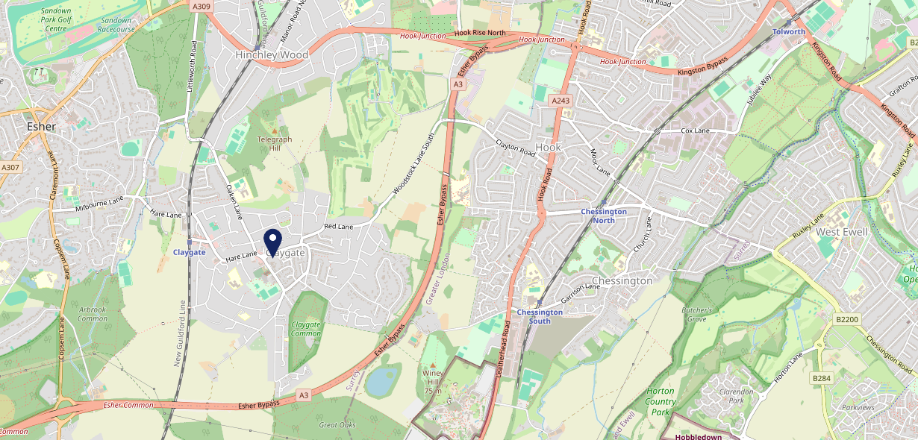
Site Intel
Hare & Hounds KT100JL
1 Miles
371 Chains
16/04/2025 - 08/04/2026
Site Summary
Hare & Hounds KT100JL
Work Area
Region
TV Region
Urbanicity
Slough and Heathrow
South East
London
Urban major conurbation
KT100JL
Laine Pub Company
Top Competitors
ATV
Gender
Foley
#1
£14.68
64.64%
Male
KT100LZ
Youngs Managed
Affluence
Segmentation
Griffin
#2
68.81%
38.74%
High Income
Flourishing Society
KT100HW
Pub / Bar
Age Group
Visit Day
Jose Pizarro The Swan
#3
27.18%
22.99%
KT109BS
55 to 64
Sat
Pub / Bar
Nearest Station
Claygate(0.65 miles)
1373 Site Customers
35 Competitors
8415 Competitor Customers

Slide 2
Site Intel
Hare & Hounds KT100JL
1 Miles
371 Chains
16/04/2025 - 08/04/2026
Spend by Weekpart
How is customer spend distributed throughout the week for Hare & Hounds KT100JL versus its competitors?
% of spend for Hare & Hounds KT100JL and 371 Chains in 1 Miles from 16/04/2025 - 08/04/2026 split by Day of Week
1373 Site Customers
35 Competitors
8415 Competitor Customers

Slide 3
Site Intel
Hare & Hounds KT100JL
1 Miles
371 Chains
16/04/2025 - 08/04/2026
Visit Frequency
How frequently per year do customers visit Hare & Hounds KT100JL versus its competitors?
% of customer numbers for Hare & Hounds KT100JL and 371 Chains in 1 Miles from 16/04/2025 - 08/04/2026 and the number of visits made Per Annum
1373 Site Customers
35 Competitors
8415 Competitor Customers

Slide 4
Site Intel
Hare & Hounds KT100JL
1 Miles
371 Chains
16/04/2025 - 08/04/2026
ATV Change
How has ATV changed between two date ranges?
1373 Site Customers

Slide 5
Site Intel
Hare & Hounds KT100JL
1 Miles
371 Chains
16/04/2025 - 08/04/2026
Market Share Change
How has market share changed between two date ranges?
% of market share spend for Hare & Hounds KT100JL and 371 Chains in 1 Miles from 16/04/2025 - 08/04/2026
1373 Site Customers

Slide 6
Site Intel
Hare & Hounds KT100JL
1 Miles
371 Chains
16/04/2025 - 08/04/2026
Age
How does the age profile of customers who visit Hare & Hounds KT100JL compare versus its competitors?
% of spend for Hare & Hounds KT100JL and 371 Chains in 1 Miles from 16/04/2025 - 08/04/2026 split by Age Range
669 Site Customers
35 Competitors
4282 Competitor Customers

Slide 7
Site Intel
Hare & Hounds KT100JL
1 Miles
371 Chains
16/04/2025 - 08/04/2026
Affluence
How does the affluence of customers who visit Hare & Hounds KT100JL compare versus its competitors?
% of spend for Hare & Hounds KT100JL and 371 Chains in 1 Miles from 16/04/2025 - 08/04/2026 split by Affluence
642 Site Customers
35 Competitors
4054 Competitor Customers

Slide 8
Site Intel
Hare & Hounds KT100JL
1 Miles
371 Chains
16/04/2025 - 08/04/2026
Gender
How does the gender profile of customers who visit Hare & Hounds KT100JL compare versus its competitors?
% of spend for Hare & Hounds KT100JL and 371 Chains in 1 Miles from 16/04/2025 - 08/04/2026 split by Gender
653 Site Customers
35 Competitors
4169 Competitor Customers

Slide 9
Site Intel
Hare & Hounds KT100JL
1 Miles
371 Chains
16/04/2025 - 08/04/2026
Punch Segmentation
How does the Custom segmentation profile of customers who visit Hare & Hounds KT100JL compare versus its competitors?
% of spend for Hare & Hounds KT100JL and 371 Chains in 1 Miles from 16/04/2025 - 08/04/2026 split by Segment
1373 Site Customers
35 Competitors
8415 Competitor Customers

Slide 10
Site Intel
Hare & Hounds KT100JL
1 Miles
371 Chains
16/04/2025 - 08/04/2026
Spend by Distance
How does the spend profile of Hare & Hounds KT100JL compare versus its competitors based on travel distances?
% of spend for Hare & Hounds KT100JL and 371 Chains in 1 Miles from 16/04/2025 - 08/04/2026 split by Distance travelled
653 Site Customers
35 Competitors
4161 Competitor Customers

Slide 11
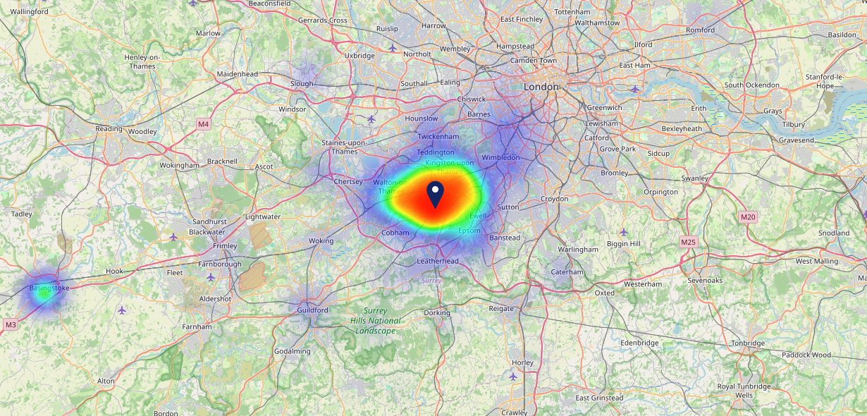
Site Intel
Hare & Hounds KT100JL
16/04/2025 - 08/04/2026
Map of Guest Origin
Where do customers of Hare & Hounds KT100JL come from?
Where do customers of Hare & Hounds KT100JL for 16/04/2025 - 08/04/2026 live
653 Site Customers

Slide 12
Site Intel
Hare & Hounds KT100JL
1 Miles
371 Chains
16/04/2025 - 08/04/2026
Share of Wallet
What are the Top 20 venues (by spend) that customers of Hare & Hounds KT100JL also visit?
For customers of Hare & Hounds KT100JL, who are the top 20 competitors from 371 Chains in 1 Miles for 16/04/2025 - 08/04/2026 split by Venue
1373 Site Customers

Slide 13
Site Intel
Hare & Hounds KT100JL
1 Miles
371 Chains
16/04/2025 - 08/04/2026
Share of Wallet Change
How has share of wallet of customers of Hare & Hounds KT100JL changed between two date ranges?
1373 Site Customers

Slide 14
Site Intel
Hare & Hounds KT100JL
16/04/2025 - 08/04/2026
Market Summary
How does the local area for Hare & Hounds KT100JL compare to the national average (1 = low, 10 = high)
Data Type | Name | Spend in 250m | 250m Spend vs National | Spend in 500m | 500m Spend vs National | Spend in 1 mile | 1 mile Spend vs National | Spend in 3 miles | 3 mile Spend vs National
Total | Annual Sales | £1.97M | 6 | £4.41M | 6 | £8.11M | 4 | £119.65M | 7
Weekpart | Mon - Thu | 39.1% | 5 | 39.4% | 5 | 41.5% | 6 | 41.6% | 5
Weekpart | Fri - Sat | 41.4% | 4 | 40.7% | 3 | 39.8% | 3 | 42.5% | 6
Weekpart | Sun | 19.5% | 9 | 19.9% | 9 | 18.7% | 9 | 15.9% | 6
Age | 18 to 24 | 1.0% | 1 | 1.1% | 1 | 0.8% | 1 | 2.3% | 1
Age | 25 to 34 | 4.2% | 1 | 4.5% | 1 | 5.7% | 1 | 10.3% | 1
Age | 35 to 44 | 22.1% | 5 | 19.2% | 3 | 18.6% | 2 | 24.3% | 7
Age | 45 to 54 | 26.6% | 10 | 26.6% | 10 | 27.4% | 10 | 24.3% | 10
Age | 55 to 64 | 23.6% | 9 | 21.2% | 9 | 22.5% | 10 | 20.4% | 9
Age | 65 to 74 | 12.7% | 9 | 16.5% | 10 | 16.2% | 10 | 11.4% | 9
Age | 75+ | 9.7% | 10 | 10.9% | 10 | 8.8% | 10 | 6.8% | 10
CAMEO | Business Elite | 27.4% | 10 | 30.4% | 10 | 31.9% | 10 | 24.6% | 10
CAMEO | Prosperous Professionals | 11.1% | 9 | 9.0% | 8 | 7.8% | 7 | 8.0% | 8
CAMEO | Flourishing Society | 34.1% | 10 | 29.9% | 10 | 30.4% | 10 | 26.3% | 10
CAMEO | Content Communities | 9.6% | 3 | 10.1% | 3 | 10.3% | 3 | 10.6% | 3
CAMEO | White Collar Neighbourhoods | 5.8% | 1 | 8.3% | 3 | 8.4% | 2 | 11.4% | 5
CAMEO | Enterprising Mainstream | 1.2% | 1 | 2.1% | 1 | 1.8% | 1 | 3.3% | 1
CAMEO | Paying The Mortgage | 8.4% | 2 | 7.2% | 1 | 5.6% | 1 | 9.0% | 1
CAMEO | Cash Conscious Communities | 1.2% | 1 | 1.1% | 1 | 2.3% | 1 | 3.4% | 1
CAMEO | On A Budget | 1.2% | 1 | 1.8% | 1 | 1.3% | 1 | 3.0% | 1
CAMEO | Family Value | 0.0% | 1 | 0.1% | 1 | 0.2% | 1 | 0.5% | 1
Affluence | AB | 72.5% | 10 | 69.3% | 10 | 70.1% | 10 | 58.8% | 10
Affluence | C1C2 | 25.0% | 1 | 27.7% | 1 | 26.1% | 1 | 34.3% | 1
Affluence | DE | 2.5% | 1 | 3.0% | 1 | 3.8% | 1 | 6.9% | 1

