Slide 1











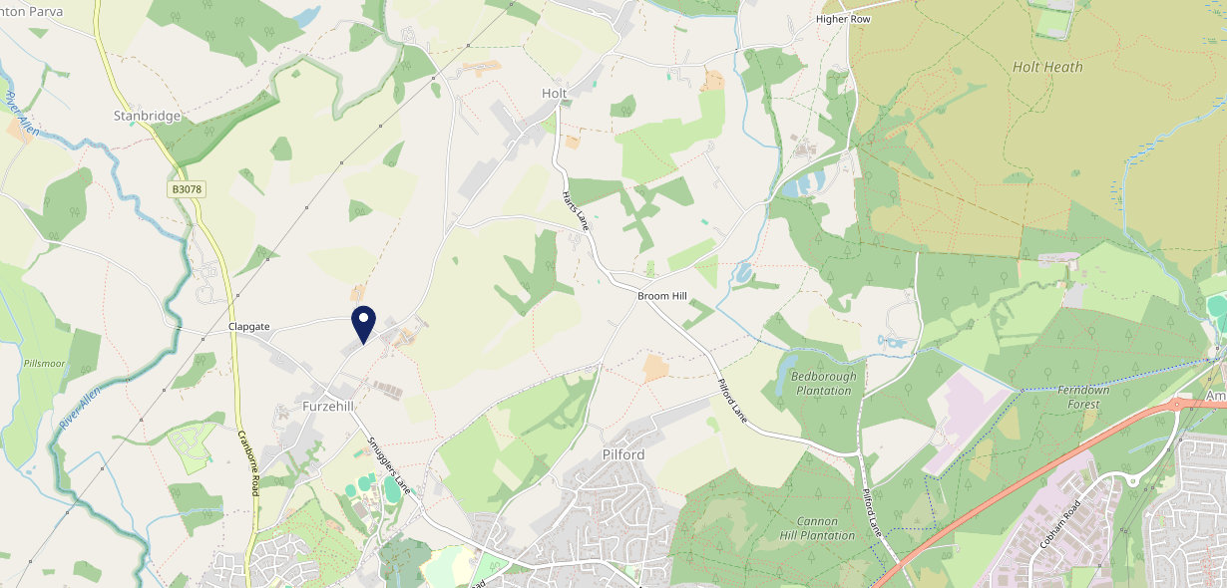











Site Intel
Stocks Inn BH214HT
1 Miles
338 Chains
29/01/2025 - 21/01/2026
Site Summary
Stocks Inn BH214HT
Work Area
Region
TV Region
Urbanicity
Poole
South West
South
Rural hamlet and isolated dwellings
BH214HT
Punch T&L
Top Competitors
ATV
Gender
The Barley Mow Inn
#1
£34.66
62.96%
Male
BH217AH
Hall & Woodhouse - L&T
Affluence
Segmentation
Aunt Fannys
#2
54.08%
26.26%
Middle Income
Content Communities
BH214HW
Restaurant
Age Group
Visit Day
The Horns Inn
#3
31.31%
25.32%
BH217AA
75+
Sun
Hall & Woodhouse - L&T
Nearest Station
Hamworthy(11.14 miles)
1125 Site Customers
3 Competitors
4075 Competitor Customers

Slide 2

Site Intel
Stocks Inn BH214HT
1 Miles
338 Chains
29/01/2025 - 21/01/2026
Spend by Weekpart
How is customer spend distributed throughout the week for Stocks Inn BH214HT versus its competitors?
% of spend for Stocks Inn BH214HT and 338 Chains in 1 Miles from 29/01/2025 - 21/01/2026 split by Day of Week
1125 Site Customers
3 Competitors
4075 Competitor Customers

Slide 3
Site Intel
Stocks Inn BH214HT
1 Miles
338 Chains
29/01/2025 - 21/01/2026
Visit Frequency
How frequently per year do customers visit Stocks Inn BH214HT versus its competitors?
% of customer numbers for Stocks Inn BH214HT and 338 Chains in 1 Miles from 29/01/2025 - 21/01/2026 and the number of visits made Per Annum
1125 Site Customers
3 Competitors
4075 Competitor Customers

Slide 4
Site Intel
Stocks Inn BH214HT
1 Miles
338 Chains
29/01/2025 - 21/01/2026
ATV Change
How has ATV changed between two date ranges?
1125 Site Customers

Slide 5
Site Intel
Stocks Inn BH214HT
1 Miles
338 Chains
29/01/2025 - 21/01/2026
Market Share Change
How has market share changed between two date ranges?
% of market share spend for Stocks Inn BH214HT and 338 Chains in 1 Miles from 29/01/2025 - 21/01/2026
1125 Site Customers

Slide 6
Site Intel
Stocks Inn BH214HT
1 Miles
338 Chains
29/01/2025 - 21/01/2026
Age
How does the age profile of customers who visit Stocks Inn BH214HT compare versus its competitors?
% of spend for Stocks Inn BH214HT and 338 Chains in 1 Miles from 29/01/2025 - 21/01/2026 split by Age Range
668 Site Customers
3 Competitors
2375 Competitor Customers

Slide 7
Site Intel
Stocks Inn BH214HT
1 Miles
338 Chains
29/01/2025 - 21/01/2026
Affluence
How does the affluence of customers who visit Stocks Inn BH214HT compare versus its competitors?
% of spend for Stocks Inn BH214HT and 338 Chains in 1 Miles from 29/01/2025 - 21/01/2026 split by Affluence
632 Site Customers
3 Competitors
2209 Competitor Customers

Slide 8
Site Intel
Stocks Inn BH214HT
1 Miles
338 Chains
29/01/2025 - 21/01/2026
Gender
How does the gender profile of customers who visit Stocks Inn BH214HT compare versus its competitors?
% of spend for Stocks Inn BH214HT and 338 Chains in 1 Miles from 29/01/2025 - 21/01/2026 split by Gender
649 Site Customers
3 Competitors
2302 Competitor Customers

Slide 9
Site Intel
Stocks Inn BH214HT
1 Miles
338 Chains
29/01/2025 - 21/01/2026
Punch Segmentation
How does the Custom segmentation profile of customers who visit Stocks Inn BH214HT compare versus its competitors?
% of spend for Stocks Inn BH214HT and 338 Chains in 1 Miles from 29/01/2025 - 21/01/2026 split by Segment
1125 Site Customers
3 Competitors
4075 Competitor Customers

Slide 10
Site Intel
Stocks Inn BH214HT
1 Miles
338 Chains
29/01/2025 - 21/01/2026
Spend by Distance
How does the spend profile of Stocks Inn BH214HT compare versus its competitors based on travel distances?
% of spend for Stocks Inn BH214HT and 338 Chains in 1 Miles from 29/01/2025 - 21/01/2026 split by Distance travelled
648 Site Customers
3 Competitors
2296 Competitor Customers

Slide 11
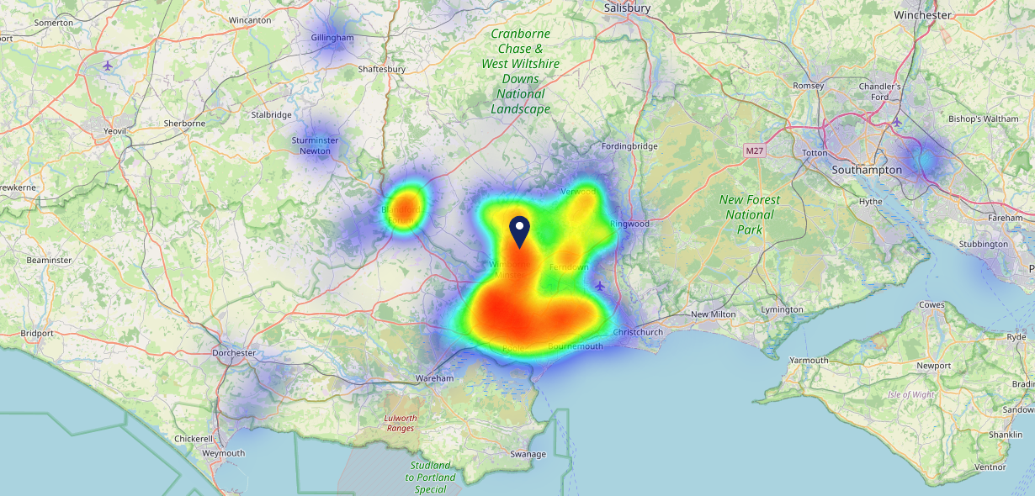

Site Intel
Stocks Inn BH214HT
29/01/2025 - 21/01/2026
Map of Guest Origin
Where do customers of Stocks Inn BH214HT come from?
Where do customers of Stocks Inn BH214HT for 29/01/2025 - 21/01/2026 live
648 Site Customers

Slide 12
Site Intel
Stocks Inn BH214HT
1 Miles
338 Chains
29/01/2025 - 21/01/2026
Share of Wallet
What are the Top 20 venues (by spend) that customers of Stocks Inn BH214HT also visit?
For customers of Stocks Inn BH214HT, who are the top 20 competitors from 338 Chains in 1 Miles for 29/01/2025 - 21/01/2026 split by Venue
1125 Site Customers

Slide 13
Site Intel
Stocks Inn BH214HT
1 Miles
338 Chains
29/01/2025 - 21/01/2026
Share of Wallet Change
How has share of wallet of customers of Stocks Inn BH214HT changed between two date ranges?
1125 Site Customers

Slide 14
Site Intel
Stocks Inn BH214HT
29/01/2025 - 21/01/2026
Market Summary
How does the local area for Stocks Inn BH214HT compare to the national average (1 = low, 10 = high)
Data Type | Name | Spend in 250m | 250m Spend vs National | Spend in 500m | 500m Spend vs National | Spend in 1 mile | 1 mile Spend vs National | Spend in 3 miles | 3 mile Spend vs National
Total | Annual Sales | £741K | 4 | £741K | 3 | £2.57M | 2 | £33.88M | 4
Weekpart | Mon - Thu | 37.3% | 4 | 37.3% | 3 | 39.7% | 4 | 40.1% | 3
Weekpart | Fri - Sat | 39.9% | 3 | 39.9% | 3 | 39.8% | 3 | 45.2% | 9
Weekpart | Sun | 22.8% | 10 | 22.8% | 10 | 20.5% | 10 | 14.6% | 3
Age | 18 to 24 | 1.0% | 1 | 1.0% | 1 | 1.5% | 1 | 3.5% | 1
Age | 25 to 34 | 3.5% | 1 | 3.5% | 1 | 5.8% | 1 | 10.7% | 1
Age | 35 to 44 | 8.4% | 1 | 8.4% | 1 | 15.4% | 1 | 18.1% | 1
Age | 45 to 54 | 13.7% | 1 | 13.7% | 1 | 14.8% | 1 | 18.7% | 3
Age | 55 to 64 | 16.0% | 6 | 16.0% | 6 | 20.4% | 9 | 21.8% | 10
Age | 65 to 74 | 21.8% | 10 | 21.8% | 10 | 24.3% | 10 | 16.3% | 10
Age | 75+ | 35.6% | 10 | 35.6% | 10 | 17.8% | 10 | 10.9% | 10
CAMEO | Business Elite | 5.7% | 5 | 5.7% | 5 | 7.0% | 5 | 7.3% | 5
CAMEO | Prosperous Professionals | 13.4% | 10 | 13.4% | 10 | 16.9% | 10 | 14.8% | 10
CAMEO | Flourishing Society | 23.1% | 9 | 23.1% | 9 | 17.0% | 8 | 17.2% | 8
CAMEO | Content Communities | 26.7% | 10 | 26.7% | 10 | 21.5% | 10 | 22.1% | 10
CAMEO | White Collar Neighbourhoods | 7.7% | 2 | 7.7% | 2 | 9.3% | 3 | 10.7% | 4
CAMEO | Enterprising Mainstream | 10.4% | 7 | 10.4% | 7 | 13.2% | 9 | 11.5% | 8
CAMEO | Paying The Mortgage | 6.9% | 1 | 6.9% | 1 | 7.8% | 1 | 8.2% | 1
CAMEO | Cash Conscious Communities | 3.8% | 2 | 3.8% | 1 | 4.2% | 1 | 4.6% | 1
CAMEO | On A Budget | 1.4% | 1 | 1.4% | 1 | 2.5% | 1 | 2.7% | 1
CAMEO | Family Value | 0.9% | 3 | 0.9% | 3 | 0.6% | 1 | 0.9% | 2
Affluence | AB | 42.1% | 8 | 42.1% | 8 | 40.9% | 8 | 39.2% | 8
Affluence | C1C2 | 51.7% | 7 | 51.7% | 7 | 51.7% | 7 | 52.5% | 7
Affluence | DE | 6.1% | 1 | 6.1% | 1 | 7.4% | 1 | 8.2% | 1

Slide 15

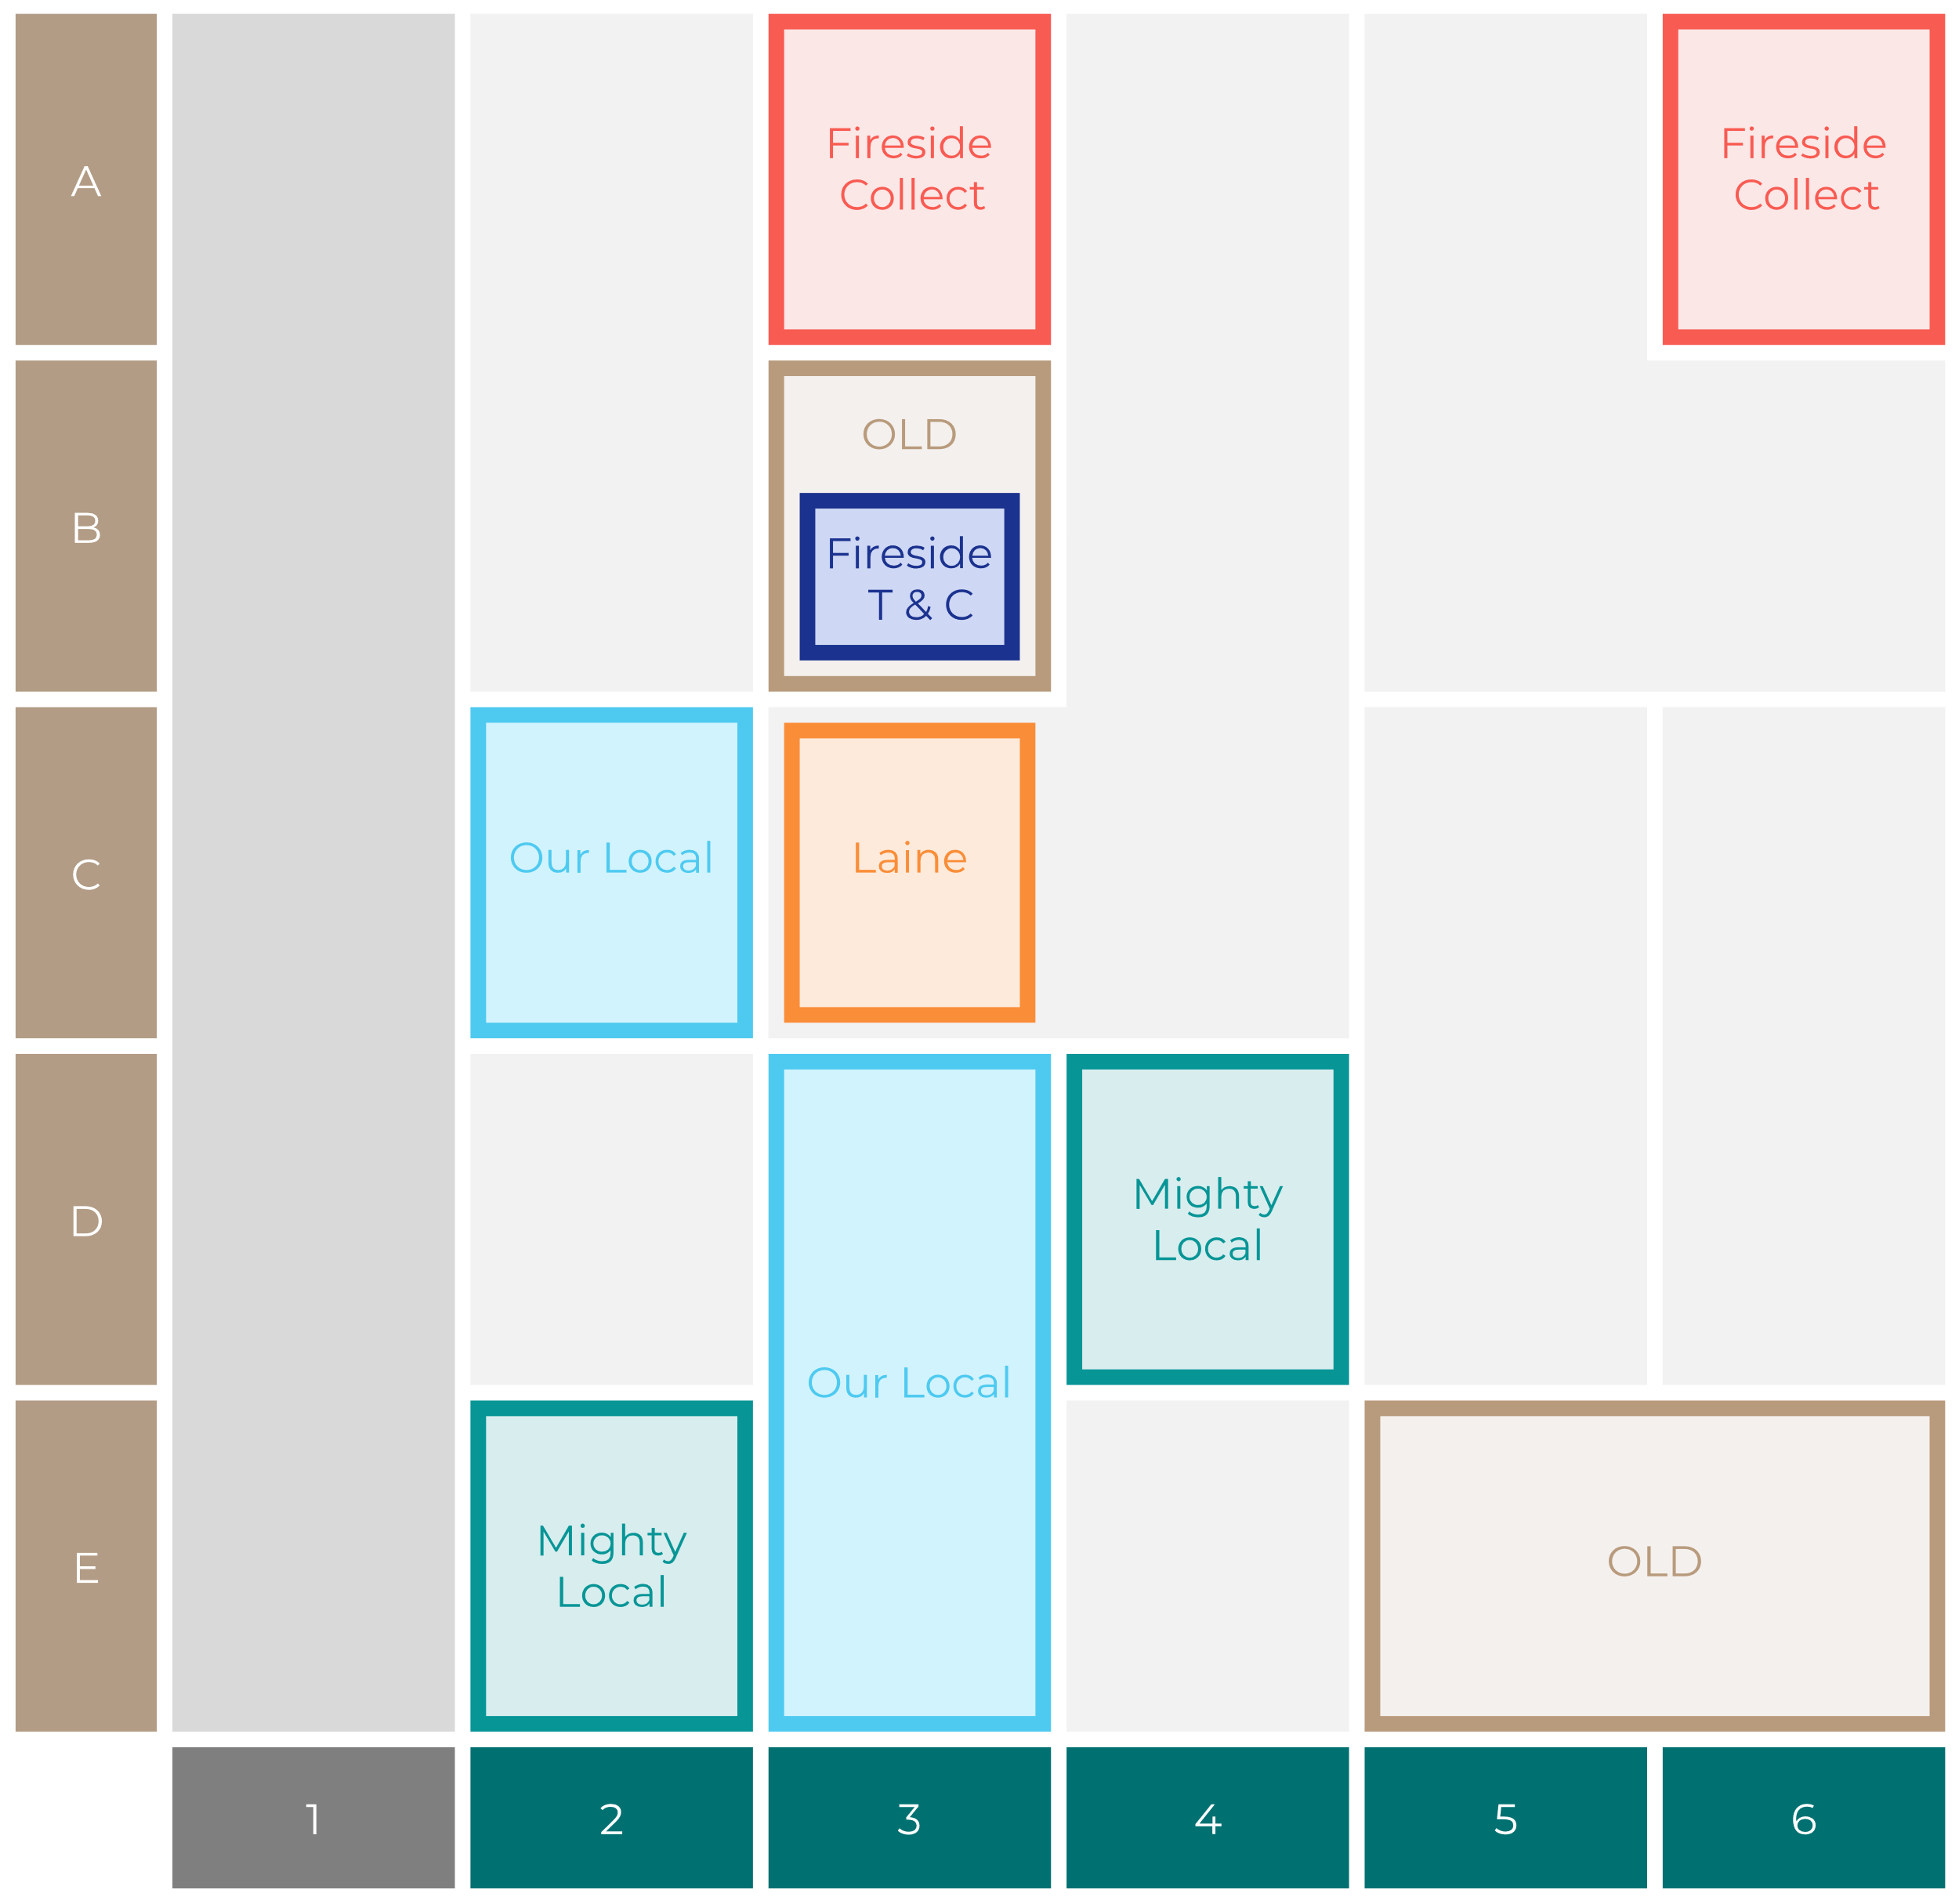

Site Intel
Stocks Inn BH214HT
Site Potential 1
Site Characteristics
£3000
£18000
OCC Concept Fit
Achievable Average Weekly Takings
Fireside Scenic
£6500
A Food-Led High Affluence B Food-Led Mid Affluence C Wet-Led Mid/High Affluence D Wet-Led Low Affluence E Food-Led Low Affluence
AWT 2 Local Regulars 3 Local Passing Trade 4 Destination Wet-Led 5 Destination Food-Led 6 Destination Very Food-Led
A
B
C
D
E
1
2
3
4
5
6

Slide 16
Site Intel
Stocks Inn BH214HT
Site Potential 2
Concept Recommendation

Slide 17
Site Intel
Stocks Inn BH214HT
Local Market Profile
Mix of spend by customer segment in Punch site and local market
 | Customer Count | Family Familiar | Occasional & Local | Mid-Week Seniors | Part Of The Pub | Metro Sophisticates | Young & Connected | Bubbly Weekenders | Upmarket Diners
Stocks Inn | 204 | 11.23% | 2.48% | 28.94% | 3.02% | 7.47% | 6.61% | 4.79% | 35.41%
Local Catchment | 581 | 10.36% | 1.31% | 40.88% | 1.81% | 2.97% | 9.47% | 7.49% | 25.66%
Punch T&L | 97363 | 8.87% | 6.07% | 28.72% | 10.99% | 11.36% | 10.95% | 7.17% | 15.82%
Stocks Inn vs Local Catchment |  | 0.87% | 1.17% | -11.94% | 1.21% | 4.50% | -2.86% | -2.70% | 9.75%
Stocks Inn vs Punch T&L |  | 2.36% | -3.59% | 0.22% | -7.97% | -3.89% | -4.34% | -2.38% | 19.59%
Local Catchment vs Punch T&L |  | 1.49% | -4.76% | 12.16% | -9.18% | -8.39% | -1.48% | 0.32% | 9.84%

Slide 18
Site Intel
Stocks Inn BH214HT
Local Competitor Profiles
Mix of spend by customer segment in Punch site and local competitors
 | Customer Count | Family Familiar | Occasional & Local | Mid-Week Seniors | Part Of The Pub | Metro Sophisticates | Young & Connected | Bubbly Weekenders | Upmarket Diners
Stocks Inn BH214HT | 204 | 11.23% | 2.48% | 28.94% | 3.02% | 7.47% | 6.61% | 4.79% | 35.41%
The Barley Mow Inn BH217AH | 114 | 6.34% | 0.87% | 58.39% | 0.73% | 3.51% | 5.15% | 3.56% | 21.41%
Aunt Fannys BH214HW | 381 | 12.71% | 2.13% | 30.54% | 1.52% | 2.36% | 12.17% | 10.13% | 28.40%
The Horns Inn BH217AA | 131 | 13.25% | 0.12% | 28.63% | 5.10% | 3.40% | 12.06% | 9.40% | 27.99%

