Slide 1











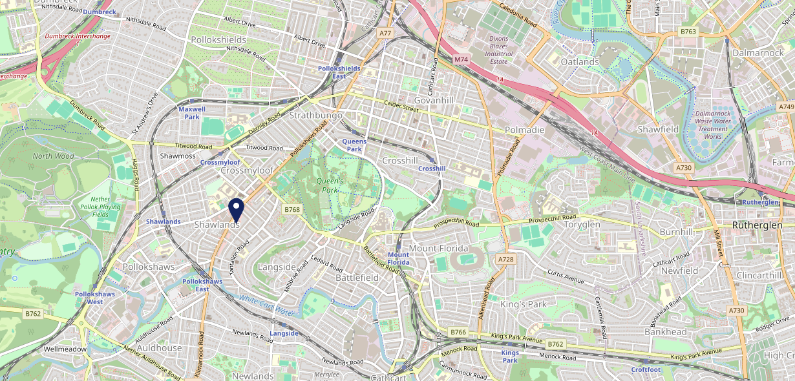











Site Intel
The James Tassie Glasgow G413YR
1 Miles
338 Chains
29/01/2025 - 21/01/2026
Site Summary
The James Tassie Glasgow G413YR
Work Area
Region
TV Region
Urbanicity
Glasgow
Scotland
Scotland
Large urban area
G413YR
Proper Pubs
Top Competitors
ATV
Gender
Quaich (Glasgow)
#1
£8.33
67.41%
Male
G431UF
GK Proper Locals
Affluence
Segmentation
The Granary
#2
42.04%
20.32%
Middle Income
Enterprising Mainstream
G413NH
M&B High Street
Age Group
Visit Day
Marlborough
#3
20.75%
35.38%
G412QS
65 to 74
Sat
Restaurant
Nearest Station
Pollokshaws East(0.50 miles)
1535 Site Customers
431 Competitors
202855 Competitor Customers

Slide 2

Site Intel
The James Tassie Glasgow G413YR
1 Miles
338 Chains
29/01/2025 - 21/01/2026
Spend by Weekpart
How is customer spend distributed throughout the week for The James Tassie Glasgow G413YR versus its competitors?
% of spend for The James Tassie Glasgow G413YR and 338 Chains in 1 Miles from 29/01/2025 - 21/01/2026 split by Day of Week
1535 Site Customers
431 Competitors
202855 Competitor Customers

Slide 3
Site Intel
The James Tassie Glasgow G413YR
1 Miles
338 Chains
29/01/2025 - 21/01/2026
Visit Frequency
How frequently per year do customers visit The James Tassie Glasgow G413YR versus its competitors?
% of customer numbers for The James Tassie Glasgow G413YR and 338 Chains in 1 Miles from 29/01/2025 - 21/01/2026 and the number of visits made Per Annum
1535 Site Customers
431 Competitors
202855 Competitor Customers

Slide 4
Site Intel
The James Tassie Glasgow G413YR
1 Miles
338 Chains
29/01/2025 - 21/01/2026
ATV Change
How has ATV changed between two date ranges?
1535 Site Customers

Slide 5
Site Intel
The James Tassie Glasgow G413YR
1 Miles
338 Chains
29/01/2025 - 21/01/2026
Market Share Change
How has market share changed between two date ranges?
% of market share spend for The James Tassie Glasgow G413YR and 338 Chains in 1 Miles from 29/01/2025 - 21/01/2026
1535 Site Customers

Slide 6
Site Intel
The James Tassie Glasgow G413YR
1 Miles
338 Chains
29/01/2025 - 21/01/2026
Age
How does the age profile of customers who visit The James Tassie Glasgow G413YR compare versus its competitors?
% of spend for The James Tassie Glasgow G413YR and 338 Chains in 1 Miles from 29/01/2025 - 21/01/2026 split by Age Range
596 Site Customers
431 Competitors
82846 Competitor Customers

Slide 7
Site Intel
The James Tassie Glasgow G413YR
1 Miles
338 Chains
29/01/2025 - 21/01/2026
Affluence
How does the affluence of customers who visit The James Tassie Glasgow G413YR compare versus its competitors?
% of spend for The James Tassie Glasgow G413YR and 338 Chains in 1 Miles from 29/01/2025 - 21/01/2026 split by Affluence
529 Site Customers
431 Competitors
75566 Competitor Customers

Slide 8
Site Intel
The James Tassie Glasgow G413YR
1 Miles
338 Chains
29/01/2025 - 21/01/2026
Gender
How does the gender profile of customers who visit The James Tassie Glasgow G413YR compare versus its competitors?
% of spend for The James Tassie Glasgow G413YR and 338 Chains in 1 Miles from 29/01/2025 - 21/01/2026 split by Gender
570 Site Customers
431 Competitors
80086 Competitor Customers

Slide 9
Site Intel
The James Tassie Glasgow G413YR
1 Miles
338 Chains
29/01/2025 - 21/01/2026
Punch Segmentation
How does the Custom segmentation profile of customers who visit The James Tassie Glasgow G413YR compare versus its competitors?
% of spend for The James Tassie Glasgow G413YR and 338 Chains in 1 Miles from 29/01/2025 - 21/01/2026 split by Segment
1535 Site Customers
431 Competitors
202855 Competitor Customers

Slide 10
Site Intel
The James Tassie Glasgow G413YR
1 Miles
338 Chains
29/01/2025 - 21/01/2026
Spend by Distance
How does the spend profile of The James Tassie Glasgow G413YR compare versus its competitors based on travel distances?
% of spend for The James Tassie Glasgow G413YR and 338 Chains in 1 Miles from 29/01/2025 - 21/01/2026 split by Distance travelled
569 Site Customers
431 Competitors
80055 Competitor Customers

Slide 11
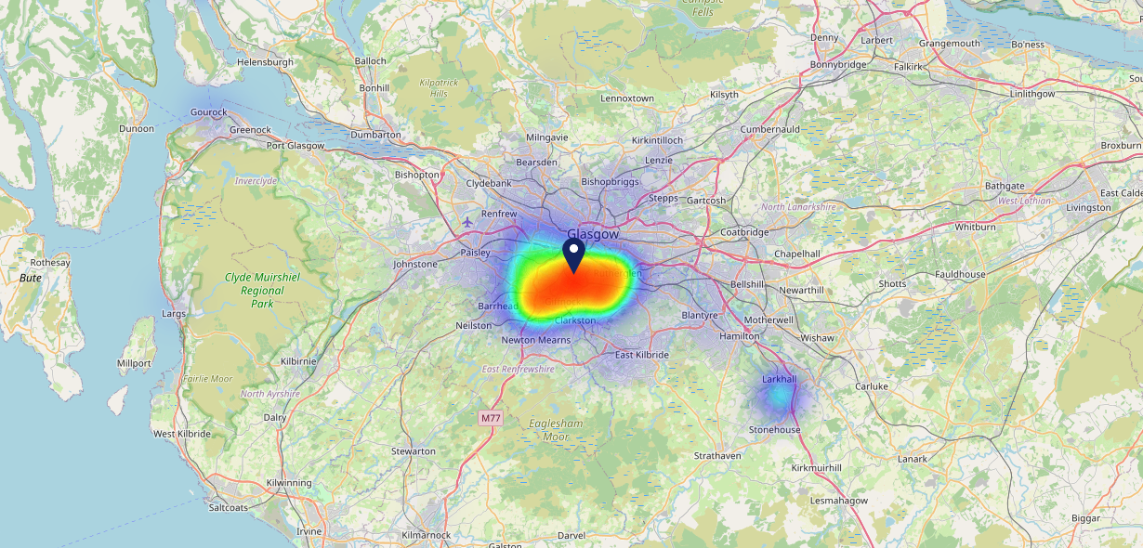

Site Intel
The James Tassie Glasgow G413YR
29/01/2025 - 21/01/2026
Map of Guest Origin
Where do customers of The James Tassie Glasgow G413YR come from?
Where do customers of The James Tassie Glasgow G413YR for 29/01/2025 - 21/01/2026 live
569 Site Customers

Slide 12
Site Intel
The James Tassie Glasgow G413YR
1 Miles
338 Chains
29/01/2025 - 21/01/2026
Share of Wallet
What are the Top 20 venues (by spend) that customers of The James Tassie Glasgow G413YR also visit?
For customers of The James Tassie Glasgow G413YR, who are the top 20 competitors from 338 Chains in 1 Miles for 29/01/2025 - 21/01/2026 split by Venue
1535 Site Customers

Slide 13
Site Intel
The James Tassie Glasgow G413YR
1 Miles
338 Chains
29/01/2025 - 21/01/2026
Share of Wallet Change
How has share of wallet of customers of The James Tassie Glasgow G413YR changed between two date ranges?
1535 Site Customers

Slide 14
Site Intel
The James Tassie Glasgow G413YR
29/01/2025 - 21/01/2026
Market Summary
How does the local area for The James Tassie Glasgow G413YR compare to the national average (1 = low, 10 = high)
Data Type | Name | Spend in 250m | 250m Spend vs National | Spend in 500m | 500m Spend vs National | Spend in 1 mile | 1 mile Spend vs National | Spend in 3 miles | 3 mile Spend vs National
Total | Annual Sales | £13.38M | 9 | £35.25M | 9 | £93.80M | 9 | £1.26B | 10
Weekpart | Mon - Thu | 36.0% | 3 | 34.6% | 2 | 36.7% | 2 | 38.4% | 1
Weekpart | Fri - Sat | 48.3% | 8 | 48.2% | 8 | 46.6% | 9 | 47.0% | 10
Weekpart | Sun | 15.7% | 7 | 17.2% | 8 | 16.7% | 8 | 14.6% | 3
Age | 18 to 24 | 9.0% | 8 | 9.8% | 8 | 7.6% | 6 | 9.0% | 7
Age | 25 to 34 | 25.4% | 7 | 28.1% | 8 | 25.0% | 7 | 20.0% | 4
Age | 35 to 44 | 20.8% | 4 | 21.1% | 4 | 22.1% | 4 | 23.1% | 5
Age | 45 to 54 | 18.0% | 3 | 16.6% | 2 | 16.5% | 2 | 20.1% | 5
Age | 55 to 64 | 16.7% | 6 | 15.1% | 5 | 17.0% | 7 | 18.1% | 8
Age | 65 to 74 | 8.0% | 7 | 7.8% | 7 | 8.7% | 8 | 7.6% | 7
Age | 75+ | 2.1% | 5 | 1.7% | 4 | 3.0% | 6 | 2.1% | 4
CAMEO | Business Elite | 25.7% | 10 | 27.6% | 10 | 25.8% | 10 | 16.1% | 9
CAMEO | Prosperous Professionals | 7.1% | 7 | 6.9% | 6 | 6.9% | 6 | 8.1% | 8
CAMEO | Flourishing Society | 24.4% | 10 | 23.5% | 9 | 23.3% | 9 | 24.1% | 10
CAMEO | Content Communities | 7.0% | 2 | 6.5% | 1 | 6.9% | 1 | 8.0% | 1
CAMEO | White Collar Neighbourhoods | 15.0% | 9 | 15.1% | 9 | 16.2% | 9 | 11.4% | 5
CAMEO | Enterprising Mainstream | 3.9% | 2 | 4.3% | 2 | 4.9% | 3 | 4.4% | 2
CAMEO | Paying The Mortgage | 4.6% | 1 | 4.5% | 1 | 4.6% | 1 | 9.3% | 2
CAMEO | Cash Conscious Communities | 5.7% | 3 | 6.1% | 3 | 5.8% | 2 | 7.3% | 4
CAMEO | On A Budget | 5.3% | 4 | 4.5% | 3 | 4.5% | 3 | 7.7% | 7
CAMEO | Family Value | 1.2% | 4 | 1.0% | 3 | 1.2% | 3 | 3.5% | 6
Affluence | AB | 57.3% | 10 | 58.0% | 10 | 56.0% | 10 | 48.4% | 10
Affluence | C1C2 | 30.5% | 1 | 30.5% | 1 | 32.6% | 1 | 33.1% | 1
Affluence | DE | 12.3% | 3 | 11.6% | 2 | 11.4% | 2 | 18.6% | 5

