Slide 1











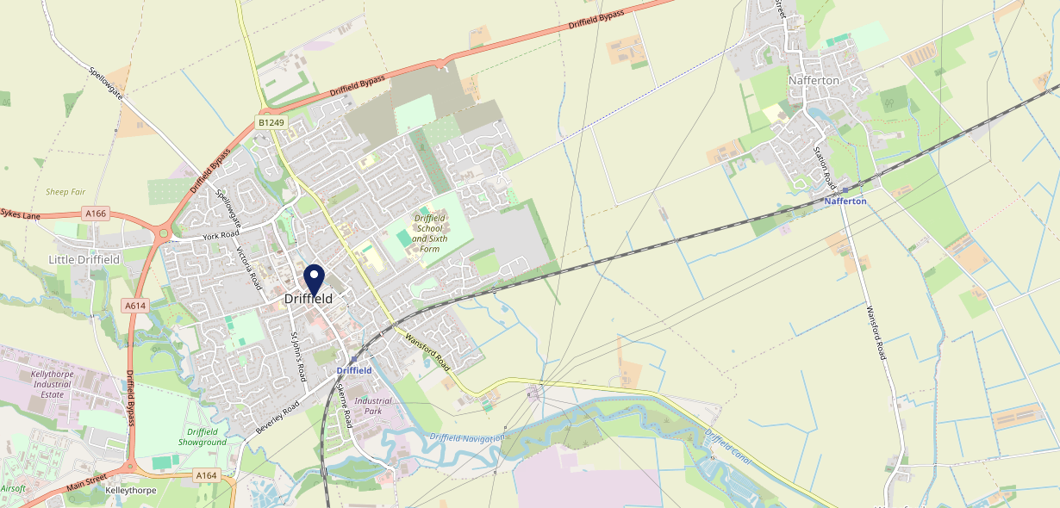











Site Intel
Tiger Inn Driffield YO256AW
1 Miles
338 Chains
29/01/2025 - 21/01/2026
Site Summary
Tiger Inn Driffield YO256AW
Work Area
Region
TV Region
Urbanicity
Hull
Yorkshire and The Humber
Yorkshire
Urban city and town
YO256AW
Craft Union
Top Competitors
ATV
Gender
Buck Hotel Driffield
#1
£6.70
66.01%
Male
YO256AP
Craft Union
Affluence
Segmentation
The Benjamin Fawcett
#2
61.69%
21.37%
Middle Income
Cash Conscious Communities
YO256SW
JD Wetherspoon
Age Group
Visit Day
Greggs
#3
26.49%
39.11%
YO256PS
45 to 54
Sat
Greggs
Nearest Station
Driffield(0.48 miles)
489 Site Customers
75 Competitors
17693 Competitor Customers

Slide 2

Site Intel
Tiger Inn Driffield YO256AW
1 Miles
338 Chains
29/01/2025 - 21/01/2026
Spend by Weekpart
How is customer spend distributed throughout the week for Tiger Inn Driffield YO256AW versus its competitors?
% of spend for Tiger Inn Driffield YO256AW and 338 Chains in 1 Miles from 29/01/2025 - 21/01/2026 split by Day of Week
489 Site Customers
75 Competitors
17693 Competitor Customers

Slide 3
Site Intel
Tiger Inn Driffield YO256AW
1 Miles
338 Chains
29/01/2025 - 21/01/2026
Visit Frequency
How frequently per year do customers visit Tiger Inn Driffield YO256AW versus its competitors?
% of customer numbers for Tiger Inn Driffield YO256AW and 338 Chains in 1 Miles from 29/01/2025 - 21/01/2026 and the number of visits made Per Annum
489 Site Customers
75 Competitors
17693 Competitor Customers

Slide 4
Site Intel
Tiger Inn Driffield YO256AW
1 Miles
338 Chains
29/01/2025 - 21/01/2026
ATV Change
How has ATV changed between two date ranges?
489 Site Customers

Slide 5
Site Intel
Tiger Inn Driffield YO256AW
1 Miles
338 Chains
29/01/2025 - 21/01/2026
Market Share Change
How has market share changed between two date ranges?
% of market share spend for Tiger Inn Driffield YO256AW and 338 Chains in 1 Miles from 29/01/2025 - 21/01/2026
489 Site Customers

Slide 6
Site Intel
Tiger Inn Driffield YO256AW
1 Miles
338 Chains
29/01/2025 - 21/01/2026
Age
How does the age profile of customers who visit Tiger Inn Driffield YO256AW compare versus its competitors?
% of spend for Tiger Inn Driffield YO256AW and 338 Chains in 1 Miles from 29/01/2025 - 21/01/2026 split by Age Range
226 Site Customers
75 Competitors
8353 Competitor Customers

Slide 7
Site Intel
Tiger Inn Driffield YO256AW
1 Miles
338 Chains
29/01/2025 - 21/01/2026
Affluence
How does the affluence of customers who visit Tiger Inn Driffield YO256AW compare versus its competitors?
% of spend for Tiger Inn Driffield YO256AW and 338 Chains in 1 Miles from 29/01/2025 - 21/01/2026 split by Affluence
200 Site Customers
75 Competitors
7373 Competitor Customers

Slide 8
Site Intel
Tiger Inn Driffield YO256AW
1 Miles
338 Chains
29/01/2025 - 21/01/2026
Gender
How does the gender profile of customers who visit Tiger Inn Driffield YO256AW compare versus its competitors?
% of spend for Tiger Inn Driffield YO256AW and 338 Chains in 1 Miles from 29/01/2025 - 21/01/2026 split by Gender
218 Site Customers
75 Competitors
8064 Competitor Customers

Slide 9
Site Intel
Tiger Inn Driffield YO256AW
1 Miles
338 Chains
29/01/2025 - 21/01/2026
Punch Segmentation
How does the Custom segmentation profile of customers who visit Tiger Inn Driffield YO256AW compare versus its competitors?
% of spend for Tiger Inn Driffield YO256AW and 338 Chains in 1 Miles from 29/01/2025 - 21/01/2026 split by Segment
489 Site Customers
75 Competitors
17693 Competitor Customers

Slide 10
Site Intel
Tiger Inn Driffield YO256AW
1 Miles
338 Chains
29/01/2025 - 21/01/2026
Spend by Distance
How does the spend profile of Tiger Inn Driffield YO256AW compare versus its competitors based on travel distances?
% of spend for Tiger Inn Driffield YO256AW and 338 Chains in 1 Miles from 29/01/2025 - 21/01/2026 split by Distance travelled
218 Site Customers
75 Competitors
8055 Competitor Customers

Slide 11
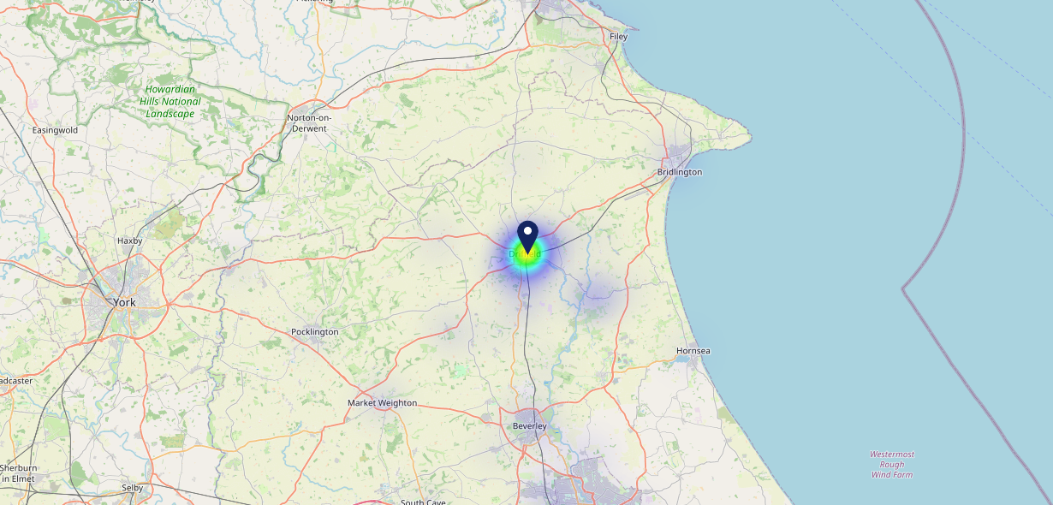

Site Intel
Tiger Inn Driffield YO256AW
29/01/2025 - 21/01/2026
Map of Guest Origin
Where do customers of Tiger Inn Driffield YO256AW come from?
Where do customers of Tiger Inn Driffield YO256AW for 29/01/2025 - 21/01/2026 live
218 Site Customers

Slide 12
Site Intel
Tiger Inn Driffield YO256AW
1 Miles
338 Chains
29/01/2025 - 21/01/2026
Share of Wallet
What are the Top 20 venues (by spend) that customers of Tiger Inn Driffield YO256AW also visit?
For customers of Tiger Inn Driffield YO256AW, who are the top 20 competitors from 338 Chains in 1 Miles for 29/01/2025 - 21/01/2026 split by Venue
489 Site Customers

Slide 13
Site Intel
Tiger Inn Driffield YO256AW
1 Miles
338 Chains
29/01/2025 - 21/01/2026
Share of Wallet Change
How has share of wallet of customers of Tiger Inn Driffield YO256AW changed between two date ranges?
489 Site Customers

Slide 14
Site Intel
Tiger Inn Driffield YO256AW
29/01/2025 - 21/01/2026
Market Summary
How does the local area for Tiger Inn Driffield YO256AW compare to the national average (1 = low, 10 = high)
Data Type | Name | Spend in 250m | 250m Spend vs National | Spend in 500m | 500m Spend vs National | Spend in 1 mile | 1 mile Spend vs National | Spend in 3 miles | 3 mile Spend vs National
Total | Annual Sales | £5.98M | 8 | £7.05M | 7 | £8.07M | 4 | £9.36M | 2
Weekpart | Mon - Thu | 40.9% | 6 | 41.3% | 6 | 41.2% | 6 | 39.5% | 2
Weekpart | Fri - Sat | 46.5% | 7 | 45.8% | 7 | 46.2% | 8 | 46.1% | 10
Weekpart | Sun | 12.6% | 3 | 12.9% | 3 | 12.6% | 2 | 14.4% | 2
Age | 18 to 24 | 4.8% | 5 | 4.4% | 4 | 4.0% | 3 | 3.6% | 1
Age | 25 to 34 | 14.1% | 2 | 13.7% | 2 | 13.7% | 2 | 13.5% | 1
Age | 35 to 44 | 20.7% | 4 | 20.5% | 3 | 20.5% | 3 | 20.9% | 3
Age | 45 to 54 | 26.2% | 10 | 24.5% | 9 | 24.5% | 10 | 23.4% | 10
Age | 55 to 64 | 20.4% | 8 | 22.9% | 9 | 23.1% | 10 | 23.2% | 10
Age | 65 to 74 | 9.5% | 8 | 10.0% | 8 | 10.3% | 9 | 10.6% | 9
Age | 75+ | 4.1% | 8 | 4.0% | 8 | 4.0% | 8 | 4.9% | 9
CAMEO | Business Elite | 1.6% | 2 | 1.7% | 2 | 1.8% | 1 | 1.9% | 1
CAMEO | Prosperous Professionals | 3.4% | 3 | 3.2% | 3 | 3.1% | 2 | 3.5% | 2
CAMEO | Flourishing Society | 6.9% | 3 | 6.7% | 3 | 7.1% | 2 | 8.0% | 2
CAMEO | Content Communities | 16.2% | 9 | 15.6% | 8 | 16.6% | 9 | 17.2% | 9
CAMEO | White Collar Neighbourhoods | 7.8% | 2 | 7.5% | 2 | 7.4% | 2 | 7.5% | 1
CAMEO | Enterprising Mainstream | 18.6% | 10 | 20.5% | 10 | 19.9% | 10 | 20.2% | 10
CAMEO | Paying The Mortgage | 18.3% | 8 | 18.9% | 8 | 18.5% | 8 | 18.0% | 8
CAMEO | Cash Conscious Communities | 21.2% | 10 | 20.1% | 10 | 19.4% | 10 | 17.8% | 10
CAMEO | On A Budget | 1.9% | 1 | 1.8% | 1 | 1.8% | 1 | 1.6% | 1
CAMEO | Family Value | 3.9% | 7 | 3.9% | 7 | 4.5% | 7 | 4.2% | 7
Affluence | AB | 12.0% | 2 | 11.6% | 2 | 11.9% | 2 | 13.4% | 2
Affluence | C1C2 | 61.0% | 10 | 62.5% | 10 | 62.4% | 10 | 62.9% | 10
Affluence | DE | 27.0% | 7 | 25.9% | 7 | 25.7% | 7 | 23.7% | 7

