Slide 1











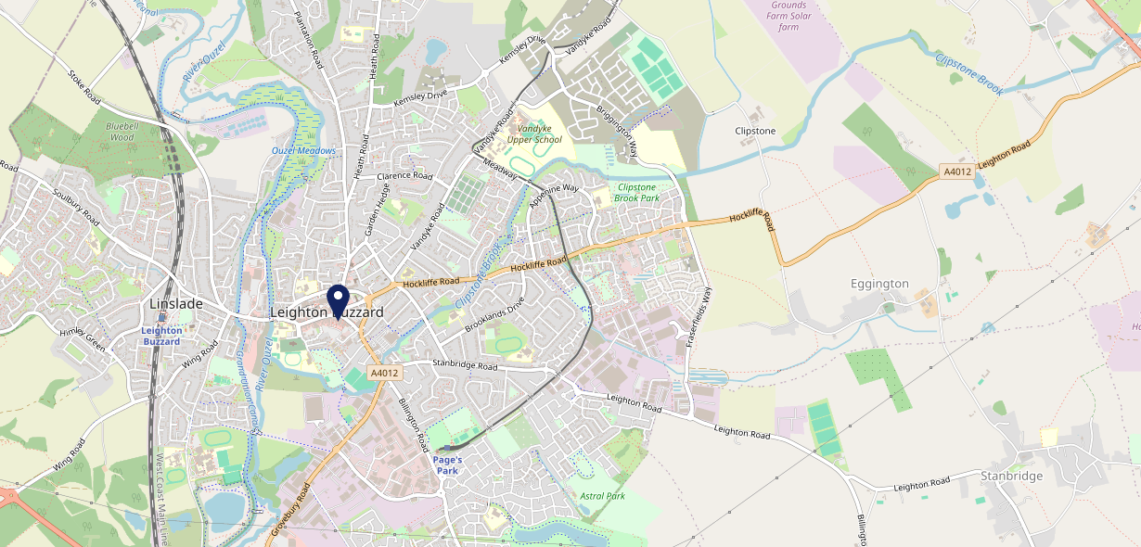











Site Intel
Top Bell Leighton Buzzard LU71EY
1 Miles
338 Chains
29/01/2025 - 21/01/2026
Site Summary
Top Bell Leighton Buzzard LU71EY
Work Area
Region
TV Region
Urbanicity
Milton Keynes
East of England
Anglia
Urban city and town
LU71EY
Craft Union
Top Competitors
ATV
Gender
The Picture House Leighton Buzzard
#1
£6.90
84.79%
Male
LU71RT
Proper Pubs
Affluence
Segmentation
The Swan Hotel
#2
48.97%
29.30%
Middle Income
Business Elite
LU71EA
JD Wetherspoon
Age Group
Visit Day
Sun Leighton Buzzard
#3
37.38%
31.30%
LU71RX
25 to 34
Sat
Craft Union
Nearest Station
Leighton Buzzard(1.08 miles)
294 Site Customers
154 Competitors
52317 Competitor Customers

Slide 2

Site Intel
Top Bell Leighton Buzzard LU71EY
1 Miles
338 Chains
29/01/2025 - 21/01/2026
Spend by Weekpart
How is customer spend distributed throughout the week for Top Bell Leighton Buzzard LU71EY versus its competitors?
% of spend for Top Bell Leighton Buzzard LU71EY and 338 Chains in 1 Miles from 29/01/2025 - 21/01/2026 split by Day of Week
294 Site Customers
154 Competitors
52317 Competitor Customers

Slide 3
Site Intel
Top Bell Leighton Buzzard LU71EY
1 Miles
338 Chains
29/01/2025 - 21/01/2026
Visit Frequency
How frequently per year do customers visit Top Bell Leighton Buzzard LU71EY versus its competitors?
% of customer numbers for Top Bell Leighton Buzzard LU71EY and 338 Chains in 1 Miles from 29/01/2025 - 21/01/2026 and the number of visits made Per Annum
294 Site Customers
154 Competitors
52317 Competitor Customers

Slide 4
Site Intel
Top Bell Leighton Buzzard LU71EY
1 Miles
338 Chains
29/01/2025 - 21/01/2026
ATV Change
How has ATV changed between two date ranges?
294 Site Customers

Slide 5
Site Intel
Top Bell Leighton Buzzard LU71EY
1 Miles
338 Chains
29/01/2025 - 21/01/2026
Market Share Change
How has market share changed between two date ranges?
% of market share spend for Top Bell Leighton Buzzard LU71EY and 338 Chains in 1 Miles from 29/01/2025 - 21/01/2026
294 Site Customers

Slide 6
Site Intel
Top Bell Leighton Buzzard LU71EY
1 Miles
338 Chains
29/01/2025 - 21/01/2026
Age
How does the age profile of customers who visit Top Bell Leighton Buzzard LU71EY compare versus its competitors?
% of spend for Top Bell Leighton Buzzard LU71EY and 338 Chains in 1 Miles from 29/01/2025 - 21/01/2026 split by Age Range
106 Site Customers
154 Competitors
22599 Competitor Customers

Slide 7
Site Intel
Top Bell Leighton Buzzard LU71EY
1 Miles
338 Chains
29/01/2025 - 21/01/2026
Affluence
How does the affluence of customers who visit Top Bell Leighton Buzzard LU71EY compare versus its competitors?
% of spend for Top Bell Leighton Buzzard LU71EY and 338 Chains in 1 Miles from 29/01/2025 - 21/01/2026 split by Affluence
96 Site Customers
154 Competitors
19969 Competitor Customers

Slide 8
Site Intel
Top Bell Leighton Buzzard LU71EY
1 Miles
338 Chains
29/01/2025 - 21/01/2026
Gender
How does the gender profile of customers who visit Top Bell Leighton Buzzard LU71EY compare versus its competitors?
% of spend for Top Bell Leighton Buzzard LU71EY and 338 Chains in 1 Miles from 29/01/2025 - 21/01/2026 split by Gender
100 Site Customers
154 Competitors
21898 Competitor Customers

Slide 9
Site Intel
Top Bell Leighton Buzzard LU71EY
1 Miles
338 Chains
29/01/2025 - 21/01/2026
Punch Segmentation
How does the Custom segmentation profile of customers who visit Top Bell Leighton Buzzard LU71EY compare versus its competitors?
% of spend for Top Bell Leighton Buzzard LU71EY and 338 Chains in 1 Miles from 29/01/2025 - 21/01/2026 split by Segment
294 Site Customers
154 Competitors
52317 Competitor Customers

Slide 10
Site Intel
Top Bell Leighton Buzzard LU71EY
1 Miles
338 Chains
29/01/2025 - 21/01/2026
Spend by Distance
How does the spend profile of Top Bell Leighton Buzzard LU71EY compare versus its competitors based on travel distances?
% of spend for Top Bell Leighton Buzzard LU71EY and 338 Chains in 1 Miles from 29/01/2025 - 21/01/2026 split by Distance travelled
100 Site Customers
154 Competitors
21893 Competitor Customers

Slide 11
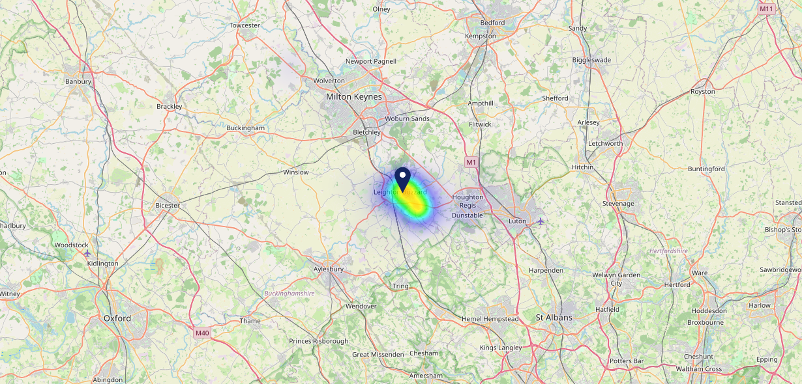

Site Intel
Top Bell Leighton Buzzard LU71EY
29/01/2025 - 21/01/2026
Map of Guest Origin
Where do customers of Top Bell Leighton Buzzard LU71EY come from?
Where do customers of Top Bell Leighton Buzzard LU71EY for 29/01/2025 - 21/01/2026 live
100 Site Customers

Slide 12
Site Intel
Top Bell Leighton Buzzard LU71EY
1 Miles
338 Chains
29/01/2025 - 21/01/2026
Share of Wallet
What are the Top 20 venues (by spend) that customers of Top Bell Leighton Buzzard LU71EY also visit?
For customers of Top Bell Leighton Buzzard LU71EY, who are the top 20 competitors from 338 Chains in 1 Miles for 29/01/2025 - 21/01/2026 split by Venue
294 Site Customers

Slide 13
Site Intel
Top Bell Leighton Buzzard LU71EY
1 Miles
338 Chains
29/01/2025 - 21/01/2026
Share of Wallet Change
How has share of wallet of customers of Top Bell Leighton Buzzard LU71EY changed between two date ranges?
294 Site Customers

Slide 14
Site Intel
Top Bell Leighton Buzzard LU71EY
29/01/2025 - 21/01/2026
Market Summary
How does the local area for Top Bell Leighton Buzzard LU71EY compare to the national average (1 = low, 10 = high)
Data Type | Name | Spend in 250m | 250m Spend vs National | Spend in 500m | 500m Spend vs National | Spend in 1 mile | 1 mile Spend vs National | Spend in 3 miles | 3 mile Spend vs National
Total | Annual Sales | £12.81M | 9 | £15.78M | 8 | £24.21M | 7 | £38.87M | 4
Weekpart | Mon - Thu | 38.9% | 5 | 37.8% | 3 | 38.1% | 3 | 40.1% | 3
Weekpart | Fri - Sat | 48.6% | 8 | 49.7% | 9 | 47.5% | 9 | 44.4% | 8
Weekpart | Sun | 12.5% | 3 | 12.5% | 3 | 14.4% | 4 | 15.5% | 5
Age | 18 to 24 | 4.9% | 5 | 4.7% | 4 | 4.0% | 3 | 3.9% | 2
Age | 25 to 34 | 15.4% | 3 | 15.2% | 2 | 14.9% | 2 | 15.9% | 2
Age | 35 to 44 | 24.1% | 6 | 24.2% | 6 | 25.0% | 7 | 25.4% | 8
Age | 45 to 54 | 19.2% | 4 | 20.2% | 5 | 20.0% | 5 | 19.4% | 4
Age | 55 to 64 | 18.8% | 8 | 19.1% | 8 | 18.8% | 8 | 18.1% | 8
Age | 65 to 74 | 12.8% | 9 | 12.0% | 9 | 12.3% | 9 | 12.6% | 10
Age | 75+ | 4.9% | 9 | 4.7% | 8 | 4.9% | 9 | 4.7% | 9
CAMEO | Business Elite | 7.1% | 6 | 6.4% | 5 | 6.2% | 5 | 6.8% | 5
CAMEO | Prosperous Professionals | 6.0% | 6 | 5.9% | 5 | 6.1% | 5 | 6.1% | 5
CAMEO | Flourishing Society | 12.6% | 6 | 12.0% | 5 | 13.1% | 6 | 13.7% | 6
CAMEO | Content Communities | 14.0% | 7 | 13.5% | 7 | 13.8% | 7 | 15.1% | 8
CAMEO | White Collar Neighbourhoods | 13.0% | 7 | 13.2% | 8 | 13.7% | 8 | 13.3% | 8
CAMEO | Enterprising Mainstream | 10.7% | 8 | 10.7% | 8 | 10.4% | 7 | 9.7% | 7
CAMEO | Paying The Mortgage | 19.3% | 8 | 20.2% | 9 | 19.3% | 9 | 18.6% | 9
CAMEO | Cash Conscious Communities | 8.2% | 5 | 8.0% | 5 | 7.7% | 4 | 7.5% | 4
CAMEO | On A Budget | 7.5% | 7 | 8.3% | 7 | 8.0% | 7 | 7.5% | 7
CAMEO | Family Value | 1.5% | 4 | 1.8% | 5 | 1.9% | 4 | 1.7% | 4
Affluence | AB | 25.7% | 5 | 24.3% | 5 | 25.4% | 5 | 26.6% | 5
Affluence | C1C2 | 57.0% | 9 | 57.6% | 9 | 57.1% | 9 | 56.7% | 9
Affluence | DE | 17.2% | 4 | 18.1% | 5 | 17.5% | 4 | 16.7% | 3

