Slide 1











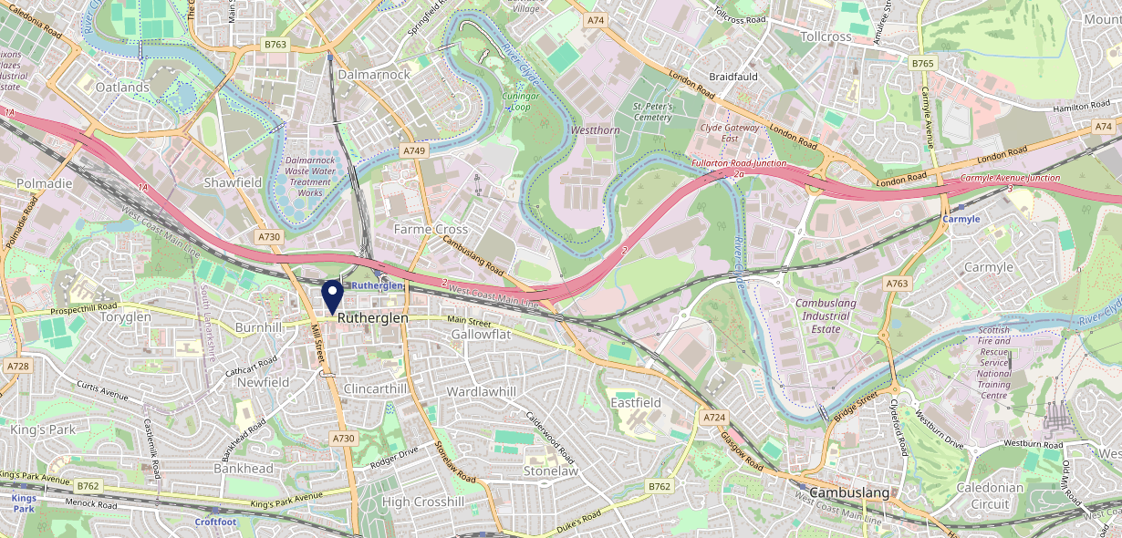











Site Intel
Vogue Bar Ruthergl G732JH
1 Miles
338 Chains
29/01/2025 - 21/01/2026
Site Summary
Vogue Bar Ruthergl G732JH
Work Area
Region
TV Region
Urbanicity
Glasgow
Scotland
Scotland
Large urban area
G732JH
Pub / Bar
Top Competitors
ATV
Gender
An Ruadh-Ghleann
#1
G732HY
JD Wetherspoon
Affluence
Segmentation
Millcroft (Rutherglen)
#2
G732NA
GK Proper Locals
Age Group
Visit Day
Greggs Rutherglen Main St
#3
G732HY
Greggs
Nearest Station
Rutherglen(0.40 miles)
200 Competitors
99276 Competitor Customers

Slide 2

Site Intel
Vogue Bar Ruthergl G732JH
1 Miles
338 Chains
29/01/2025 - 21/01/2026
Spend by Weekpart
How is customer spend distributed throughout the week for Vogue Bar Ruthergl G732JH versus its competitors?
% of spend for Vogue Bar Ruthergl G732JH and 338 Chains in 1 Miles from 29/01/2025 - 21/01/2026 split by Day of Week
200 Competitors
99276 Competitor Customers

Slide 3
Site Intel
Vogue Bar Ruthergl G732JH
1 Miles
338 Chains
29/01/2025 - 21/01/2026
Visit Frequency
How frequently per year do customers visit Vogue Bar Ruthergl G732JH versus its competitors?
% of customer numbers for Vogue Bar Ruthergl G732JH and 338 Chains in 1 Miles from 29/01/2025 - 21/01/2026 and the number of visits made Per Annum
200 Competitors
99276 Competitor Customers

Slide 4
Site Intel
Vogue Bar Ruthergl G732JH
1 Miles
338 Chains
29/01/2025 - 21/01/2026
ATV Change
How has ATV changed between two date ranges?

Slide 5
Site Intel
Vogue Bar Ruthergl G732JH
1 Miles
338 Chains
29/01/2025 - 21/01/2026
Market Share Change
How has market share changed between two date ranges?
% of market share spend for Vogue Bar Ruthergl G732JH and 338 Chains in 1 Miles from 29/01/2025 - 21/01/2026

Slide 6
Site Intel
Vogue Bar Ruthergl G732JH
1 Miles
338 Chains
29/01/2025 - 21/01/2026
Age
How does the age profile of customers who visit Vogue Bar Ruthergl G732JH compare versus its competitors?
% of spend for Vogue Bar Ruthergl G732JH and 338 Chains in 1 Miles from 29/01/2025 - 21/01/2026 split by Age Range
200 Competitors
39049 Competitor Customers

Slide 7
Site Intel
Vogue Bar Ruthergl G732JH
1 Miles
338 Chains
29/01/2025 - 21/01/2026
Affluence
How does the affluence of customers who visit Vogue Bar Ruthergl G732JH compare versus its competitors?
% of spend for Vogue Bar Ruthergl G732JH and 338 Chains in 1 Miles from 29/01/2025 - 21/01/2026 split by Affluence
200 Competitors
34747 Competitor Customers

Slide 8
Site Intel
Vogue Bar Ruthergl G732JH
1 Miles
338 Chains
29/01/2025 - 21/01/2026
Gender
How does the gender profile of customers who visit Vogue Bar Ruthergl G732JH compare versus its competitors?
% of spend for Vogue Bar Ruthergl G732JH and 338 Chains in 1 Miles from 29/01/2025 - 21/01/2026 split by Gender
200 Competitors
37513 Competitor Customers

Slide 9
Site Intel
Vogue Bar Ruthergl G732JH
1 Miles
338 Chains
29/01/2025 - 21/01/2026
Punch Segmentation
How does the Custom segmentation profile of customers who visit Vogue Bar Ruthergl G732JH compare versus its competitors?
% of spend for Vogue Bar Ruthergl G732JH and 338 Chains in 1 Miles from 29/01/2025 - 21/01/2026 split by Segment
200 Competitors
99276 Competitor Customers

Slide 10
Site Intel
Vogue Bar Ruthergl G732JH
1 Miles
338 Chains
29/01/2025 - 21/01/2026
Spend by Distance
How does the spend profile of Vogue Bar Ruthergl G732JH compare versus its competitors based on travel distances?
% of spend for Vogue Bar Ruthergl G732JH and 338 Chains in 1 Miles from 29/01/2025 - 21/01/2026 split by Distance travelled
200 Competitors
37501 Competitor Customers

Slide 11


Site Intel
Vogue Bar Ruthergl G732JH
29/01/2025 - 21/01/2026
Map of Guest Origin
Where do customers of Vogue Bar Ruthergl G732JH come from?
Where do customers of Vogue Bar Ruthergl G732JH for 29/01/2025 - 21/01/2026 live

Slide 12
Site Intel
Vogue Bar Ruthergl G732JH
1 Miles
338 Chains
29/01/2025 - 21/01/2026
Share of Wallet
What are the Top 20 venues (by spend) that customers of Vogue Bar Ruthergl G732JH also visit?
For customers of Vogue Bar Ruthergl G732JH, who are the top 20 competitors from 338 Chains in 1 Miles for 29/01/2025 - 21/01/2026 split by Venue

Slide 13
Site Intel
Vogue Bar Ruthergl G732JH
1 Miles
338 Chains
29/01/2025 - 21/01/2026
Share of Wallet Change
How has share of wallet of customers of Vogue Bar Ruthergl G732JH changed between two date ranges?

Slide 14
Site Intel
Vogue Bar Ruthergl G732JH
29/01/2025 - 21/01/2026
Market Summary
How does the local area for Vogue Bar Ruthergl G732JH compare to the national average (1 = low, 10 = high)
Data Type | Name | Spend in 250m | 250m Spend vs National | Spend in 500m | 500m Spend vs National | Spend in 1 mile | 1 mile Spend vs National | Spend in 3 miles | 3 mile Spend vs National
Total | Annual Sales | £5.64M | 8 | £8.98M | 7 | £34.51M | 7 | £1.08B | 10
Weekpart | Mon - Thu | 40.2% | 5 | 42.1% | 7 | 44.5% | 8 | 40.2% | 3
Weekpart | Fri - Sat | 42.5% | 4 | 42.1% | 4 | 39.4% | 3 | 45.8% | 9
Weekpart | Sun | 17.3% | 8 | 15.8% | 7 | 16.0% | 7 | 14.1% | 2
Age | 18 to 24 | 4.5% | 4 | 5.4% | 5 | 7.8% | 7 | 8.6% | 7
Age | 25 to 34 | 16.6% | 3 | 17.2% | 3 | 22.0% | 5 | 20.2% | 4
Age | 35 to 44 | 25.1% | 7 | 24.2% | 6 | 27.6% | 9 | 22.9% | 5
Age | 45 to 54 | 19.2% | 5 | 19.8% | 5 | 17.8% | 2 | 20.1% | 5
Age | 55 to 64 | 19.1% | 8 | 19.7% | 8 | 15.2% | 6 | 18.5% | 9
Age | 65 to 74 | 11.8% | 9 | 10.7% | 9 | 7.5% | 7 | 7.6% | 7
Age | 75+ | 3.7% | 8 | 2.9% | 7 | 2.1% | 5 | 2.0% | 4
CAMEO | Business Elite | 5.6% | 5 | 5.7% | 5 | 7.5% | 6 | 14.2% | 8
CAMEO | Prosperous Professionals | 3.5% | 3 | 3.0% | 3 | 4.1% | 3 | 7.5% | 7
CAMEO | Flourishing Society | 15.7% | 7 | 14.8% | 7 | 21.5% | 9 | 23.7% | 10
CAMEO | Content Communities | 4.2% | 1 | 4.1% | 1 | 5.6% | 1 | 8.1% | 1
CAMEO | White Collar Neighbourhoods | 10.4% | 5 | 10.6% | 5 | 12.3% | 7 | 11.6% | 5
CAMEO | Enterprising Mainstream | 2.9% | 1 | 3.0% | 1 | 2.8% | 1 | 4.3% | 2
CAMEO | Paying The Mortgage | 14.9% | 6 | 13.6% | 5 | 13.4% | 5 | 9.8% | 2
CAMEO | Cash Conscious Communities | 14.8% | 9 | 16.9% | 9 | 12.0% | 8 | 8.2% | 5
CAMEO | On A Budget | 20.6% | 10 | 20.8% | 10 | 15.3% | 10 | 8.7% | 8
CAMEO | Family Value | 7.4% | 8 | 7.4% | 8 | 5.4% | 7 | 4.0% | 6
Affluence | AB | 24.9% | 5 | 23.5% | 4 | 33.2% | 7 | 45.4% | 9
Affluence | C1C2 | 32.4% | 1 | 31.3% | 1 | 34.1% | 1 | 33.8% | 1
Affluence | DE | 42.8% | 10 | 45.2% | 10 | 32.8% | 9 | 20.9% | 6

