Slide 1
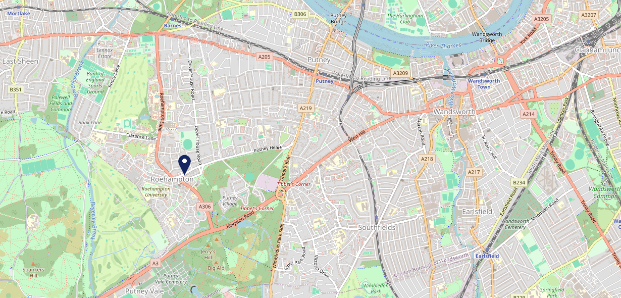
Site Intel
Angel SW154HL
1 Miles
371 Chains
16/04/2025 - 08/04/2026
Site Summary
Angel SW154HL
Work Area
Region
TV Region
Urbanicity
London
London
London
Urban major conurbation
SW154HL
Punch Unity
Top Competitors
ATV
Gender
The Telegraph
#1
£8.22
56.64%
Male
SW153TU
Brunning & Price
Affluence
Segmentation
Kings Head Roehampton
#2
50.22%
27.85%
Low Income
Cash Conscious Communities
SW154HL
Youngs Managed
Age Group
Visit Day
Greggs
#3
37.57%
25.54%
SW154DQ
45 to 54
Sat
Greggs
Nearest Station
Barnes(1.86 miles)
224 Site Customers
74 Competitors
30630 Competitor Customers

Slide 2
Site Intel
Angel SW154HL
1 Miles
371 Chains
16/04/2025 - 08/04/2026
Spend by Weekpart
How is customer spend distributed throughout the week for Angel SW154HL versus its competitors?
% of spend for Angel SW154HL and 371 Chains in 1 Miles from 16/04/2025 - 08/04/2026 split by Day of Week
224 Site Customers
74 Competitors
30630 Competitor Customers

Slide 3
Site Intel
Angel SW154HL
1 Miles
371 Chains
16/04/2025 - 08/04/2026
Visit Frequency
How frequently per year do customers visit Angel SW154HL versus its competitors?
% of customer numbers for Angel SW154HL and 371 Chains in 1 Miles from 16/04/2025 - 08/04/2026 and the number of visits made Per Annum
224 Site Customers
74 Competitors
30630 Competitor Customers

Slide 4
Site Intel
Angel SW154HL
1 Miles
371 Chains
16/04/2025 - 08/04/2026
ATV Change
How has ATV changed between two date ranges?
224 Site Customers

Slide 5
Site Intel
Angel SW154HL
1 Miles
371 Chains
16/04/2025 - 08/04/2026
Market Share Change
How has market share changed between two date ranges?
% of market share spend for Angel SW154HL and 371 Chains in 1 Miles from 16/04/2025 - 08/04/2026
224 Site Customers

Slide 6
Site Intel
Angel SW154HL
1 Miles
371 Chains
16/04/2025 - 08/04/2026
Age
How does the age profile of customers who visit Angel SW154HL compare versus its competitors?
% of spend for Angel SW154HL and 371 Chains in 1 Miles from 16/04/2025 - 08/04/2026 split by Age Range
85 Site Customers
74 Competitors
12381 Competitor Customers

Slide 7
Site Intel
Angel SW154HL
1 Miles
371 Chains
16/04/2025 - 08/04/2026
Affluence
How does the affluence of customers who visit Angel SW154HL compare versus its competitors?
% of spend for Angel SW154HL and 371 Chains in 1 Miles from 16/04/2025 - 08/04/2026 split by Affluence
76 Site Customers
74 Competitors
11625 Competitor Customers

Slide 8
Site Intel
Angel SW154HL
1 Miles
371 Chains
16/04/2025 - 08/04/2026
Gender
How does the gender profile of customers who visit Angel SW154HL compare versus its competitors?
% of spend for Angel SW154HL and 371 Chains in 1 Miles from 16/04/2025 - 08/04/2026 split by Gender
80 Site Customers
74 Competitors
11923 Competitor Customers

Slide 9
Site Intel
Angel SW154HL
1 Miles
371 Chains
16/04/2025 - 08/04/2026
Punch Segmentation
How does the Custom segmentation profile of customers who visit Angel SW154HL compare versus its competitors?
% of spend for Angel SW154HL and 371 Chains in 1 Miles from 16/04/2025 - 08/04/2026 split by Segment
224 Site Customers
74 Competitors
30630 Competitor Customers

Slide 10
Site Intel
Angel SW154HL
1 Miles
371 Chains
16/04/2025 - 08/04/2026
Spend by Distance
How does the spend profile of Angel SW154HL compare versus its competitors based on travel distances?
% of spend for Angel SW154HL and 371 Chains in 1 Miles from 16/04/2025 - 08/04/2026 split by Distance travelled
80 Site Customers
74 Competitors
11918 Competitor Customers

Slide 11
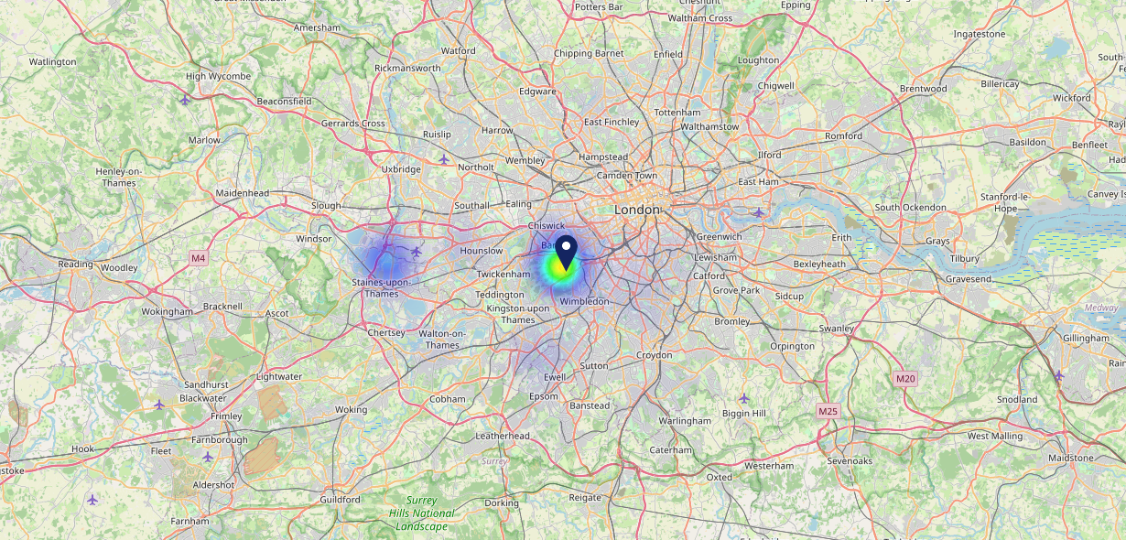
Site Intel
Angel SW154HL
16/04/2025 - 08/04/2026
Map of Guest Origin
Where do customers of Angel SW154HL come from?
Where do customers of Angel SW154HL for 16/04/2025 - 08/04/2026 live
80 Site Customers

Slide 12
Site Intel
Angel SW154HL
1 Miles
371 Chains
16/04/2025 - 08/04/2026
Share of Wallet
What are the Top 20 venues (by spend) that customers of Angel SW154HL also visit?
For customers of Angel SW154HL, who are the top 20 competitors from 371 Chains in 1 Miles for 16/04/2025 - 08/04/2026 split by Venue
224 Site Customers

Slide 13
Site Intel
Angel SW154HL
1 Miles
371 Chains
16/04/2025 - 08/04/2026
Share of Wallet Change
How has share of wallet of customers of Angel SW154HL changed between two date ranges?
224 Site Customers

Slide 14
Site Intel
Angel SW154HL
16/04/2025 - 08/04/2026
Market Summary
How does the local area for Angel SW154HL compare to the national average (1 = low, 10 = high)
Data Type | Name | Spend in 250m | 250m Spend vs National | Spend in 500m | 500m Spend vs National | Spend in 1 mile | 1 mile Spend vs National | Spend in 3 miles | 3 mile Spend vs National
Total | Annual Sales | £2.20M | 6 | £2.39M | 5 | £14.45M | 5 | £594.28M | 9
Weekpart | Mon - Thu | 52.9% | 10 | 51.9% | 10 | 46.7% | 9 | 42.8% | 7
Weekpart | Fri - Sat | 35.0% | 1 | 36.9% | 2 | 37.4% | 2 | 41.7% | 5
Weekpart | Sun | 12.1% | 3 | 11.2% | 2 | 15.9% | 7 | 15.5% | 5
Age | 18 to 24 | 4.4% | 4 | 3.8% | 3 | 1.5% | 1 | 3.2% | 1
Age | 25 to 34 | 15.1% | 3 | 13.5% | 2 | 10.3% | 1 | 14.4% | 1
Age | 35 to 44 | 23.9% | 6 | 22.7% | 5 | 21.6% | 4 | 22.1% | 4
Age | 45 to 54 | 26.4% | 10 | 25.1% | 9 | 24.4% | 10 | 22.4% | 9
Age | 55 to 64 | 18.1% | 7 | 17.8% | 7 | 19.6% | 9 | 21.6% | 10
Age | 65 to 74 | 8.2% | 7 | 11.0% | 9 | 11.8% | 9 | 10.5% | 9
Age | 75+ | 4.0% | 8 | 6.1% | 9 | 10.8% | 10 | 5.8% | 9
CAMEO | Business Elite | 11.4% | 8 | 14.1% | 8 | 29.4% | 10 | 26.7% | 10
CAMEO | Prosperous Professionals | 3.1% | 3 | 5.2% | 5 | 8.1% | 8 | 9.5% | 9
CAMEO | Flourishing Society | 7.3% | 3 | 7.3% | 3 | 12.6% | 6 | 15.0% | 7
CAMEO | Content Communities | 8.1% | 2 | 8.4% | 2 | 14.4% | 8 | 13.4% | 7
CAMEO | White Collar Neighbourhoods | 9.7% | 4 | 10.0% | 4 | 6.9% | 1 | 11.2% | 5
CAMEO | Enterprising Mainstream | 4.9% | 3 | 4.6% | 3 | 4.6% | 2 | 3.9% | 1
CAMEO | Paying The Mortgage | 10.3% | 3 | 10.3% | 3 | 7.0% | 1 | 7.2% | 1
CAMEO | Cash Conscious Communities | 20.4% | 10 | 18.1% | 10 | 8.5% | 5 | 7.6% | 4
CAMEO | On A Budget | 20.5% | 10 | 18.4% | 10 | 7.4% | 7 | 4.9% | 3
CAMEO | Family Value | 4.3% | 7 | 3.7% | 6 | 1.1% | 3 | 0.6% | 1
Affluence | AB | 21.8% | 4 | 26.5% | 5 | 50.1% | 10 | 51.3% | 10
Affluence | C1C2 | 33.0% | 1 | 33.3% | 1 | 32.9% | 1 | 35.6% | 1
Affluence | DE | 45.2% | 10 | 40.2% | 9 | 17.1% | 4 | 13.1% | 2

