Slide 1
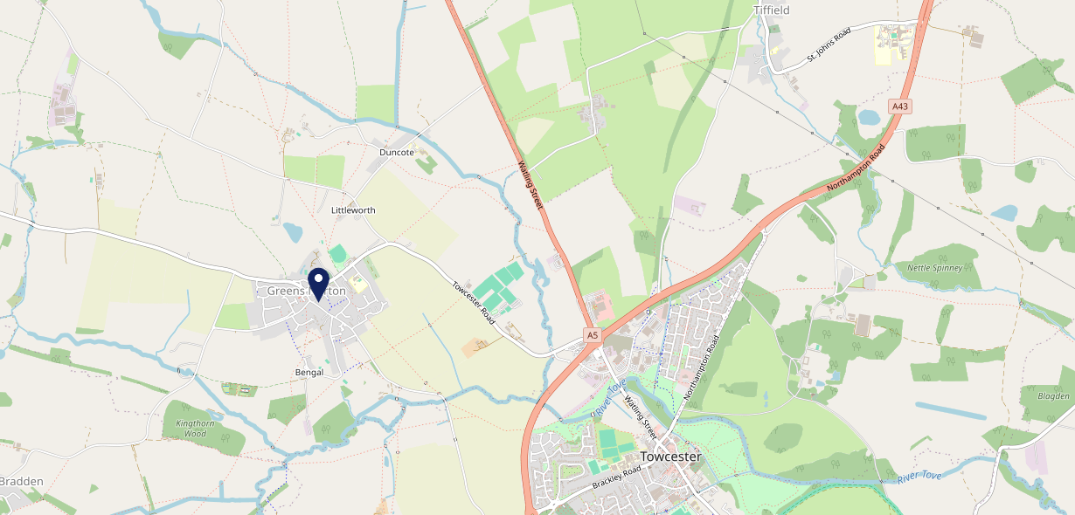
Site Intel
Butchers Arms NN128BA
1 Miles
371 Chains
16/04/2025 - 08/04/2026
Site Summary
Butchers Arms NN128BA
Work Area
Region
TV Region
Urbanicity
Northampton
East Midlands
Anglia
Rural town and fringe
NN128BA
Punch T&L
Top Competitors
ATV
Gender
Towcestrians Sports Club
#1
£15.17
59.30%
Male
NN128AW
Clubs
Affluence
Segmentation
Greens Norton Royal British Legion Club
#2
50.20%
36.97%
Middle Income
Content Communities
NN128BU
Clubs
Age Group
Visit Day
#3
31.54%
24.04%
45 to 54
Sun
Nearest Station
Northampton(13.29 miles)
601 Site Customers
4 Competitors
609 Competitor Customers

Slide 2
Site Intel
Butchers Arms NN128BA
1 Miles
371 Chains
16/04/2025 - 08/04/2026
Spend by Weekpart
How is customer spend distributed throughout the week for Butchers Arms NN128BA versus its competitors?
% of spend for Butchers Arms NN128BA and 371 Chains in 1 Miles from 16/04/2025 - 08/04/2026 split by Day of Week
601 Site Customers
4 Competitors
609 Competitor Customers

Slide 3
Site Intel
Butchers Arms NN128BA
1 Miles
371 Chains
16/04/2025 - 08/04/2026
Visit Frequency
How frequently per year do customers visit Butchers Arms NN128BA versus its competitors?
% of customer numbers for Butchers Arms NN128BA and 371 Chains in 1 Miles from 16/04/2025 - 08/04/2026 and the number of visits made Per Annum
601 Site Customers
4 Competitors
609 Competitor Customers

Slide 4
Site Intel
Butchers Arms NN128BA
1 Miles
371 Chains
16/04/2025 - 08/04/2026
ATV Change
How has ATV changed between two date ranges?
601 Site Customers

Slide 5
Site Intel
Butchers Arms NN128BA
1 Miles
371 Chains
16/04/2025 - 08/04/2026
Market Share Change
How has market share changed between two date ranges?
% of market share spend for Butchers Arms NN128BA and 371 Chains in 1 Miles from 16/04/2025 - 08/04/2026
601 Site Customers

Slide 6
Site Intel
Butchers Arms NN128BA
1 Miles
371 Chains
16/04/2025 - 08/04/2026
Age
How does the age profile of customers who visit Butchers Arms NN128BA compare versus its competitors?
% of spend for Butchers Arms NN128BA and 371 Chains in 1 Miles from 16/04/2025 - 08/04/2026 split by Age Range
298 Site Customers
4 Competitors
270 Competitor Customers

Slide 7
Site Intel
Butchers Arms NN128BA
1 Miles
371 Chains
16/04/2025 - 08/04/2026
Affluence
How does the affluence of customers who visit Butchers Arms NN128BA compare versus its competitors?
% of spend for Butchers Arms NN128BA and 371 Chains in 1 Miles from 16/04/2025 - 08/04/2026 split by Affluence
269 Site Customers
4 Competitors
246 Competitor Customers

Slide 8
Site Intel
Butchers Arms NN128BA
1 Miles
371 Chains
16/04/2025 - 08/04/2026
Gender
How does the gender profile of customers who visit Butchers Arms NN128BA compare versus its competitors?
% of spend for Butchers Arms NN128BA and 371 Chains in 1 Miles from 16/04/2025 - 08/04/2026 split by Gender
287 Site Customers
4 Competitors
262 Competitor Customers

Slide 9
Site Intel
Butchers Arms NN128BA
1 Miles
371 Chains
16/04/2025 - 08/04/2026
Punch Segmentation
How does the Custom segmentation profile of customers who visit Butchers Arms NN128BA compare versus its competitors?
% of spend for Butchers Arms NN128BA and 371 Chains in 1 Miles from 16/04/2025 - 08/04/2026 split by Segment
601 Site Customers
4 Competitors
609 Competitor Customers

Slide 10
Site Intel
Butchers Arms NN128BA
1 Miles
371 Chains
16/04/2025 - 08/04/2026
Spend by Distance
How does the spend profile of Butchers Arms NN128BA compare versus its competitors based on travel distances?
% of spend for Butchers Arms NN128BA and 371 Chains in 1 Miles from 16/04/2025 - 08/04/2026 split by Distance travelled
287 Site Customers
4 Competitors
262 Competitor Customers

Slide 11
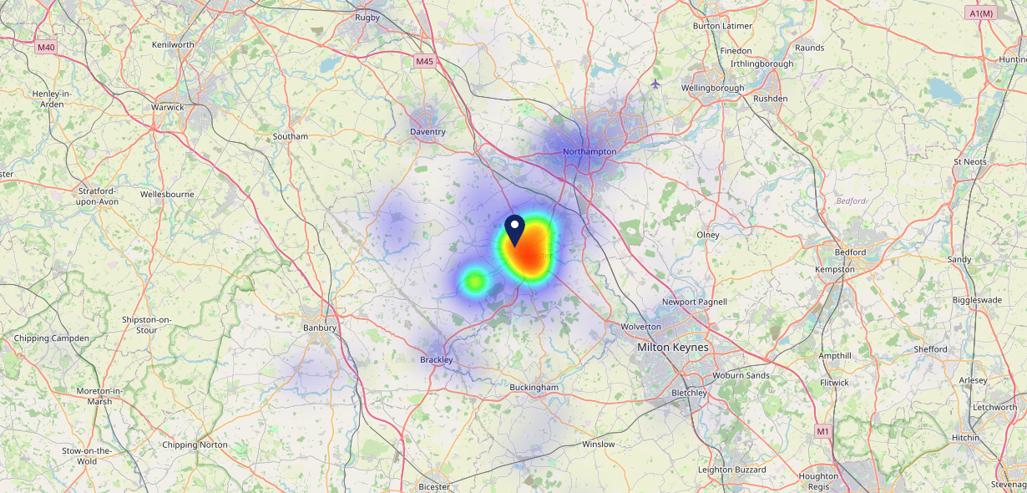
Site Intel
Butchers Arms NN128BA
16/04/2025 - 08/04/2026
Map of Guest Origin
Where do customers of Butchers Arms NN128BA come from?
Where do customers of Butchers Arms NN128BA for 16/04/2025 - 08/04/2026 live
287 Site Customers

Slide 12
Site Intel
Butchers Arms NN128BA
1 Miles
371 Chains
16/04/2025 - 08/04/2026
Share of Wallet
What are the Top 20 venues (by spend) that customers of Butchers Arms NN128BA also visit?
For customers of Butchers Arms NN128BA, who are the top 20 competitors from 371 Chains in 1 Miles for 16/04/2025 - 08/04/2026 split by Venue
601 Site Customers

Slide 13
Site Intel
Butchers Arms NN128BA
1 Miles
371 Chains
16/04/2025 - 08/04/2026
Share of Wallet Change
How has share of wallet of customers of Butchers Arms NN128BA changed between two date ranges?
601 Site Customers

Slide 14
Site Intel
Butchers Arms NN128BA
16/04/2025 - 08/04/2026
Market Summary
How does the local area for Butchers Arms NN128BA compare to the national average (1 = low, 10 = high)
Data Type | Name | Spend in 250m | 250m Spend vs National | Spend in 500m | 500m Spend vs National | Spend in 1 mile | 1 mile Spend vs National | Spend in 3 miles | 3 mile Spend vs National
Total | Annual Sales | £409K | 3 | £409K | 2 | £630K | 1 | £16.32M | 2
Weekpart | Mon - Thu | 36.8% | 3 | 36.9% | 3 | 32.9% | 1 | 40.0% | 3
Weekpart | Fri - Sat | 37.4% | 2 | 37.4% | 2 | 47.1% | 9 | 44.3% | 8
Weekpart | Sun | 25.8% | 10 | 25.7% | 10 | 20.0% | 10 | 15.7% | 6
Age | 18 to 24 | 1.0% | 1 | 1.0% | 1 | 1.7% | 1 | 5.9% | 4
Age | 25 to 34 | 6.0% | 1 | 6.0% | 1 | 8.4% | 1 | 13.3% | 1
Age | 35 to 44 | 17.4% | 2 | 17.4% | 2 | 20.7% | 3 | 23.3% | 5
Age | 45 to 54 | 35.6% | 10 | 35.5% | 10 | 31.2% | 10 | 22.7% | 9
Age | 55 to 64 | 7.3% | 1 | 7.3% | 1 | 7.9% | 1 | 18.6% | 9
Age | 65 to 74 | 27.9% | 10 | 27.9% | 10 | 21.5% | 10 | 11.9% | 9
Age | 75+ | 4.7% | 8 | 4.9% | 9 | 8.6% | 10 | 4.2% | 8
CAMEO | Business Elite | 3.5% | 3 | 3.5% | 3 | 5.5% | 5 | 6.4% | 5
CAMEO | Prosperous Professionals | 12.0% | 10 | 12.0% | 10 | 11.8% | 10 | 12.9% | 10
CAMEO | Flourishing Society | 23.1% | 9 | 23.3% | 9 | 22.2% | 9 | 18.0% | 8
CAMEO | Content Communities | 44.3% | 10 | 44.2% | 10 | 39.8% | 10 | 18.4% | 10
CAMEO | White Collar Neighbourhoods | 2.4% | 1 | 2.4% | 1 | 3.2% | 1 | 8.7% | 2
CAMEO | Enterprising Mainstream | 5.7% | 4 | 5.7% | 4 | 7.4% | 5 | 9.9% | 7
CAMEO | Paying The Mortgage | 2.7% | 1 | 2.7% | 1 | 2.8% | 1 | 10.8% | 3
CAMEO | Cash Conscious Communities | 3.9% | 2 | 3.9% | 1 | 4.9% | 2 | 9.2% | 6
CAMEO | On A Budget | 1.8% | 1 | 1.8% | 1 | 1.6% | 1 | 3.3% | 1
CAMEO | Family Value | 0.6% | 2 | 0.6% | 2 | 0.7% | 2 | 2.3% | 5
Affluence | AB | 38.6% | 8 | 38.8% | 8 | 39.5% | 8 | 37.4% | 7
Affluence | C1C2 | 55.1% | 8 | 55.0% | 8 | 53.3% | 8 | 47.8% | 5
Affluence | DE | 6.3% | 1 | 6.3% | 1 | 7.2% | 1 | 14.8% | 3

Slide 15
Site Intel
Butchers Arms NN128BA
Local Market Profile
Mix of spend by customer segment in Punch site and local market
 | Customer Count | Family Familiar | Occasional & Local | Mid-Week Seniors | Part Of The Pub | Metro Sophisticates | Young & Connected | Bubbly Weekenders | Upmarket Diners
Butchers Arms | 96 | 2.32% | 0.72% | 70.19% | 1.41% | 5.35% | 1.20% | 2.66% | 16.11%
Local Catchment | 101 | 32.76% | 1.97% | 16.52% | 0.00% | 8.57% | 2.82% | 13.33% | 24.00%
Punch T&L | 95687 | 8.84% | 6.07% | 28.69% | 10.97% | 11.46% | 11.00% | 7.08% | 15.85%
Butchers Arms vs Local Catchment |  | -30.44% | -1.25% | 53.67% | 0.00% | -3.22% | -1.62% | -10.67% | -7.89%
Butchers Arms vs Punch T&L |  | -6.52% | -5.35% | 41.50% | -9.56% | -6.11% | -9.80% | -4.42% | 0.26%
Local Catchment vs Punch T&L |  | 23.92% | -4.10% | -12.17% | 0.00% | -2.89% | -8.18% | 6.25% | 8.15%

Slide 16
Site Intel
Butchers Arms NN128BA
Local Competitor Profiles
Mix of spend by customer segment in Punch site and local competitors
 | Customer Count | Family Familiar | Occasional & Local | Mid-Week Seniors | Part Of The Pub | Metro Sophisticates | Young & Connected | Bubbly Weekenders | Upmarket Diners
Butchers Arms NN128BA | 96 | 2.32% | 0.72% | 70.19% | 1.41% | 5.35% | 1.20% | 2.66% | 16.11%
Towcestrians Sports Club NN128AW | 98 | 33.20% | 1.67% | 16.74% | 0.00% | 8.68% | 2.79% | 13.51% | 23.37%
Greens Norton Royal British Legion Club NN128BU | 2 | 0.00% | 83.33% | 0.00% | 0.00% | 0.00% | 16.66% | 0.00% | 0.00%

