Slide 1
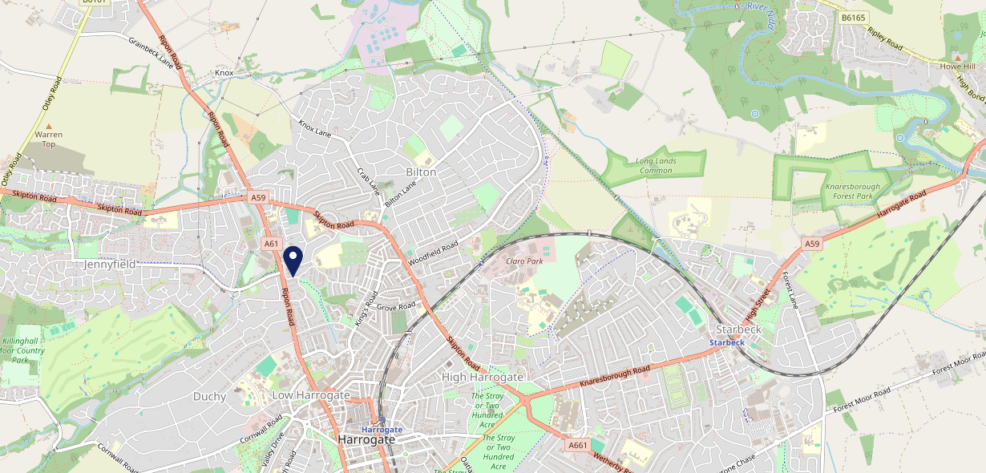
Site Intel
Claro Beagle HG12DR
1 Miles
371 Chains
16/04/2025 - 08/04/2026
Site Summary
Claro Beagle HG12DR
Work Area
Region
TV Region
Urbanicity
Harrogate
Yorkshire and The Humber
Tyne Tees
Urban city and town
HG12DR
Punch Unity
Top Competitors
ATV
Gender
McDonalds Cambridge Rd
#1
£6.90
88.58%
Male
HG11NS
McDonalds
Affluence
Segmentation
Bilton Grange Social Club
#2
72.23%
28.87%
Middle Income
Enterprising Mainstream
HG14LL
Clubs
Age Group
Visit Day
Knox Arms
#3
46.73%
21.40%
HG13AP
45 to 54
Fri
Star Pubs & Bars
Nearest Station
Harrogate(1.20 miles)
422 Site Customers
449 Competitors
243281 Competitor Customers

Slide 2
Site Intel
Claro Beagle HG12DR
1 Miles
371 Chains
16/04/2025 - 08/04/2026
Spend by Weekpart
How is customer spend distributed throughout the week for Claro Beagle HG12DR versus its competitors?
% of spend for Claro Beagle HG12DR and 371 Chains in 1 Miles from 16/04/2025 - 08/04/2026 split by Day of Week
422 Site Customers
449 Competitors
243281 Competitor Customers

Slide 3
Site Intel
Claro Beagle HG12DR
1 Miles
371 Chains
16/04/2025 - 08/04/2026
Visit Frequency
How frequently per year do customers visit Claro Beagle HG12DR versus its competitors?
% of customer numbers for Claro Beagle HG12DR and 371 Chains in 1 Miles from 16/04/2025 - 08/04/2026 and the number of visits made Per Annum
422 Site Customers
449 Competitors
243281 Competitor Customers

Slide 4
Site Intel
Claro Beagle HG12DR
1 Miles
371 Chains
16/04/2025 - 08/04/2026
ATV Change
How has ATV changed between two date ranges?
422 Site Customers

Slide 5
Site Intel
Claro Beagle HG12DR
1 Miles
371 Chains
16/04/2025 - 08/04/2026
Market Share Change
How has market share changed between two date ranges?
% of market share spend for Claro Beagle HG12DR and 371 Chains in 1 Miles from 16/04/2025 - 08/04/2026
422 Site Customers

Slide 6
Site Intel
Claro Beagle HG12DR
1 Miles
371 Chains
16/04/2025 - 08/04/2026
Age
How does the age profile of customers who visit Claro Beagle HG12DR compare versus its competitors?
% of spend for Claro Beagle HG12DR and 371 Chains in 1 Miles from 16/04/2025 - 08/04/2026 split by Age Range
169 Site Customers
449 Competitors
115282 Competitor Customers

Slide 7
Site Intel
Claro Beagle HG12DR
1 Miles
371 Chains
16/04/2025 - 08/04/2026
Affluence
How does the affluence of customers who visit Claro Beagle HG12DR compare versus its competitors?
% of spend for Claro Beagle HG12DR and 371 Chains in 1 Miles from 16/04/2025 - 08/04/2026 split by Affluence
154 Site Customers
449 Competitors
105615 Competitor Customers

Slide 8
Site Intel
Claro Beagle HG12DR
1 Miles
371 Chains
16/04/2025 - 08/04/2026
Gender
How does the gender profile of customers who visit Claro Beagle HG12DR compare versus its competitors?
% of spend for Claro Beagle HG12DR and 371 Chains in 1 Miles from 16/04/2025 - 08/04/2026 split by Gender
161 Site Customers
449 Competitors
111964 Competitor Customers

Slide 9
Site Intel
Claro Beagle HG12DR
1 Miles
371 Chains
16/04/2025 - 08/04/2026
Punch Segmentation
How does the Custom segmentation profile of customers who visit Claro Beagle HG12DR compare versus its competitors?
% of spend for Claro Beagle HG12DR and 371 Chains in 1 Miles from 16/04/2025 - 08/04/2026 split by Segment
422 Site Customers
449 Competitors
243281 Competitor Customers

Slide 10
Site Intel
Claro Beagle HG12DR
1 Miles
371 Chains
16/04/2025 - 08/04/2026
Spend by Distance
How does the spend profile of Claro Beagle HG12DR compare versus its competitors based on travel distances?
% of spend for Claro Beagle HG12DR and 371 Chains in 1 Miles from 16/04/2025 - 08/04/2026 split by Distance travelled
161 Site Customers
449 Competitors
111857 Competitor Customers

Slide 11
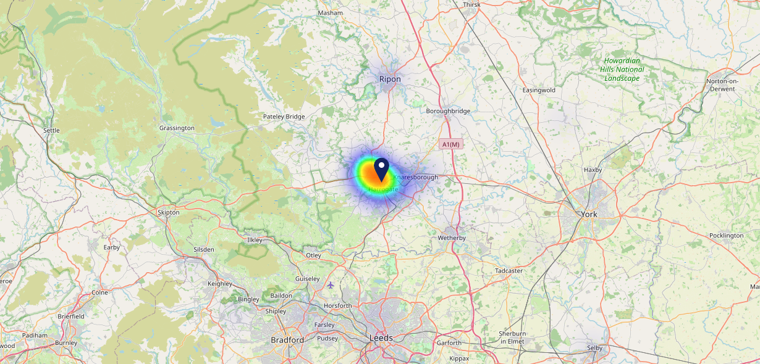
Site Intel
Claro Beagle HG12DR
16/04/2025 - 08/04/2026
Map of Guest Origin
Where do customers of Claro Beagle HG12DR come from?
Where do customers of Claro Beagle HG12DR for 16/04/2025 - 08/04/2026 live
161 Site Customers

Slide 12
Site Intel
Claro Beagle HG12DR
1 Miles
371 Chains
16/04/2025 - 08/04/2026
Share of Wallet
What are the Top 20 venues (by spend) that customers of Claro Beagle HG12DR also visit?
For customers of Claro Beagle HG12DR, who are the top 20 competitors from 371 Chains in 1 Miles for 16/04/2025 - 08/04/2026 split by Venue
422 Site Customers

Slide 13
Site Intel
Claro Beagle HG12DR
1 Miles
371 Chains
16/04/2025 - 08/04/2026
Share of Wallet Change
How has share of wallet of customers of Claro Beagle HG12DR changed between two date ranges?
422 Site Customers

Slide 14
Site Intel
Claro Beagle HG12DR
16/04/2025 - 08/04/2026
Market Summary
How does the local area for Claro Beagle HG12DR compare to the national average (1 = low, 10 = high)
Data Type | Name | Spend in 250m | 250m Spend vs National | Spend in 500m | 500m Spend vs National | Spend in 1 mile | 1 mile Spend vs National | Spend in 3 miles | 3 mile Spend vs National
Total | Annual Sales | £479K | 3 | £546K | 3 | £95.32M | 9 | £127.60M | 7
Weekpart | Mon - Thu | 44.1% | 7 | 45.1% | 8 | 38.0% | 3 | 39.7% | 3
Weekpart | Fri - Sat | 40.0% | 3 | 40.2% | 3 | 47.3% | 9 | 45.0% | 9
Weekpart | Sun | 15.8% | 7 | 14.7% | 5 | 14.7% | 4 | 15.3% | 5
Age | 18 to 24 | 2.2% | 2 | 2.3% | 2 | 3.1% | 2 | 2.7% | 1
Age | 25 to 34 | 4.8% | 1 | 6.1% | 1 | 12.3% | 1 | 11.7% | 1
Age | 35 to 44 | 12.6% | 1 | 14.4% | 1 | 19.8% | 2 | 19.6% | 2
Age | 45 to 54 | 45.7% | 10 | 43.1% | 10 | 22.1% | 8 | 21.0% | 7
Age | 55 to 64 | 32.2% | 10 | 31.5% | 10 | 23.6% | 10 | 23.4% | 10
Age | 65 to 74 | 0.6% | 1 | 0.9% | 1 | 12.6% | 9 | 13.5% | 10
Age | 75+ | 1.9% | 5 | 1.7% | 4 | 6.5% | 9 | 8.0% | 10
CAMEO | Business Elite | 1.8% | 2 | 1.8% | 2 | 12.7% | 8 | 13.5% | 8
CAMEO | Prosperous Professionals | 1.7% | 2 | 1.7% | 1 | 11.1% | 9 | 11.3% | 10
CAMEO | Flourishing Society | 0.5% | 1 | 3.9% | 1 | 12.9% | 6 | 12.8% | 5
CAMEO | Content Communities | 13.9% | 7 | 13.0% | 6 | 13.5% | 7 | 13.6% | 7
CAMEO | White Collar Neighbourhoods | 2.1% | 1 | 2.5% | 1 | 12.0% | 6 | 11.6% | 5
CAMEO | Enterprising Mainstream | 31.1% | 10 | 28.5% | 10 | 10.7% | 8 | 10.9% | 8
CAMEO | Paying The Mortgage | 27.1% | 10 | 27.5% | 10 | 13.4% | 5 | 13.2% | 4
CAMEO | Cash Conscious Communities | 4.3% | 2 | 4.6% | 2 | 7.1% | 4 | 6.7% | 3
CAMEO | On A Budget | 6.7% | 6 | 6.6% | 6 | 3.7% | 2 | 3.7% | 2
CAMEO | Family Value | 10.8% | 9 | 9.9% | 9 | 2.9% | 6 | 2.6% | 5
Affluence | AB | 4.0% | 1 | 7.3% | 1 | 36.7% | 7 | 37.6% | 7
Affluence | C1C2 | 74.2% | 10 | 71.5% | 10 | 49.6% | 6 | 49.4% | 6
Affluence | DE | 21.8% | 6 | 21.2% | 6 | 13.7% | 3 | 13.0% | 2

