Slide 1
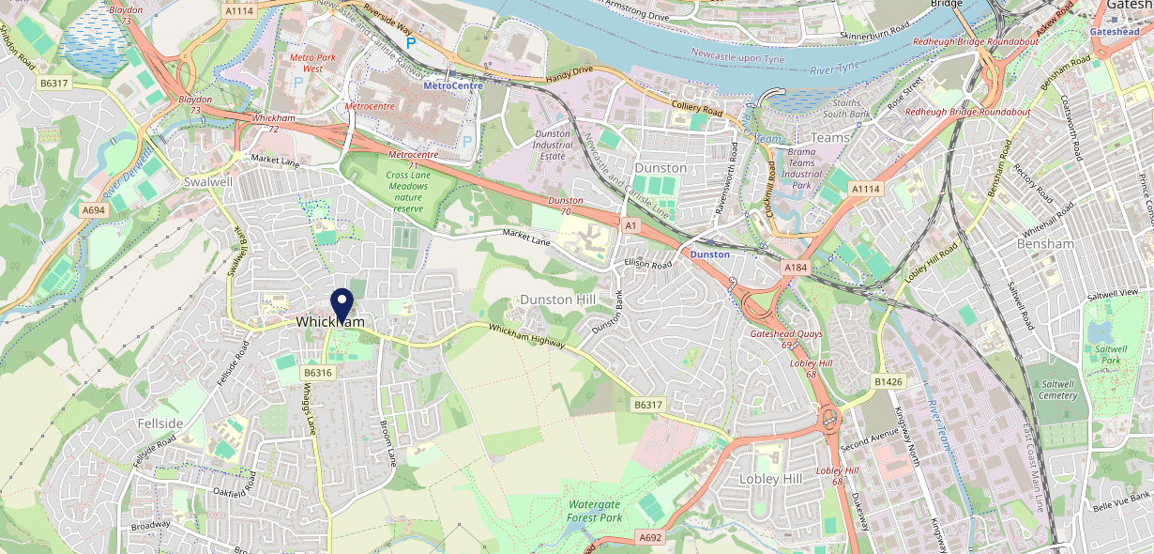
Site Intel
Crown NE164DT
1 Miles
371 Chains
16/04/2025 - 08/04/2026
Site Summary
Crown NE164DT
Work Area
Region
TV Region
Urbanicity
Newcastle
North East
Tyne Tees
Urban major conurbation
NE164DT
Punch T&L
Top Competitors
ATV
Gender
Bay Horse (Whickham)
#1
£9.64
65.65%
Male
NE164EF
GK - Pub & Social
Affluence
Segmentation
The Harry Clasper
#2
64.78%
30.52%
Middle Income
Enterprising Mainstream
NE164HF
JD Wetherspoon
Age Group
Visit Day
Bridle Path Whickham
#3
32.87%
40.08%
NE164JJ
45 to 54
Sat
Proper Pubs
Nearest Station
MetroCentre(1.57 miles)
409 Site Customers
176 Competitors
252218 Competitor Customers

Slide 2
Site Intel
Crown NE164DT
1 Miles
371 Chains
16/04/2025 - 08/04/2026
Spend by Weekpart
How is customer spend distributed throughout the week for Crown NE164DT versus its competitors?
% of spend for Crown NE164DT and 371 Chains in 1 Miles from 16/04/2025 - 08/04/2026 split by Day of Week
409 Site Customers
176 Competitors
252218 Competitor Customers

Slide 3
Site Intel
Crown NE164DT
1 Miles
371 Chains
16/04/2025 - 08/04/2026
Visit Frequency
How frequently per year do customers visit Crown NE164DT versus its competitors?
% of customer numbers for Crown NE164DT and 371 Chains in 1 Miles from 16/04/2025 - 08/04/2026 and the number of visits made Per Annum
409 Site Customers
176 Competitors
252218 Competitor Customers

Slide 4
Site Intel
Crown NE164DT
1 Miles
371 Chains
16/04/2025 - 08/04/2026
ATV Change
How has ATV changed between two date ranges?
409 Site Customers

Slide 5
Site Intel
Crown NE164DT
1 Miles
371 Chains
16/04/2025 - 08/04/2026
Market Share Change
How has market share changed between two date ranges?
% of market share spend for Crown NE164DT and 371 Chains in 1 Miles from 16/04/2025 - 08/04/2026
409 Site Customers

Slide 6
Site Intel
Crown NE164DT
1 Miles
371 Chains
16/04/2025 - 08/04/2026
Age
How does the age profile of customers who visit Crown NE164DT compare versus its competitors?
% of spend for Crown NE164DT and 371 Chains in 1 Miles from 16/04/2025 - 08/04/2026 split by Age Range
182 Site Customers
176 Competitors
110287 Competitor Customers

Slide 7
Site Intel
Crown NE164DT
1 Miles
371 Chains
16/04/2025 - 08/04/2026
Affluence
How does the affluence of customers who visit Crown NE164DT compare versus its competitors?
% of spend for Crown NE164DT and 371 Chains in 1 Miles from 16/04/2025 - 08/04/2026 split by Affluence
170 Site Customers
176 Competitors
98976 Competitor Customers

Slide 8
Site Intel
Crown NE164DT
1 Miles
371 Chains
16/04/2025 - 08/04/2026
Gender
How does the gender profile of customers who visit Crown NE164DT compare versus its competitors?
% of spend for Crown NE164DT and 371 Chains in 1 Miles from 16/04/2025 - 08/04/2026 split by Gender
177 Site Customers
176 Competitors
106567 Competitor Customers

Slide 9
Site Intel
Crown NE164DT
1 Miles
371 Chains
16/04/2025 - 08/04/2026
Punch Segmentation
How does the Custom segmentation profile of customers who visit Crown NE164DT compare versus its competitors?
% of spend for Crown NE164DT and 371 Chains in 1 Miles from 16/04/2025 - 08/04/2026 split by Segment
409 Site Customers
176 Competitors
252218 Competitor Customers

Slide 10
Site Intel
Crown NE164DT
1 Miles
371 Chains
16/04/2025 - 08/04/2026
Spend by Distance
How does the spend profile of Crown NE164DT compare versus its competitors based on travel distances?
% of spend for Crown NE164DT and 371 Chains in 1 Miles from 16/04/2025 - 08/04/2026 split by Distance travelled
177 Site Customers
176 Competitors
106516 Competitor Customers

Slide 11
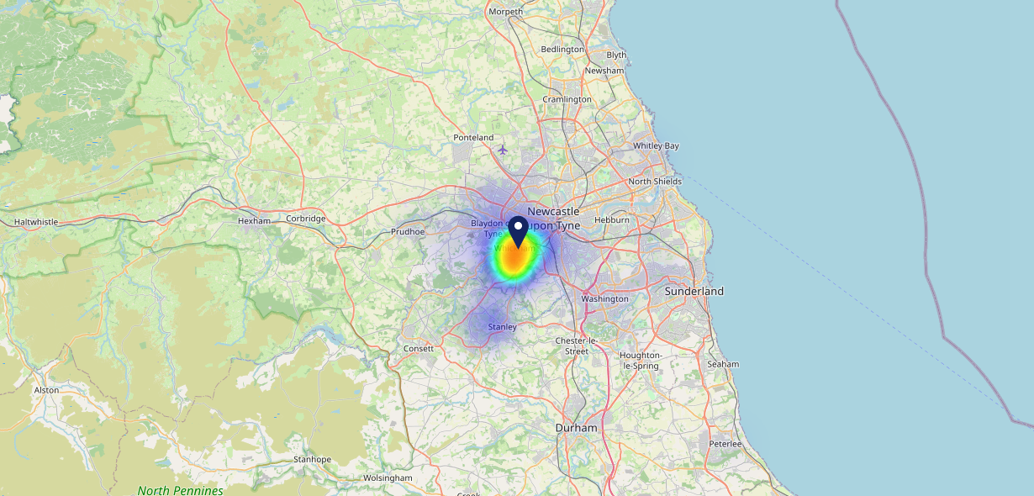
Site Intel
Crown NE164DT
16/04/2025 - 08/04/2026
Map of Guest Origin
Where do customers of Crown NE164DT come from?
Where do customers of Crown NE164DT for 16/04/2025 - 08/04/2026 live
177 Site Customers

Slide 12
Site Intel
Crown NE164DT
1 Miles
371 Chains
16/04/2025 - 08/04/2026
Share of Wallet
What are the Top 20 venues (by spend) that customers of Crown NE164DT also visit?
For customers of Crown NE164DT, who are the top 20 competitors from 371 Chains in 1 Miles for 16/04/2025 - 08/04/2026 split by Venue
409 Site Customers

Slide 13
Site Intel
Crown NE164DT
1 Miles
371 Chains
16/04/2025 - 08/04/2026
Share of Wallet Change
How has share of wallet of customers of Crown NE164DT changed between two date ranges?
409 Site Customers

Slide 14
Site Intel
Crown NE164DT
16/04/2025 - 08/04/2026
Market Summary
How does the local area for Crown NE164DT compare to the national average (1 = low, 10 = high)
Data Type | Name | Spend in 250m | 250m Spend vs National | Spend in 500m | 500m Spend vs National | Spend in 1 mile | 1 mile Spend vs National | Spend in 3 miles | 3 mile Spend vs National
Total | Annual Sales | £1.70M | 5 | £3.49M | 5 | £62.71M | 8 | £227.32M | 8
Weekpart | Mon - Thu | 35.9% | 3 | 35.0% | 2 | 43.4% | 7 | 37.8% | 1
Weekpart | Fri - Sat | 51.2% | 9 | 51.7% | 10 | 41.5% | 4 | 46.4% | 10
Weekpart | Sun | 12.8% | 4 | 13.3% | 3 | 15.1% | 5 | 15.8% | 6
Age | 18 to 24 | 3.5% | 3 | 3.2% | 3 | 7.1% | 6 | 9.6% | 8
Age | 25 to 34 | 11.7% | 1 | 9.7% | 1 | 18.0% | 3 | 19.2% | 3
Age | 35 to 44 | 26.2% | 7 | 22.8% | 5 | 31.0% | 10 | 28.9% | 10
Age | 45 to 54 | 27.1% | 10 | 30.0% | 10 | 21.1% | 7 | 20.6% | 6
Age | 55 to 64 | 19.4% | 8 | 22.6% | 9 | 14.0% | 4 | 14.3% | 5
Age | 65 to 74 | 8.8% | 7 | 9.3% | 8 | 6.6% | 6 | 5.8% | 4
Age | 75+ | 3.3% | 7 | 2.3% | 5 | 2.2% | 5 | 1.6% | 2
CAMEO | Business Elite | 2.4% | 2 | 2.9% | 3 | 2.9% | 2 | 4.2% | 3
CAMEO | Prosperous Professionals | 2.8% | 3 | 4.3% | 4 | 2.9% | 2 | 3.3% | 2
CAMEO | Flourishing Society | 3.1% | 1 | 5.1% | 2 | 6.5% | 2 | 7.3% | 2
CAMEO | Content Communities | 14.7% | 8 | 14.9% | 8 | 9.5% | 2 | 8.7% | 1
CAMEO | White Collar Neighbourhoods | 19.6% | 10 | 16.8% | 10 | 10.9% | 5 | 11.1% | 5
CAMEO | Enterprising Mainstream | 8.8% | 6 | 7.6% | 5 | 7.8% | 5 | 7.9% | 5
CAMEO | Paying The Mortgage | 15.5% | 6 | 17.0% | 7 | 16.9% | 7 | 16.6% | 7
CAMEO | Cash Conscious Communities | 13.8% | 8 | 14.5% | 9 | 14.6% | 9 | 13.9% | 9
CAMEO | On A Budget | 1.6% | 1 | 1.5% | 1 | 5.9% | 5 | 6.6% | 5
CAMEO | Family Value | 17.7% | 10 | 15.4% | 10 | 22.1% | 10 | 20.4% | 10
Affluence | AB | 8.3% | 1 | 12.3% | 2 | 12.3% | 2 | 14.8% | 2
Affluence | C1C2 | 58.6% | 9 | 56.3% | 9 | 45.1% | 4 | 44.3% | 4
Affluence | DE | 33.1% | 9 | 31.4% | 8 | 42.6% | 10 | 40.9% | 10

Slide 15
Site Intel
Crown NE164DT
Local Market Profile
Mix of spend by customer segment in Punch site and local market
 | Customer Count | Family Familiar | Occasional & Local | Mid-Week Seniors | Part Of The Pub | Metro Sophisticates | Young & Connected | Bubbly Weekenders | Upmarket Diners
Crown | 74 | 8.44% | 3.30% | 5.19% | 21.56% | 4.80% | 33.15% | 16.66% | 6.86%
Local Catchment | 11545 | 26.50% | 5.62% | 11.06% | 5.23% | 5.48% | 19.58% | 16.86% | 9.62%
Punch T&L | 95687 | 8.84% | 6.07% | 28.69% | 10.97% | 11.46% | 11.00% | 7.08% | 15.85%
Crown vs Local Catchment |  | -18.06% | -2.32% | -5.87% | 16.33% | -0.68% | 13.57% | -0.20% | -2.76%
Crown vs Punch T&L |  | -0.40% | -2.77% | -23.50% | 10.59% | -6.66% | 22.15% | 9.58% | -8.99%
Local Catchment vs Punch T&L |  | 17.66% | -0.45% | -17.63% | -5.74% | -5.98% | 8.58% | 9.78% | -6.23%

Slide 16
Site Intel
Crown NE164DT
Local Competitor Profiles
Mix of spend by customer segment in Punch site and local competitors
 | Customer Count | Family Familiar | Occasional & Local | Mid-Week Seniors | Part Of The Pub | Metro Sophisticates | Young & Connected | Bubbly Weekenders | Upmarket Diners
Bay Horse (Whickham) NE164EF | 237 | 11.16% | 3.03% | 10.29% | 26.50% | 8.46% | 24.15% | 12.61% | 3.76%
The Harry Clasper NE164HF | 296 | 8.73% | 4.75% | 14.90% | 37.73% | 5.73% | 14.70% | 8.73% | 4.70%
Bridle Path Whickham NE164JJ | 166 | 14.13% | 4.93% | 8.15% | 22.63% | 8.97% | 15.32% | 18.98% | 6.86%
Crown NE164DT | 74 | 8.44% | 3.30% | 5.19% | 21.56% | 4.80% | 33.15% | 16.66% | 6.86%
One Eyed Stag NE164JB | 91 | 3.29% | 1.14% | 9.53% | 12.33% | 7.71% | 11.30% | 40.22% | 14.45%
McDonalds Gateshead Cameron Park NE119XU | 842 | 33.26% | 8.40% | 5.80% | 1.71% | 2.90% | 23.28% | 18.29% | 6.32%
Miahs Whickham NE164AB | 45 | 16.17% | 0.46% | 9.43% | 7.52% | 1.21% | 5.52% | 32.47% | 27.18%
Jamdani Restaurant NE164JB | 83 | 12.17% | 3.98% | 17.84% | 11.22% | 4.48% | 9.99% | 20.42% | 19.86%
Fellsider NE165BY | 98 | 15.48% | 6.90% | 4.25% | 23.36% | 12.05% | 16.00% | 11.25% | 10.67%
Crown Kitchen NE164DT | 73 | 13.81% | 12.39% | 5.23% | 18.31% | 10.57% | 24.16% | 8.97% | 6.53%
Greggs Plc NE164DN | 156 | 24.55% | 3.77% | 10.08% | 5.41% | 5.31% | 12.09% | 26.56% | 12.20%
Wetherspoons NE119YP | 699 | 28.44% | 11.19% | 23.36% | 11.49% | 4.09% | 12.61% | 5.60% | 3.19%
Oli And Joes Whickham NE164DT | 47 | 4.28% | 3.81% | 20.78% | 1.80% | 8.39% | 17.16% | 13.05% | 30.68%
Starbucks NE119ZG | 564 | 16.56% | 5.33% | 6.28% | 1.05% | 6.97% | 16.87% | 32.01% | 14.89%
Kato Whickham NE164JA | 53 | 14.70% | 8.26% | 23.02% | 6.30% | 13.10% | 12.14% | 14.12% | 8.31%
1771 Club House NE163AA | 57 | 27.76% | 3.31% | 4.15% | 7.18% | 4.46% | 19.71% | 15.46% | 17.93%
365 NE119XU | 500 | 27.20% | 7.16% | 9.59% | 4.02% | 5.72% | 19.24% | 20.12% | 6.90%
Wagamama Gateshead Metro Centre NE119XZ | 688 | 21.55% | 2.66% | 10.82% | 1.56% | 5.66% | 23.11% | 19.24% | 15.36%
Whickham Fish Kitchen NE164AB | 61 | 6.53% | 4.65% | 19.51% | 3.53% | 10.87% | 7.78% | 21.19% | 25.90%
Greggs NE119YA | 632 | 27.61% | 6.91% | 8.58% | 4.25% | 8.49% | 17.24% | 17.58% | 9.30%
McDonalds Metro Centre Yellow NE119XY | 1000 | 40.29% | 6.85% | 5.62% | 3.43% | 1.78% | 25.49% | 12.80% | 3.70%
The Highwayman NE119QJ | 74 | 15.77% | 5.21% | 2.22% | 59.34% | 0.95% | 4.72% | 11.63% | 0.12%
Caffe Nero NE119YG | 923 | 16.60% | 17.30% | 12.76% | 1.75% | 6.45% | 14.87% | 17.98% | 12.26%
Greggs NE164DN | 139 | 21.53% | 1.93% | 9.43% | 3.16% | 7.90% | 19.25% | 20.17% | 16.60%
Toby Carvery Metrocentre NE119ZG | 281 | 38.95% | 9.92% | 12.76% | 4.95% | 1.82% | 12.52% | 14.33% | 4.71%

