Slide 1
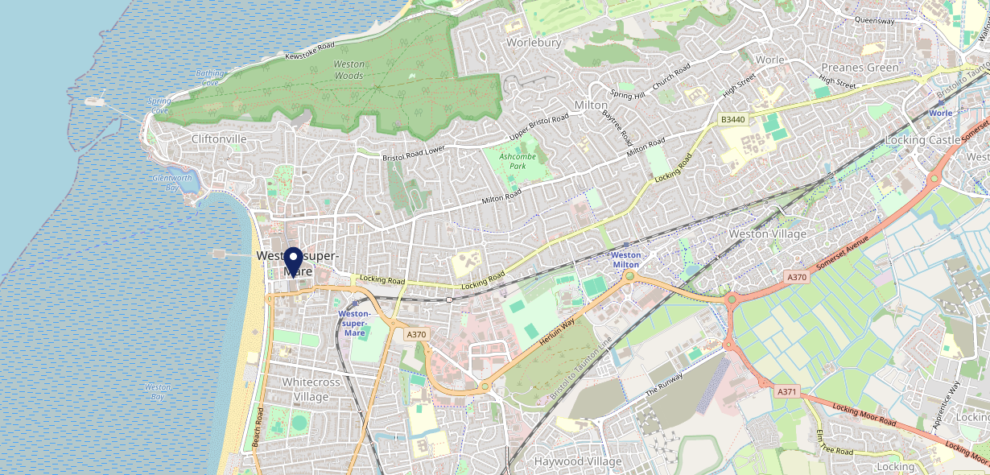
Site Intel
Duke of Oxford BS231TF
3 Miles
113 Chains
22/02/2023 - 14/02/2024
Site Summary
Duke of Oxford BS231TF
Work Area
Region
TV Region
Urbanicity
Weston-super-Mare
South West
Harwest
Urban city and town
BS231TF
Punch T&L
Top Competitors
ATV
Gender
Cabot Court Hotel
#1
£10.39
61.29%
Male
BS232AH
JD Wetherspoon
Affluence
Segmentation
Brunello Lounge
#2
57.09%
17.50%
Middle Income
Paying The Mortgage
BS231AS
Lounge
Age Group
Visit Day
Observatory
#3
23.79%
30.76%
BS227TA
35 to 44
Sat
Marstons Community Non Catering
Nearest Station
Weston-Super-Mare(0.53 miles)
3795 Site Customers
16 Competitors
35215 Competitor Customers

Slide 2
Site Intel
Duke of Oxford BS231TF
3 Miles
113 Chains
22/02/2023 - 14/02/2024
Spend by Weekpart
How is customer spend distributed throughout the week for Duke of Oxford BS231TF versus its competitors?
% of spend for Duke of Oxford BS231TF and 113 Chains in 3 Miles from 22/02/2023 - 14/02/2024 split by Day of Week
3795 Site Customers
16 Competitors
35215 Competitor Customers

Slide 3
Site Intel
Duke of Oxford BS231TF
3 Miles
113 Chains
22/02/2023 - 14/02/2024
Visit Frequency
How frequently per year do customers visit Duke of Oxford BS231TF versus its competitors?
% of customer numbers for Duke of Oxford BS231TF and 113 Chains in 3 Miles from 22/02/2023 - 14/02/2024 and the number of visits made Per Annum
3795 Site Customers
16 Competitors
35215 Competitor Customers

Slide 4
Site Intel
Duke of Oxford BS231TF
3 Miles
113 Chains
22/02/2023 - 14/02/2024
ATV Change
How has ATV changed between two date ranges?
3795 Site Customers

Slide 5
Site Intel
Duke of Oxford BS231TF
3 Miles
113 Chains
22/02/2023 - 14/02/2024
Market Share Change
How has market share changed between two date ranges?
% of market share spend for Duke of Oxford BS231TF and 113 Chains in 3 Miles from 22/02/2023 - 14/02/2024
3795 Site Customers

Slide 6
Site Intel
Duke of Oxford BS231TF
3 Miles
113 Chains
22/02/2023 - 14/02/2024
Age
How does the age profile of customers who visit Duke of Oxford BS231TF compare versus its competitors?
% of spend for Duke of Oxford BS231TF and 113 Chains in 3 Miles from 22/02/2023 - 14/02/2024 split by Age Range
1902 Site Customers
16 Competitors
18121 Competitor Customers

Slide 7
Site Intel
Duke of Oxford BS231TF
3 Miles
113 Chains
22/02/2023 - 14/02/2024
Affluence
How does the affluence of customers who visit Duke of Oxford BS231TF compare versus its competitors?
% of spend for Duke of Oxford BS231TF and 113 Chains in 3 Miles from 22/02/2023 - 14/02/2024 split by Affluence
1753 Site Customers
16 Competitors
16780 Competitor Customers

Slide 8
Site Intel
Duke of Oxford BS231TF
3 Miles
113 Chains
22/02/2023 - 14/02/2024
Gender
How does the gender profile of customers who visit Duke of Oxford BS231TF compare versus its competitors?
% of spend for Duke of Oxford BS231TF and 113 Chains in 3 Miles from 22/02/2023 - 14/02/2024 split by Gender
1837 Site Customers
16 Competitors
17728 Competitor Customers

Slide 9
Site Intel
Duke of Oxford BS231TF
3 Miles
113 Chains
22/02/2023 - 14/02/2024
Punch Segmentation
How does the Custom segmentation profile of customers who visit Duke of Oxford BS231TF compare versus its competitors?
% of spend for Duke of Oxford BS231TF and 113 Chains in 3 Miles from 22/02/2023 - 14/02/2024 split by Segment
3795 Site Customers
16 Competitors
35215 Competitor Customers

Slide 10
Site Intel
Duke of Oxford BS231TF
3 Miles
113 Chains
22/02/2023 - 14/02/2024
Spend by Distance
How does the spend profile of Duke of Oxford BS231TF compare versus its competitors based on travel distances?
% of spend for Duke of Oxford BS231TF and 113 Chains in 3 Miles from 22/02/2023 - 14/02/2024 split by Distance travelled
1837 Site Customers
16 Competitors
17725 Competitor Customers

Slide 11
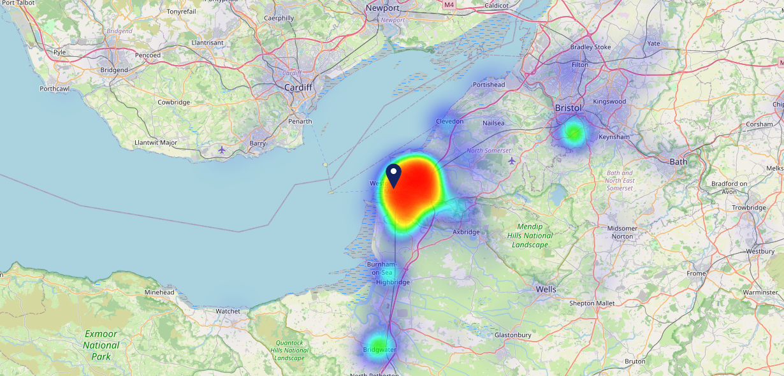
Site Intel
Duke of Oxford BS231TF
22/02/2023 - 14/02/2024
Map of Guest Origin
Where do customers of Duke of Oxford BS231TF come from?
Where do customers of Duke of Oxford BS231TF for 22/02/2023 - 14/02/2024 live
1837 Site Customers

Slide 12
Site Intel
Duke of Oxford BS231TF
3 Miles
113 Chains
22/02/2023 - 14/02/2024
Share of Wallet
What are the Top 20 venues (by spend) that customers of Duke of Oxford BS231TF also visit?
For customers of Duke of Oxford BS231TF, who are the top 20 competitors from 113 Chains in 3 Miles for 22/02/2023 - 14/02/2024 split by Venue
3795 Site Customers

Slide 13
Site Intel
Duke of Oxford BS231TF
3 Miles
113 Chains
22/02/2023 - 14/02/2024
Share of Wallet Change
How has share of wallet of customers of Duke of Oxford BS231TF changed between two date ranges?
3795 Site Customers

Slide 14
Site Intel
Duke of Oxford BS231TF
22/02/2023 - 14/02/2024
Market Summary
How does the local area for Duke of Oxford BS231TF compare to the national average (1 = low, 10 = high)
Data Type | Name | Spend in 250m | 250m Spend vs National | Spend in 500m | 500m Spend vs National | Spend in 1 mile | 1 mile Spend vs National | Spend in 3 miles | 3 mile Spend vs National
Total | Annual Sales | £21.35M | 10 | £33.53M | 9 | £58.92M | 8 | £104.71M | 7
Weekpart | Mon - Thu | 39.6% | 5 | 38.2% | 4 | 39.1% | 4 | 41.9% | 6
Weekpart | Fri - Sat | 45.0% | 6 | 45.6% | 7 | 44.5% | 7 | 42.3% | 6
Weekpart | Sun | 15.4% | 6 | 16.2% | 7 | 16.5% | 8 | 15.8% | 6
Age | 18 to 24 | 6.6% | 6 | 6.8% | 6 | 5.9% | 5 | 5.6% | 4
Age | 25 to 34 | 14.9% | 2 | 14.4% | 2 | 14.1% | 2 | 14.4% | 1
Age | 35 to 44 | 24.4% | 6 | 23.0% | 5 | 21.4% | 4 | 21.5% | 3
Age | 45 to 54 | 20.5% | 6 | 20.0% | 5 | 19.7% | 5 | 19.8% | 5
Age | 55 to 64 | 19.1% | 8 | 19.8% | 8 | 21.3% | 9 | 20.6% | 9
Age | 65 to 74 | 10.0% | 8 | 10.5% | 8 | 11.5% | 9 | 11.6% | 9
Age | 75+ | 4.5% | 8 | 5.5% | 9 | 6.0% | 9 | 6.4% | 10
CAMEO | Business Elite | 2.6% | 3 | 2.6% | 2 | 2.6% | 2 | 2.2% | 1
CAMEO | Prosperous Professionals | 6.2% | 6 | 5.9% | 5 | 6.1% | 5 | 6.0% | 5
CAMEO | Flourishing Society | 9.3% | 4 | 9.2% | 4 | 9.5% | 4 | 10.3% | 4
CAMEO | Content Communities | 14.7% | 8 | 14.4% | 8 | 14.5% | 8 | 15.4% | 8
CAMEO | White Collar Neighbourhoods | 14.0% | 8 | 14.5% | 9 | 14.7% | 9 | 14.4% | 9
CAMEO | Enterprising Mainstream | 11.8% | 8 | 11.9% | 8 | 11.8% | 8 | 13.3% | 9
CAMEO | Paying The Mortgage | 16.8% | 7 | 16.9% | 7 | 16.7% | 7 | 16.4% | 7
CAMEO | Cash Conscious Communities | 12.8% | 8 | 12.7% | 8 | 13.3% | 9 | 11.9% | 8
CAMEO | On A Budget | 8.1% | 7 | 7.9% | 7 | 7.4% | 6 | 7.2% | 6
CAMEO | Family Value | 3.6% | 7 | 4.0% | 7 | 3.4% | 6 | 2.9% | 6
Affluence | AB | 18.1% | 3 | 17.7% | 3 | 18.2% | 3 | 18.6% | 3
Affluence | C1C2 | 57.3% | 9 | 57.7% | 9 | 57.7% | 9 | 59.4% | 10
Affluence | DE | 24.6% | 7 | 24.6% | 7 | 24.1% | 7 | 22.0% | 6

Slide 15
Site Intel
Duke of Oxford BS231TF
Local Market Profile
Mix of spend by customer segment in Punch site and local market
 | Customer Count | Family Familiar | Occasional & Local | Mid-Week Seniors | Part Of The Pub | Metro Sophisticates | Young & Connected | Bubbly Weekenders | Upmarket Diners
Duke of Oxford | 829 | 14.06% | 7.98% | 15.71% | 17.05% | 9.98% | 20.28% | 8.38% | 6.54%
Local Catchment | 4539 | 20.18% | 7.07% | 17.57% | 16.99% | 3.31% | 21.21% | 8.94% | 4.68%
Punch T&L | 111300 | 7.84% | 6.06% | 29.39% | 10.79% | 11.70% | 11.49% | 7.04% | 15.64%
Duke of Oxford vs Local Catchment |  | -6.12% | 0.91% | -1.86% | 0.06% | 6.67% | -0.93% | -0.56% | 1.86%
Duke of Oxford vs Punch T&L |  | 6.22% | 1.92% | -13.68% | 6.26% | -1.72% | 8.79% | 1.34% | -9.10%
Local Catchment vs Punch T&L |  | 12.34% | 1.01% | -11.82% | 6.20% | -8.39% | 9.72% | 1.90% | -10.96%

Slide 16
Site Intel
Duke of Oxford BS231TF
Local Competitor Profiles
Mix of spend by customer segment in Punch site and local competitors
 | Customer Count | Family Familiar | Occasional & Local | Mid-Week Seniors | Part Of The Pub | Metro Sophisticates | Young & Connected | Bubbly Weekenders | Upmarket Diners
Duke of Oxford BS231TF | 829 | 14.06% | 7.98% | 15.71% | 17.05% | 9.98% | 20.28% | 8.38% | 6.54%
Cabot Court Hotel BS232AH | 1566 | 17.42% | 8.03% | 16.42% | 22.61% | 4.04% | 22.30% | 7.27% | 1.85%
Brunello Lounge BS231AS | 1036 | 17.39% | 4.49% | 21.01% | 4.08% | 7.77% | 24.98% | 10.72% | 9.53%
Observatory BS227TA | 136 | 3.97% | 4.14% | 4.05% | 40.79% | 1.64% | 11.76% | 33.14% | 0.47%
Landing Light BS248EE | 756 | 22.13% | 4.39% | 28.43% | 5.86% | 3.08% | 21.43% | 5.63% | 9.02%
The Regent Weston Super Mare BS231SQ | 661 | 16.32% | 8.86% | 8.57% | 15.37% | 3.11% | 36.12% | 9.18% | 2.44%
Popworld & Zinc Weston Super Mare BS231SY | 273 | 7.41% | 1.24% | 3.10% | 10.05% | 4.32% | 66.05% | 7.01% | 0.78%
The Old Manor Inn BS229LP | 340 | 23.45% | 13.61% | 12.62% | 29.49% | 0.74% | 15.19% | 3.76% | 1.09%
Beefeater The Pavilion BS228LY | 592 | 29.64% | 7.93% | 24.53% | 7.47% | 1.92% | 16.26% | 5.88% | 6.34%
Golden Lion Worle BS226ET | 170 | 5.64% | 7.09% | 2.47% | 62.46% | 2.17% | 16.77% | 2.44% | 0.92%
Old Colonial BS232AW | 397 | 17.27% | 14.83% | 14.08% | 22.78% | 4.33% | 17.13% | 6.40% | 3.14%
Catherine's Inn (Weston-Super-Mare) BS240PZ | 357 | 36.72% | 8.19% | 19.34% | 10.57% | 3.08% | 13.91% | 4.46% | 3.69%
Brewers Fayre Weston-Super-Mare BS231TT | 476 | 39.73% | 8.18% | 16.08% | 4.36% | 1.27% | 19.75% | 5.82% | 4.76%
Captains Cabin BS232EF | 115 | 18.28% | 4.44% | 34.20% | 13.37% | 2.58% | 13.09% | 8.18% | 5.82%
Seaton Hotel BS231AU | 102 | 28.50% | 4.10% | 33.63% | 10.22% | 2.61% | 12.71% | 1.37% | 6.81%

