Slide 1
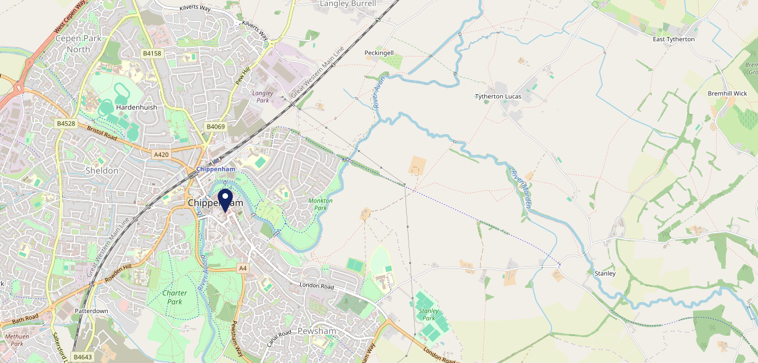
Site Intel
Flying Monk SN153HD
1 Miles
371 Chains
16/04/2025 - 08/04/2026
Site Summary
Flying Monk SN153HD
Work Area
Region
TV Region
Urbanicity
Trowbridge
South West
HarWest
Urban city and town
SN153HD
Pub / Bar
Top Competitors
ATV
Gender
Old Road Tavern Chippenham
#1
£11.73
88.27%
Male
SN151JA
Stonegate PP
Affluence
Segmentation
Old Lane
#2
43.96%
21.62%
Middle Income
Enterprising Mainstream
SN153SY
Marstons Community Wet
Age Group
Visit Day
The Bridge House
#3
51.90%
30.66%
SN153WL
55 to 64
Sat
JD Wetherspoon
Nearest Station
Chippenham(0.51 miles)
806 Site Customers
133 Competitors
64213 Competitor Customers

Slide 2
Site Intel
Flying Monk SN153HD
1 Miles
371 Chains
16/04/2025 - 08/04/2026
Spend by Weekpart
How is customer spend distributed throughout the week for Flying Monk SN153HD versus its competitors?
% of spend for Flying Monk SN153HD and 371 Chains in 1 Miles from 16/04/2025 - 08/04/2026 split by Day of Week
806 Site Customers
133 Competitors
64213 Competitor Customers

Slide 3
Site Intel
Flying Monk SN153HD
1 Miles
371 Chains
16/04/2025 - 08/04/2026
Visit Frequency
How frequently per year do customers visit Flying Monk SN153HD versus its competitors?
% of customer numbers for Flying Monk SN153HD and 371 Chains in 1 Miles from 16/04/2025 - 08/04/2026 and the number of visits made Per Annum
806 Site Customers
133 Competitors
64213 Competitor Customers

Slide 4
Site Intel
Flying Monk SN153HD
1 Miles
371 Chains
16/04/2025 - 08/04/2026
ATV Change
How has ATV changed between two date ranges?
806 Site Customers

Slide 5
Site Intel
Flying Monk SN153HD
1 Miles
371 Chains
16/04/2025 - 08/04/2026
Market Share Change
How has market share changed between two date ranges?
% of market share spend for Flying Monk SN153HD and 371 Chains in 1 Miles from 16/04/2025 - 08/04/2026
806 Site Customers

Slide 6
Site Intel
Flying Monk SN153HD
1 Miles
371 Chains
16/04/2025 - 08/04/2026
Age
How does the age profile of customers who visit Flying Monk SN153HD compare versus its competitors?
% of spend for Flying Monk SN153HD and 371 Chains in 1 Miles from 16/04/2025 - 08/04/2026 split by Age Range
444 Site Customers
133 Competitors
32621 Competitor Customers

Slide 7
Site Intel
Flying Monk SN153HD
1 Miles
371 Chains
16/04/2025 - 08/04/2026
Affluence
How does the affluence of customers who visit Flying Monk SN153HD compare versus its competitors?
% of spend for Flying Monk SN153HD and 371 Chains in 1 Miles from 16/04/2025 - 08/04/2026 split by Affluence
410 Site Customers
133 Competitors
29356 Competitor Customers

Slide 8
Site Intel
Flying Monk SN153HD
1 Miles
371 Chains
16/04/2025 - 08/04/2026
Gender
How does the gender profile of customers who visit Flying Monk SN153HD compare versus its competitors?
% of spend for Flying Monk SN153HD and 371 Chains in 1 Miles from 16/04/2025 - 08/04/2026 split by Gender
427 Site Customers
133 Competitors
31753 Competitor Customers

Slide 9
Site Intel
Flying Monk SN153HD
1 Miles
371 Chains
16/04/2025 - 08/04/2026
Punch Segmentation
How does the Custom segmentation profile of customers who visit Flying Monk SN153HD compare versus its competitors?
% of spend for Flying Monk SN153HD and 371 Chains in 1 Miles from 16/04/2025 - 08/04/2026 split by Segment
806 Site Customers
133 Competitors
64213 Competitor Customers

Slide 10
Site Intel
Flying Monk SN153HD
1 Miles
371 Chains
16/04/2025 - 08/04/2026
Spend by Distance
How does the spend profile of Flying Monk SN153HD compare versus its competitors based on travel distances?
% of spend for Flying Monk SN153HD and 371 Chains in 1 Miles from 16/04/2025 - 08/04/2026 split by Distance travelled
427 Site Customers
133 Competitors
31733 Competitor Customers

Slide 11
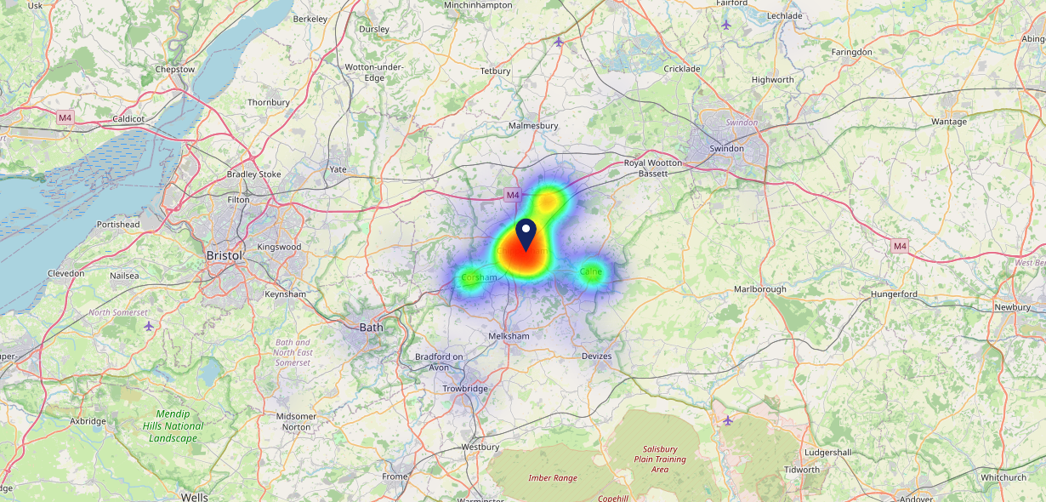
Site Intel
Flying Monk SN153HD
16/04/2025 - 08/04/2026
Map of Guest Origin
Where do customers of Flying Monk SN153HD come from?
Where do customers of Flying Monk SN153HD for 16/04/2025 - 08/04/2026 live
427 Site Customers

Slide 12
Site Intel
Flying Monk SN153HD
1 Miles
371 Chains
16/04/2025 - 08/04/2026
Share of Wallet
What are the Top 20 venues (by spend) that customers of Flying Monk SN153HD also visit?
For customers of Flying Monk SN153HD, who are the top 20 competitors from 371 Chains in 1 Miles for 16/04/2025 - 08/04/2026 split by Venue
806 Site Customers

Slide 13
Site Intel
Flying Monk SN153HD
1 Miles
371 Chains
16/04/2025 - 08/04/2026
Share of Wallet Change
How has share of wallet of customers of Flying Monk SN153HD changed between two date ranges?
806 Site Customers

Slide 14
Site Intel
Flying Monk SN153HD
16/04/2025 - 08/04/2026
Market Summary
How does the local area for Flying Monk SN153HD compare to the national average (1 = low, 10 = high)
Data Type | Name | Spend in 250m | 250m Spend vs National | Spend in 500m | 500m Spend vs National | Spend in 1 mile | 1 mile Spend vs National | Spend in 3 miles | 3 mile Spend vs National
Total | Annual Sales | £9.22M | 8 | £15.61M | 8 | £23.57M | 7 | £46.55M | 4
Weekpart | Mon - Thu | 42.7% | 7 | 40.9% | 6 | 41.5% | 6 | 43.4% | 8
Weekpart | Fri - Sat | 45.8% | 6 | 46.7% | 7 | 46.4% | 8 | 41.6% | 5
Weekpart | Sun | 11.5% | 3 | 12.4% | 3 | 12.1% | 1 | 14.9% | 4
Age | 18 to 24 | 2.7% | 3 | 3.0% | 3 | 3.2% | 2 | 3.9% | 2
Age | 25 to 34 | 16.2% | 3 | 16.5% | 3 | 16.7% | 2 | 17.1% | 2
Age | 35 to 44 | 20.5% | 4 | 22.3% | 5 | 23.1% | 5 | 23.3% | 5
Age | 45 to 54 | 18.0% | 3 | 19.9% | 5 | 19.9% | 5 | 19.5% | 4
Age | 55 to 64 | 23.1% | 9 | 21.5% | 9 | 21.3% | 9 | 20.0% | 9
Age | 65 to 74 | 12.6% | 9 | 11.3% | 9 | 10.7% | 9 | 11.1% | 9
Age | 75+ | 6.9% | 9 | 5.5% | 9 | 5.1% | 9 | 5.0% | 9
CAMEO | Business Elite | 2.4% | 2 | 2.2% | 2 | 2.4% | 2 | 3.0% | 2
CAMEO | Prosperous Professionals | 8.1% | 8 | 7.0% | 7 | 6.7% | 6 | 6.5% | 5
CAMEO | Flourishing Society | 14.2% | 7 | 13.0% | 6 | 12.8% | 6 | 14.5% | 7
CAMEO | Content Communities | 14.0% | 7 | 14.7% | 8 | 13.5% | 7 | 14.6% | 8
CAMEO | White Collar Neighbourhoods | 11.7% | 6 | 11.0% | 5 | 11.0% | 5 | 10.7% | 4
CAMEO | Enterprising Mainstream | 15.7% | 10 | 16.3% | 10 | 16.6% | 10 | 15.9% | 10
CAMEO | Paying The Mortgage | 11.5% | 4 | 12.5% | 4 | 12.6% | 4 | 12.1% | 4
CAMEO | Cash Conscious Communities | 9.5% | 6 | 9.7% | 6 | 10.2% | 6 | 9.7% | 6
CAMEO | On A Budget | 12.1% | 9 | 12.7% | 9 | 13.4% | 10 | 12.1% | 10
CAMEO | Family Value | 0.8% | 3 | 0.8% | 2 | 0.8% | 2 | 0.9% | 1
Affluence | AB | 24.7% | 5 | 22.2% | 4 | 21.9% | 4 | 24.1% | 4
Affluence | C1C2 | 52.9% | 7 | 54.5% | 8 | 53.7% | 8 | 53.3% | 8
Affluence | DE | 22.5% | 6 | 23.2% | 6 | 24.4% | 7 | 22.7% | 7

