Slide 1
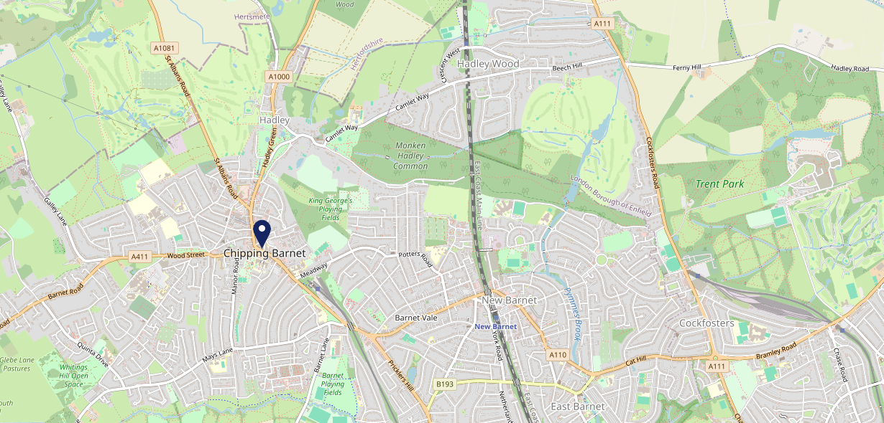
Site Intel
Kings Head EN55SN
1 Miles
371 Chains
16/04/2025 - 08/04/2026
Site Summary
Kings Head EN55SN
Work Area
Region
TV Region
Urbanicity
London
London
London
Urban major conurbation
EN55SN
Punch Unity
Top Competitors
ATV
Gender
Butchers Arms
#1
£9.58
79.18%
Male
EN55XP
Pub / Bar
Affluence
Segmentation
Ye Olde Monken Holt (Barnet)
#2
44.65%
42.79%
High Income
Flourishing Society
EN55SU
GK Pub Partners
Age Group
Visit Day
Ye Olde Mitre (Barnet)
#3
47.93%
25.12%
EN55SJ
55 to 64
Fri
GK Heritage
Nearest Station
High Barnet(0.50 miles)
168 Site Customers
198 Competitors
68969 Competitor Customers

Slide 2
Site Intel
Kings Head EN55SN
1 Miles
371 Chains
16/04/2025 - 08/04/2026
Spend by Weekpart
How is customer spend distributed throughout the week for Kings Head EN55SN versus its competitors?
% of spend for Kings Head EN55SN and 371 Chains in 1 Miles from 16/04/2025 - 08/04/2026 split by Day of Week
168 Site Customers
198 Competitors
68969 Competitor Customers

Slide 3
Site Intel
Kings Head EN55SN
1 Miles
371 Chains
16/04/2025 - 08/04/2026
Visit Frequency
How frequently per year do customers visit Kings Head EN55SN versus its competitors?
% of customer numbers for Kings Head EN55SN and 371 Chains in 1 Miles from 16/04/2025 - 08/04/2026 and the number of visits made Per Annum
168 Site Customers
198 Competitors
68969 Competitor Customers

Slide 4
Site Intel
Kings Head EN55SN
1 Miles
371 Chains
16/04/2025 - 08/04/2026
ATV Change
How has ATV changed between two date ranges?
168 Site Customers

Slide 5
Site Intel
Kings Head EN55SN
1 Miles
371 Chains
16/04/2025 - 08/04/2026
Market Share Change
How has market share changed between two date ranges?
% of market share spend for Kings Head EN55SN and 371 Chains in 1 Miles from 16/04/2025 - 08/04/2026
168 Site Customers

Slide 6
Site Intel
Kings Head EN55SN
1 Miles
371 Chains
16/04/2025 - 08/04/2026
Age
How does the age profile of customers who visit Kings Head EN55SN compare versus its competitors?
% of spend for Kings Head EN55SN and 371 Chains in 1 Miles from 16/04/2025 - 08/04/2026 split by Age Range
77 Site Customers
198 Competitors
29576 Competitor Customers

Slide 7
Site Intel
Kings Head EN55SN
1 Miles
371 Chains
16/04/2025 - 08/04/2026
Affluence
How does the affluence of customers who visit Kings Head EN55SN compare versus its competitors?
% of spend for Kings Head EN55SN and 371 Chains in 1 Miles from 16/04/2025 - 08/04/2026 split by Affluence
71 Site Customers
198 Competitors
27629 Competitor Customers

Slide 8
Site Intel
Kings Head EN55SN
1 Miles
371 Chains
16/04/2025 - 08/04/2026
Gender
How does the gender profile of customers who visit Kings Head EN55SN compare versus its competitors?
% of spend for Kings Head EN55SN and 371 Chains in 1 Miles from 16/04/2025 - 08/04/2026 split by Gender
72 Site Customers
198 Competitors
28530 Competitor Customers

Slide 9
Site Intel
Kings Head EN55SN
1 Miles
371 Chains
16/04/2025 - 08/04/2026
Punch Segmentation
How does the Custom segmentation profile of customers who visit Kings Head EN55SN compare versus its competitors?
% of spend for Kings Head EN55SN and 371 Chains in 1 Miles from 16/04/2025 - 08/04/2026 split by Segment
168 Site Customers
198 Competitors
68969 Competitor Customers

Slide 10
Site Intel
Kings Head EN55SN
1 Miles
371 Chains
16/04/2025 - 08/04/2026
Spend by Distance
How does the spend profile of Kings Head EN55SN compare versus its competitors based on travel distances?
% of spend for Kings Head EN55SN and 371 Chains in 1 Miles from 16/04/2025 - 08/04/2026 split by Distance travelled
72 Site Customers
198 Competitors
28511 Competitor Customers

Slide 11
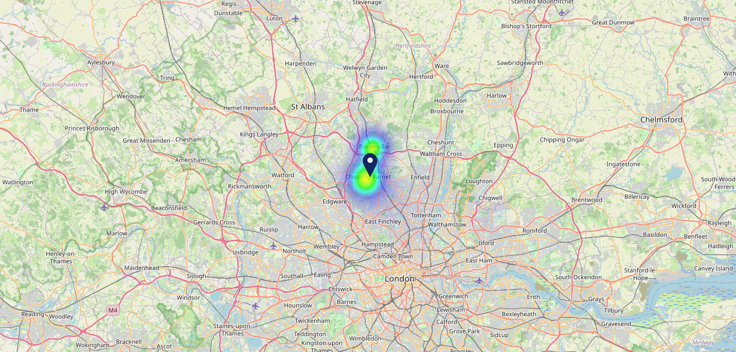
Site Intel
Kings Head EN55SN
16/04/2025 - 08/04/2026
Map of Guest Origin
Where do customers of Kings Head EN55SN come from?
Where do customers of Kings Head EN55SN for 16/04/2025 - 08/04/2026 live
72 Site Customers

Slide 12
Site Intel
Kings Head EN55SN
1 Miles
371 Chains
16/04/2025 - 08/04/2026
Share of Wallet
What are the Top 20 venues (by spend) that customers of Kings Head EN55SN also visit?
For customers of Kings Head EN55SN, who are the top 20 competitors from 371 Chains in 1 Miles for 16/04/2025 - 08/04/2026 split by Venue
168 Site Customers

Slide 13
Site Intel
Kings Head EN55SN
1 Miles
371 Chains
16/04/2025 - 08/04/2026
Share of Wallet Change
How has share of wallet of customers of Kings Head EN55SN changed between two date ranges?
168 Site Customers

Slide 14
Site Intel
Kings Head EN55SN
16/04/2025 - 08/04/2026
Market Summary
How does the local area for Kings Head EN55SN compare to the national average (1 = low, 10 = high)
Data Type | Name | Spend in 250m | 250m Spend vs National | Spend in 500m | 500m Spend vs National | Spend in 1 mile | 1 mile Spend vs National | Spend in 3 miles | 3 mile Spend vs National
Total | Annual Sales | £6.82M | 8 | £16.66M | 8 | £23.51M | 7 | £130.43M | 7
Weekpart | Mon - Thu | 48.6% | 9 | 46.0% | 8 | 46.7% | 9 | 43.2% | 7
Weekpart | Fri - Sat | 37.1% | 2 | 38.6% | 3 | 38.2% | 2 | 39.3% | 2
Weekpart | Sun | 14.3% | 5 | 15.4% | 6 | 15.1% | 5 | 17.5% | 9
Age | 18 to 24 | 3.6% | 3 | 3.3% | 3 | 2.8% | 2 | 4.2% | 2
Age | 25 to 34 | 12.1% | 2 | 11.4% | 1 | 11.8% | 1 | 12.0% | 1
Age | 35 to 44 | 24.3% | 6 | 22.8% | 5 | 22.2% | 4 | 23.1% | 5
Age | 45 to 54 | 21.1% | 6 | 21.4% | 7 | 21.3% | 7 | 22.4% | 9
Age | 55 to 64 | 19.9% | 8 | 20.2% | 8 | 20.0% | 9 | 19.3% | 9
Age | 65 to 74 | 13.5% | 9 | 14.2% | 10 | 13.9% | 10 | 12.1% | 10
Age | 75+ | 5.6% | 9 | 6.8% | 9 | 8.0% | 10 | 7.0% | 10
CAMEO | Business Elite | 12.2% | 8 | 17.9% | 9 | 17.6% | 9 | 20.4% | 9
CAMEO | Prosperous Professionals | 4.9% | 4 | 4.8% | 4 | 4.6% | 4 | 4.4% | 3
CAMEO | Flourishing Society | 20.0% | 9 | 21.3% | 9 | 20.6% | 9 | 17.9% | 8
CAMEO | Content Communities | 15.7% | 8 | 15.4% | 8 | 16.7% | 9 | 16.5% | 9
CAMEO | White Collar Neighbourhoods | 15.3% | 9 | 12.0% | 6 | 12.2% | 6 | 11.5% | 5
CAMEO | Enterprising Mainstream | 4.4% | 3 | 3.2% | 1 | 3.3% | 1 | 4.1% | 1
CAMEO | Paying The Mortgage | 12.0% | 4 | 10.9% | 3 | 10.3% | 3 | 10.9% | 3
CAMEO | Cash Conscious Communities | 7.6% | 4 | 7.9% | 5 | 8.0% | 4 | 7.6% | 4
CAMEO | On A Budget | 6.6% | 6 | 5.7% | 5 | 5.9% | 5 | 5.8% | 4
CAMEO | Family Value | 1.3% | 4 | 0.8% | 2 | 0.8% | 2 | 1.1% | 3
Affluence | AB | 37.1% | 7 | 44.1% | 9 | 42.9% | 9 | 42.6% | 9
Affluence | C1C2 | 47.4% | 5 | 41.5% | 3 | 42.4% | 3 | 42.9% | 3
Affluence | DE | 15.5% | 4 | 14.5% | 3 | 14.8% | 3 | 14.5% | 3

