Slide 1
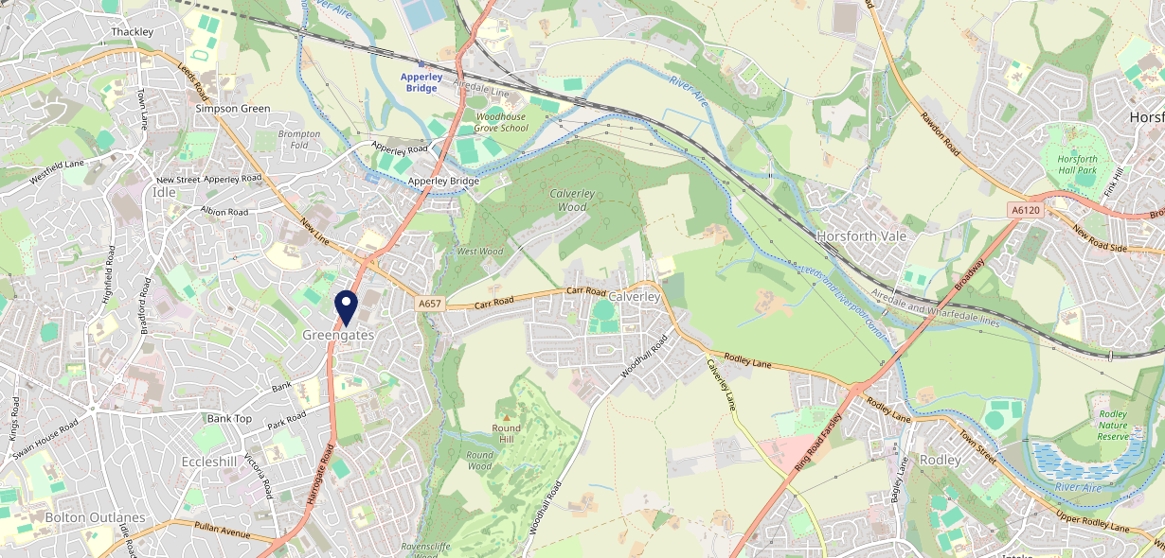
Site Intel
Oddfellows Arms BD100QE
3 Miles
113 Chains
22/02/2023 - 14/02/2024
Site Summary
Oddfellows Arms BD100QE
Work Area
Region
TV Region
Urbanicity
Bradford
Yorkshire and The Humber
Yorkshire
Urban major conurbation
BD100QE
Punch T&L
Top Competitors
ATV
Gender
Hitching Post Bradford
#1
£17.43
67.63%
Male
BD109SX
Marstons Community Food - Carvery
Affluence
Segmentation
The Wrose Bull
#2
57.07%
25.80%
Low Income
Cash Conscious Communities
BD181JF
Sizzling
Age Group
Visit Day
Noble Comb (Shipley)
#3
27.25%
21.26%
BD183ST
55 to 64
Fri
Hungry Horse
Nearest Station
Apperley Bridge(1.62 miles)
1120 Site Customers
21 Competitors
27298 Competitor Customers

Slide 2
Site Intel
Oddfellows Arms BD100QE
3 Miles
113 Chains
22/02/2023 - 14/02/2024
Spend by Weekpart
How is customer spend distributed throughout the week for Oddfellows Arms BD100QE versus its competitors?
% of spend for Oddfellows Arms BD100QE and 113 Chains in 3 Miles from 22/02/2023 - 14/02/2024 split by Day of Week
1120 Site Customers
21 Competitors
27298 Competitor Customers

Slide 3
Site Intel
Oddfellows Arms BD100QE
3 Miles
113 Chains
22/02/2023 - 14/02/2024
Visit Frequency
How frequently per year do customers visit Oddfellows Arms BD100QE versus its competitors?
% of customer numbers for Oddfellows Arms BD100QE and 113 Chains in 3 Miles from 22/02/2023 - 14/02/2024 and the number of visits made Per Annum
1120 Site Customers
21 Competitors
27298 Competitor Customers

Slide 4
Site Intel
Oddfellows Arms BD100QE
3 Miles
113 Chains
22/02/2023 - 14/02/2024
ATV Change
How has ATV changed between two date ranges?
1120 Site Customers

Slide 5
Site Intel
Oddfellows Arms BD100QE
3 Miles
113 Chains
22/02/2023 - 14/02/2024
Market Share Change
How has market share changed between two date ranges?
% of market share spend for Oddfellows Arms BD100QE and 113 Chains in 3 Miles from 22/02/2023 - 14/02/2024
1120 Site Customers

Slide 6
Site Intel
Oddfellows Arms BD100QE
3 Miles
113 Chains
22/02/2023 - 14/02/2024
Age
How does the age profile of customers who visit Oddfellows Arms BD100QE compare versus its competitors?
% of spend for Oddfellows Arms BD100QE and 113 Chains in 3 Miles from 22/02/2023 - 14/02/2024 split by Age Range
515 Site Customers
21 Competitors
13417 Competitor Customers

Slide 7
Site Intel
Oddfellows Arms BD100QE
3 Miles
113 Chains
22/02/2023 - 14/02/2024
Affluence
How does the affluence of customers who visit Oddfellows Arms BD100QE compare versus its competitors?
% of spend for Oddfellows Arms BD100QE and 113 Chains in 3 Miles from 22/02/2023 - 14/02/2024 split by Affluence
489 Site Customers
21 Competitors
12593 Competitor Customers

Slide 8
Site Intel
Oddfellows Arms BD100QE
3 Miles
113 Chains
22/02/2023 - 14/02/2024
Gender
How does the gender profile of customers who visit Oddfellows Arms BD100QE compare versus its competitors?
% of spend for Oddfellows Arms BD100QE and 113 Chains in 3 Miles from 22/02/2023 - 14/02/2024 split by Gender
503 Site Customers
21 Competitors
13153 Competitor Customers

Slide 9
Site Intel
Oddfellows Arms BD100QE
3 Miles
113 Chains
22/02/2023 - 14/02/2024
Punch Segmentation
How does the Custom segmentation profile of customers who visit Oddfellows Arms BD100QE compare versus its competitors?
% of spend for Oddfellows Arms BD100QE and 113 Chains in 3 Miles from 22/02/2023 - 14/02/2024 split by Segment
1120 Site Customers
21 Competitors
27298 Competitor Customers

Slide 10
Site Intel
Oddfellows Arms BD100QE
3 Miles
113 Chains
22/02/2023 - 14/02/2024
Spend by Distance
How does the spend profile of Oddfellows Arms BD100QE compare versus its competitors based on travel distances?
% of spend for Oddfellows Arms BD100QE and 113 Chains in 3 Miles from 22/02/2023 - 14/02/2024 split by Distance travelled
503 Site Customers
21 Competitors
13136 Competitor Customers

Slide 11
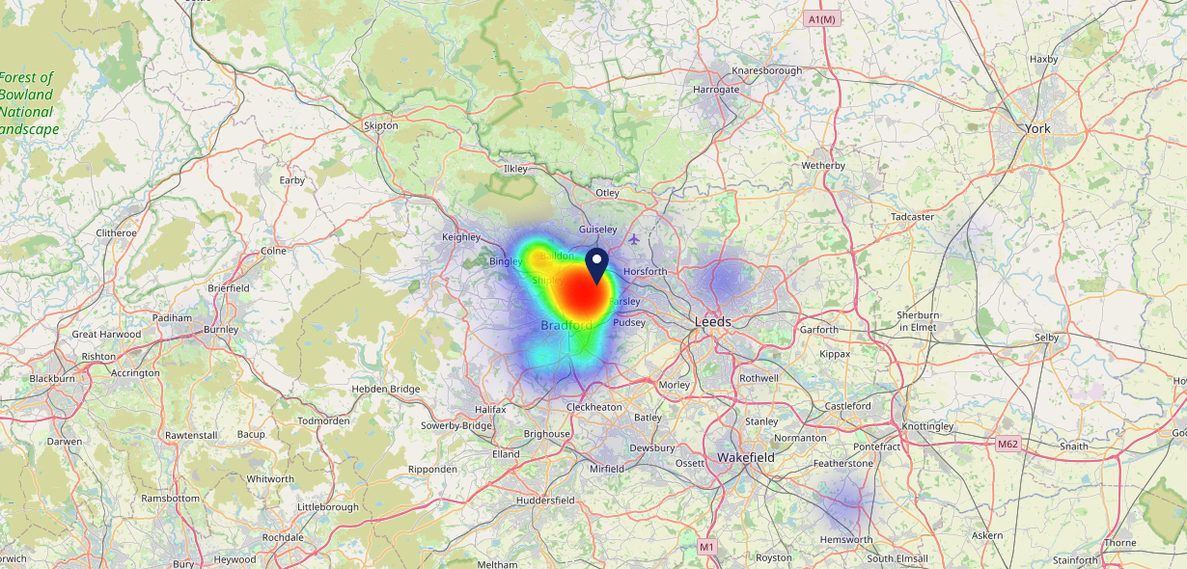
Site Intel
Oddfellows Arms BD100QE
22/02/2023 - 14/02/2024
Map of Guest Origin
Where do customers of Oddfellows Arms BD100QE come from?
Where do customers of Oddfellows Arms BD100QE for 22/02/2023 - 14/02/2024 live
503 Site Customers

Slide 12
Site Intel
Oddfellows Arms BD100QE
3 Miles
113 Chains
22/02/2023 - 14/02/2024
Share of Wallet
What are the Top 20 venues (by spend) that customers of Oddfellows Arms BD100QE also visit?
For customers of Oddfellows Arms BD100QE, who are the top 20 competitors from 113 Chains in 3 Miles for 22/02/2023 - 14/02/2024 split by Venue
1120 Site Customers

Slide 13
Site Intel
Oddfellows Arms BD100QE
3 Miles
113 Chains
22/02/2023 - 14/02/2024
Share of Wallet Change
How has share of wallet of customers of Oddfellows Arms BD100QE changed between two date ranges?
1120 Site Customers

Slide 14
Site Intel
Oddfellows Arms BD100QE
22/02/2023 - 14/02/2024
Market Summary
How does the local area for Oddfellows Arms BD100QE compare to the national average (1 = low, 10 = high)
Data Type | Name | Spend in 250m | 250m Spend vs National | Spend in 500m | 500m Spend vs National | Spend in 1 mile | 1 mile Spend vs National | Spend in 3 miles | 3 mile Spend vs National
Total | Annual Sales | £880K | 4 | £4.35M | 6 | £21.09M | 6 | £165.68M | 8
Weekpart | Mon - Thu | 46.4% | 8 | 41.9% | 6 | 42.8% | 7 | 42.9% | 7
Weekpart | Fri - Sat | 36.7% | 2 | 42.0% | 4 | 41.0% | 4 | 41.8% | 5
Weekpart | Sun | 16.9% | 8 | 16.0% | 7 | 16.1% | 7 | 15.3% | 4
Age | 18 to 24 | 10.5% | 8 | 6.6% | 6 | 6.8% | 6 | 5.8% | 4
Age | 25 to 34 | 11.6% | 1 | 13.2% | 2 | 16.1% | 2 | 17.3% | 2
Age | 35 to 44 | 16.9% | 2 | 21.8% | 4 | 26.4% | 8 | 28.7% | 10
Age | 45 to 54 | 11.8% | 1 | 22.4% | 8 | 21.0% | 6 | 21.7% | 8
Age | 55 to 64 | 26.8% | 10 | 22.4% | 9 | 18.3% | 8 | 16.2% | 7
Age | 65 to 74 | 18.1% | 10 | 10.3% | 8 | 8.7% | 8 | 7.8% | 7
Age | 75+ | 4.3% | 8 | 3.2% | 7 | 2.8% | 6 | 2.6% | 5
CAMEO | Business Elite | 0.0% | 1 | 2.5% | 2 | 1.5% | 1 | 4.0% | 3
CAMEO | Prosperous Professionals | 1.2% | 1 | 3.1% | 3 | 1.8% | 1 | 3.7% | 2
CAMEO | Flourishing Society | 2.0% | 1 | 7.1% | 3 | 6.1% | 2 | 6.4% | 2
CAMEO | Content Communities | 12.8% | 6 | 7.2% | 2 | 6.7% | 1 | 9.0% | 2
CAMEO | White Collar Neighbourhoods | 5.8% | 1 | 10.9% | 5 | 10.4% | 4 | 10.8% | 4
CAMEO | Enterprising Mainstream | 5.7% | 4 | 11.3% | 8 | 15.5% | 10 | 12.4% | 9
CAMEO | Paying The Mortgage | 8.7% | 2 | 14.4% | 6 | 17.0% | 7 | 19.0% | 9
CAMEO | Cash Conscious Communities | 23.3% | 10 | 14.5% | 9 | 14.8% | 9 | 12.2% | 8
CAMEO | On A Budget | 14.7% | 10 | 12.7% | 9 | 11.5% | 9 | 12.3% | 10
CAMEO | Family Value | 25.8% | 10 | 16.2% | 10 | 14.8% | 10 | 10.2% | 9
Affluence | AB | 3.2% | 1 | 12.8% | 2 | 9.4% | 1 | 14.1% | 2
Affluence | C1C2 | 33.0% | 1 | 43.9% | 4 | 49.5% | 6 | 51.2% | 7
Affluence | DE | 63.8% | 10 | 43.4% | 10 | 41.1% | 10 | 34.7% | 9

Slide 15
Site Intel
Oddfellows Arms BD100QE
Local Market Profile
Mix of spend by customer segment in Punch site and local market
 | Customer Count | Family Familiar | Occasional & Local | Mid-Week Seniors | Part Of The Pub | Metro Sophisticates | Young & Connected | Bubbly Weekenders | Upmarket Diners
Oddfellows Arms | 181 | 19.63% | 13.66% | 24.10% | 6.96% | 1.45% | 29.56% | 2.89% | 1.72%
Local Catchment | 3649 | 20.68% | 8.60% | 13.24% | 20.59% | 10.92% | 13.48% | 6.91% | 5.54%
Punch T&L | 111300 | 7.84% | 6.06% | 29.39% | 10.79% | 11.70% | 11.49% | 7.04% | 15.64%
Oddfellows Arms vs Local Catchment |  | -1.05% | 5.06% | 10.86% | -13.63% | -9.47% | 16.08% | -4.02% | -3.82%
Oddfellows Arms vs Punch T&L |  | 11.79% | 7.60% | -5.29% | -3.83% | -10.25% | 18.07% | -4.15% | -13.92%
Local Catchment vs Punch T&L |  | 12.84% | 2.54% | -16.15% | 9.80% | -0.78% | 1.99% | -0.13% | -10.10%

Slide 16
Site Intel
Oddfellows Arms BD100QE
Local Competitor Profiles
Mix of spend by customer segment in Punch site and local competitors
 | Customer Count | Family Familiar | Occasional & Local | Mid-Week Seniors | Part Of The Pub | Metro Sophisticates | Young & Connected | Bubbly Weekenders | Upmarket Diners
Oddfellows Arms BD100QE | 181 | 19.63% | 13.66% | 24.10% | 6.96% | 1.45% | 29.56% | 2.89% | 1.72%
Hitching Post Bradford BD109SX | 245 | 44.49% | 22.58% | 5.34% | 8.34% | 2.92% | 10.60% | 3.43% | 2.26%
The Wrose Bull BD181JF | 194 | 22.09% | 9.82% | 4.00% | 51.11% | 2.22% | 6.16% | 3.11% | 1.46%
Noble Comb (Shipley) BD183ST | 465 | 35.75% | 9.23% | 5.76% | 22.38% | 3.84% | 16.05% | 5.41% | 1.55%
George & Dragon BD100PU | 314 | 23.23% | 1.37% | 14.68% | 6.08% | 10.92% | 12.34% | 12.10% | 19.23%
The Turls Green BD11HY | 936 | 19.11% | 13.58% | 8.27% | 22.65% | 4.56% | 22.34% | 6.92% | 2.53%
Toby Carvery Horsforth LS184DH | 459 | 33.01% | 7.02% | 5.69% | 7.12% | 7.33% | 22.05% | 10.15% | 7.61%
The Calverley Arms LS285QQ | 509 | 19.78% | 3.61% | 23.48% | 3.70% | 15.12% | 9.28% | 9.26% | 15.72%
The Clothiers Arms LS197PP | 367 | 24.13% | 10.43% | 7.39% | 29.02% | 5.51% | 16.29% | 2.04% | 5.17%
Robin Hood Yeadon LS197EP | 80 | 10.94% | 9.93% | 1.19% | 51.78% | 5.19% | 18.39% | 2.54% | 0.00%
Malt Shovel (Baildon) BD176JZ | 185 | 12.51% | 4.33% | 20.90% | 30.90% | 9.45% | 10.51% | 6.87% | 4.48%
Queens Hotel Bradford BD11JU | 231 | 13.44% | 22.32% | 6.70% | 16.05% | 8.32% | 17.28% | 11.99% | 3.87%
The Stone Trough LS196LP | 241 | 32.03% | 2.56% | 14.79% | 18.52% | 8.67% | 14.77% | 5.28% | 3.33%
Angel (Baildon) BD176LX | 268 | 8.68% | 6.34% | 40.93% | 5.14% | 18.93% | 8.96% | 7.42% | 3.55%
New Inn Calverley LS285RH | 111 | 7.50% | 26.60% | 8.19% | 15.09% | 25.64% | 9.40% | 6.34% | 1.20%
New Inn Charlestown BD177JN | 75 | 14.61% | 5.50% | 27.01% | 30.40% | 1.19% | 11.18% | 10.07% | 0.00%
Woolpack Inn LS197SE | 185 | 22.03% | 6.12% | 4.41% | 41.53% | 8.28% | 11.26% | 3.26% | 3.06%
Old Hall LS285EU | 230 | 3.25% | 5.57% | 9.91% | 31.61% | 25.46% | 16.80% | 6.63% | 0.73%
Sun Hotel BD183QP | 41 | 6.03% | 44.35% | 3.71% | 23.79% | 6.26% | 9.67% | 6.16% | 0.00%
Bay Horse Inn Farsley LS285LF | 212 | 4.27% | 10.92% | 6.15% | 46.63% | 12.34% | 8.32% | 9.80% | 1.55%

