Slide 1
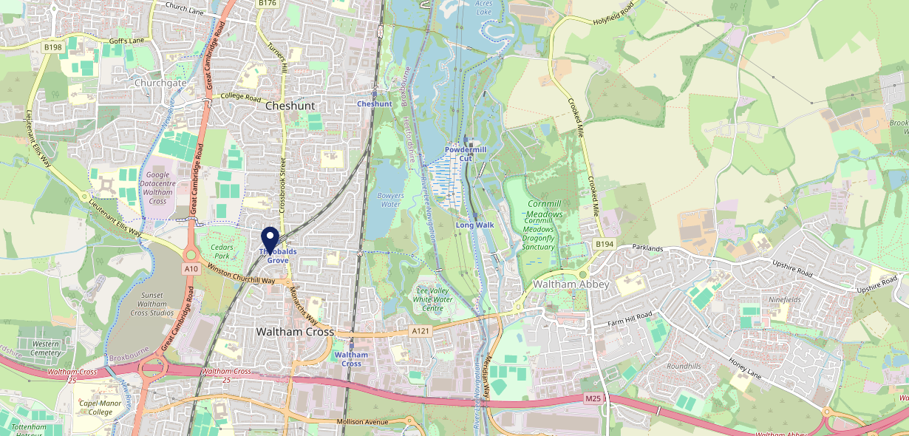
Site Intel
Wheatsheaf Waltham Cross EN87BG
1 Miles
371 Chains
16/04/2025 - 08/04/2026
Site Summary
Wheatsheaf Waltham Cross EN87BG
Work Area
Region
TV Region
Urbanicity
London
East of England
London
Urban major conurbation
EN87BG
Punch Unity
Top Competitors
ATV
Gender
Red Cow Cheshunt
#1
EN89AF
Stonegate PP
Affluence
Segmentation
Crocodile
#2
EN89NQ
McMullens
Age Group
Visit Day
Vine
#3
EN87AY
McMullens
Nearest Station
Theobalds Grove(0.16 miles)
225 Competitors
65994 Competitor Customers

Slide 2
Site Intel
Wheatsheaf Waltham Cross EN87BG
1 Miles
371 Chains
16/04/2025 - 08/04/2026
Spend by Weekpart
How is customer spend distributed throughout the week for Wheatsheaf Waltham Cross EN87BG versus its competitors?
% of spend for Wheatsheaf Waltham Cross EN87BG and 371 Chains in 1 Miles from 16/04/2025 - 08/04/2026 split by Day of Week
225 Competitors
65994 Competitor Customers

Slide 3
Site Intel
Wheatsheaf Waltham Cross EN87BG
1 Miles
371 Chains
16/04/2025 - 08/04/2026
Visit Frequency
How frequently per year do customers visit Wheatsheaf Waltham Cross EN87BG versus its competitors?
% of customer numbers for Wheatsheaf Waltham Cross EN87BG and 371 Chains in 1 Miles from 16/04/2025 - 08/04/2026 and the number of visits made Per Annum
225 Competitors
65994 Competitor Customers

Slide 4
Site Intel
Wheatsheaf Waltham Cross EN87BG
1 Miles
371 Chains
16/04/2025 - 08/04/2026
ATV Change
How has ATV changed between two date ranges?

Slide 5
Site Intel
Wheatsheaf Waltham Cross EN87BG
1 Miles
371 Chains
16/04/2025 - 08/04/2026
Market Share Change
How has market share changed between two date ranges?
% of market share spend for Wheatsheaf Waltham Cross EN87BG and 371 Chains in 1 Miles from 16/04/2025 - 08/04/2026

Slide 6
Site Intel
Wheatsheaf Waltham Cross EN87BG
1 Miles
371 Chains
16/04/2025 - 08/04/2026
Age
How does the age profile of customers who visit Wheatsheaf Waltham Cross EN87BG compare versus its competitors?
% of spend for Wheatsheaf Waltham Cross EN87BG and 371 Chains in 1 Miles from 16/04/2025 - 08/04/2026 split by Age Range
225 Competitors
26281 Competitor Customers

Slide 7
Site Intel
Wheatsheaf Waltham Cross EN87BG
1 Miles
371 Chains
16/04/2025 - 08/04/2026
Affluence
How does the affluence of customers who visit Wheatsheaf Waltham Cross EN87BG compare versus its competitors?
% of spend for Wheatsheaf Waltham Cross EN87BG and 371 Chains in 1 Miles from 16/04/2025 - 08/04/2026 split by Affluence
225 Competitors
24316 Competitor Customers

Slide 8
Site Intel
Wheatsheaf Waltham Cross EN87BG
1 Miles
371 Chains
16/04/2025 - 08/04/2026
Gender
How does the gender profile of customers who visit Wheatsheaf Waltham Cross EN87BG compare versus its competitors?
% of spend for Wheatsheaf Waltham Cross EN87BG and 371 Chains in 1 Miles from 16/04/2025 - 08/04/2026 split by Gender
225 Competitors
25224 Competitor Customers

Slide 9
Site Intel
Wheatsheaf Waltham Cross EN87BG
1 Miles
371 Chains
16/04/2025 - 08/04/2026
Punch Segmentation
How does the Custom segmentation profile of customers who visit Wheatsheaf Waltham Cross EN87BG compare versus its competitors?
% of spend for Wheatsheaf Waltham Cross EN87BG and 371 Chains in 1 Miles from 16/04/2025 - 08/04/2026 split by Segment
225 Competitors
65994 Competitor Customers

Slide 10
Site Intel
Wheatsheaf Waltham Cross EN87BG
1 Miles
371 Chains
16/04/2025 - 08/04/2026
Spend by Distance
How does the spend profile of Wheatsheaf Waltham Cross EN87BG compare versus its competitors based on travel distances?
% of spend for Wheatsheaf Waltham Cross EN87BG and 371 Chains in 1 Miles from 16/04/2025 - 08/04/2026 split by Distance travelled
225 Competitors
25197 Competitor Customers

Slide 11

Site Intel
Wheatsheaf Waltham Cross EN87BG
16/04/2025 - 08/04/2026
Map of Guest Origin
Where do customers of Wheatsheaf Waltham Cross EN87BG come from?
Where do customers of Wheatsheaf Waltham Cross EN87BG for 16/04/2025 - 08/04/2026 live

Slide 12
Site Intel
Wheatsheaf Waltham Cross EN87BG
1 Miles
371 Chains
16/04/2025 - 08/04/2026
Share of Wallet
What are the Top 20 venues (by spend) that customers of Wheatsheaf Waltham Cross EN87BG also visit?
For customers of Wheatsheaf Waltham Cross EN87BG, who are the top 20 competitors from 371 Chains in 1 Miles for 16/04/2025 - 08/04/2026 split by Venue

Slide 13
Site Intel
Wheatsheaf Waltham Cross EN87BG
1 Miles
371 Chains
16/04/2025 - 08/04/2026
Share of Wallet Change
How has share of wallet of customers of Wheatsheaf Waltham Cross EN87BG changed between two date ranges?

Slide 14
Site Intel
Wheatsheaf Waltham Cross EN87BG
16/04/2025 - 08/04/2026
Market Summary
How does the local area for Wheatsheaf Waltham Cross EN87BG compare to the national average (1 = low, 10 = high)
Data Type | Name | Spend in 250m | 250m Spend vs National | Spend in 500m | 500m Spend vs National | Spend in 1 mile | 1 mile Spend vs National | Spend in 3 miles | 3 mile Spend vs National
Total | Annual Sales | £2.31M | 6 | £2.58M | 5 | £25.41M | 7 | £105.07M | 7
Weekpart | Mon - Thu | 41.7% | 6 | 41.6% | 6 | 45.5% | 9 | 44.7% | 9
Weekpart | Fri - Sat | 42.8% | 5 | 43.1% | 5 | 39.4% | 3 | 39.8% | 3
Weekpart | Sun | 15.5% | 7 | 15.3% | 6 | 15.1% | 5 | 15.5% | 5
Age | 18 to 24 | 4.1% | 4 | 4.3% | 4 | 6.4% | 5 | 6.0% | 4
Age | 25 to 34 | 9.9% | 1 | 10.6% | 1 | 14.2% | 2 | 14.9% | 1
Age | 35 to 44 | 25.1% | 7 | 25.2% | 7 | 28.4% | 9 | 28.1% | 10
Age | 45 to 54 | 24.4% | 9 | 24.3% | 9 | 21.8% | 8 | 22.3% | 9
Age | 55 to 64 | 21.7% | 9 | 20.8% | 9 | 18.4% | 8 | 17.3% | 8
Age | 65 to 74 | 10.6% | 8 | 10.1% | 8 | 7.6% | 7 | 7.8% | 7
Age | 75+ | 4.3% | 8 | 4.8% | 9 | 3.2% | 7 | 3.6% | 7
CAMEO | Business Elite | 5.2% | 5 | 5.2% | 5 | 6.9% | 5 | 7.2% | 5
CAMEO | Prosperous Professionals | 1.6% | 1 | 1.5% | 1 | 3.1% | 2 | 3.3% | 2
CAMEO | Flourishing Society | 15.5% | 7 | 15.2% | 7 | 18.6% | 8 | 17.6% | 8
CAMEO | Content Communities | 7.9% | 2 | 8.0% | 2 | 8.7% | 2 | 9.1% | 2
CAMEO | White Collar Neighbourhoods | 18.3% | 10 | 17.1% | 10 | 12.1% | 6 | 11.1% | 5
CAMEO | Enterprising Mainstream | 7.6% | 5 | 7.1% | 5 | 4.0% | 2 | 4.5% | 2
CAMEO | Paying The Mortgage | 19.4% | 9 | 19.9% | 9 | 19.9% | 9 | 21.1% | 10
CAMEO | Cash Conscious Communities | 8.8% | 5 | 8.9% | 5 | 9.7% | 6 | 10.1% | 6
CAMEO | On A Budget | 14.9% | 10 | 15.6% | 10 | 15.3% | 10 | 14.0% | 10
CAMEO | Family Value | 0.8% | 3 | 1.4% | 4 | 1.6% | 4 | 2.1% | 5
Affluence | AB | 22.2% | 4 | 21.9% | 4 | 28.7% | 6 | 28.0% | 5
Affluence | C1C2 | 53.2% | 7 | 52.2% | 7 | 44.7% | 4 | 45.8% | 4
Affluence | DE | 24.5% | 7 | 25.9% | 7 | 26.6% | 8 | 26.2% | 8

