Slide 1
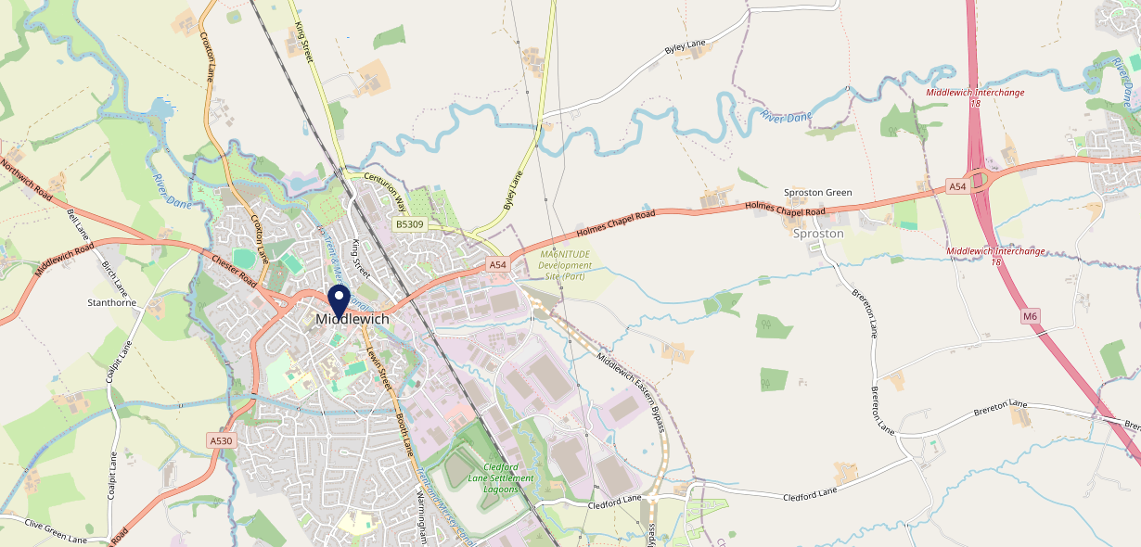
Site Intel
White Bear Hotel CW109AG
3 Miles
113 Chains
22/02/2023 - 14/02/2024
Site Summary
White Bear Hotel CW109AG
Work Area
Region
TV Region
Urbanicity
Crewe
North West
North West
Urban city and town
CW109AG
Punch T&L
Top Competitors
ATV
Gender
Turnpike
#1
£12.70
67.68%
Male
CW100DJ
Punch - Our Local
Affluence
Segmentation
Hayhurst Arms
#2
72.76%
24.28%
Middle Income
Paying The Mortgage
CW109JP
Brunning & Price
Age Group
Visit Day
Miller Carter
#3
29.58%
28.07%
CW100JB
55 to 64
Sat
Miller & Carter
Nearest Station
Winsford(3.19 miles)
1683 Site Customers
8 Competitors
14635 Competitor Customers

Slide 2
Site Intel
White Bear Hotel CW109AG
3 Miles
113 Chains
22/02/2023 - 14/02/2024
Spend by Weekpart
How is customer spend distributed throughout the week for White Bear Hotel CW109AG versus its competitors?
% of spend for White Bear Hotel CW109AG and 113 Chains in 3 Miles from 22/02/2023 - 14/02/2024 split by Day of Week
1683 Site Customers
8 Competitors
14635 Competitor Customers

Slide 3
Site Intel
White Bear Hotel CW109AG
3 Miles
113 Chains
22/02/2023 - 14/02/2024
Visit Frequency
How frequently per year do customers visit White Bear Hotel CW109AG versus its competitors?
% of customer numbers for White Bear Hotel CW109AG and 113 Chains in 3 Miles from 22/02/2023 - 14/02/2024 and the number of visits made Per Annum
1683 Site Customers
8 Competitors
14635 Competitor Customers

Slide 4
Site Intel
White Bear Hotel CW109AG
3 Miles
113 Chains
22/02/2023 - 14/02/2024
ATV Change
How has ATV changed between two date ranges?
1683 Site Customers

Slide 5
Site Intel
White Bear Hotel CW109AG
3 Miles
113 Chains
22/02/2023 - 14/02/2024
Market Share Change
How has market share changed between two date ranges?
% of market share spend for White Bear Hotel CW109AG and 113 Chains in 3 Miles from 22/02/2023 - 14/02/2024
1683 Site Customers

Slide 6
Site Intel
White Bear Hotel CW109AG
3 Miles
113 Chains
22/02/2023 - 14/02/2024
Age
How does the age profile of customers who visit White Bear Hotel CW109AG compare versus its competitors?
% of spend for White Bear Hotel CW109AG and 113 Chains in 3 Miles from 22/02/2023 - 14/02/2024 split by Age Range
861 Site Customers
8 Competitors
7385 Competitor Customers

Slide 7
Site Intel
White Bear Hotel CW109AG
3 Miles
113 Chains
22/02/2023 - 14/02/2024
Affluence
How does the affluence of customers who visit White Bear Hotel CW109AG compare versus its competitors?
% of spend for White Bear Hotel CW109AG and 113 Chains in 3 Miles from 22/02/2023 - 14/02/2024 split by Affluence
809 Site Customers
8 Competitors
6701 Competitor Customers

Slide 8
Site Intel
White Bear Hotel CW109AG
3 Miles
113 Chains
22/02/2023 - 14/02/2024
Gender
How does the gender profile of customers who visit White Bear Hotel CW109AG compare versus its competitors?
% of spend for White Bear Hotel CW109AG and 113 Chains in 3 Miles from 22/02/2023 - 14/02/2024 split by Gender
868 Site Customers
8 Competitors
7264 Competitor Customers

Slide 9
Site Intel
White Bear Hotel CW109AG
3 Miles
113 Chains
22/02/2023 - 14/02/2024
Punch Segmentation
How does the Custom segmentation profile of customers who visit White Bear Hotel CW109AG compare versus its competitors?
% of spend for White Bear Hotel CW109AG and 113 Chains in 3 Miles from 22/02/2023 - 14/02/2024 split by Segment
1683 Site Customers
8 Competitors
14635 Competitor Customers

Slide 10
Site Intel
White Bear Hotel CW109AG
3 Miles
113 Chains
22/02/2023 - 14/02/2024
Spend by Distance
How does the spend profile of White Bear Hotel CW109AG compare versus its competitors based on travel distances?
% of spend for White Bear Hotel CW109AG and 113 Chains in 3 Miles from 22/02/2023 - 14/02/2024 split by Distance travelled
867 Site Customers
8 Competitors
7262 Competitor Customers

Slide 11
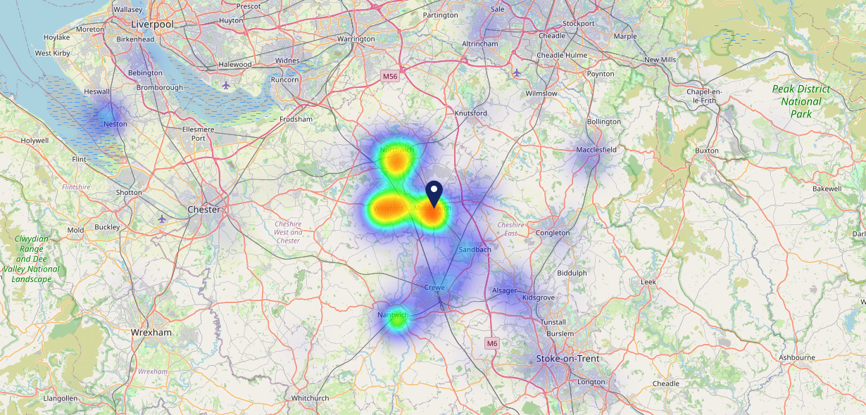
Site Intel
White Bear Hotel CW109AG
22/02/2023 - 14/02/2024
Map of Guest Origin
Where do customers of White Bear Hotel CW109AG come from?
Where do customers of White Bear Hotel CW109AG for 22/02/2023 - 14/02/2024 live
867 Site Customers

Slide 12
Site Intel
White Bear Hotel CW109AG
3 Miles
113 Chains
22/02/2023 - 14/02/2024
Share of Wallet
What are the Top 20 venues (by spend) that customers of White Bear Hotel CW109AG also visit?
For customers of White Bear Hotel CW109AG, who are the top 20 competitors from 113 Chains in 3 Miles for 22/02/2023 - 14/02/2024 split by Venue
1683 Site Customers

Slide 13
Site Intel
White Bear Hotel CW109AG
3 Miles
113 Chains
22/02/2023 - 14/02/2024
Share of Wallet Change
How has share of wallet of customers of White Bear Hotel CW109AG changed between two date ranges?
1683 Site Customers

Slide 14
Site Intel
White Bear Hotel CW109AG
22/02/2023 - 14/02/2024
Market Summary
How does the local area for White Bear Hotel CW109AG compare to the national average (1 = low, 10 = high)
Data Type | Name | Spend in 250m | 250m Spend vs National | Spend in 500m | 500m Spend vs National | Spend in 1 mile | 1 mile Spend vs National | Spend in 3 miles | 3 mile Spend vs National
Total | Annual Sales | £3.25M | 7 | £4.20M | 6 | £10.41M | 5 | £38.60M | 4
Weekpart | Mon - Thu | 30.5% | 1 | 32.4% | 1 | 36.8% | 2 | 43.1% | 7
Weekpart | Fri - Sat | 55.8% | 10 | 53.7% | 10 | 48.5% | 10 | 39.9% | 3
Weekpart | Sun | 13.7% | 4 | 13.9% | 4 | 14.6% | 4 | 17.0% | 9
Age | 18 to 24 | 3.8% | 4 | 3.6% | 3 | 4.5% | 3 | 6.7% | 5
Age | 25 to 34 | 14.8% | 2 | 12.8% | 2 | 15.4% | 2 | 19.7% | 3
Age | 35 to 44 | 20.5% | 4 | 19.3% | 3 | 23.3% | 5 | 23.1% | 5
Age | 45 to 54 | 18.7% | 4 | 16.1% | 2 | 18.7% | 3 | 17.5% | 2
Age | 55 to 64 | 26.4% | 10 | 31.2% | 10 | 25.2% | 10 | 19.7% | 9
Age | 65 to 74 | 10.8% | 8 | 12.6% | 9 | 9.6% | 8 | 9.1% | 8
Age | 75+ | 4.9% | 9 | 4.4% | 8 | 3.3% | 7 | 4.3% | 8
CAMEO | Business Elite | 3.3% | 3 | 2.7% | 2 | 3.7% | 3 | 4.4% | 3
CAMEO | Prosperous Professionals | 3.0% | 3 | 2.6% | 2 | 4.1% | 3 | 4.2% | 3
CAMEO | Flourishing Society | 7.2% | 3 | 6.7% | 3 | 7.7% | 3 | 7.6% | 2
CAMEO | Content Communities | 19.2% | 10 | 21.6% | 10 | 16.5% | 9 | 14.6% | 8
CAMEO | White Collar Neighbourhoods | 14.8% | 9 | 16.4% | 9 | 14.0% | 9 | 11.5% | 5
CAMEO | Enterprising Mainstream | 13.8% | 9 | 13.6% | 9 | 13.4% | 9 | 13.4% | 9
CAMEO | Paying The Mortgage | 23.9% | 10 | 22.1% | 9 | 24.3% | 10 | 19.5% | 9
CAMEO | Cash Conscious Communities | 7.7% | 4 | 7.1% | 4 | 8.0% | 4 | 10.8% | 7
CAMEO | On A Budget | 5.4% | 4 | 5.6% | 4 | 6.0% | 5 | 7.9% | 7
CAMEO | Family Value | 1.7% | 5 | 1.8% | 5 | 2.3% | 5 | 6.0% | 7
Affluence | AB | 13.5% | 2 | 12.0% | 2 | 15.5% | 2 | 16.2% | 2
Affluence | C1C2 | 71.7% | 10 | 73.6% | 10 | 68.2% | 10 | 59.0% | 10
Affluence | DE | 14.8% | 4 | 14.4% | 3 | 16.3% | 4 | 24.8% | 7

Slide 15
Site Intel
White Bear Hotel CW109AG
Local Market Profile
Mix of spend by customer segment in Punch site and local market
 | Customer Count | Family Familiar | Occasional & Local | Mid-Week Seniors | Part Of The Pub | Metro Sophisticates | Young & Connected | Bubbly Weekenders | Upmarket Diners
White Bear Hotel | 374 | 4.83% | 3.58% | 31.21% | 19.90% | 12.04% | 6.98% | 6.82% | 14.62%
Local Catchment | 2015 | 17.07% | 4.15% | 21.56% | 7.38% | 4.95% | 9.37% | 7.28% | 28.20%
Punch T&L | 111300 | 7.84% | 6.06% | 29.39% | 10.79% | 11.70% | 11.49% | 7.04% | 15.64%
White Bear Hotel vs Local Catchment |  | -12.24% | -0.57% | 9.65% | 12.52% | 7.09% | -2.39% | -0.46% | -13.58%
White Bear Hotel vs Punch T&L |  | -3.01% | -2.48% | 1.82% | 9.11% | 0.34% | -4.51% | -0.22% | -1.02%
Local Catchment vs Punch T&L |  | 9.23% | -1.91% | -7.83% | -3.41% | -6.75% | -2.12% | 0.24% | 12.56%

Slide 16
Site Intel
White Bear Hotel CW109AG
Local Competitor Profiles
Mix of spend by customer segment in Punch site and local competitors
 | Customer Count | Family Familiar | Occasional & Local | Mid-Week Seniors | Part Of The Pub | Metro Sophisticates | Young & Connected | Bubbly Weekenders | Upmarket Diners
White Bear Hotel CW109AG | 374 | 4.83% | 3.58% | 31.21% | 19.90% | 12.04% | 6.98% | 6.82% | 14.62%
Turnpike CW100DJ | 129 | 12.23% | 12.50% | 18.09% | 35.40% | 1.37% | 9.06% | 10.27% | 1.04%
Hayhurst Arms CW109JP | 727 | 6.18% | 1.47% | 25.73% | 1.60% | 6.03% | 4.70% | 4.92% | 49.33%
Miller Carter CW100JB | 270 | 15.69% | 4.79% | 13.38% | 3.92% | 8.07% | 13.72% | 11.58% | 28.80%
Fox & Hounds CW47LW | 516 | 13.18% | 2.85% | 25.36% | 3.00% | 6.80% | 6.11% | 10.05% | 32.61%
Brighton Belle (Winsford) CW73NQ | 512 | 34.83% | 7.53% | 18.38% | 11.39% | 1.29% | 17.20% | 6.21% | 3.13%
The Wharton Park CW73DB | 432 | 42.45% | 4.88% | 15.16% | 8.59% | 2.97% | 16.29% | 5.01% | 4.62%
Top House Winsford CW73AE | 51 | 19.04% | 1.59% | 30.02% | 27.48% | 0.45% | 10.12% | 10.85% | 0.40%

